Slide 1
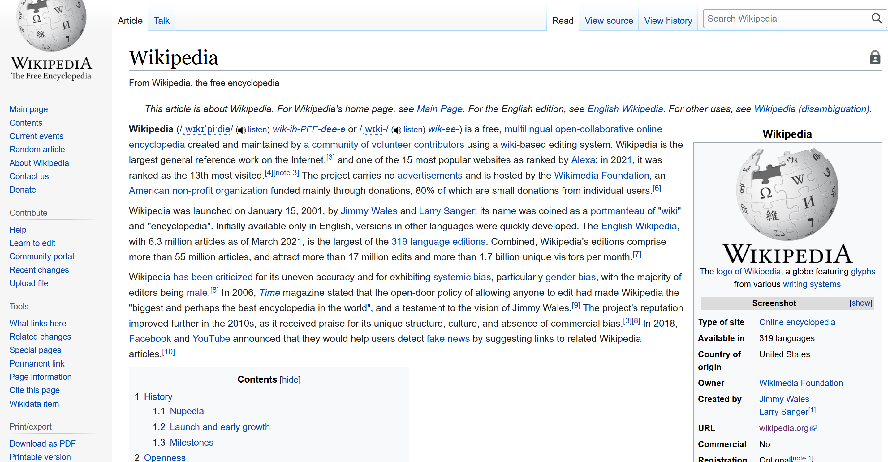
Linking within a Web Page

Slide 2
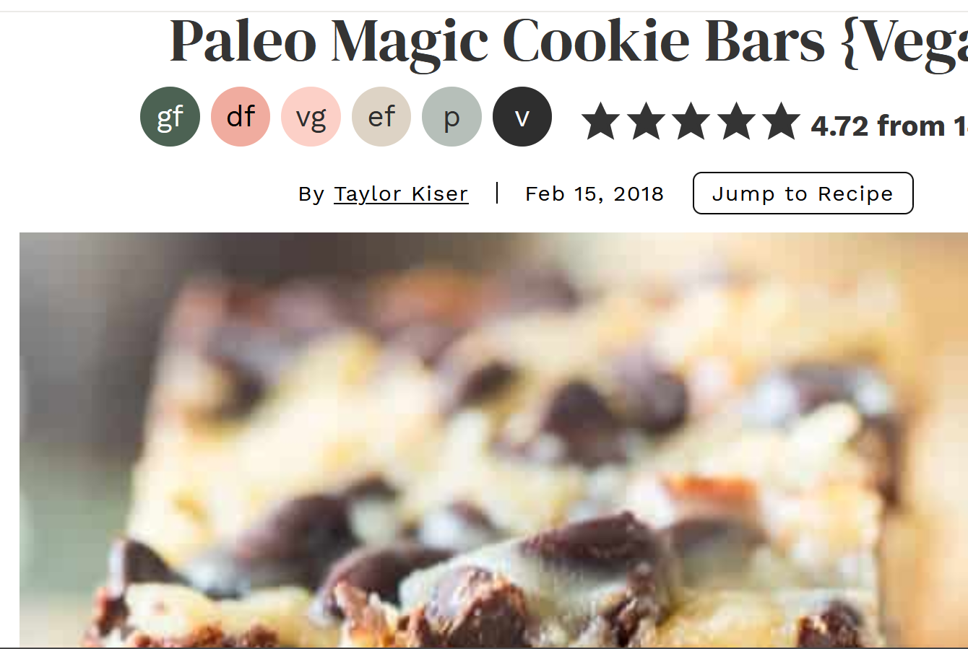
Linking to within a web page
Sometimes you want to link to a spot within a web page
As opposed to just linking to an entire web page
Example:
“Back to top” link at bottom of page
An index of links at the top of a web page
“Jump to Recipe” on recipe pages (I like to cook!)
Wikipedia is filled with these links!

Slide 3
How to link from one place in a page to another:
Step one:
Add an id to where you want to link to
e.g.,
at top of page could have:
<a id = “top”>top of web page </a>
Or with the recipe example, could have:
<a id = “recipe”> Magic Cookie Bar Recipe</a>
Note: You can give ids to already existing things on a web page:
<p id = “firstparagraph”>This is the first paragraph on a web page that I made up so you could see an example </p>
<h2 id = “kittens”>Header of the Kitten Section of a web page</h2>
NOTE 2: ALL IDs on every web page MUST BE UNIQUE!!
Ids uniquely identify a tag or element in your web page
You can’t use the same id twice on one web page

Slide 4
Linking to within the same page:
Step 2: add a href (a hypertext reference)
Now to link to it within the same page, we’d use:
<a href = “#top”> Back to top</a>
<a href = “#recipe”> Jump to Recipe</a>
<a href = “#firstparagraph”> Go to the first paragraph</a>
<a href = “#kittens”> Jump to kitten section</a>
Note the #
this means go to that id, not that web page
E.g., #top means to go the location within the web page that has the id top,
Not go to the web page called top.html

Slide 5
Linking to a place in a different page
Give what you want to link to an id: … <a id=“cookierecipe”> Chocolate Chip Recipe </a> …
Add the click link: … While you can purchase these cookies, you may wish to
<a href = “recipe.html#cookierecipe”> see the recipe</a> …
You see this A LOT on Wikipedia pages!

Slide 6
TakeAways:
To link inside of a web page:
Give what you want to link to an id
Each id name must be unique within a web page
You can give ids to any html item,e.g.,
<p id =“para_on_chocolates”> Chocolate is the best food in the whole entire world!!! </p>
Or you can create a new anchor for an id, e.g.,
<a id = “wordoftheday”>Scintillate </a>
Create a link to the area with the id:
For within one web page:
<a href = “#para_on_chocolates” >Go to paragraph on chocolates</a>
For within another web page within your web site:
Follow rules for linking relatively, and add #id
E.g.,
<a href = “../Animals.html#cougars”>go to cougar info</a>
<a href = “recipe.html#cookierecipe”>Go to choc chip cookie recipe on recipes web page</a>

