Slide 1
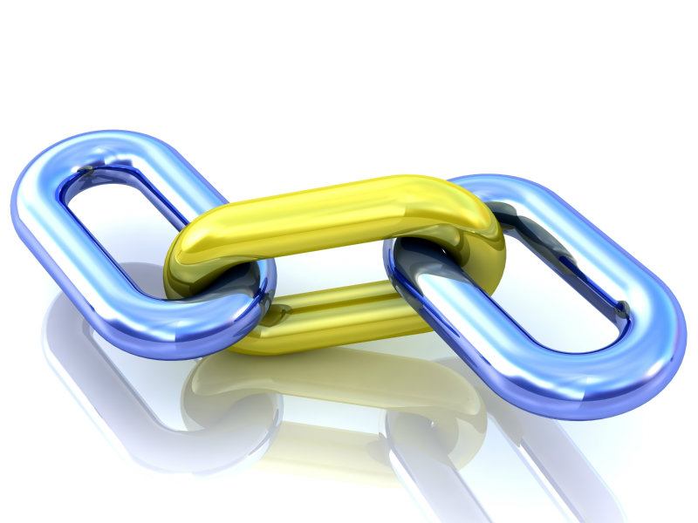
Links
How to add links to your web page

Slide 2


Absolute Links:
  Absolute Links:
  Links to something outside of your web site
  (like to google, or to amazon, or to any web site that you don’t own and is not part of your web site.
  Example:
  <a href = “http://www.cutekittens.org/cats.html” > Cute Kittens! </a>
  Break it down:
  <a> </a>
  stands for anchor
  (we’re making a link. I don’t explain why they call a link an anchor)
  href = “http://www.cutekittens.org/cats.html”
  the hypertext reference (what you’re linking to)
  ALL absolute links start with http or https!!!
  Cute Kittens!
  what you click on to go to the URL (above)
  In your browser, looks like:

Slide 3
Absolute Links (continued)
Absolute Paths
  MUST START with http or https
    HyperText Transfer Protocol
    https: the secure version of http
  Specifying the entire URL
    <a href = “http://www.cnn.com/” > CNN </a>
  When you click on CNN, your browser connects to the Web Server that holds www.cnn.com
    That web server sends your browser that web page.

Slide 4

Images as Links:
On a web page you could click on this and
you’d go to faithful friends web page
Anything between the
<a href =…> And the </a>
acts as a link you can click on.
E.g.,
  <a href = “https://faithfulfriends.us/”>Link to animal Shelter</a>
  Link to animal Shelter is the part you can click on
You can replace that with an image:
E.g., if the image is:
<img src = “kitten.jpg” style = “height: 100px; width: 150px; alt = “kitten up for adoption”>
Plop that where Link to animal Shelter is:
    <a href = “https://faithfulfriends.us/”>
    <img src = “kitten.jpg” style = “height: 100px; width: 150px; alt = “kitten up for adoption”>
    </a>

