Slide 1
Forms

Slide 2
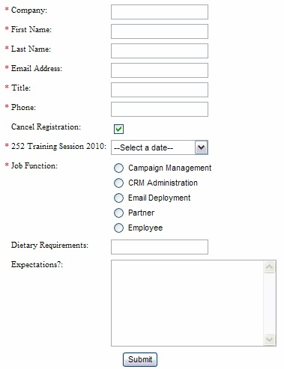
Forms
You’ve filled out forms on web pages!
Fill out data
Click submit
The data goes somewhere to be processed
We’re creating the form part that you see on the web page now!
(Not the part that processes the data)

Slide 3
Form elements:
action="https://example.com"
<form>
</form>
Goes around a form
Usually forms have actions, e.g.,
<form action= “https://www.process.com/process.php”>
We’re not going to worry about the action right now
We’re not processing the data, just creating the form on a web page

Slide 4
Textbox:
<form>
<p>
Just type in your name and click Submit to enter the contest: <br >
First name: <input type= "text" name="firstname" value=" " > <br >
Last name: <input type= "text" name="lastname" value=" " > <br >
</p>
</form>
These form elements are for short, 1-line answers
This is the text box created

Slide 5
Form element: textarea
<textarea name="comments" rows="10" cols="48">Default text goes here</textarea><br >
textarea element creates a multiline text area
you can type into.
It creates a scrollbar if you type more than will fit in the area allotted.

Slide 6
Takeaways:
Every form should have <form> and </form> around all the form tags belonging to one form
So far we’ve seen two form tags:
We’re working on the front-end
– the stuff you see and type in/on
The data should go somewhere and be processed
That’s for back end programming (we’re not doing that)
Text (<input type = “text” name = “a_name” value = “ “>)
For short, one-line answers
And textarea
<textarea name="comments" rows="10" cols="48"> default
</textarea>
For textboxes to type in longer answers

