Slide 1
Comments

Slide 2
Comments:
Comments are ways of making the browser ignore text in our web page.
Comments serve 2 purposes:
To leave notes to ourselves and others that we want the browser to ignore and not display
To comment out code that either isn’t working or we don’t want displayed on our web page for the moment.
If you’ve been watching my videos, you’ve seen comments!

Slide 3
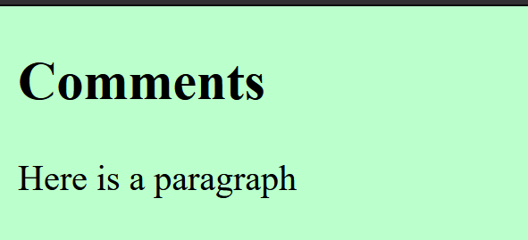
How do you make a comment?
<h2> Comments</h2>
<!-- This is a comment – the browser won’t display it -->
<p> Here is a paragraph </p>
See how the comment doesn’t show up in the web page (on the right)?
Only the uncommented code will show up in your web page

Slide 4
Example:
<h3> Pictures of Lilly
</h3>
<p> These are pictures of my adorable new puppy Lilly. She’s only 9 weeks old!
<!--Reminder: Add those pictures we took of Lilly on her first day in the pool -->
</p>
You can use comments to leave notes to yourself or to your partner for later…

Slide 5
One more:
<!--<tr>
<th>head for col1</th>
<th>head for col2</th>
<th>head for col3</th>
</tr>-->
You can put comments around multiple html tags and code to comment them out while you work on something else!

