Slide 1
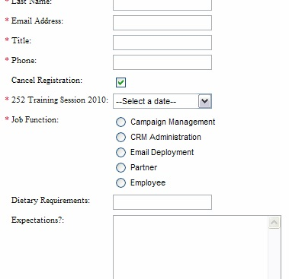
Forms:
Checkbox and radio buttons

Slide 2
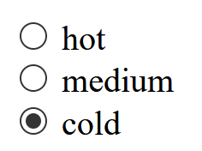
Radio Button (form element)
<input type=“radio” name=“hotornot” value=“hot” > hot <br >
<input type=“radio” name=“hotornot” value=“med” > medium <br >
<input type=“radio” name=“hotornot” value=“cold” checked = “checked”> cold <br >
This input type creates the above
only one button can be selected at a time.
The Cold button is selected as the default (checked = “checked”)
NOTE: the name for all 3 inputs is “hotornot”
That makes all three part of the SAME radio button set
So only one of any radio button named “hotornot can be selected

Slide 3
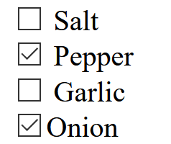
Checkbox (form element)
<input type= "checkbox" name="spice" value="salt" > Salt <br >
<input type= "checkbox" name="spice" value="pepper"> Pepper <br>
<input type= "checkbox" name="spice" value="garlic"> Garlic<br>
<input type= "checkbox" name="spice" value= =“onion">Onion<br>
Checkbox: every box with the same name belongs to the same set of checkboxes.
Unlike radio buttons, you can select more than one checkbox
Think pizza toppings = you can select multiple toppings for your pizza!
I clicked on Pepper and Onion –
They are not selected as default…

Slide 4
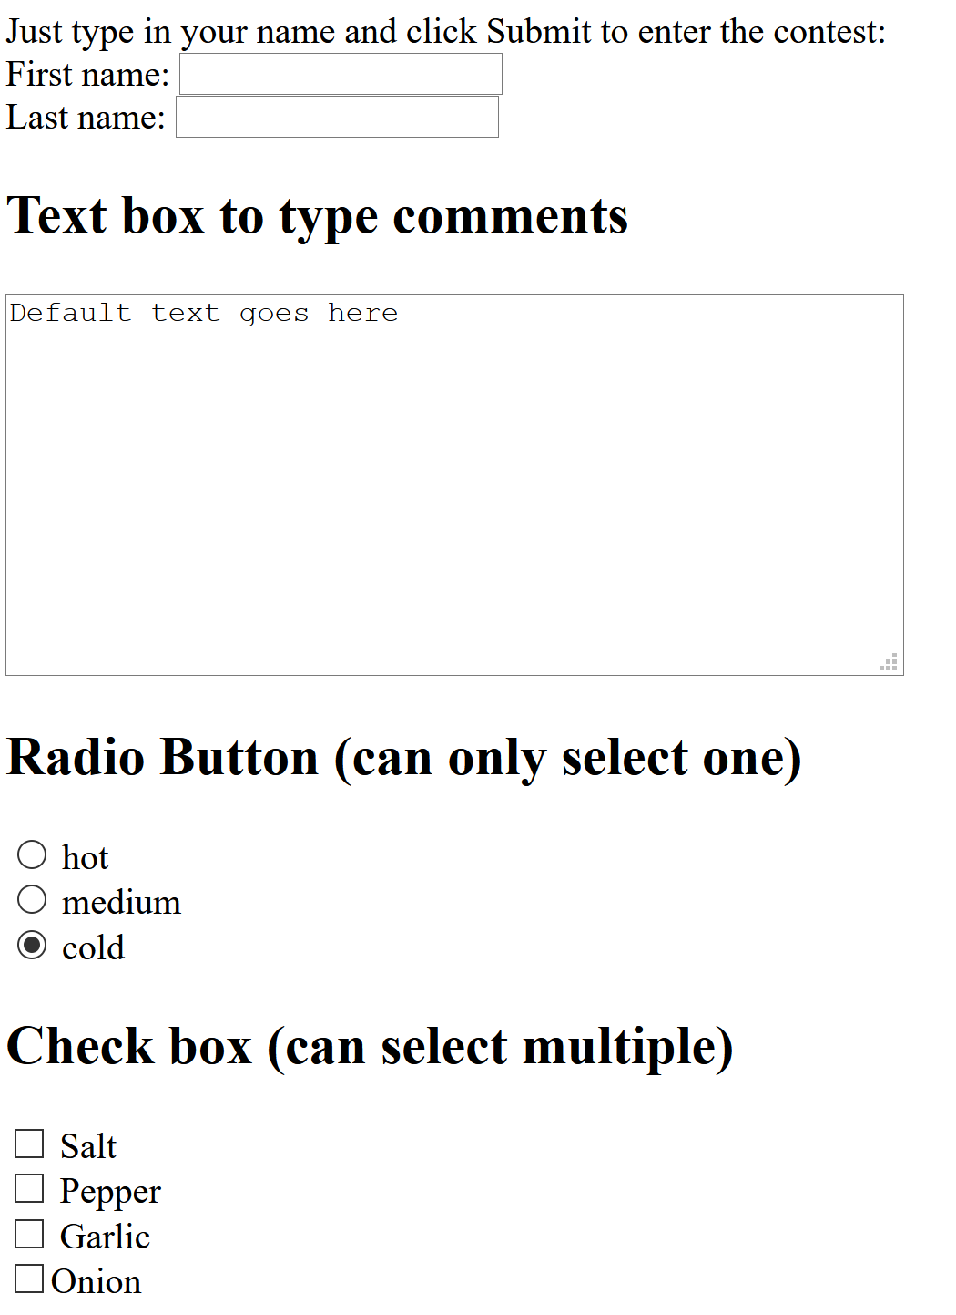
Form So Far…
<form>
<p>
Just type in your name and click Submit to enter the contest: <br >
First name: <input type= "text" name="firstname" value=" " > <br >
Last name: <input type= "text" name="lastname" value=" " > <br >
</p>
<h2> Text box to type comments </h2>
<textarea name="comments" rows="10" cols="48">Default text goes here</textarea><br >
<h2> Radio Button (can only select one)</h2>
<input type="radio" name="hotornot" value="hot" > hot <br >
<input type="radio" name="hotornot" value="med" > medium <br >
<input type="radio" name="hotornot" value="cold" checked = "checked"> cold <br >
<h2> Check box (can select multiple) </h2>
<input type= "checkbox" name="spice" value="salt" > Salt <br >
<input type= "checkbox" name="spice" value="pepper"> Pepper <br>
<input type= "checkbox" name="spice" value="garlic"> Garlic<br>
<input type= "checkbox" name="spice" value= =“onion">Onion<br>
</form>

