Slide 1
Forms: Buttons, Select, Datalist

Slide 2
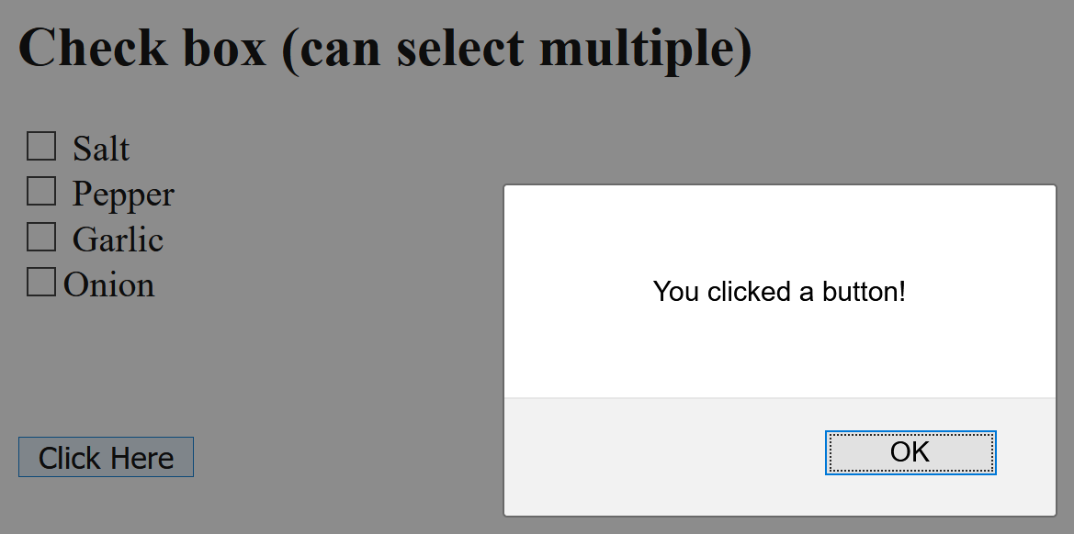
Buttons:
<input type = "button" value = "Click Here" onClick = "alert('You clicked a button!')">
Breaking it down:
Input : a group of form elements that allow the reader of the web page (the user) to interact with the element
Type = “button”: this input element is and will appear as a button on your web page.
Value =”Click Here”: this is the text that will appear on the button. It can be anything – it doesn’t have to be “Click Here”. Try changing it and reloading the web page. You’ll see the text on the button changes.
onClick = “Alert(‘You clicked a button!’)”: onClick indicates that clicking on the button will cause an action. The action in this case is to bring up an Alert box that says, “You clicked a button!”. Try changing the text “You clicked a button!” to “This is an Alert Box” and reload your web page and click on the button. The new text should show up in the Alert box.
NOTE: The Input element is another element that doesn’t require a separate closing tag.

Slide 3
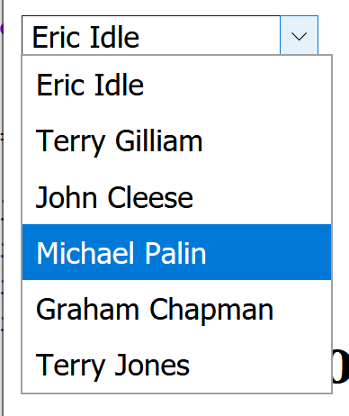
Select Box: (kinda cool drop-down box):
<select name="characters">
<option value="Eric"> Eric Idle </option>
<option value="TGilliam"> Terry Gilliam</option>
<option value="John"> John Cleese</option>
<option value = "Michael">Michael Palin </option>
<option value = "Graham">Graham Chapman </option>
<option value = "TJones">Terry Jones </option>
</select>
Mistake I see people make with select boxes:
forgetting to close the </option>s, and
Forgetting to close the </select> tag

Slide 4
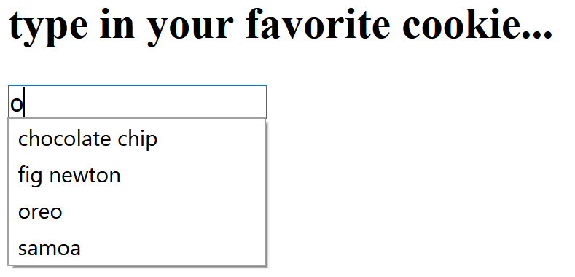
DataList (html 5)
<h2>type in your favorite cookie…</h2>
<input list="cookies">
<datalist id="cookies">
<option value="chocolate chip">
<option value="fig newton">
<option value="thin mint">
<option value="oreo">
<option value="samoa">
<option value="ginger snaps">
</datalist>
Start typing – will choose whichever value(s) have the text you’ve typed so far…

Slide 5
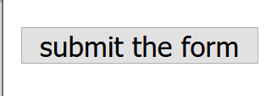
Submit
Most forms have one (and only one) submit button
This takes all the data the user filled in and send it somewhere
E.g., if you have something like:
<form action = “http://www.udel.edu/processform.php”>
When you hit the submit button, it will send all the info to the processform.ph
Looks like this:
<input type = "submit" onClick = "submit the form">
And in the browser it will look like:

Slide 6
Takeaways:
Forms – how users enter data
Group together different elements into one form (for processing) by putting <form> and </form> around the whole thing
Elements to put in a form:
Text (single line)
Text area (textbox)
Radio button (set of buttons in which you can only choose 1)
Checkbox (set of buttons in which you can choose multiple answers
Button – can click on to make things happen
Select box – drop down menu with options
Data list – lets you start typing and auto-suggests based on what you’ve typed
We’re dealing with the front end of a form here
When you hit submit, will send data to whatever action the form has (if the form has an action)

