Slide 1
Making a Web Page
Title, paragraphs, and header tags

Slide 2
Step 1: Create a new html file
Open your valid template.html in whatever editor you’re using
Notepad++, BBEdit, Bracket, etc.
Save as another file (e.g., firstwebpage.html)
Make sure you save it as an html file, with the .html extension
NO SPACES!!
E.g., DON’T name it: first web page.html!!!
Spaces in names of files are a real pain in the neck in the html world.
Now you should have two valid web pages:
template.html
firstwebpage.html

Slide 3
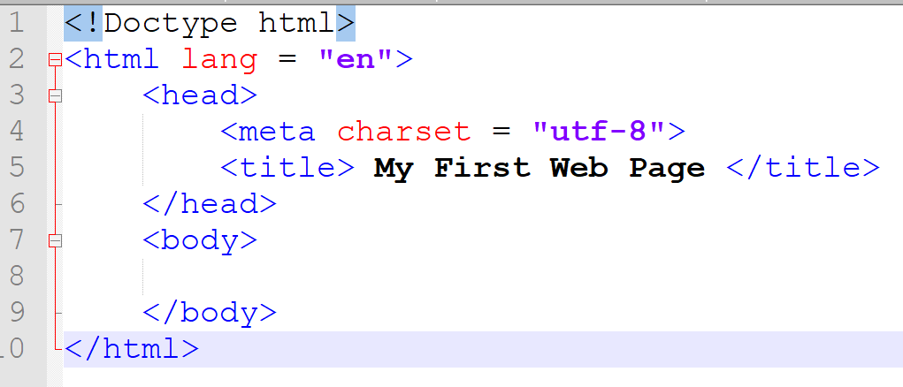
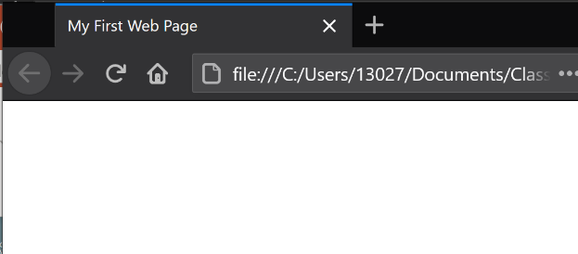
Step 2: Adding Title
NOTE: This is in the head section of your web page!
If it isn’t still open, open firstwebpage.html in your text editor of choice
Look in the head section
In between <title> and </title>, add something that might be an appropriate title for your web page (don’t make it too long)
Save your file
Validate it (https://www.validator.w3.org)
If it doesn’t validate, see video/ppt on validating your web page
If it does, load it into your browser
See the title in the tab?
Note: every web page has ONLY ONE title!

Slide 4
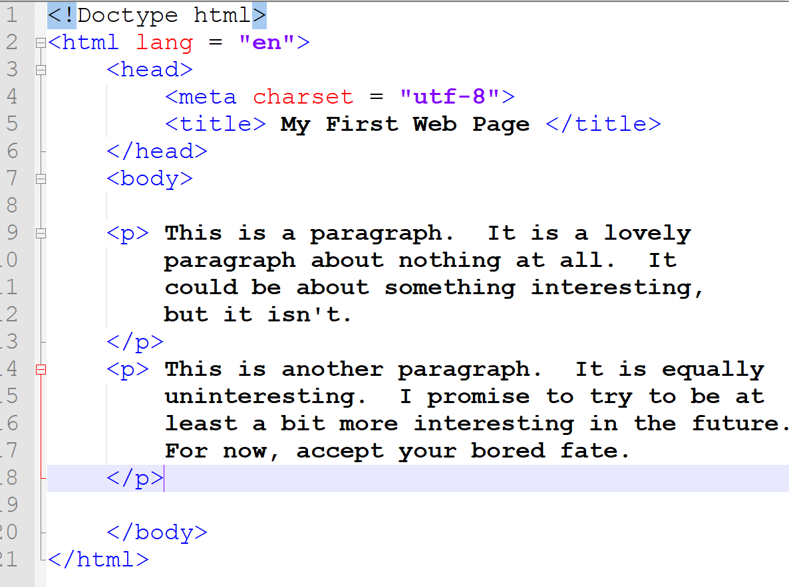
Step 2: Adding Content Paragraphs
HTML is a mark-up language
You have to tell the browser what everything is
E.g., you had to tell the browser what was the title by putting the <title> and </title> tags around it
In between the opening and closing body tags, we’ll add content.
Let’s add Paragraphs:
You must label each and every paragraph by putting an opening <p> and a closing </p> around it
See side column example!
When you have some paragraphs:
Save the file
Validate the file
View it in a web browser of your choice
You can have as many paragraphs as you want in the body, but each paragraph must be surrounded by the <p> and the </p> paragraph tags.

Slide 5
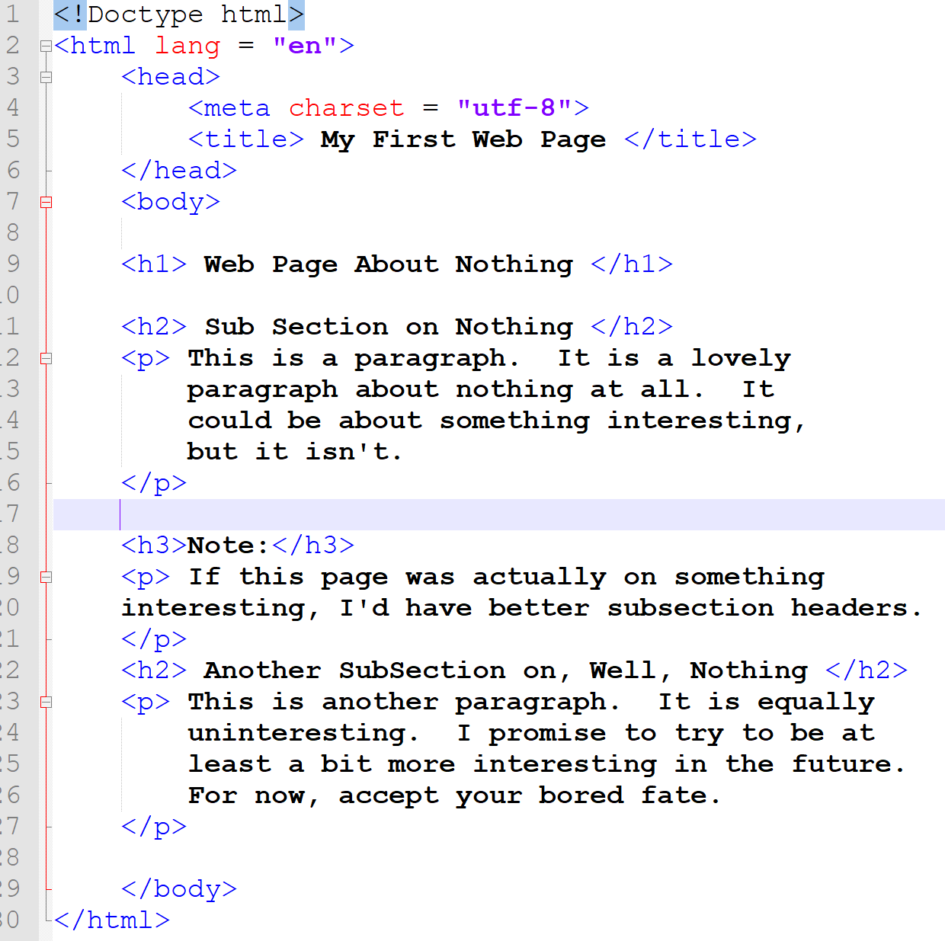
Step 2: Adding Content Headers
Headers are used to indicate headings of sections in a document
Note: This isn’t the same thing as the <title></title>, which is in the <head></head> section and appears in the tab
Because we computer scientists enjoy being confusing…
Headers are tags that go around heads of sections in the body.
They can be used multiple times
Like paragraphs
Headers that exist:
<h1> </h1>
<h2></h2>
<h3></h3>
<h4></h4>
<h5></h5>
<h6></h6>
NO H7!!!
Steps:
See examples of headers to the right
Then add some headers to your html file
Save it.
Validate it.
View it.

Slide 6
TakeAways
Use the Template to create new web pages
By opening, then saving as something else…
Title goes in the head section
Shows up in the tab (and that’s it)
Paragraphs go in the body section
Put <p> and </p> around EVERY SINGLE PARAGRAPH
Tells browser it’s a paragraph!
Headers go around section heads within the body section
There are <h1></h1> … </h6></h6>, but no <h7> onwards
You can use each header multiple times
And they don’t have to be in order
Note: search engines think headers are important because they help to indicate the topic of the web page
After you add code, ALWAYS VALIDATE
Using https://www.validator.w3.org

