Slide 1
HTML TABLES Intro
How to make a table in html

Slide 2
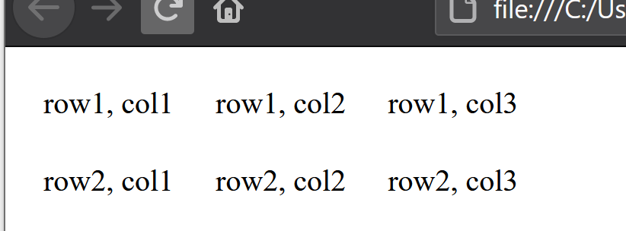
Making a table:
<table >
<tr>
<td> row1, col1 </td>
<td> row1, col2 </td>
<td>row1, col3</td>
</tr>
<tr>
<td>row2,col1</td>
<td>row2,col2</td>
<td>row2,col3</td>
</tr>
</table>
Looks like this in the browser
Note the same number of data cells per row!
<table></table>
Goes around the entire table
<tr></tr>
goes around each row
<td></td>
goes around each data cell in a row (think column)
YOU MUST HAVE THE SAME NUMBER OF DATA CELLS IN EACH ROW!!!

Slide 3
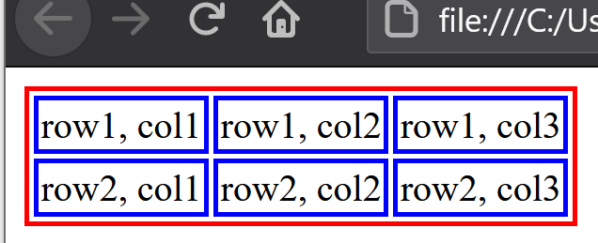
Adding Table Borders
In the head section of your html page, add:
<style>
td {
border-style:solid;
border-width: 2px;
border-color:blue;
}
table {
border-style:solid;
border-width: 2px;
border-color:red;
}
</style>
Your Entire Web Page now:
<!Doctype html>
<html lang = "en">
<head>
<meta charset = "utf-8">
<title> My First Web Page </title>
<style>
td {
border-style:solid;
border-width: 2px;
border-color:blue;
}
table {
border-style:solid;
border-width: 2px;
border-color:red;
}
</style>
</head>
<body>
<table>
<tr>
<td> row1, col1 </td>
<td> row1, col2 </td>
<td> row1, col3</td>
</tr>
<tr>
<td>row2, col1</td>
<td>row2, col2</td>
<td>row2, col3</td>
</tr>
</table>
</body>
</html>
What it looks like in your browser
This is CSS!
(but we’re doing it here so you can see the table better)

Slide 4
Adding table Headers
<table >
<tr>
<th>head for col1</th>
<th>head for col2</th>
<th>head for col3</th>
</tr>
<tr>
<td> row1, col1 </td>
<td> row1, col2 </td>
<td>row1, col3</td>
</tr>
<tr>
<td>row2,col1</td>
<td>row2,col2</td>
<td>row2,col3</td>
</tr>
</table>
Looks like this in the browser
Same number of table headers as data cells per row!
<th></th>
Goes around titles for columns
Like <td></td> but for the data cells that old the header info

Slide 5
Basic Table Rules:
<table></table> goes around entire table
Only <tr></tr> can go inside tables
<tr></tr> (table row tag) goes around each row in a table
Only <th></th> or <td></td> can go inside of table rows (<tr>)
<th></th> (table header tag) goes around table column heads
Plain text, paragraphs, <h1>…<h6> tags can all go in between the <th></th> tag
<td></td> (table data cell tag) goes around table data cells
Plain text, paragraphs, <h1>…<h6> tags can all go in between the <td></td> tag
EACH TABLE ROW MUST HAVE THE EXACT SAME NUMBER OF DATA CELLS!!!
This is the thing everyone messes up!
YES
NO
<table >
<tr>
<td> row1, col1 </td>
<td> row1, col2 </td>
<td>row1, col3</td>
</tr>
<tr>
<td>row2,col1</td>
<td>row2,col2</td>
<td>row2,col3</td>
</tr>
</table>
<table >
<tr>
<td> row1, col1 </td>
<td> row1, col2 </td>
<td>row1, col3</td>
</tr>
<tr>
<td>row2,col1</td>
<td>row2,col2</td>
</tr>
</table>
Row 1: 3 data cells!
Row 2: 2 data cells ☹
Both rows have 3 data cells! ☺

Slide 6
Take-aways!
<table></table> says everything between those tags is a table
<tr></tr> for rows
<td></td> for data cells
<th></th> for table headers
The ONLY place you can put text/paragraphs/headers/images/etc. is between the <td> and <td> tag set and the <th></th> tag set.
ALL rows in a table must have the exact same number of data cells!!!
You can add css to see the table borders
More about tables is coming!

