Slide 1
Tables inside Tables
How to

Slide 2
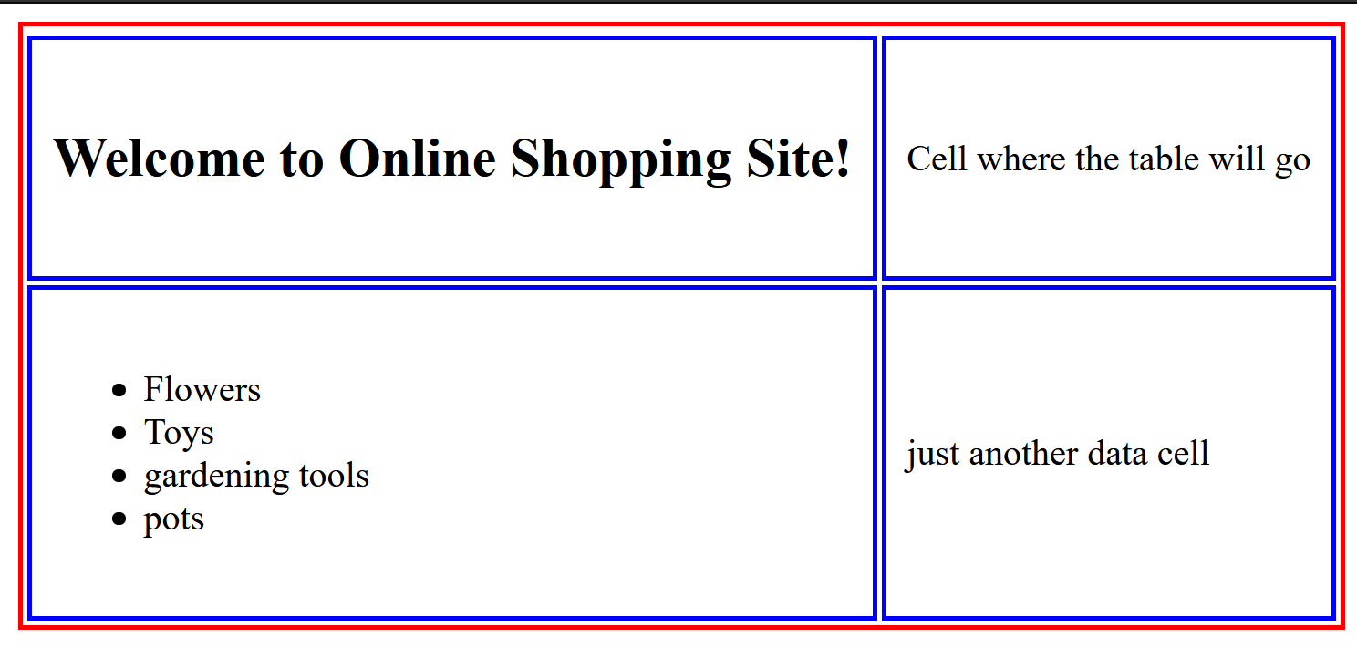
Step by step guide: Placing a table inside of a table:
Step 1) Create your outer table:
My code
What the table looks like in the browser
<table>
<tr>
<td><h2>Welcome to Online Shopping Site!</h2></td>
<td>Cell where the table will go</td>
</tr>
<tr>
<td><ul><li>Flowers</li> <li> Toys </li> <li> gardening tools</li> <li> pots</li>
</ul>
</td>
<td>just another data cell</td>
</tr>
</table>
*Note that I put both a header <h2> inside a data cell (top left) and, in the bottom left, an entire
list inside a data cell!

Slide 3
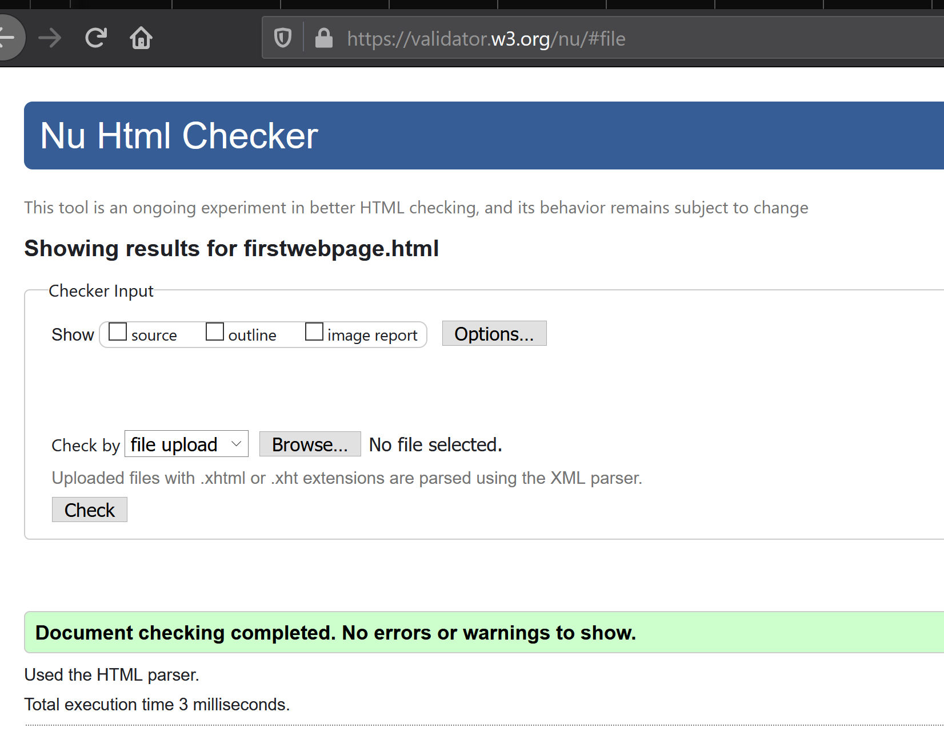
Step by step guide: Placing a table inside of a table:
Step 2) Validate your code!

Slide 4
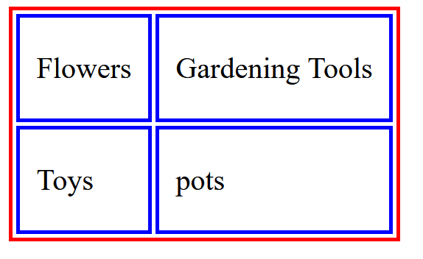
Step by step guide: Placing a table inside of a table:
Step 3) Create your inner table:
My code
What the table looks like in the browser
<table>
<tr><td>Flowers</td>
<td>Gardening Tools</td>
</tr>
<tr><td>Toys</td>
<td>pots</td>
</tr>
</table>

Slide 5
Step by step guide: Placing a table inside of a table:
Step 4) Validate your code (again! Get used to this! Do it a lot!)!

Slide 6
Step by step guide: Placing a table inside of a table:
Step5) Copy the entire second (inner) table and paste it inside any data cell in the first (outer) table
i.e., between a <td> and a </td> in the outer table
Outer Table
Table inside of table
<table>
<tr>
<td><h2>Welcome to Online Shopping Site!</h2></td>
<td>Cell where the table will go</td>
</tr>
<tr>
<td><ul><li>Flowers</li> <li> Toys </li> <li> gardening tools</li> <li> pots</li>
</ul>
</td>
<td>just another data cell</td>
</tr>
</table>
<table>
<tr>
<td><h2>Welcome to Online Shopping Site!</h2></td>
<td>Cell where the table will go
<table><tr><td>Flowers</td>
<td>Gardening Tools</td>
</tr>
<tr><td>Toys</td>
<td>pots</td>
</tr>
</table>
</td>
</tr>
<tr>
<td><ul><li>Flowers</li> <li> Toys </li>
<li> gardening tools</li>
<li> pots</li>
</ul>
</td>
<td>just another data cell</td>
</tr>
</table>
Paste whole
inner table
here
Inner Table
<table><tr><td>Flowers</td>
<td>Gardening Tools</td>
</tr>
<tr><td>Toys</td>
<td>pots</td>
</tr>
</table>

Slide 7
In Browser:

Slide 8
Step by step guide: Placing a table inside of a table:
Step 6) Validate your code (Yet again! I told you you’d be doing this a lot!)

Slide 9
TakeAways!
VALIDATE!! A LOT!!!
Make both tables separately
Validate them
Then copy one and place it in between the <td> and </td> in the other table.
Validate again.
View it in browser
Validate (just because at this point)
NOTE that THE ONLY PLACE you can put another table (or any other tag) inside of another table is between a set of <td> and </td> tags!

