Slide 1
HTML: Lists

Slide 2
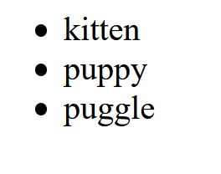
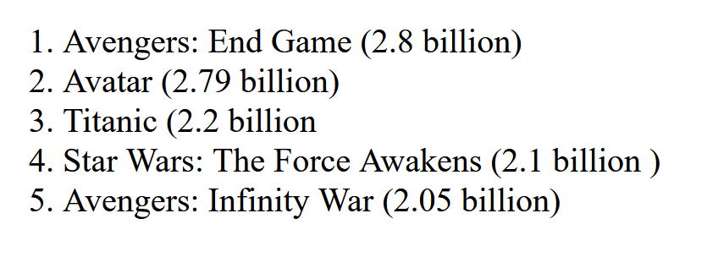
Lists
Types of Lists:
<ul></ul> for an unordered list
<ol></ol> for an ordered (numbered) list
Inside either, you have multiple list items
<li></li>
Put it together: Either:
<ul>
<li>kitten</li>
<li>puppy</li>
<li>puggle</li>
</ul>
OR
<ol>
<li> Avengers: End Game (2.8 billion) </li>
<li> Avatar (2.79 billion) </li>
<li>Titanic (2.2 billion </li>
<li>Star Wars: The Force Awakens (2.1 billion ) </li>
<li> Avengers: Infinity War (2.05 billion) </li>
</ol>
What lists look like
in your browser

Slide 3
Lists Do’s and Don’ts
NO
YES!
<p>
<ol>
<li> a list item</li>
<li> another list item</li>
</ol>
</p>
Can’t put lists inside of paragraphs or headers!!!!
<ol>
<li> <p> You can put a paragraph here </p>
</li>
<li> <h2> You can put a header here too
</h2>
<p> You can put just about anything inside
the list item
</p>
</li>
</ol>
You can put a paragraph, or a header, or multiple paragraphs and headers inside of a list item.
You can put almost any other tag inside of the list item
You can even put another list inside of a list item! (see next slide…)
This is BAD!
NO
<ol> This is a list
<li> a list item</li>
<li> another list item</li>
</ol>
Only <li></li> can go in an <ol> and a <ul>!!!
This is BAD!
<h2> This is a list</h2>
<ol> <li> a list item</li>
<li> another list item</li>
</ol>
Use the header tags to make a list header!

Slide 4
To put a list inside of a list:
Step 1: Create the outer list:
<ul><li> Cats </li>
<li> Dogs </li>
<li> Wombats </li>
</ul>
Step 2: Create the inner list:
<ol><li> Bulldog</li>
<li> Poodle </li>
<li> Husky </li>
<li> Mutt </li>
</ol>
Step 3: Validate your code!!!
Make sure these two lists are valid html code
Step 4: Copy the inner list and paste it INSIDE a list item in the outer list
In this case, I’m going to paste it inside the Dogs list item:
<ul><li> Cats </li>
<li> Dogs
<ol><li> Bulldog</li>
<li> Poodle </li>
<li> Husky </li>
<li> Mutt </li>
</ol>
</li>
<li> Wombats </li>
</ul>

Slide 5
Takeaways:
There are ordered and unordered lists (<ol> and <ul>)
ONLY list items can go inside <ol> and <ul> lists
Lists cannot go inside of headers (<h1>…<h6>) or paragraphs (<p>)
However, headers and paragraphs can go inside of list items!
E.g., <ul> <li> <h2>Cookies</h2><p> I adore cookies!!! </p> </li> </ul>
And you can put lists inside of lists
By putting the second list INSIDE of a list item in the first list
E.g., <ul> <li> Cookies <ol><li> Oreos</li> <li> Chocolate Chips </li> <li> Thin mints </li> </ol> </li> <li> donuts</li> </ul>
VALIDATE YOUR CODE!!!

