Slide 1
Adding Images

Slide 2
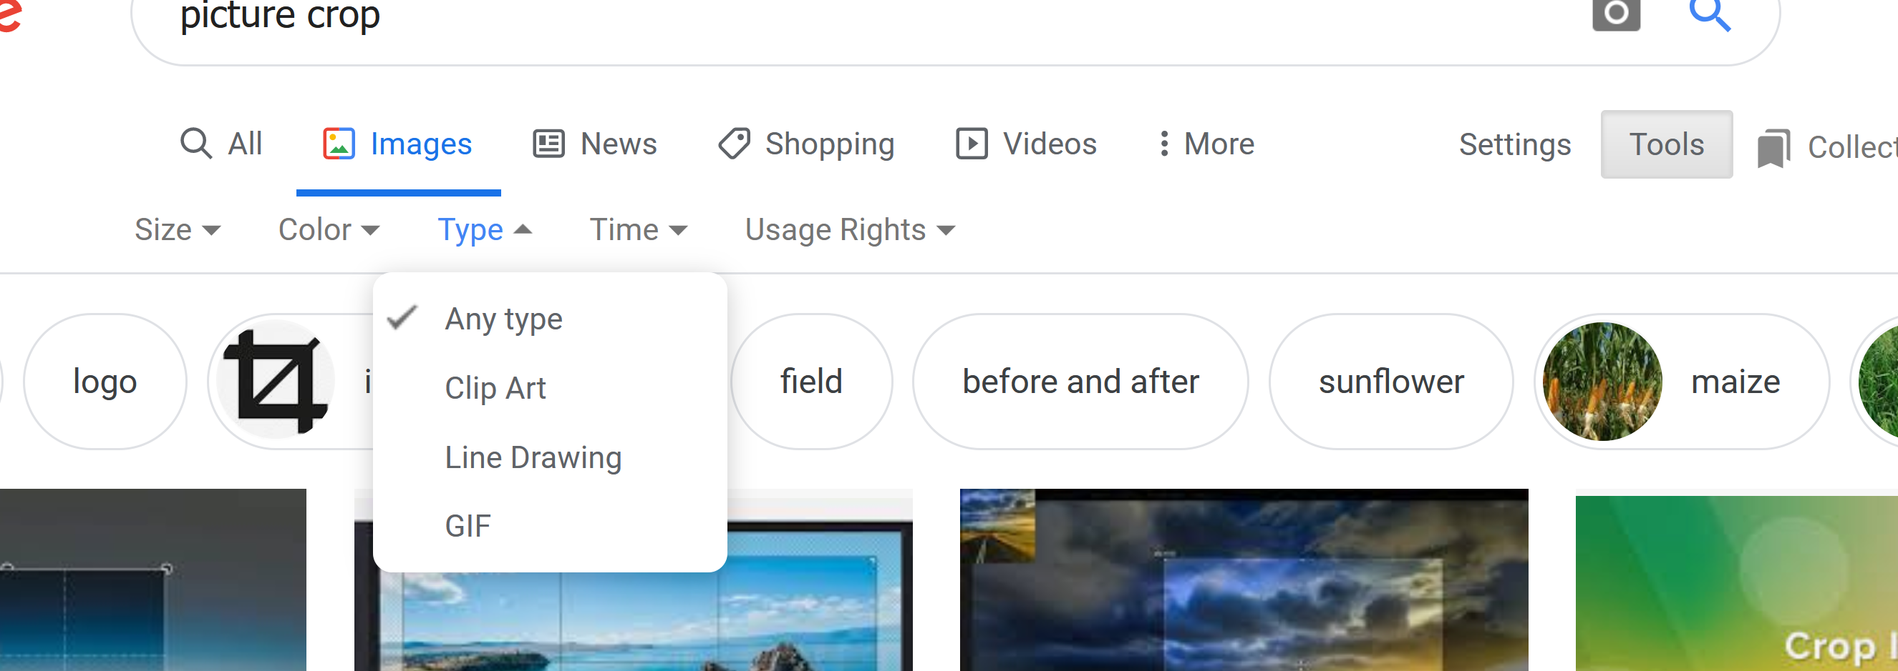
Choosing an Image
Find an image:
You want .jpg, .gif, or .png for the web
Note: you can’t just take an image of a different type and change the extension – that doesn’t actually change the type of the file.
You can google whatever you’re looking for, then click the image button to find images of it.
If you’re looking for clip art, on the right, click on tools, then in the middle click on type, then select clip art.
If you’re looking for a small icon, after clicking on tools, click on size (on the left) and then icon
This is not always reliable in terms of size, but it’s a start.
Find an image:
You want .jpg, .gif, or .png for the web
Note: you can’t just take an image of a different type and change the extension – that doesn’t actually change the type of the file.
You can google whatever you’re looking for, then click the image button to find images of it.
If you’re looking for clip art, on the right, click on tools, then in the middle click on type, then select clip art.
If you’re looking for a small icon, after clicking on tools, click on size (on the left) and then icon
This is not always reliable in terms of size, but it’s a start.

Slide 3
Adding an image
<img src = “puppy.jpg” style = “width: 150px; height: 200 px;”, alt = “an adorable puppy looking straight at you”>
Break it down:
src: the name and location of the image,
width: the width of the image in pixels
height: the height of the image in pixels,
alt: alternative text that describes the image for people who are unable to download or see the image
NOTE: To test this, the file puppy.jpg MUST BE in the same place on your pc as the html file with the above html code in it.
… for now….
“puppy.jpg”

Slide 4
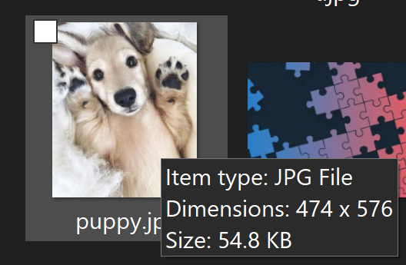
How to find width and height of an image
PC:
Run your mouse over the image.
Let it sit
A pop-up box will pop up with the dimensions (e.g., 474x576)
Mac:
Click on the image,
Under the file menu, choose get info.
You should see the dimensions in the menu that pops up

Slide 5
What if the image doesn’t show up???
Is the image in the same folder as your web page???
Did you spell the name of the image EXACTLY the same in your web page as it is named?
(e.g.,
Puppy.jpg
puppy.jpg
puppy.JPG
puppy.jpeg
Did you put a space before the words: src, width, height, and alt?
If you opened a quote, did you close it?
(e.g., <img src = “puppy.jpg style = “width: 150px; height: 200 px;”, alt = “an adorable puppy looking straight at you”> WON’T work.)
Are there funky quotes? (“ versus ") Only the second will work
The first usually happen when you’ve copied code from MS Word or powerpoints.
ONLY this will work!

Slide 6
TakeAways
<img src = “puppy.jpg” style = “width: 150px; height: 200 px;”, alt = “an adorable puppy looking straight at you”>
Only use .jpg, .gif, and .png images
You must specify:
The src (the name of the pic, caps and small letters matching EXACTLY!
The width and height
Find out by running your mouse over the pic, or
Using Get Info
An alt tag
Describes the image (we need this)
Will discuss more on this later…

