Slide 1
innerHTML 2
More about what it is and what we do with it.

Slide 2
What is innerHTML?
<p id = “firstp”> This is the innerHTML text between the opening and closing tag</p>
The innerHTML of firstp is,
This is the innerHTML text between the opening and closing tag
To be clear, though, the innerHTML is EVERYTHING between the opening and closing tag of the element with the id. So, for
<p id = “linked”> <a href = “udel.edu” id = “firstlink”> link to udel </a>
</p>
The innerHTML of linked would be
<a href = “udel.edu” id = “firstlink”> link to udel </a>
Because all of that occurs between the opening and closing tag of the p with the id of ‘linked’
Thus, to change the link to something else, you’d do the following:
document.getElementById(‘linked’).innerHTML = “<a href = ‘google.com’>link to google</a>”
You’d have to replace EVERYTHING between the opening and closing tag for the code generated by javaScript to work.
replaces

Slide 3
More innerHTML:
In the following,
<ol id = “list1”>
<li id = “firstItem”> cats </li>
<li id=“seconditem”> dogs </li>
</ol>
The innerHTML of list1 is all of the following:
<li id = “firstItem”> cats </li>
<li id=“seconditem”> dogs </li>
And given the following html code,
<div id = "idofadiv">
<h1> Horror Movies</h1>
<p> I love crazy, schlocky, funny horror movies. I don’t like gory slasher movies at all. They’re just gross. I really like the horror movies that either are psychologically scary or are just silly.
</p>
<h2>B Horror Movies</h2>
<p> There are funny horror movies, like Sean of the Dead and Zombieland, and then there are horror movies that are so bad they’re funny. I like those too!
</p>
</div>
the innerHTML of idofadiv would be all of (all the green stuff!):
<h1> Horror Movies</h1>
<p> I love crazy, schlocky, funny horror movies. I don’t like gory slasher movies at all. They’re just gross. I really like the horror movies that either are psychologically scary or are just silly.
</p>
<h2>B Horror Movies</h2>
<p> There are funny horror movies, like Sean of the Dead and Zombieland, and then there are horror movies that are so bad they’re funny. I like those too!
</p>

Slide 4
Using innerHTML to change an entire list:
HTML:
<ul id = "mylist" onClick = "changeList('mylist')">
<li> clown</li>
<li> monster</li>
<li>witch</li>
</ul>
JavaScript function:
function changeList(par) {
x="<li> ghosts</li>"
y = "<li> zombies</li>"
z = "<li>monsters</li>"
q = "<li>ghouls</li>"
v = x + y + z + q
document.getElementById(par).innerHTML = v
}
Note that I could have written out,
document.getElementById(par).innerHTML = "<li> ghosts</li><li> zombies</li><li>monsters</li><li>ghouls</li>“
This line and the code above do exactly the same thing – it’s just easier to find problems in the code above than it is to find errors in this line.

Slide 5
Troubleshooting:
Make sure that the button in your html calls a function with exactly the same name as the name of the function in your javaScript.
(so in the example above, small c in change, large L in list
Make sure in the html you’re passing in the id of the entire list (the ul) instead of an individual list item (an li)
Make sure you have an opening and closing quote for each string on each line in the function
string on the right into a variable on the left
Make sure you’ve got opening and closing { and } around the entire function.
Double check spelling of document.getElementById(...).innerHTML

Slide 6
Using getElementById to Add to an Existing List
So far, so good. But what if you want to add to the existing list?
We must first get the existing list using innerHTML:
k = document.getElementById(par).innerHTML
This line gets the current innerHTML of your list.
k will now hold all of the innerHTML of your list (the ul tag),
e.g., ALL of the list items in there so far.
Now if we put in the function:
document.getElementById(par).innerHTML = k+ v
It will add the new list item to the END OF THE EXISTING LIST!
function changeList(par) {
x="<li> ghosts</li>"
y = "<li> zombies</li>"
z = "<li>monsters</li>"
q = "<li>ghouls</li>"
v = x + y + z + q
k = document.getElementById(par).innerHTML
document.getElementById(par).innerHTML = k + v
}

Slide 7
And just this… (AKA Order matters…)
If you change the last line to be as follows:
document.getElementById(par).innerHTML = v + k
Now the new items are in the list BEFORE the old items ☺
function changeList(par) {
x="<li> ghosts</li>"
y = "<li> zombies</li>"
z = "<li>monsters</li>"
q = "<li>ghouls</li>"
v = x + y + z + q
k = document.getElementById(par).innerHTML
document.getElementById(par).innerHTML = v+k
}

Slide 8
Variable Name Side Note:
Note that computer scientists often use single letters as variables. This is because WE ARE LAZY! It is much easier to use as a variable name, k, than it is to use, ‘aVariableThatHoldsTheInnerHTMLOfTheList’ Both are perfectly legitimate variable names, as is ‘puppies’.
The best practice is to use short, simple variable names, preferably that somehow describe what the variable holds. Short variable names are easier for you and for other people who have to deal with your code. Plus you’re a lot less likely to misspell a short variable name than something longer but more descriptive.
But we go back to the basic premise that computer scientists are a lazy bunch. If you see a single letter (preferred letters include x, y, z, i, j, and k) it is almost always a variable or a parameter.
All that being said, it really is better practice to use short, descriptive variable and parameter names.

Slide 9
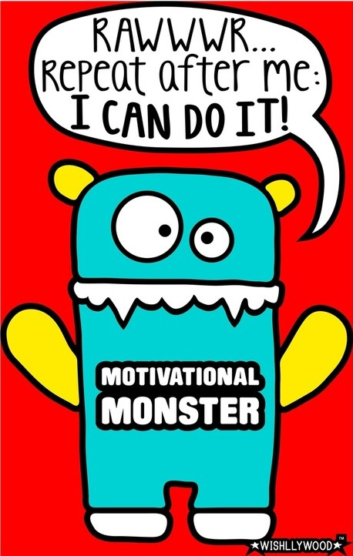
Add new (dynamic) content to list:
So far the code is relatively boring. Every time you click on the list, the exact same list is generated. Plus you’re adding the same content again and again.
To make it more interactive, use the prompt to ask the user what they want to input into the list.
E.g. (and here my variable is newl):
newl = prompt("What item do you want to add to the list?")
and then x would be:
x="<li>" + newl + "</li>“
Explained:
In this line,newl is the item the user typed in (say it’s ghouls).
But to make it a list item, we have to surround it with <li> and </li>.
Those are literal items – we literally want <li> and </li> to be written to the html page (so they go in quotes)
But we don’t want newl to literally be written to the page, we want what’s inside of newl.
So newl does not go in quotes
And, we have to join everything together using +.
And, finally, we want to put it all into the variable x.
You could also do it like this:
v= “<li>”
w = “</li>”
newitem = prompt("What item do you want to add to the list?")
x = v+newitem+w
That will result in exactly the same results.
function changeList(par) {
k = document.getElementById(par).innerHTML
newl = prompt("What item do you want to add to the list?")
x="<li>" + newl + "</li>"
y = "<li> zombies</li>"
z = "<li>monsters</li>"
q = "<li>ghouls</li>"
v = x + y + z + q
document.getElementById(par).innerHTML = k+ v
}

Slide 10
Dynamic List:
If we want to change every item in the list dynamically:
function changeList2(par) {
k = document.getElementById(par).innerHTML
newl = prompt("What item do you want to add to the list?")
x="<li>" + newl + "</li>"
newl = prompt("What item do you want to add to the list?")
y="<li>" + newl + "</li>"
newl = prompt("What item do you want to add to the list?")
z="<li>" + newl + "</li>"
newl= prompt("What item do you want to add to the list?")
q="<li>" + newl+ "</li>"
v = x + y + z + q
document.getElementById(par).innerHTML = k+ v
}

Slide 11
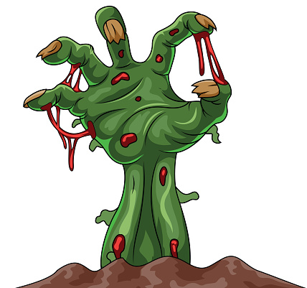
Ask user if they want to add info?
1. function changeList3(par) {
2. k = document.getElementById(par).innerHTML
3. v = ""
4. a = prompt("do you want to add an item to the list?")
5. if (a === "yes") {
6. newl = prompt("What item do you want to add to the list?")
7. x="<li>" + newl + "</li>"
8. v = v + x
9. }
10. newl = prompt("What item do you want to add to the list?")
11. y="<li>" + newl + "</li>"
12. newl = prompt("What item do you want to add to the list?")
13. z="<li>" +newl + "</li>"
14. newl= prompt("What item do you want to add to the list?")
15. q="<li>" + newl+ "</li>"
16. v = v + y + z + q
17. document.getElementById(par).innerHTML = k+ v
18. }
Make sure you modify 16. It will now add y, z, and q onto the end of v
Line 3: v initialized to a blank slate
Lines 4-6: The variable a will hold what the user types in in response to the prompt, “do you want to add an item to the list?” So it should hold “yes” or “no”
Line 5: If the user answered “yes”, then the code prompts the user for the item and put what the user typed in into the variable m.
Line 7: you’re surrounding the m with <li> and </li> tags.
line 8: joins the string in x onto the end of the string in v.

Slide 12
Checking for each item?
You can repeat this process for each of the different list items.
E.g.,
k = document.getElementById(par).innerHTML
v = ""
a = prompt("do you want to add an item to the list?")
if (a === "yes") {
newl = prompt("What item do you want to add to the list?")
x="<li>" + newl + "</li>"
v = v + x
}
a = prompt("do you want to add an item to the list?")
if (a === "yes") {
newl = prompt("What item do you want to add to the list?")
x="<li>" + newl + "</li>"
v = v+x
}
…
NOTE:
that you can re-use the variables a and m
once they’re used to generate the list item, you don’t need them again, so it’s okay to reuse them.
You could also re-use x in this code because once x is strung onto the end of v, it’s done with being useful, so you could put another value into it after that.
You got this!

Slide 13
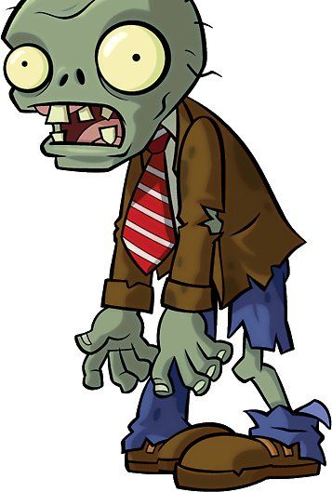
Take-Aways!
innerHTML is ALL the material between the opening and closing of a tag
So it can include other tags
E.g, div tags with ids – everything between the opening and closing <div> will be the innerHTML
Lists ul and ol – everything between the <ul> and the </ul> will be the innerHTML
We can add to the innerHTML
In this case, the list
Use getElementById and innerHTML to get the current list
Add new list items to the list
We can dynamically add to the innerHTML
Using a prompt to get info to add to the list
We can re-use variables (if we’re done using the old content)
ORDER MATTERS!

