Slide 1
innerHTML
STILL using getElementById…

Slide 2
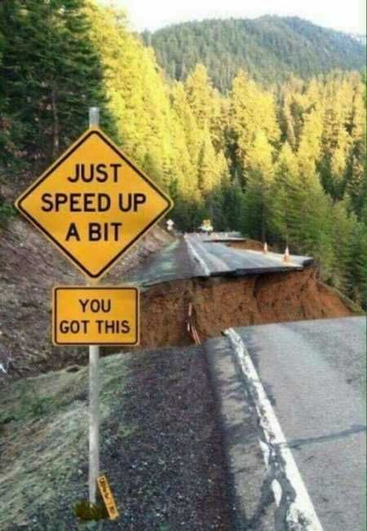
So Far:
We’ve used getElementById to:
Set (change) the .src for an image tag on a web page
Set (change) the styles of a tag on a web page
Get the style information about a tag from a web page
Get the alt text from an image tag on a web page
Information is changed when document.getElementById is on the left
we get information and put it into a variable when document.getElementById is on the right.

Slide 3
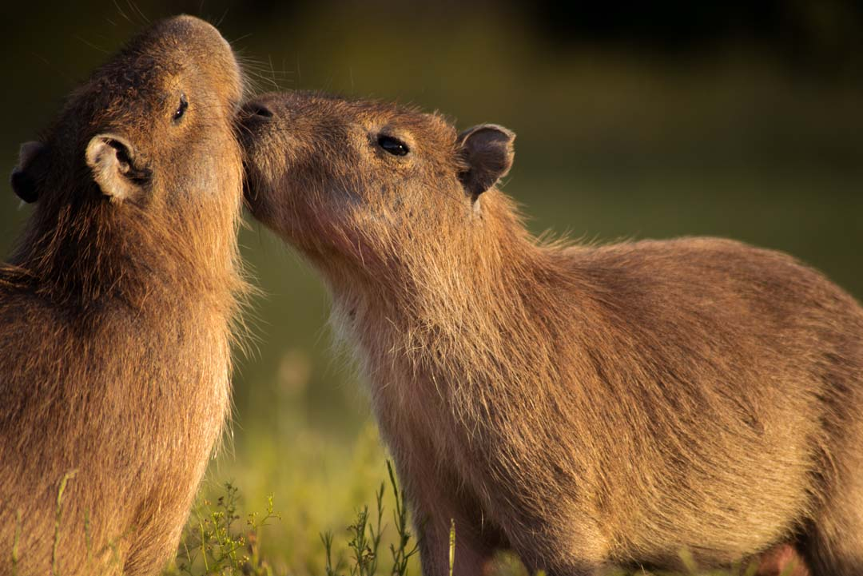
innerHTML
The innerHTML is what is between the opening and the closing tag of anything
regardless of what the tag is.
Examples:
<p id = “firstp”> This is the innerHTML text between the opening and closing tag</p>
The innerHTML of firstp is: “This is the innerHTML text between the opening and closing tag”
In this html code:
<h1 id = “largeheader”>Capybara</h1>
The innerHTML of largeheader is “Capybara”
In this html code:
<a href = "http://www.cowsareawesome.com" id = "coolcows"> link to cows are awesome</a>
The innerHTML is “link to cows are awesome”
Hey you! You got this!

Slide 4
Modifying innerHTML:
HTML:
<p id = 'p1' onClick = "changeinnerHTML('p1')">Cows</p>
JavaScript:
function changeinnerHTML(par) {
document.getElementById(par).innerHTML = "Horses“
}
Explained:
When you clicked on the paragraph, you sent the id of the paragraph into the parameter par in the function in the .js file.
Then document.getElementById(par).innerHTML, which is currently “Cow”, gets set to what is on the right, or “Horses”
In the html page, the old innerHTML gets changed to “Horses.
1
3
(2)

Slide 5
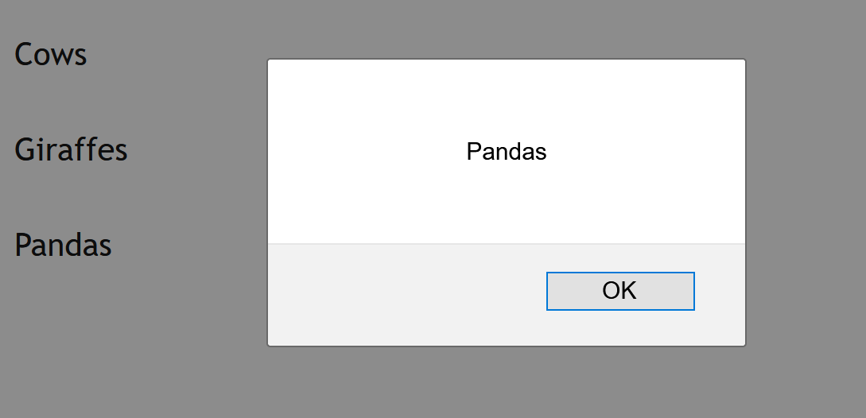
Reading innerHTML:
Just like with the style and the image information, you can also read the innerHTML from the web page.
x = document.getElementById(par).innerHTML
You just need to put the innerHTML on the right and a variable on the left.
Example:
HTML:
<p id = 'p1' onClick = "changeinnerHTML('p1')">Cows</p>
<p id = ‘p2' onClick = "changeinnerHTML(‘p2’)”>Giraffes</p>
<p id = ‘p3' onClick = "changeinnerHTML(‘p3’)”>Pandas</p>
JavaScript:
function changeinnerHTML(par) {
x = document.getElementById(par).innerHTML
alert(x)
}
If you click on each of the paragraphs, its innerHTML content should pop up (Cows, Giraffes, Pandas).

Slide 6
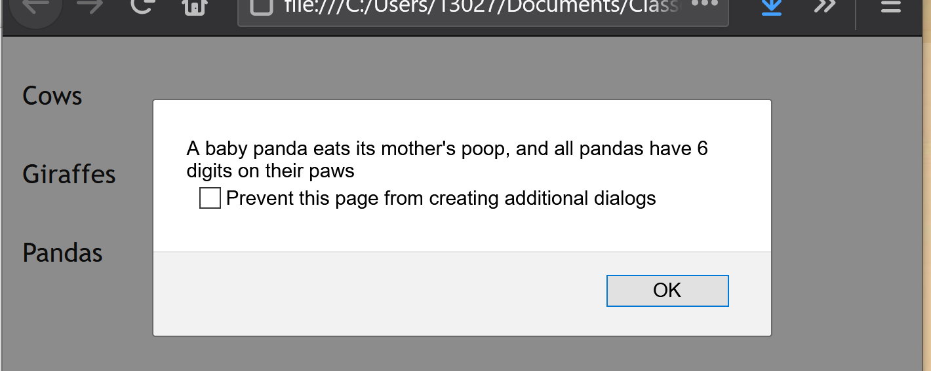
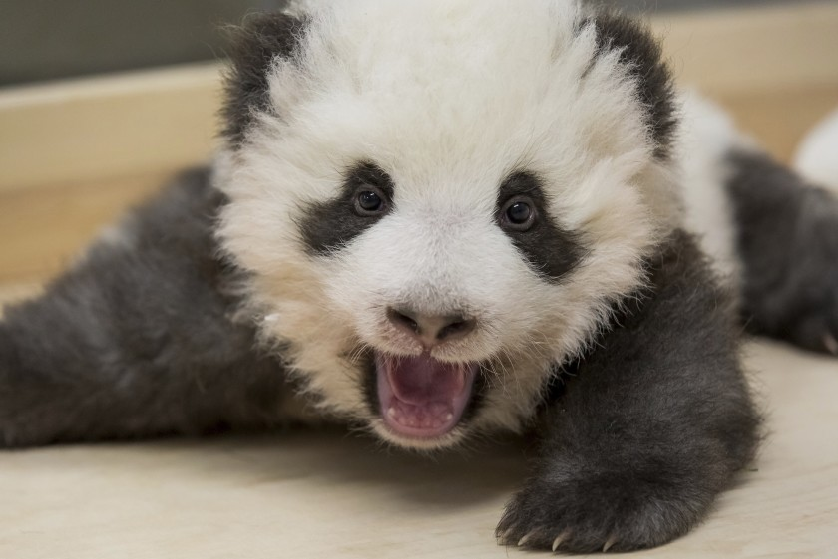
Reading innerHTML: Combined with if condition:
Let’s do both in the same function:
function changeinnerHTML(par) {
x = document.getElementById(par).innerHTML
alert(x)
if (x === 'Cows') {
y = "You are more likely to be killed by a cow than a shark"
}
else if (x === 'Giraffes') {
y = "A giraffe's legs are longer than most humans are tall, and their necks are too short to reach the ground"
}
else if (x === 'Pandas') {
y = "A baby panda eats its mother's poop, and all pandas have 6 digits on their paws"
}
alert(y)
}
This reads the innerHTML and puts it into x
Y holds one of the three sentences, based on what x was
Shows the sentence in y

Slide 7
Joining Strings (Intro):
You may want to join the old innerHTML with new content to write out:
function readinnerHTML(par) {
x = document.getElementById(par).innerHTML
if (x === 'Cows') {
y = "You are more likely to be killed by a cow than a shark"
}
else if (x === 'Giraffes') {
y = "A giraffe's legs are longer than most humans are tall, and their necks are too short to reach the ground"
}
else if (x === 'Pandas') {
y = "A baby panda eats its mother's poop, and all pandas have 6 digits on their paws"
}
z=x + ": "+y
alert(z)
}.
The Green is the new stuff (See Joining Strings Video). Let’s break it into steps:
1) We’re using the + to join strings (words and phrases) together.
e.g., “hedge” + “hog” will be “hedgehog”
2) In this case, the strings (or words and phrases) are in x and in y. I could just say:
if x holds “Pandas”
and y holds “A baby panda eats its mother’s poop, and all pandas have 6 digits on their paws”
x+y will hold “Pandas A baby panda eats its mother’s poop, and all pandas have 6 digits on their paws”
3) I could say:
x+ “:”
that would create “Pandas:”
because I joined the string in x with “:”
4) I joined the string in x with the string “:” with the string in y as follows:
x+”:”+y
and that gives me: “Pandas: A baby panda eats its mother’s poop, and all pandas have 6 digits on their paws”
5)finally, remember that everything on the right side goes into the variable on the left side. So:
z=x + ": "+y
z now holds “Pandas: A baby panda eats its mother’s poop, and all pandas have 6 digits on their paws”
And that is what goes into the alert!

Slide 8
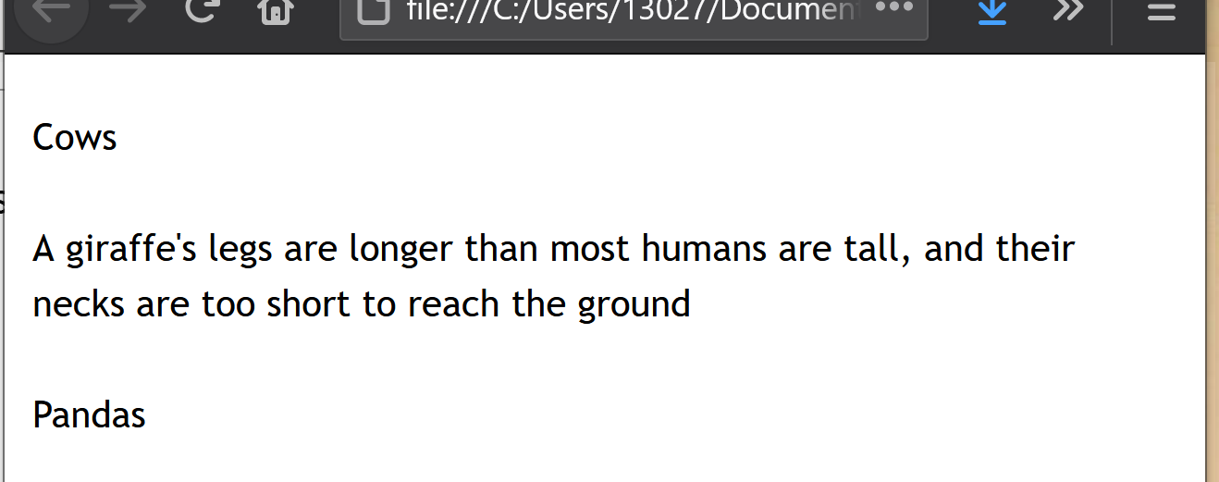
Finally:Reading & modifying innerHTML:
Let’s do both in the same function:
function changeinnerHTML(par) {
x = document.getElementById(par).innerHTML
alert(x)
if (x === 'Cows') {
y = "You are more likely to be killed by a cow than a shark"
}
else if (x === 'Giraffes') {
y = "A giraffe's legs are longer than most humans are tall, and their necks are too short to reach the ground"
}
else if (x === 'Pandas') {
y = "A baby panda eats its mother's poop, and all pandas have 6 digits on their paws"
}
document.getElementById(par).innerHTML = y
}
This reads the innerHTML and puts it into x
This modifies the innerHTML on your web page by changing it to what’s in y!

Slide 9
Takeaways:
innerHTML – what’s between an opening and closing tag
<p id = “p1”> don’t worry, be happy! </p>
<p> here comes the sun </p>
<p>happy (the song) </p>
(the green stuff is the innerHTML - it’s between the opening and closing tag)
You can modify the innerHTML using document.getElementById
if document.getElementById().innerHTML is on the left – you’re changing the innerHTML to what is on the right:
document.getElementById().innerHTML = “this is the new paragraph”
If document.getElementById().innerHTML is on the right – you’re getting the current innerHTML and putting it into the variable on the left:
x = document.getElementById().innerHTML

