Slide 1
getElementById:
One stylish pug!
Getting styles!

Slide 2
So Far:
We’ve used document.getElementById() to change something on your web page:
document.getElementById(‘img1’).src = “pug.png”
We’ve used document.getElementById() to get something from your web page:
x = document.getElementById(‘img1’).alt
Difference?
if we’re changing something on the page, the document.getElementById goes on the left
If we’re getting something, the document.getElementById goes on the right

Slide 3
Getting BorderColor Let’s get more info from your web page!
You can use document.getElementById to get style info!
As long as the html element has that style element set!!
x = document.getElementById(par).style.borderColor
now x holds the html element’s border color.
Example:
HTML:
<img src = "penguin.jpg"
style = "width:175px; height: 175px;
border: 4px solid red;"
alt = "penguin pic"
id = "cute"
onClick ="getBorderColor('cute’)”>
JS Function:
function getBorderColor(par) {
x = document.getElementById(par).style.borderColor
alert(x)
}

Slide 4
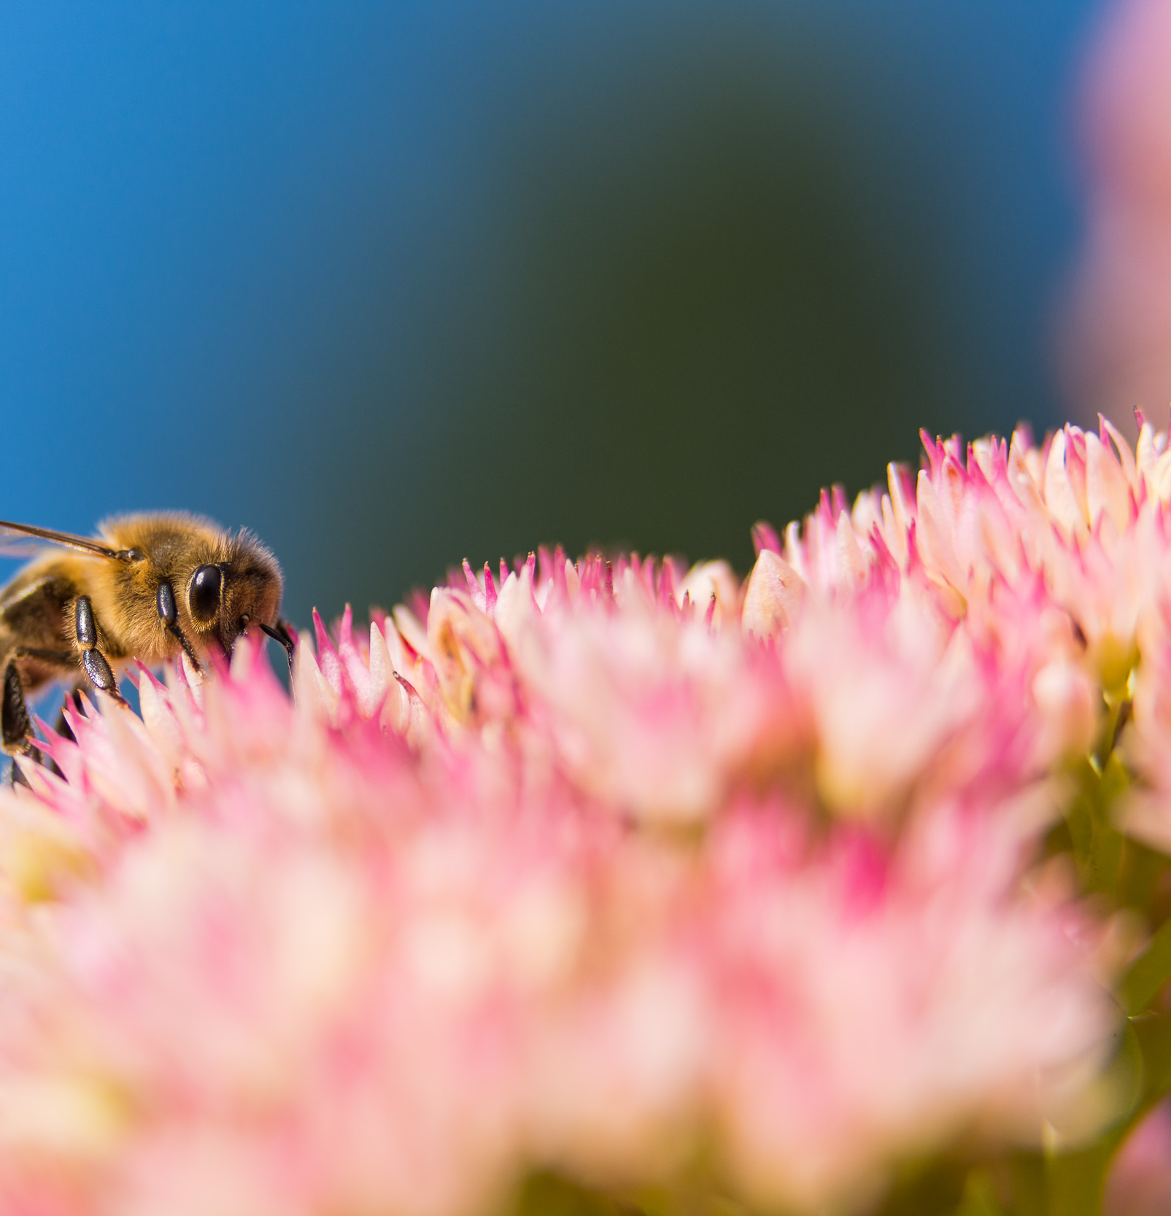
Works for anything with a border!
<p id = "p1"
style = "width:100px; height:100px; padding: 8px;
font-family: Arial; font-size: 22px;
border: 6px solid purple;
border-radius: 25px; box-shadow: 8px 8px 5px gray;“ onClick = “getBorderInfo(‘p1’)”>
Bees Para </p>

Slide 5
Combining getting info and setting info…
We can use document.getElementById to first get information (in this case, the color of the border) and then, based on the current color, change the border color to a new color!!!
function changeColor(par) {
x = document.getElementById(par).style.borderColor
if (x ==='red') {
document.getElementById(par).style.borderColor = 'blue'
}
else if (x ==='blue') {
document.getElementById(par).style.borderColor = 'brown'
}
else if (x ==='brown') {
document.getElementById(par).style.borderColor = 'green'
}
else if (x ==='green') {
document.getElementById(par).style.borderColor = 'purple'
}
else if (x ==='purple') {
document.getElementById(par).style.borderColor = 'red'
}
}
Gets the current border color and puts it into the variable x
If x holds red, change the border color to blue
If x holds blue, change the border color to brown
If x holds brown, change the border color to green
If x holds green, change the border color to purple
If x holds purple, change the border color to red

Slide 6
More: Switching Back and forth
function switchColor(par) {
x = document.getElementById(par).style.borderColor
if (x === "darkgray") {
document.getElementById(par).style.borderColor = "deeppink"
}
else if (x === "deeppink") {
document.getElementById(par).style.borderColor = "darkgray"
}
x = document.getElementById(par).style.backgroundColor
if (x === "lightgray") {
document.getElementById(par).style.backgroundColor = "gold"
}
else if (x === "gold") {
document.getElementById(par).style.backgroundColor = "lightgray"
}
x = document.getElementById(par).style.color
if (x === "gray") {
document.getElementById(par).style.color = "mediumblue"
}
else if (x === "mediumblue") {
document.getElementById(par).style.color = "gray"
}
}
Switches border color between deeppink and darkgray
Switches background color between gold and lightgray
Switches font color between medium blue and gray

Slide 7
Takeaways:
You can use getElementById to both get and change thing on your web page
You can use getElementById to get info about the style, and then change it
You can both get info about and change:
The border color
The background color
The font color
ANY STYLE THAT IS SET IN YOUR HTML CODE OR CSS CODE!

