Slide 1
Joining Strings together:

Slide 2
String: Anything between quotes!
Javascript considers anything between quotes to be a string.
The quotes can either be double quotes or single quotes.
So a string is
“cat”,
“p1”
“This is a string”
“10”
Yep, if you put quotes around it, it’s considered a string, even if what is between the quotes is a number.

Slide 3
Joining Strings:
You can join 2 different strings together into a new string using the + sign as follows:
x = “<p>”
y = “dog”
z = “</p>”
q = x + y + z
This gives you “<p> dog </p>”

Slide 4
Adding to the end of a string
But you can also just add on to the end of a string. So, instead of a variable being something new, you’d say:
x = “”
x = x + “<p>”
x = x + “dog”
x = x + “</p>”
x = “”
X is initialized (starts out) holding no characters – it’s an empty string. We want to “clear the slate” before we start adding to it.
x = x + “<p>”
Next you’ve joined on to the end of x (which is currently empty) the <p>. When you do that, you join <p> to the empty string. So now x holds <p>.
x = x + “dog”
Next you join dog onto the end of x. So you’re joining dog onto <p> , resulting in <p>dog
x = x + “</p>”
And next you’re joining </p> onto the end of x, so you’d end up with <p>dog</p> inside of x
All Together:
function joinString(par) {
x = ""
alert("x currently holds: "+x)
x = x + "<p>"
alert("x currently holds: "+x)
x = x + "dog"
alert("x currently holds: "+x)
x = x + "</p>"
alert("x currently holds: "+x)
document.getElementById(par).innerHTML = x
}

Slide 5
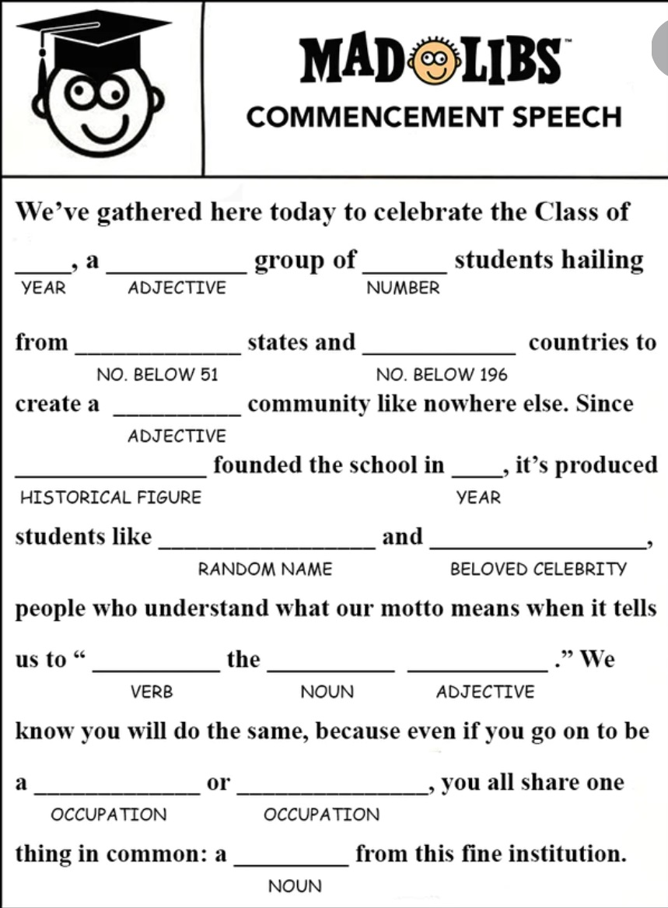
Joining strings using prompt:
You could use a prompt to get a variable, and then join that to a variable:
In the previous example, change the alert lines to:
y=prompt(“Enter a pronoun”)
z = prompt(“Enter an adverb”)
q=prompt(“Enter a verb”)
r = prompt(“Enter a noun phrase”)
All Together:
function joinString2(par) {
x = ""
y = prompt("Enter a pronoun")
x = x + y
z = prompt("Enter an adverb")
x = x + z
q = prompt("Enter a verb")
x = x + q
r = prompt("Enter a noun or noun phrase")
x = x + r
document.getElementById(par).innerHTML = x
}
Right now, all the words might be strung together. To fix that:
x = x + y + " "
for each time you join a new variable to x, you want to join a space as well.
Now there should be spaces between the prompted words

Slide 6
Numbers vs Strings of characters
We’re using + to join strings together.
If you had numbers, you’d add the numbers*
E.g., if you have x = “hi” + “ there”
x should hold “hi there”
if you have x = 3 + 4
x should hold 7, and not “34”
+ works differently with numbers and with strings.
*This is called operator overloading, and it means that the same operator, the + sign, does something different with strings of characters (or words) than it does with numbers.

Slide 7
Meanness:
If there are “”around something, it’s a string, even if the quotes are around a number.
So x = “3” + “4”
Now x will hold “34”
Example: Try:
function NumAsStrings(par) {
y = prompt (“Enter a number”)
z = prompt(“Enter another number”)
document.getElementById(par).innerHTML = y + z
}
Hmmmm.

Slide 8
parseInt
Kind of ugly word to convert a string to a number that can be added.
You need to tell the computer that the numbers you are reading in are numbers, and not strings.
So you will need to add parseInt
(that’s an I as in Iguana, not an L as in Llama) to each prompt:
y = parseInt(prompt(“Enter a number”))
This converts a string of characters to an integer.
Try:
function NumAsStrings(par) {
y = parseInt(prompt ("Enter a number"))
z = parseInt(prompt("Enter another number"))
document.getElementById(par).innerHTML = y + z
}
Think of texting – if you texted “I’m 2 tired 4 work”, those numbers are really being used as a word, or string of characters. But if you wanted to add, you’d use 2 differently. The computer sees 2 and “2” as two different entities. In order to be able to tell the difference between those 2, parseInt clarifies that the number should be used as number.

Slide 9
TakeAways:
Strings are words or phrases (in other words, a series of characters) with quotes around them
Either single or double
You can join two strings using +
x = “thunder” + “storm”
Now x holds “thunderstorm”
This is different from adding numbers
x = 4 + 2
x now holds 6
Prompt returns strings!!!
x = prompt(“enter a num”)
x will hold maybe “7” as opposed to 7
To make it a number:
x = parseInt(prompt(“enter a num”))
Now x might hold 7

