Slide 1
WWW and Browser

Slide 2
World Wide Web
Uses client-server model
client : Your browser
Browser requests web page from web server,
Server: a computer or set of computers (ELSEWHERE) that stores web pages
Client (browser) requests Web pages, images, sound files, movies, etc from Server.
If Server can locate the requested file, it sends the file back to browser
If it can’t locate the file, it sends back an error (e.g., 404)

Slide 3
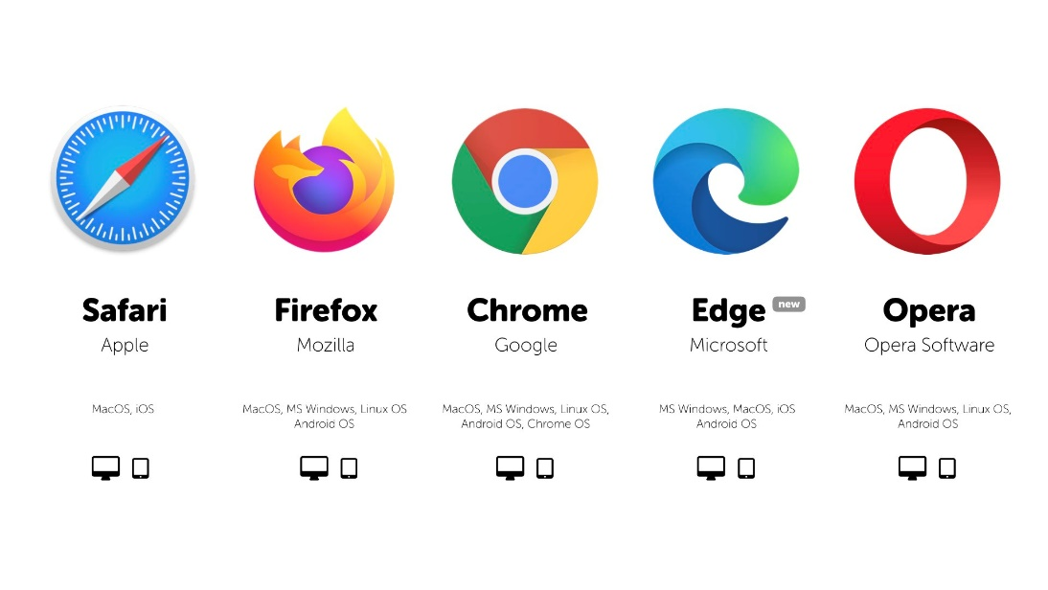
Browsers
Browsers:
Chrome, Safari, Edge, Firefox, etc.
do 2 key things:
Locate and request web sites from servers
using unique addresses (URL)
Display web pages
(displays html code, css, javascript, etc.)
You don’t see the code, you see the display

Slide 4
URL
URL
A website’s unique address
It consists of
The web communication protocol, http
The domain name of the web server
The directory or folder on that server
The file within the directory, including optional extension
http://udel.edu/fall20/webfile.HTML
protocol
domain name
Directory (folder)
file name . extension

Slide 5
Domain Name:
Domain names:
Plain English version of the IP addresses
So you don’t have to type in a bunch of numbers
Tells the browser where to go to find the web page/web site
e.g., tells the browser where the server is
Domain name suffixes:
indicates which top level domain (TLD) it belongs to.
gov - Government agencies
edu - Educational institutions
org - Organizations (nonprofit)
mil - Military
com - commercial business
net - Network organizations
ca - Canada
th - Thailand

Slide 6
Protocols for Transferring web pages
HTTP:
The internet protocol used to access the World Wide Web
rules that govern communication between a web client and a web server
Stands for HyperText Transfer Protocol
HTTPS
The secure version of HTTP

Slide 7
Take-Aways
WWW uses client-server model
Browser: client; does 2 things: requests files from server, and displays those files
Url: unique web page address
Domain Name: IP address (unique web page address) in a form that isn’t a number
Web page transfer protocols: http (not secure) and https (secure)

