Slide 1
Validating your HTML Code

Slide 2
Validating: checking that your code is correct
Background – many different browsers
Chrome, Safari, Firefox, IE, Edge,etc.
Totally different companies make these browsers
Microsoft doesn’t really like to talk with Apple, etc.
So how do we know that the different browsers will all read THE SAME html/css/javascript code????

Slide 3
Validating: W3C
STANDARDS!!!
An organization (World Wide Web Consortium, or W3C) was formed to create standards for html/css/javascript that ALL browsers should be able to read
W3C creates the rules for what is VALID code!
To check, validate your code at:
https://validator.w3.org/

Slide 4
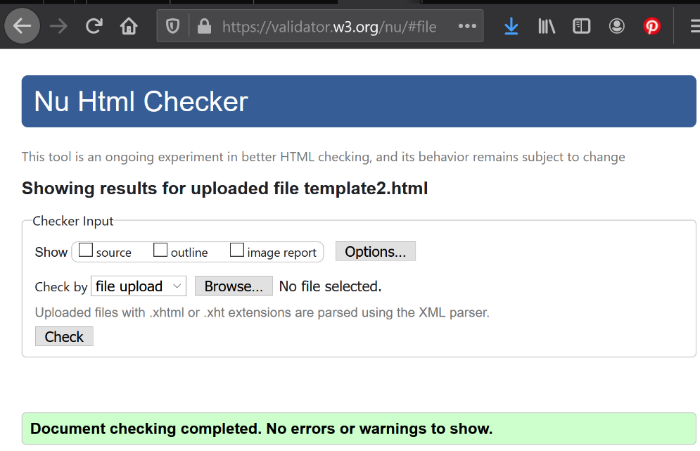
W3c validator
template.html
Choose Validate by file upload
Browse to the html file (in this case template.html)
Click on the check button
If the html code on your web page (in this case, template.html) is valid, you’ll get the green bar!
You can use this valid template by copying it for other web pages!

Slide 5
It Didn’t Validate
Make sure you typed the tags exactly as I have them in the template
Order matters with the template tags
Opening and closing matters
E.g.,
<html> opens html code area,
</html> closes the html code
Make sure you saved the file as a .html file!!
Make sure you don’t copy and paste from Microsoft word (or ppt or something like that
BIG ISSUE: “en” versus "en"
See the quotes? Word has funky quotes, html only understands the insanely plain quotes just up and down, no difference between the first and second quote)
It’s so small, but it will kill the validator!!!!!
If none of the above work, then look at the errors. Most errors have a line number. Go to that line in your html file and look at the line right above it and that line very closely
Fix the first error, then revalidate
A lot of times, fixing the first error fixes more than one error
Ignore the message – the validator gives horrible error messages!!!

Slide 6
Take-Aways!
Validate your html code
Using W3C validator
So you know all browsers will read and display your html code properly
For us, validate by file upload
If you don’t get the green happy bar, check the following:
You have all the opening and closing tags in the correct order
You didn’t misspell anything
You saved the file as a .html file
You DIDN’T INCLUDE FUNKY QUOTES
Copied from ms word/ ppt, etc.
If all else fails, look at the line number of the error, and look at the line above and the line with that line number in your html code
Fix the first error and revalidate
Once the template validates, you can copy it to use with all your other web pages!

