Slide 1
Other Web Terms

Slide 2
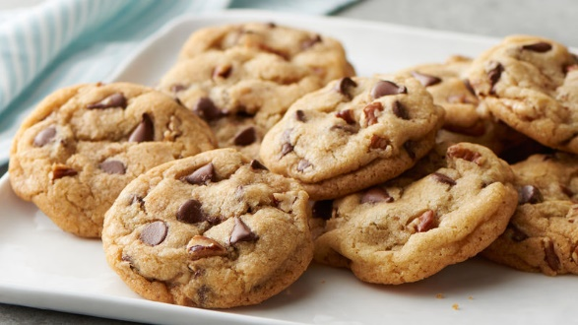
Other Terms:
Cookies: data saved by your browser that identifies you/your preferences
Small text files
Frequently store login information
Cache: a copy of a web page/ image/ sound file saved locally on your computer after you’ve visited that web page
So when you load it into your browser again, it doesn’t have to be transferred across the internet again
Saves time
But you might have an old copy of a web page on your computer

Slide 3
Other Terms:
W3C: World Wide Web consortium
An organization designed to define standards for web browsers
i.e., standards for html/css that all browsers should recognize and display in a particular way
ARIA: technical specification published by the W3c that specifies how to increase the accessibility of web pages
So, for example, if a person who is blind is accessing your web page using a screenreader, it will work for them

Slide 4
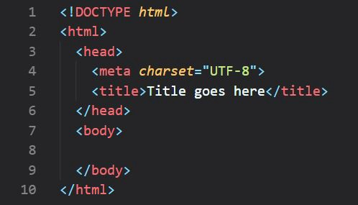
HTML
HTML
The language used in writing and publishing web pages
The set of tags used for formatting and linking to other documents on the web
NOT a programming language (but it can contain programming code)
Hypertext links connect one web document to another

Slide 5
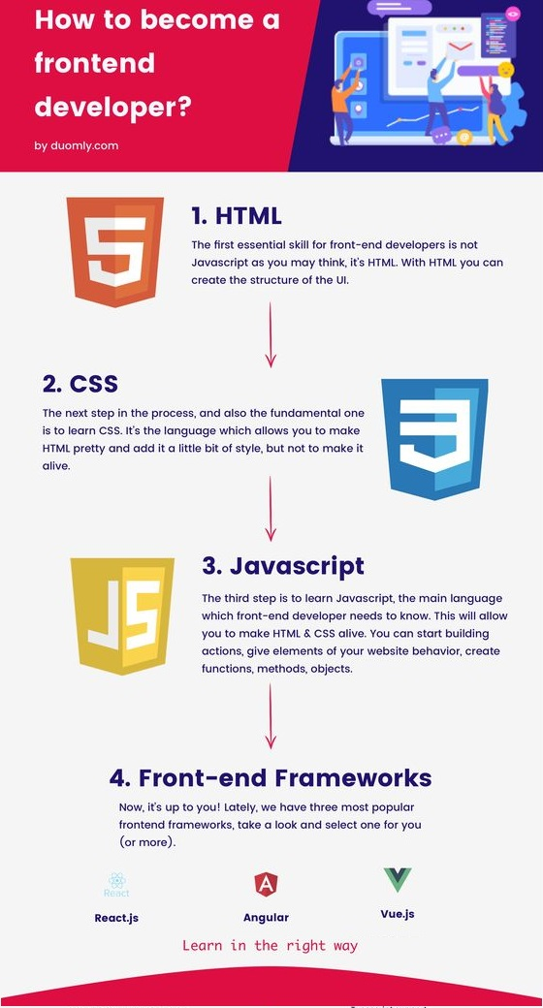
Other Terms
CSS –
Cascading Style Sheets
used for styling web page
HTML is for formatting
CSS is used for styling
Javascript
Client-side scripting language
Not stand-alone, but an add-on to HTML
Most popular scripting language
Notes:
L

Slide 6
Cookies: text files web sites put on your computer to keep track of info about you
Cache: holds old copies of web sites and files to save time
W3C: Web standards authority
ARIA: tags for web page accessibility
HTML: for formatting web pages
CSS: for styling web pages
JavaScript: programming language for making web pages interactive
WOO WOO!!! TERMINOLOGY IS DONE!!!
…for now…

