Slide 1
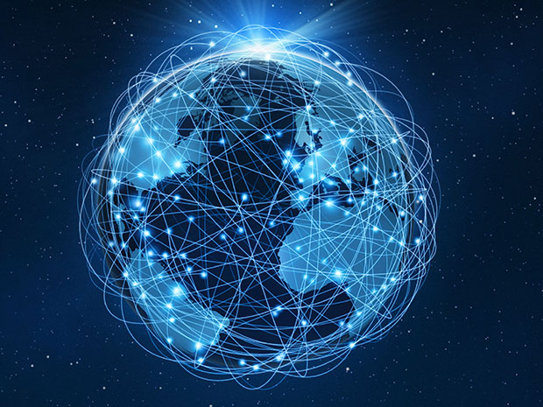
Intro to the Internet
Internet:
a network of network
global
consists of thousands of smaller networks
All these networks use the SAME SET OF RULES to communicate with each other

Slide 2
From 5 to 3,840,675,500 computers/networks
Internet History
Began with 1969’s ARPANET for US Dept. of Defense
62 computers in 1974
500 computers in 1983
28,000 computers in 1987
Early 1990s, multimedia (www) became available on internet
Today: 3,840,675,500 Plus…
(we’re running out of places to put everyone!)

Slide 3
TCP-IP: The internet’s rule system
Protocols
set of rules
Whenever you see a P in anything computer related, it’s a good guess to assume the P stands for protocol
Internet uses TCP/IP
Rules used for all internet transactions
Base protocol on which all other protocols are built
ALL networks/computers on the internet use the SAME TCP/IP rules

Slide 4
TCP-IP Rules
TCP
Rules for Transferring the data (files)
Files are broken into smaller pieces
Can send small pieces across the internet more quickly than one large file
Files are reassembled at their destination once all the pieces get there
Packets
Fixed-length blocks of data
Files are broken up into packets
Not all packets from the same file follow the same path when traveling the internet
Data is reassembled at the other end

Slide 5
TCP: File is puzzle pieces
Think of a file like a completed puzzle.
The file is broken into the puzzle pieces
Each piece is sent separately across the internet
The puzzle pieces are reassembled into one big complete puzzle at the other end.
Why?
If one piece doesn’t make it, just have to re-send the one puzzle piece, not the entire file
Files travel from place to place as they head towards their final destination.
Tiny puzzle pieces can each follow a different path
(may not, but could…)
If each small puzzle piece follows a different path, no one place is getting bogged down with the whole big file passing through at the same time.

Slide 6
IP Address
IP Addresses
Internet Protocol Address – a unique address that identifies every computer and device connected to the internet
Everything connected to the Internet gets a unique IP address

Slide 7
Take-aways:
Internet is a network of many networks
All networks communicate using the same TCP-IP rule set
Protocols – stands for rules.
Whenever you see a P, it probably stands for protocol
TCP:
rules for breaking files into small pieces to be sent across the internet and then rules for reassembling at the file’s end destination
Goal: fast, accurate transmission of data
IP:
The address that uniquely identifies a computer or network that’s connected to the internet.

