Slide 1
Client-Server Model
What it is, how we use it

Slide 2
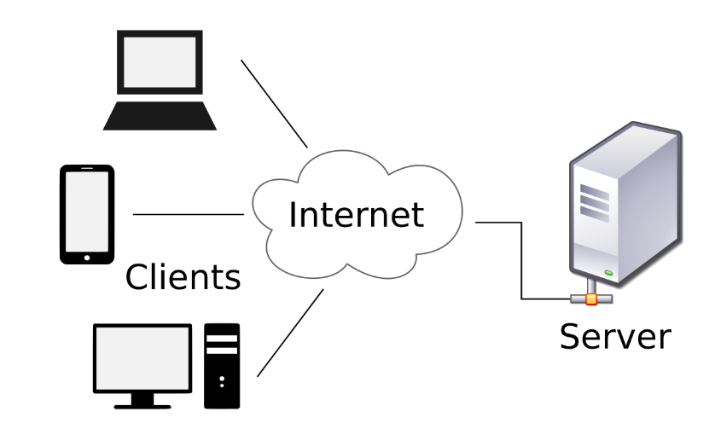
Important Internet Model:
Client/Server Model
Built on top of TCP/IP
Client: a computer program requesting data or services from another computer program
Server: a very powerful computer or network of computers whose job is to answer requests from the client
Server “serves” the client whatever the client asks for

Slide 3
Examples of Client Server Model:
Email:
Server: computer/network somewhere with a boatload of people’s email
Client: Software on you computer/phone.
When you log into that software, it requests your email from the email server.
The server sends your email to your client email software
The client email software displays your email for you to read/delete/etc.
Bank:
Banks have VERY SECURE servers with everyone’s bank account information.
Client: software on your phone/laptop that requests your account info from the bank’s server.
When you log in, your client software makes a request from the bank server for information about your account.

Slide 4
Take Aways
Client Server model
Is rules that work on top of the TCP-IP rules
Servers: big, powerful computers or networks that are usually always on and hold a bunch of files/data/whatever
Clients: local software on your computer that:
asks for data from a server, and then…
usually displays and lets you manipulate the data that the server sent it.

