Slide 1
Notice: Changed TA Office hour Thursday
11am-1pm → noon-2pm

Slide 2
HW10
Different ways of solving it
Using a queue
Using a sorted set (e.g. treap or red-black tree)
Embedding a doubly-linked list inside of a hash table
Other approaches?
Time complexity
Add(CaptchaPair cp)
RemoveMin()
Remove(CaptchaPair cp)

Slide 3
HW10 (Average Time Complexity)
 | Add(CaptchaPair cp) | RemoveMin() | Remove(CaptchaPair cp)
Queue | O(1) | O(1) | O(n)
SortedSet | O(log n) | O(log n) | O(log n)
HashTable + DLList | O(1) | O(1) | O(1)

Slide 4
HW 10 Pitfalls
clock() lacks precision in some computers
What to do?
Define a counter variable “int count”
Increment the counter every time an addition occurs

Slide 5
Questions?

Slide 6
Sorting
What are some sorting algorithms that you know?
What is the best?
How would you sort a pile of papers alphabetically?

Slide 7
Sorting
Insertion Sort (Why useful)?
Merge Sort
Quick Sort
Heap Sort
Quick Sort + Insertion Sort
Quick Sort + Heap Sort

Slide 8
Insertion Sort PsuedoCode
for (int i=2; i<n; i++)
for (k = i; k > 1 && a[k] < a[k-1]; k--)
swap(a[k], a[k-1]);

Slide 9
Array index
0
1
2
3
4
5
6
7
8
9
Value
2.78
7.42
0.56
1.12
1.17
0.32
6.21
4.42
3.14
7.71
Iteration 0: step 0.

Slide 10
Array index
0
1
2
3
4
5
6
7
8
9
Value
2.78
7.42
0.56
1.12
1.17
0.32
6.21
4.42
3.14
7.71
Iteration 1: step 0.

Slide 11
Array index
0
1
2
3
4
5
6
7
8
9
Value
2.78
7.42
0.56
0.56
7.42
1.12
1.17
0.32
6.21
4.42
3.14
7.71
Iteration 2: step 0.

Slide 12
Array index
0
1
2
3
4
5
6
7
8
9
Value
2.78
0.56
0.56
2.78
7.42
1.12
1.17
0.32
6.21
4.42
3.14
7.71
Iteration 2: step 1.

Slide 13
Array index
0
1
2
3
4
5
6
7
8
9
Value
0.56
2.78
7.42
1.12
1.17
0.32
6.21
4.42
3.14
7.71
Iteration 2: step 2.

Slide 14
Array index
0
1
2
3
4
5
6
7
8
9
Value
0.56
2.78
7.42
1.12
1.12
7.42
1.17
0.32
6.21
4.42
3.14
7.71
Iteration 3: step 0.

Slide 15
Array index
0
1
2
3
4
5
6
7
8
9
Value
0.56
2.78
1.12
1.12
2.78
7.42
1.17
0.32
6.21
4.42
3.14
7.71
Iteration 3: step 1.

Slide 16
Array index
0
1
2
3
4
5
6
7
8
9
Value
0.56
1.12
2.78
7.42
1.17
0.32
6.21
4.42
3.14
7.71
Iteration 3: step 2.

Slide 17
Array index
0
1
2
3
4
5
6
7
8
9
Value
0.56
1.12
2.78
7.42
1.17
1.17
7.42
0.32
6.21
4.42
3.14
7.71
Iteration 4: step 0.

Slide 18
Array index
0
1
2
3
4
5
6
7
8
9
Value
0.56
1.12
2.78
1.17
1.17
2.78
7.42
0.32
6.21
4.42
3.14
7.71
Iteration 4: step 1.

Slide 19
Array index
0
1
2
3
4
5
6
7
8
9
Value
0.56
1.12
1.17
2.78
7.42
0.32
6.21
4.42
3.14
7.71
Iteration 4: step 2.

Slide 20
Array index
0
1
2
3
4
5
6
7
8
9
Value
0.56
1.12
1.17
2.78
7.42
0.32
0.32
7.42
6.21
4.42
3.14
7.71
Iteration 5: step 0.

Slide 21
Array index
0
1
2
3
4
5
6
7
8
9
Value
0.56
1.12
1.17
2.78
0.32
0.32
2.78
7.42
6.21
4.42
3.14
7.71
Iteration 5: step 1.

Slide 22
Array index
0
1
2
3
4
5
6
7
8
9
Value
0.56
1.12
1.17
0.32
0.32
1.17
2.78
7.42
6.21
4.42
3.14
7.71
Iteration 5: step 2.

Slide 23
Array index
0
1
2
3
4
5
6
7
8
9
Value
0.56
1.12
0.32
0.32
1.12
1.17
2.78
7.42
6.21
4.42
3.14
7.71
Iteration 5: step 3.

Slide 24
Array index
0
1
2
3
4
5
6
7
8
9
Value
0.56
0.32
0.32
0.56
1.12
1.17
2.78
7.42
6.21
4.42
3.14
7.71
Iteration 5: step 4.

Slide 25
Array index
0
1
2
3
4
5
6
7
8
9
Value
0.32
0.56
1.12
1.17
2.78
7.42
6.21
4.42
3.14
7.71
Iteration 5: step 5.

Slide 26
Array index
0
1
2
3
4
5
6
7
8
9
Value
0.32
0.56
1.12
1.17
2.78
7.42
6.21
6.21
7.42
4.42
3.14
7.71
Iteration 6: step 0.

Slide 27
Best Case Scenario for Insertion Sort?

Slide 28
K-Nearly Sorted Arrays
Input | 3 | 2 | 1 | 5 | 4 | 6 | 8 | 9 | 7
Sorted | 1 | 2 | 3 | 4 | 5 | 6 | 7 | 8 | 9
Abs Diff | 2 | 0 | 2 | 1 | 1 | 0 | 1 | 1 | 2
K here is 2
What is the running time of insertion sort?

Slide 29
Optimize
How would you optimize insertion sort for human sorting?

Slide 30
Divide and Conquer
Smaller problems and be solved more efficiently
(If needed) Solutions to smaller problems can be combined efficiently
Mergesort and quicksort

Slide 31
Merge Sort

Slide 32
MergeSort
How many levels are there in a merge sort?
What is the complexity of the merge operation?

Slide 33
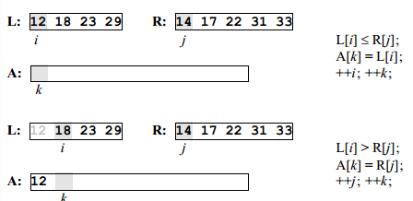
Merge

Slide 34
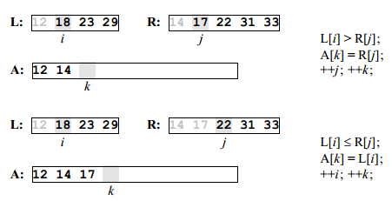
Merge

Slide 35
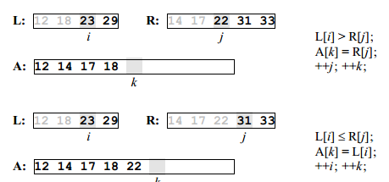
Merge

Slide 36
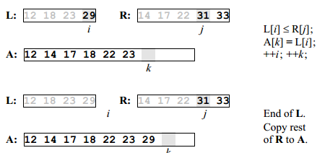
Merge

Slide 37
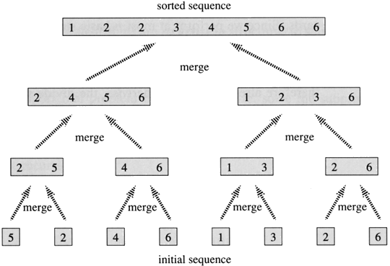
Merge Sort Analysis
Complexity of Merge Operation? O(n)
Number of levels? O(log n)
Worst case time complexity?

Slide 38
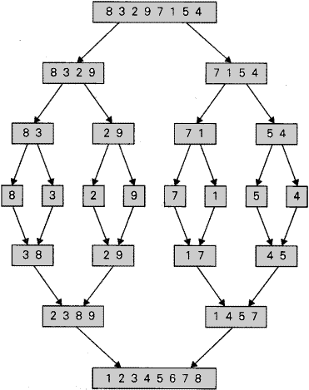
Merge Sort PseudoCode
MergeSort(a[1], …, a[n/2])
MergeSort(a[n/2+1], … , a[n])
Merge(a[1], …, a[n])

Slide 39
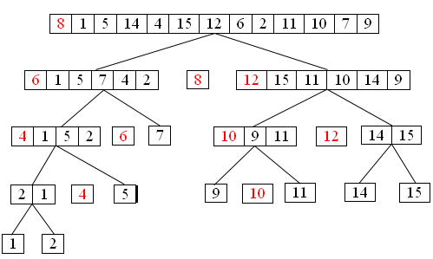
Quick Sort

Slide 40
Quick Sort PseudoCode
Choose pivot element p
Perform partition so that items less than p are in a[1, …, k-1] and items greater or equal to p are in a[k+1, …, n]
QuickSort(a[1, … , k-1])
QuickSort(a[k+1, …, n])

Slide 41
QuickSort Advantages over MergeSort
Partition can be done in-place

Slide 42
In-place Partition Algorithm (2-way)
http://me.dt.in.th/page/Quicksort/

Slide 43
Quick Sort Optimizations
Choosing the pivot
Partition Algorithm

Slide 44
Quick Sort
Worst Case?

Slide 45
Quick Sort

Slide 46
HeapSort
Can you use heaps to sort?

Slide 47
Heap Sort
Build heap (What is the complexity?)
Remove items from heap (What is the complexity?)

Slide 48
K-Nearly Sorted Arrays
Input | 3 | 2 | 1 | 5 | 4 | 6 | 8 | 9 | 7
Sorted | 1 | 2 | 3 | 4 | 5 | 6 | 7 | 8 | 9
Abs Diff | 2 | 0 | 2 | 1 | 1 | 0 | 1 | 1 | 2
K here is 2
What is the running time of insertion sort?

Slide 49
Heap Sort for K-nearly sorted arrays
Build heap H of size K
for(int i=K; i<n; i++)
A[i-K] = H.removeMin();
H.add(A[i]);
RemoveMin() from the heap, and add to A[] until empty
Time Complexity? O(n log(k) ) vs O(n * k) for insertion sort (good when k is much smaller than n)

Slide 50
Run Time Complexity
 | Average | Worst | In place?
Insertion Sort | O(n^2) | O(n^2) | Yes
Merge Sort | O(n log n) | O(n log n) | No
Quick Sort | O(n log n) | O(n^2) | Yes
Heap Sort | O(n log n) | O(n log n) | Yes
Quick Sort + Insertion Sort | ? | ? | ?
Introspective Sort | ? | ? | ?

Slide 51
Demos
http://www.sorting-algorithms.com/quick-sort

