Slide 1
Study of Automated Extraction of Security Policy from Natural-Language Software Documents*
Nov. 21, 2013, Kaidi Ma, Man Sun
Computer Information Science
University of Delaware
kdma@udel.edu
*: Original paper from: Xusheng Xiao, Amit Paradkar, Suresh Thummalapenta,Tao Xie, FSE '12 Proceedings of the ACM SIGSOFT 20th International Symposium on the Foundations of Software Engineering
Article No. 12, ACM New York, NY, USA ©2012, table of contents ISBN: 978-1-4503-1614-9 doi>10.1145/2393596.2393608

Slide 2


Problem and Importance
ACP Specifies Principals and Access Control
  e.g. Which resources are accessible to which group of people. (Group, Role, etc..)
Very important
  Ensures the Correctness and Consistency
  Prevent security vulnerabilities
Problem
  Tedious to extract ACPs from
  requirement documents manually
Notes:
Access control is often governed by an Access Control Policy (ACP) that includes a set of rules specifying which principals
(such as users or processes) have access to which resources. ACPs are crucial in preventing security vulnerabilities,
since decisions (such as accept or deny) on user requests are based on ACPs. In ACP practice, there exist two major
issues that can result in serious consequences such as allowing an unauthorized user to access protected resources:
incorrect specification of ACPs and incorrect enforcement of ACP specifications in the system implementation.

Slide 3
State of Art
Anton [19] proposed a manual approach to extract ACPs from various NL documents.
Etzioni et al. [14] proposed an approach to extract lists of named entities found on the web using a set of patterns.
Pandita and Zhong proposed approaches that focus on parsing API documents, and used the specific characteristics of API documents to improve the NLP analysis.
Sinha et al. [38, 39] adapt NLP techniques to parse and represent use-case contents in use-case models.

Slide 4
Paper’s Contribution
Main Work:
  Text2Policy extracts ACPs from NL documents and produces formal specifications.
  Incorporate syntactic and semantic NL analysis.
  Generate ACPs in the format of XACML.
Summary:
  With customized NLP techniques, extraction of security policies from NL documents in a specific domain helps effectively reduce manual effort and assist policy construction and understanding.

Slide 5
Text2Policy
  Extract
    1) ACPs from NL Software Documents
    2) Resource-access information (action steps) from NL Scenario-based Functional Requirements
  Generates
    1) Machine enforceable ACPs in specification languages such as XACML
    2) Access control request from action steps
  Validate
    Validate the access control request against extracted ACPs for detecting inconsistencies

Slide 6
Background
Examples of ACPs
  ACP-1: An HCP should not change a patient’s account.
  ACP-2: An HCP is disallowed to change a patient’s account.
Example of use case
  AS-1: An HCP creates an account.
  AS-2: He edits the account.
  AS-3: The system updates the account.
  AS-4: The system displays the updated account.

Slide 7
Challenges
TC1-Anaphora: Identifying and replacing pronouns with noun phrases based on the context
  He in AS-2 shown in Figure 2 needs to be replaced with the HCP from AS-1
    TC2- Semantic-Structure Variance: Different ways (semantic structures) to describe the same ACP rule

Slide 8
Challenges
    TC3-Negative-Meaning Implicitness
  ACP-1 and ACP-2 both contain negative expressions that need to be identify.
    TC4-Transitive Actor
      AS-3 implies that an HCP (the actor from AS-2) is the initiating actor of AS-3
    TC5-Perspective Variance
      AS-4 implies that an HCP views the updated account, requiring a conversion to replace the actor and action of AS-4

Slide 9
Main steps of Text2Policy
Step1:
  Apply linguistic analysis to parse NL documents and annotate words and phrases in sentences from NL documents with semantic meanings
Step2:
  Construct model instances using annotated words and phrases in the sentences
Step3:
  Transform these model instances into formal specifications

Slide 10
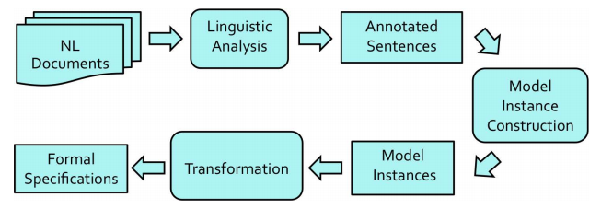
Main steps of Text2Policy
Action Step and Approach of Extraction
From Automated Extraction of Security Policies from Natural-Language Software Documents, Xusheng X, et al, FSE '12 Proceedings of the ACM SIGSOFT 20th International Symposium on the Foundations of Software Engineering,Article No. 12

Slide 11
ACP Model
ACP model is used to identify whether a sentence is a ACP sentence
A typical role-based ACP rule
  subject, a user or process that may request to access resources (e.g., an HCP in ACP-1)
  action, an action (e.g., change in ACP-1) that the principal may request to perform
  resource,(e.g., a patient’s account in ACP-1) to which access is restricted
  effect. (i.e., permit, deny, oblige, or refrain)

Slide 12
Common Linguistic-Analysis Techniques
Shallow Parsing: Identifies phrases, clauses, and grammatical functions of phrases, such as subject, main verb, and object
  ACP-1: [subject: An HCP] [main verb group: should not change] [object: a patient’s account.]
Domain Dictionary: Associate verbs with pre-defined semantic classes
  ACP-2: The domain dictionary is used to associate change with the UPDATE semantic class, and disallow with the NEGATIVE semantic class
  Addresses TC2- Semantic-Structure Variance, TC3-Negative-Meaning Implicitness

Slide 13
Common Linguistic-Analysis Techniques
Anaphora Resolution
  Algorithm introduced by Kennedy
  Additional rule: A pronoun in the position of a subject is replaceable only by noun phrases that also appear as subjects of a previous sentence.
  Addresses TC1-Anaphora

Slide 14
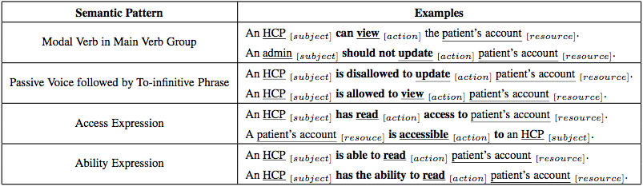
Unique Linguistic-Analysis Techniques
  Semantic-Pattern Matching,
    Compose different semantic patterns based on the grammatical function of phrases identified by shallow parsing.
    Filters out sentences that do not match with any of these provided patterns.
        Addresses TC2- Semantic-Structure Variance
  Negative-Expression Identification,
    composes patterns to identify negative expressions in a subject and main verb group.
    use the negative-expression identification while inferring policy effect for an ACP rule.

Slide 15
Unique Linguistic-Analysis Techniques
  Negative-Expression Identification,
    Composes patterns to identify negative expressions in a subject and main verb group.
    Use the negative-expression identification while inferring policy effect for an ACP rule.

Slide 16
Linguistic-Analysis Technique for Use-case
  Syntactic-Pattern Matching
    Identify sentences with syntactic elements (subject, main verb group, and object) required for constructing an action step.
  Methods that improve precision
    check whether the subject is a user of the system and whether the object is a resource defined in the system
    use the technique of negative-meaning inference to filter out sentences that contain negative meaning, since these negative-meaning sentences tend not to describe action steps.

Slide 17
Model-Instance construction
ACP-Model Construction:
  Model-Element Identification
  Policy-Effect Inference
  Model-Instance Construction

Slide 18
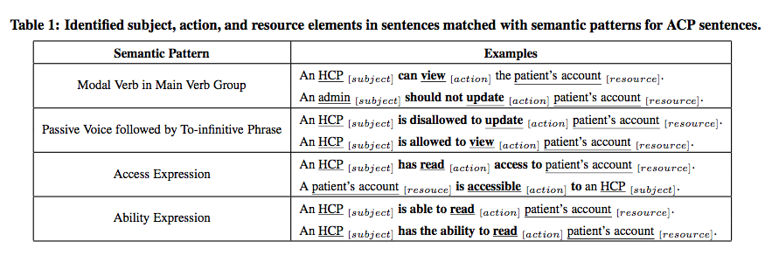
ACP-Model Construction:
  Model-Element Identification
  Based on the matched semantic patterns, this approach identifies subject, action, resource elements from different syntactic structures in sentences.
From Automated Extraction of Security Policies from Natural-Language Software Documents, Xusheng X, et al, FSE '12 Proceedings of the ACM SIGSOFT 20th International Symposium on the Foundations of Software Engineering,Article No. 12

Slide 19
ACP-Model Construction:
  Policy-Effect Inference:
  Two factors that technique of negative-meaning inference should consider:
  negative expression
  negative- meaning words in the main verb group
  Model-Instance Construction:
  Using the identified elements and inferred policy effect, our approach constructs an ACP-model instance for an ACP sentence.
  Example of constructed model instance: [Subject: HCP] [Action: change - UPDATE] [Resource: patient.account.] [Effect: deny].

Slide 20
Action Step Model Construction
Identify actor, action and parameter elements (use-case pattern) [effect? ]
Model-Element Identification
  Using known patterns (industry use cases, iTrust, published articles) of use-case action steps
    Sentence subject -> actor
    Verb group -> action
    Object -> parameter
  Patterns should be easily updated or extended based on domain characteristics of use cases.

Slide 21
Action Step Model Construction
Model-Instance Construction.
  Using identified actor, action, parameter elements to construct instances.
  A patient views access log =>
  [Actor: patient] [Action: view - READ] [Parameter: access log]
  READ is a semantic class. (Why need this?)

Slide 22
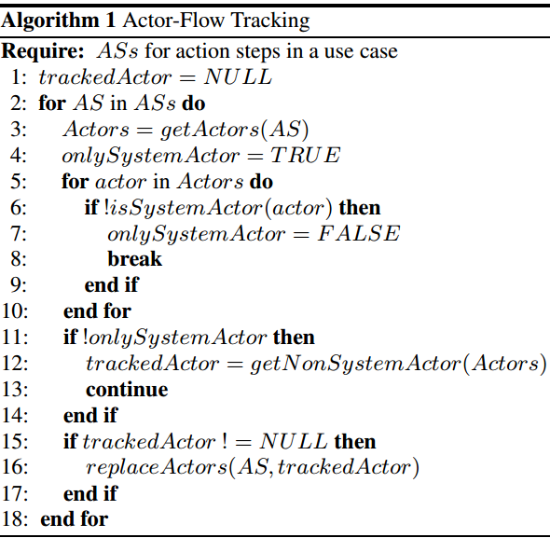
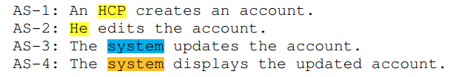
Action Step Model Construction
Address TC4-Transitive Actor: (e.g. He->HCP in AS-2)
  Actor-Flow Tracking (AFT) algorithm
What if “others cannot… ”?
From Automated Extraction of Security Policies from Natural-Language Software Documents, Xusheng X, et al, FSE '12 Proceedings of the ACM SIGSOFT 20th International Symposium on the Foundations of Software Engineering,Article No. 12

Slide 23
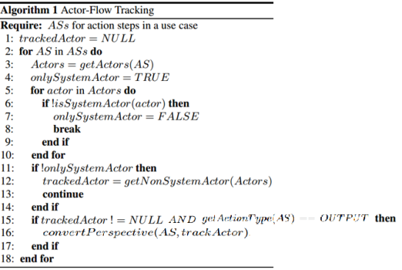
Action Step Model Construction
Address TC5-Perspective Variance:
  E.g. AS-4 implies that an HCP views the updated account, requiring a conversion to replace the actor and action of AS-4
  Perspective Conversion
This algorithm converts AS-4 into An HCP views the updated account.
actor elements -> tracked actors HCP
action element -> verb entry view
From Automated Extraction of Security Policies from Natural-Language Software Documents, Xusheng X, et al, FSE '12 Proceedings of the ACM SIGSOFT 20th International Symposium on the Foundations of Software Engineering,Article No. 12

Slide 24
Evaluation
Subjects: use cases from:
  iTurst, open source project
  115 ACP sentences from 18 sources
  25 use cases from a module in IBM enterprise application.
Evaluation Questions:
  RQ1: Effectiveness of identifying ACP sentences in NL documents
  RQ2: Effectiveness of extracting ACP rules from ACP sentences.
  RQ3: Effectiveness of extracting action steps from action-step sentences

Slide 25
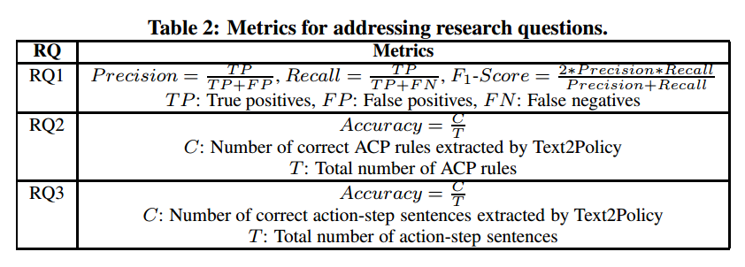
Evaluation Measures
Metrics used for evaluation
From Automated Extraction of Security Policies from Natural-Language Software Documents, Xusheng X, et al, FSE '12 Proceedings of the ACM SIGSOFT 20th International Symposium on the Foundations of Software Engineering,Article No. 12

Slide 26
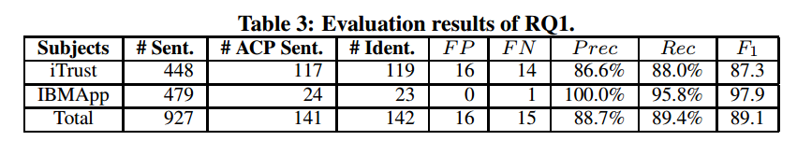
Evaluation Results: RQ1
iTrust: 37 use cases, 448 use-case sentences.
  Manually identified 117 ACP sentences.
IBMApp: 25 use cases, 479 use-case sentences.
  Manually identified 24 ACP sentences.
Compare results from Text2Policy with manual inspection.
From Automated Extraction of Security Policies from Natural-Language Software Documents, Xusheng X, et al, FSE '12 Proceedings of the ACM SIGSOFT 20th International Symposium on the Foundations of Software Engineering,Article No. 12

Slide 27
Evaluation Results: RQ1
TP: HCPs can modify or delete the fields of the office visit information.
  Reason : Semantic pattern Modal Verb in Main Verb Group helps identify out the word “can”
FP: The instructions can contain numbers, characters.
  requirement on password setting, not an ACP rule
  Reason: “can” matches the pattern Modal Verb
  Solution: expanding the domain dictionary to include commonly used nouns that are unlikely to be systems or system actors
FN: The LHCP can select a patient to obtain additional information about a patient.
  Reason: shallow parser fails to identify to-infinitive phrase
  Solution: improving the underlying shallow parser. (more training corpus)

Slide 28
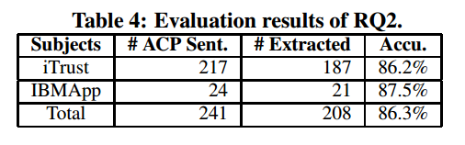
Evaluation Results: RQ2
Adding 100 more ACP sentences (published articles & public websites) into iTrust set
  Manually extract 217 ACP rules from 217 ACP sentences.
  Compare with the results from Text2Policy
  All subject, action, resource elements and effect are correct
From Automated Extraction of Security Policies from Natural-Language Software Documents, Xusheng X, et al, FSE '12 Proceedings of the ACM SIGSOFT 20th International Symposium on the Foundations of Software Engineering,Article No. 12

Slide 29
Evaluation Results: RQ2
Failure example:
  Any subject with an e-mail name in the med.example.com domain can perform any action on any resource.
  Reason: Any subject is a noun phrase followed by two prepositional phrases (with an e-mail name and in the med.example.com domain ) and not correctly handled.
  Solution: analyze the effects of prepositional phrases and long phrases for improving the accuracy of ACP extraction

Slide 30
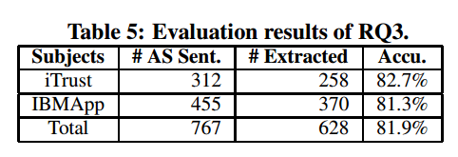
Evaluation Results: RQ3
Manually extract action steps from action-step sentences
Compare with results from Text2Policy
From Automated Extraction of Security Policies from Natural-Language Software Documents, Xusheng X, et al, FSE '12 Proceedings of the ACM SIGSOFT 20th International Symposium on the Foundations of Software Engineering,Article No. 12

Slide 31
Evaluation Results: RQ3
Failure example:
  The HCP must provide instructions, or else they cannot add the prescription.
  Reason: currently could not handle the subordinate conjunctions or else.
  The public health agent can send a fake email message to the adverse event reporter to gain more information about the report.
  Reason: shallow parser cannot correctly identify the grammatical functions

Slide 32
Detected Inconsistency
Basically NO violation detected
Name inconsistency
  ‘editor’ not matched with subjects in extracted ACPs
  In requirements, it refers to HCP, admin, all users in use case 1,2,4.
  Solution: combine validation of ACP rules and union information of extracted action steps

Slide 33
Questions or Discussion
Limitations:
  Depends on performance of several techniques
    Anaphora Resolution, Shallow Parsing, Domain Dictionary, etc.
    Corpus is based on use cases selected from iTrust (Health) and IBM enterprise application (Financial).
Q:
  What’s the relationship between Action Step (AS) and ACP?
  Where did they extract AS?

