Slide 1
More on Type Checking

Slide 2
Conversion and Coercion
Int C;
A = 1.5 + C;

Slide 3
Overloading
An id binds to >1 semantic entity in same scope
Pascal: f = f + 1
Fortran/PL1: + int or real addition
Ada: A(i)
Many languages: function decls with different parameter numbers/types
Why? What are the challenges in implementing overloaded id’s?
Notes:
Why? Conceptually similar operations/functions on different domains.
Challenges: using the name is ambiguous. Compiler needs to know what to generate in the code.

Slide 4
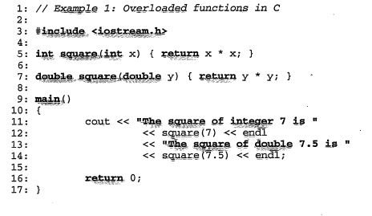
Resolving overloaded symbols
Determine unique meaning – use context
Operators (non-ids)
Ids

Slide 5
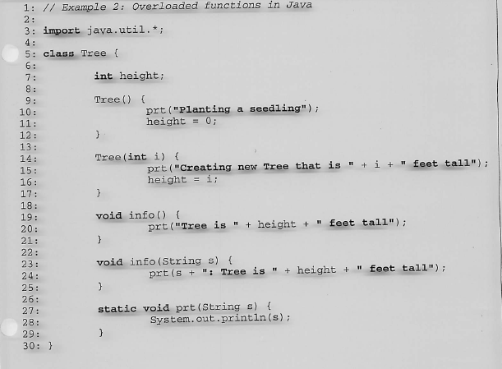
Another example

Slide 6
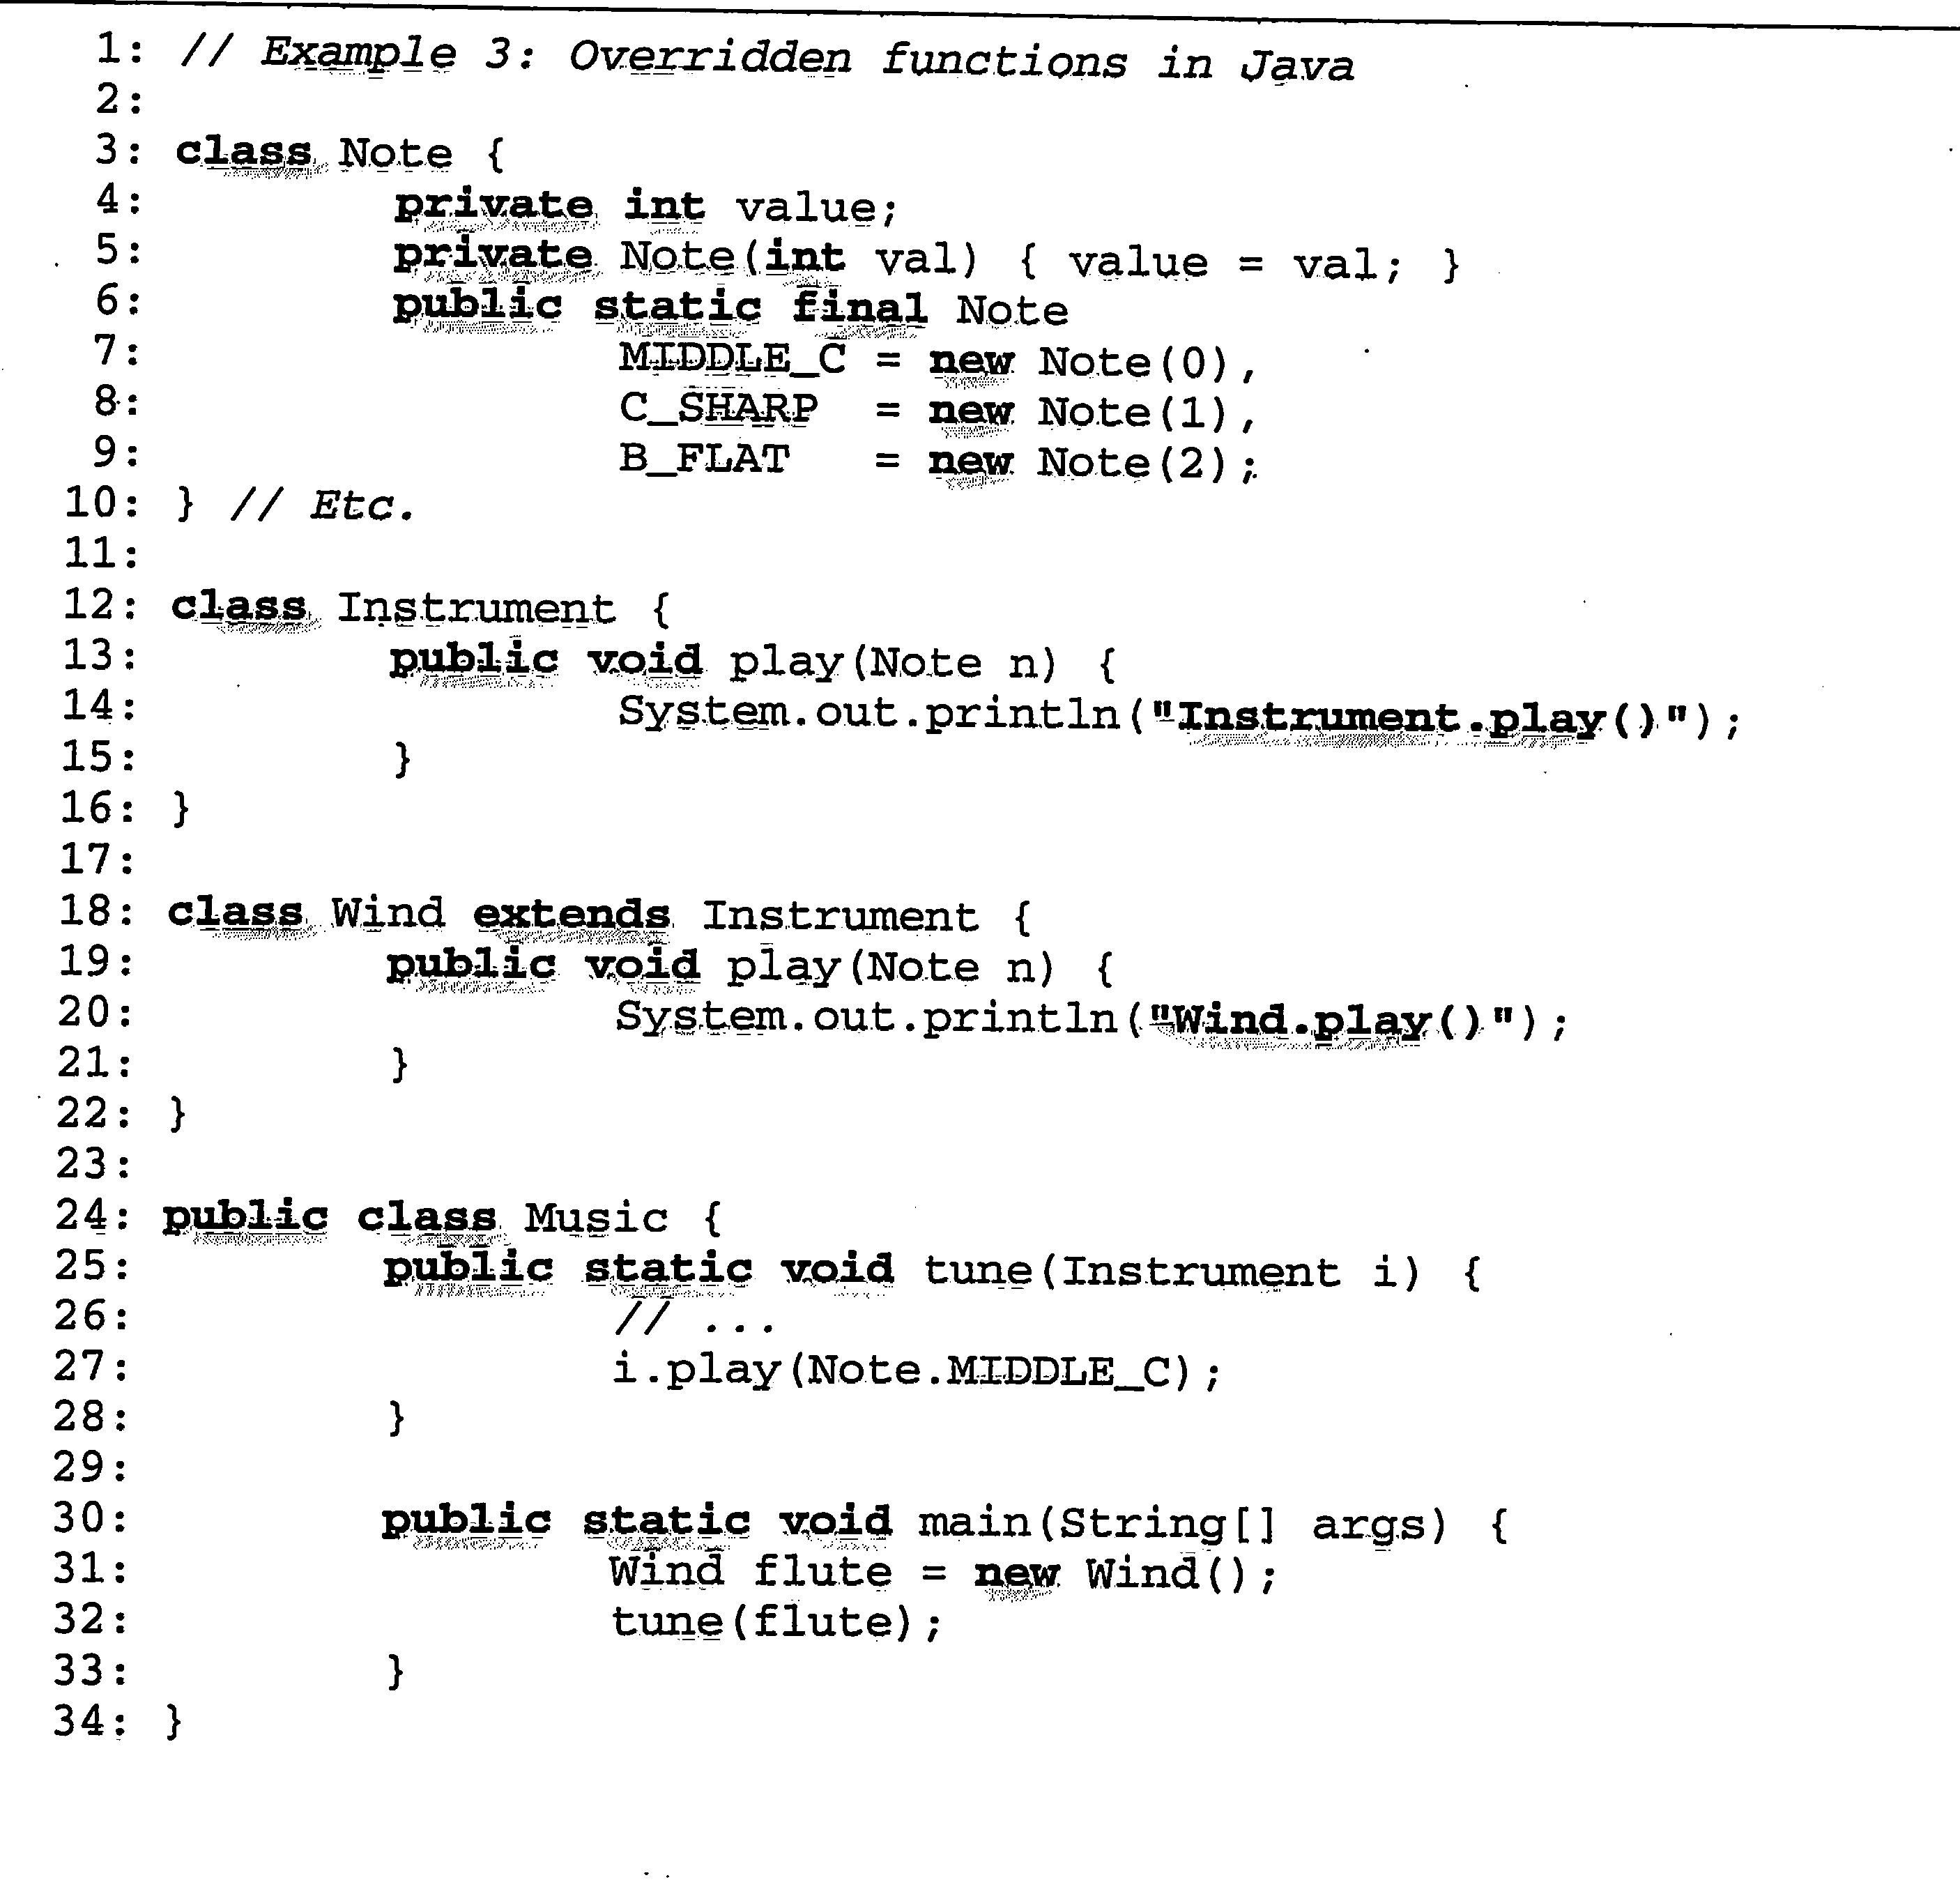
Overriding in Java
Notes:
Subclasses declare method with same name and same type signature.
Same number and type of arguments and same name, but different classes.
Resolve by inheritance graph and type of receiver object. Play function is overridden.
Wind.play(note) overrides instrument.play
Instrument brass
Read(x);
If x < 10 then then(flute)
else tune(brass);

Slide 7
Polymorphic Call Sites
Notes:
Music.tune(instrument) calls i.play(note).
What play is called? Wind or instrument?
The dynamic type of the e.x(…) tells us which method is being called?
So, a call to an overridden method is polymorphic call site.
At compiler time, semantic analysis makes sure the types are compatible at the call.
During code gen, must generate code to resolve the correct dynamic type, lookup the location of
The method in the dispatch table and jump there.

Slide 8
Polymorphic Functions: one function decl, multiple type args
Notes:
Parametric polymorphism - A single function with a body that can be executed with different type arguments. You only wrote the function once. Example tune. Music.tune(instrument) is a polymorphic method. Takes
A general instrument or a wind instrument.
One time. To type check, need concept of type variables in
Type expressions – to represent type expressions of unknown type.
Distinct occurrences of poly function can have different arg types.
Need to determine eguivalence of 2 type exprs with type vars = unification.
Can’t tell during type checking . Use type variables and unification to determine equivalence of 2 type expressions with type variables.
Music.tune(instrument) calls i.play(note).
What play is called? Wind or instrument?
The dynamic type of the e.x(…) tells us which method is being called?
So, a call to an overridden method is polymorphic call site.
At compiler time, semantic analysis makes sure the types are compatible at the call.
During code gen, must generate code to resolve the correct dynamic type, lookup the location of
The method in the dispatch table and jump there.

Slide 9
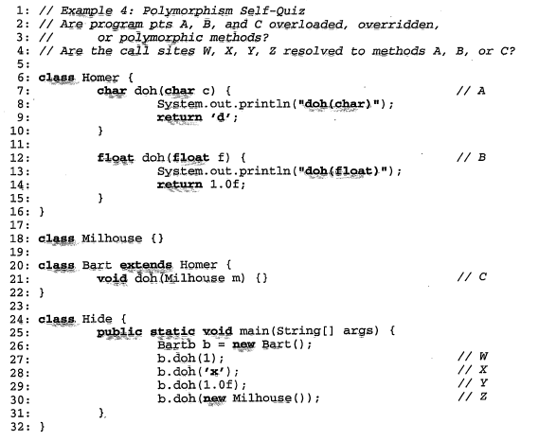
Polymorphism, Overloading, Overriding
Notes:
Doh is polymorphic.
A and B – same name in same block scope – 2 different methods, with different type args expected – overloading
C – in subclass, method with different type arg so not overriding, but instead overloading.
W – at B
X at A
Y at B
Z at 21

Slide 10
Type Checking Summary
Exercise:
With a partner, Outline the main issues you need to know to implement a type checker.

