Slide 1
Semantic Analysis

Slide 2
Find 6 problems with this code. These issues go beyond syntax.
Notes:
Answers:
number of args to fie()
• declared g[0], used g[17]
• “ab” is not an int
• wrong dimension on use of f
• undeclared variable q
• 10 is not a character string

Slide 3
What kinds of questions does the semantic analysis/code generator need to answer?

Slide 4
Semantic Analysis = Values/Meaning Context-Sensitive Analysis

Slide 5
SCOPING: Consider the following code segment in a language with nested function definitions in which all parameters are passed by reference.
int a, b, c, d;
function f(int a, int x)
{ int b = 0;
function g()
{ int c = 3;
print (“in g:”,a,b,c,d,x);
call h(a,b,c);
print(“in g:”,a,b,c,d,x);
}
{ /*in f*/
print(“in f:”,a,b,c,d,x);
call g();
print(“in f:”,a,b,c,d,x);
a = 6;
}
function h(int x, int y, int z)
{ int d = 2;
print(“in h:”,a,b,c,d,x,y,z);
x = 3; y= 4; z = 5;
}
function main()
{ a = b = c = d = 99;
call f(b,c); print(“in main”,a,b,c,d); call h(a,b,c); print(“in main”, a,b,c,d);
}
1. Show the output of this program assuming static scoping.
2. Show the output of this program assuming dynamic scoping.

Slide 6
Exercise: Identifying the Scoping Rules of a PL
Using the Decaf spec,
List how new names are introduced
List rules for visibility of names

Slide 7
Exercise: Semantic Checks
Using Decaf handout, identify what semantic checks need to be done by the compiler. Runtime environment?

Slide 8
A Symbol Table Entry
For each kind of named object, what information is needed to
Perform semantic checks
Generate code efficiently (not have to traverse AST for the information in faraway places

Slide 9
Symbol Table Operations
What are the key operations to be performed on the symbol table?

Slide 10
Implementing a Symbol Table
What possible data structures could be used for storing a single scope?
Exercise: Assigned a given data structure, create arguments to “sell” yours as the one to be used, and arguments to “not buy” the others

Slide 11
A symbol table manager and data structure must implement:
enter_scope() start a new nested scope
lookup (x) finds current x (or null) via scoping rules
insert_symbol(x) add a symbol x to the table
local-lookup(x) determines if x in local scope
exit_scope() exit current scope

Slide 12
But, we have to deal with scopes and scoping rules
Separate table for each procedure (i.e., for each scope)
At a given point have symbol table for each nesting level ≤ current nesting level
Info is deleted as well as created

Slide 13
Using a Symbol Table
● To process a portion of the program that
creates a scope (block statements, function calls, classes, etc.)
● Enter a new scope.
● Add all variable declarations to the symbol table. ● Process the body of the block/function/class. ● Exit the scope.
● Much of semantic analysis is defined in terms of recursive AST traversals like this.

Slide 14
0
P1
linear list
1
P2
symbol
table
P1
symbol
table
P2
symbol
table
P3
2
P3
*
3
P4
Top of stack:
P3
P2
P1
active
Search from top of stack
When table not needed, delete the pointer to its symbol table else keep pointers to table - code generation, debugging - - delete only from active

Slide 15
Scoping with Inheritance
Root Scope
public class Base {
public int publicBaseInt = 1; protected int baseInt = 2; }

Slide 16
Scoping with Inheritance
Root Scope
public class Base {
public int publicBaseInt = 1;
protected int baseInt = 2;
Base
}
publicBaseInt
1
baseInt
2

Slide 17
Scoping with Inheritance
Root Scope
public class Base {
public int publicBaseInt = 1;
protected int baseInt = 2; }
Base
publicBaseInt 1
public class Derived extends Base { public int derivedInt = 3;
baseInt 2
public int publicBaseInt = 4;
public void doSomething() { System.out.println(publicBaseInt);
System.out.println(baseInt); System.out.println(derivedInt);
int publicBaseInt = 6;
System.out.println(publicBaseInt); }
}

Slide 18
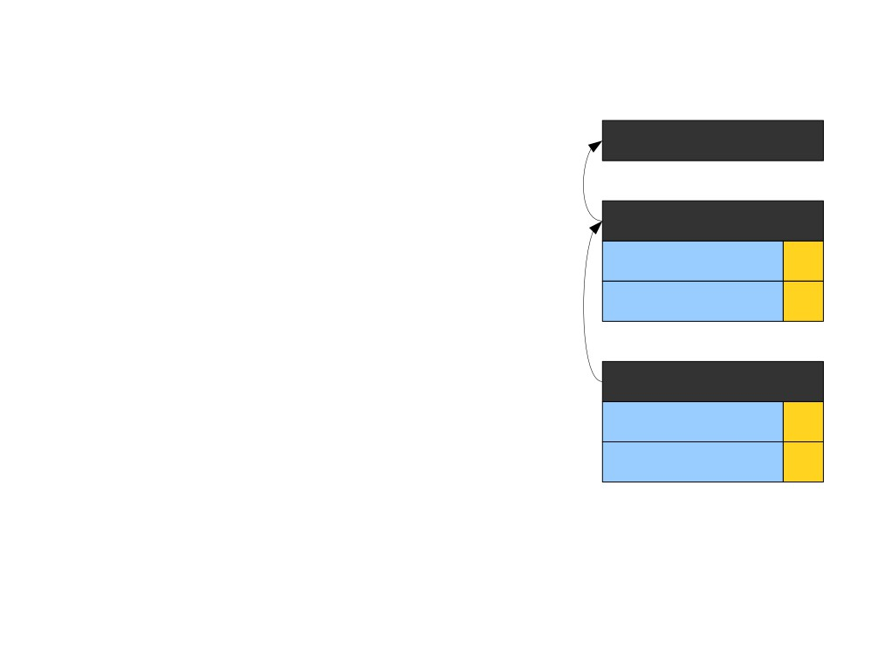
Scoping with Inheritance
Root Scope
public class Base {
public int publicBaseInt = 1;
protected int baseInt = 2; }
Base
publicBaseInt 1
public class Derived extends Base { public int derivedInt = 3;
baseInt 2
public int publicBaseInt = 4;
public void doSomething() { System.out.println(publicBaseInt);
Derived
System.out.println(baseInt); System.out.println(derivedInt);
derivedInt 3
publicBaseInt 4
int publicBaseInt = 6;
System.out.println(publicBaseInt); }
}

Slide 19
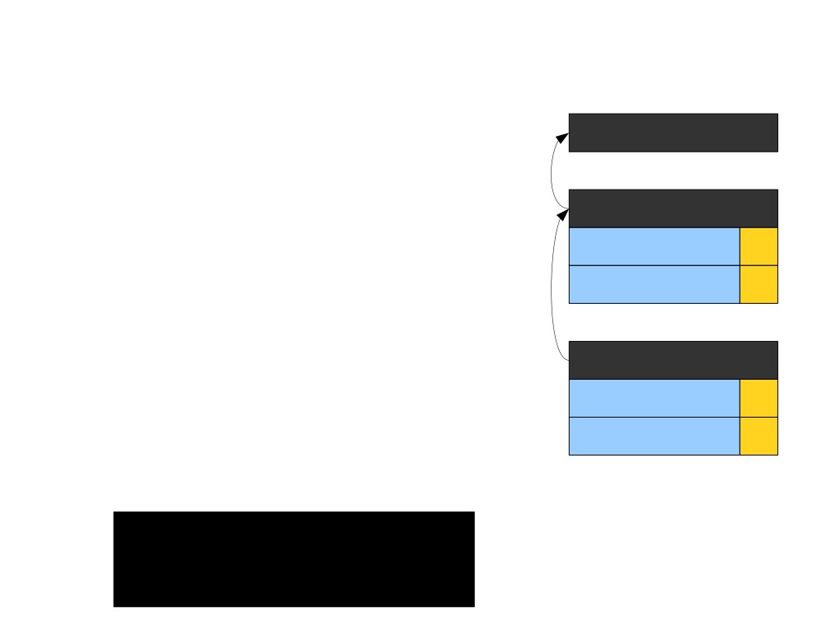
Scoping with Inheritance
Root Scope
public class Base {
public int publicBaseInt = 1;
protected int baseInt = 2; }
Base
publicBaseInt 1
public class Derived extends Base { public int derivedInt = 3;
baseInt 2
public int publicBaseInt = 4;
public void doSomething() { System.out.println(publicBaseInt);
Derived
System.out.println(baseInt); System.out.println(derivedInt);
derivedInt 3
publicBaseInt 4
int publicBaseInt = 6;
System.out.println(publicBaseInt); }
} >

Slide 20
Scoping with Inheritance
Root Scope
public class Base {
public int publicBaseInt = 1;
protected int baseInt = 2; }
Base
publicBaseInt 1
public class Derived extends Base { public int derivedInt = 3;
baseInt 2
public int publicBaseInt = 4;
public void doSomething() {
Derived
System.out.println(publicBaseInt); System.out.println(baseInt);
derivedInt 3
System.out.println(derivedInt);
publicBaseInt 4
int publicBaseInt = 6;
System.out.println(publicBaseInt); }
} >

Slide 21
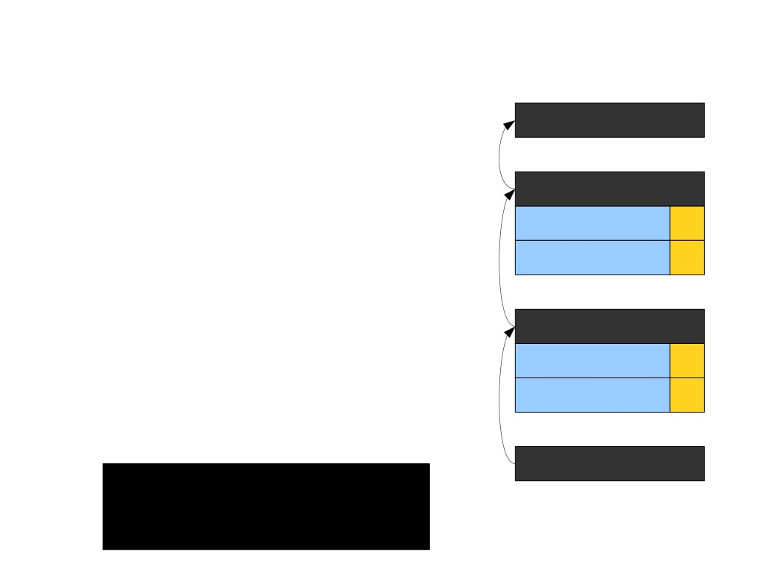
Scoping with Inheritance
Root Scope
public class Base {
public int publicBaseInt = 1;
protected int baseInt = 2; }
Base
publicBaseInt 1
public class Derived extends Base { public int derivedInt = 3;
baseInt 2
public int publicBaseInt = 4;
public void doSomething() {
Derived
System.out.println(publicBaseInt); System.out.println(baseInt);
derivedInt 3
System.out.println(derivedInt);
publicBaseInt 4
int publicBaseInt = 6;
System.out.println(publicBaseInt); }
doSomething
} >

Slide 22
Scoping with Inheritance
Root Scope
public class Base {
public int publicBaseInt = 1;
protected int baseInt = 2; }
Base
publicBaseInt 1
public class Derived extends Base { public int derivedInt = 3;
baseInt 2
public int publicBaseInt = 4;
public void doSomething() {
Derived
System.out.println(publicBaseInt);
System.out.println(baseInt); System.out.println(derivedInt);
derivedInt 3
publicBaseInt 4
int publicBaseInt = 6;
System.out.println(publicBaseInt); }
doSomething
} >

Slide 23
Scoping with Inheritance
Root Scope
public class Base {
public int publicBaseInt = 1;
protected int baseInt = 2; }
Base
publicBaseInt 1
public class Derived extends Base { public int derivedInt = 3;
baseInt 2
public int publicBaseInt = 4;
public void doSomething() {
Derived
System.out.println(publicBaseInt);
System.out.println(baseInt); System.out.println(derivedInt);
derivedInt 3
publicBaseInt 4
int publicBaseInt = 6;
System.out.println(publicBaseInt); }
doSomething
} > 4

Slide 24
Scoping with Inheritance
Root Scope
public class Base {
public int publicBaseInt = 1;
protected int baseInt = 2; }
Base
publicBaseInt 1
public class Derived extends Base { public int derivedInt = 3;
baseInt 2
public int publicBaseInt = 4;
public void doSomething() { System.out.println(publicBaseInt);
Derived
System.out.println(baseInt);
derivedInt 3
System.out.println(derivedInt);
publicBaseInt 4
int publicBaseInt = 6;
System.out.println(publicBaseInt); }
doSomething
} > 4

Slide 25
Scoping with Inheritance
Root Scope
public class Base {
public int publicBaseInt = 1;
protected int baseInt = 2; }
Base
publicBaseInt 1
public class Derived extends Base { public int derivedInt = 3;
baseInt 2
public int publicBaseInt = 4;
public void doSomething() { System.out.println(publicBaseInt);
Derived
System.out.println(baseInt);
derivedInt 3
System.out.println(derivedInt);
publicBaseInt 4
int publicBaseInt = 6;
System.out.println(publicBaseInt); }
doSomething
} > 4
2

Slide 26
Scoping with Inheritance
Root Scope
public class Base {
public int publicBaseInt = 1;
protected int baseInt = 2; }
Base
publicBaseInt 1
public class Derived extends Base { public int derivedInt = 3;
baseInt 2
public int publicBaseInt = 4;
public void doSomething() { System.out.println(publicBaseInt);
Derived
System.out.println(baseInt);
derivedInt 3
System.out.println(derivedInt);
publicBaseInt 4
int publicBaseInt = 6;
System.out.println(publicBaseInt); }
doSomething
} > 4
2

Slide 27
Scoping with Inheritance
Root Scope
public class Base {
public int publicBaseInt = 1;
protected int baseInt = 2; }
Base
publicBaseInt 1
public class Derived extends Base { public int derivedInt = 3;
baseInt 2
public int publicBaseInt = 4;
public void doSomething() { System.out.println(publicBaseInt);
Derived
System.out.println(baseInt);
derivedInt 3
System.out.println(derivedInt);
publicBaseInt 4
int publicBaseInt = 6;
System.out.println(publicBaseInt); }
doSomething
} > 4
2
3

Slide 28
Scoping with Inheritance
Root Scope
public class Base {
public int publicBaseInt = 1;
protected int baseInt = 2; }
Base
publicBaseInt 1
public class Derived extends Base { public int derivedInt = 3;
baseInt 2
public int publicBaseInt = 4;
public void doSomething() { System.out.println(publicBaseInt);
Derived
System.out.println(baseInt); System.out.println(derivedInt);
derivedInt 3
publicBaseInt 4
int publicBaseInt = 6;
System.out.println(publicBaseInt); }
doSomething
} > 4
2
3

Slide 29
Scoping with Inheritance
Root Scope
public class Base {
public int publicBaseInt = 1;
protected int baseInt = 2; }
Base
publicBaseInt 1
public class Derived extends Base { public int derivedInt = 3;
baseInt 2
public int publicBaseInt = 4;
public void doSomething() { System.out.println(publicBaseInt);
Derived
System.out.println(baseInt); System.out.println(derivedInt);
derivedInt 3
publicBaseInt 4
int publicBaseInt = 6;
System.out.println(publicBaseInt); }
doSomething
} > 4
2
publicBaseInt 6
3

Slide 30
Scoping with Inheritance
Root Scope
public class Base {
public int publicBaseInt = 1;
protected int baseInt = 2; }
Base
publicBaseInt 1
public class Derived extends Base { public int derivedInt = 3;
baseInt 2
public int publicBaseInt = 4;
public void doSomething() { System.out.println(publicBaseInt);
Derived
System.out.println(baseInt); System.out.println(derivedInt);
derivedInt 3
publicBaseInt 4
int publicBaseInt = 6;
System.out.println(publicBaseInt);
}
doSomething
} > 4
2
publicBaseInt 6
3

Slide 31
Scoping with Inheritance
Root Scope
public class Base {
public int publicBaseInt = 1;
protected int baseInt = 2; }
Base
publicBaseInt 1
public class Derived extends Base { public int derivedInt = 3;
baseInt 2
public int publicBaseInt = 4;
public void doSomething() { System.out.println(publicBaseInt);
Derived
System.out.println(baseInt); System.out.println(derivedInt);
derivedInt 3
publicBaseInt 4
int publicBaseInt = 6;
System.out.println(publicBaseInt);
}
doSomething
} > 4
2
publicBaseInt 6
3
6

Slide 32
Scoping with Inheritance
Root Scope
public class Base {
public int publicBaseInt = 1;
protected int baseInt = 2; }
Base
publicBaseInt 1
public class Derived extends Base { public int derivedInt = 3;
baseInt 2
public int publicBaseInt = 4;
public void doSomething() { System.out.println(publicBaseInt);
Derived
System.out.println(baseInt); System.out.println(derivedInt);
derivedInt 3
publicBaseInt 4
int publicBaseInt = 6;
System.out.println(publicBaseInt); }
doSomething
} > 4
2
publicBaseInt 6
3
6

Slide 33
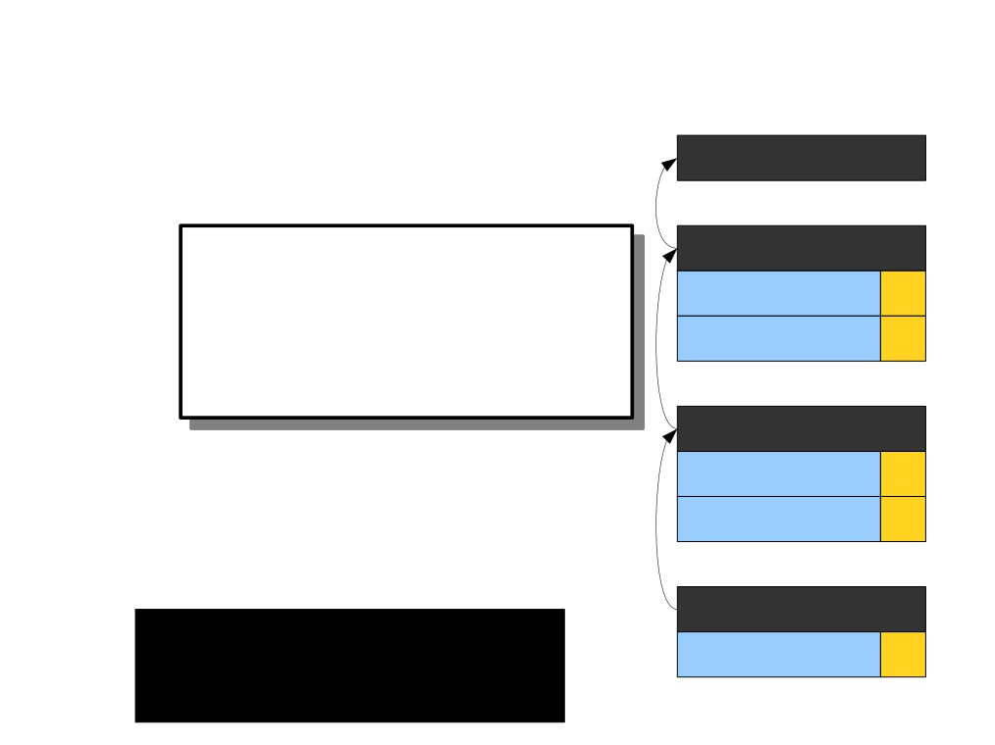
Scoping with Inheritance
Root Scope
public class Base {
public int publicBaseInt = 1;
protect
Typically the scope would also contain the names “Base” and “Derived,” along with the function
Base
}
publicBaseInt 1
public clas public
baseInt 2
name “doSomething.” For simplicity, I've left these out.
public
public v
Derived
System.out.println(publicBaseInt); System.out.println(baseInt);
derivedInt 3
System.out.println(derivedInt);
publicBaseInt 4
int publicBaseInt = 6;
System.out.println(publicBaseInt); }
doSomething
} > 4
2
publicBaseInt 6
3
6

Slide 34
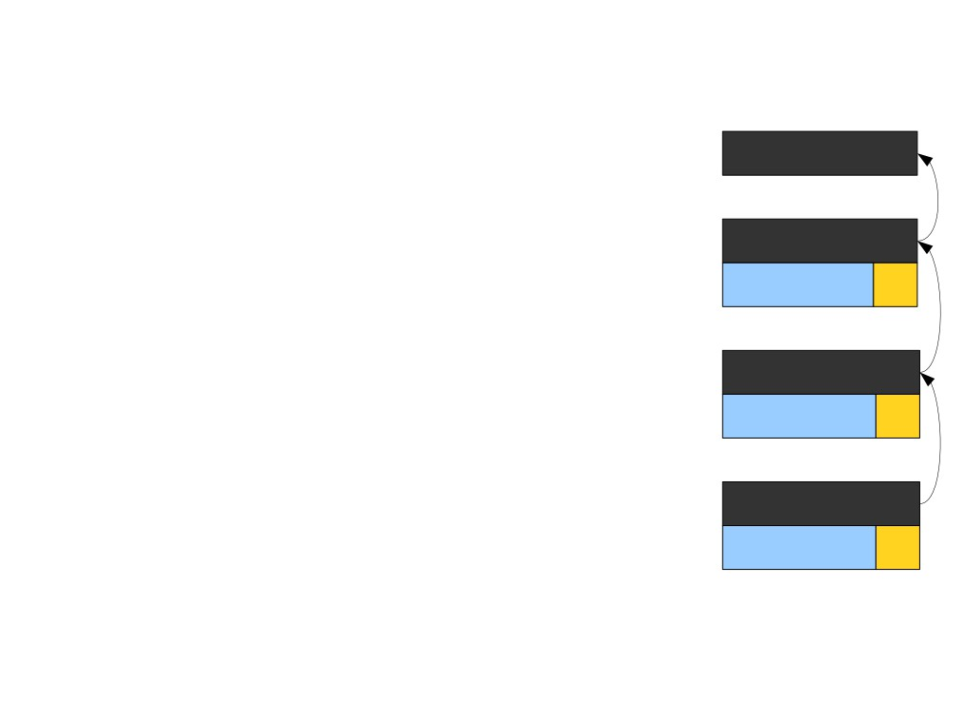
Explicit Disambiguation
Root Scope
public class Base {
public int value = 1;
}
Base
public class Derived extends Base { public int value = 2;
value 1
public void doSomething() { int value = 3;
Derived
System.out.println(value); System.out.println(this.value); System.out.println(super.value); }
value 2
}
doSomething
value 3

Slide 35
Explicit Disambiguation
Root Scope
public class Base {
public int value = 1;
}
Base
public class Derived extends Base { public int value = 2;
value 1
public void doSomething() { int value = 3;
Derived
System.out.println(value); System.out.println(this.value); System.out.println(super.value); }
value 2
}
doSomething
value 3

Slide 36
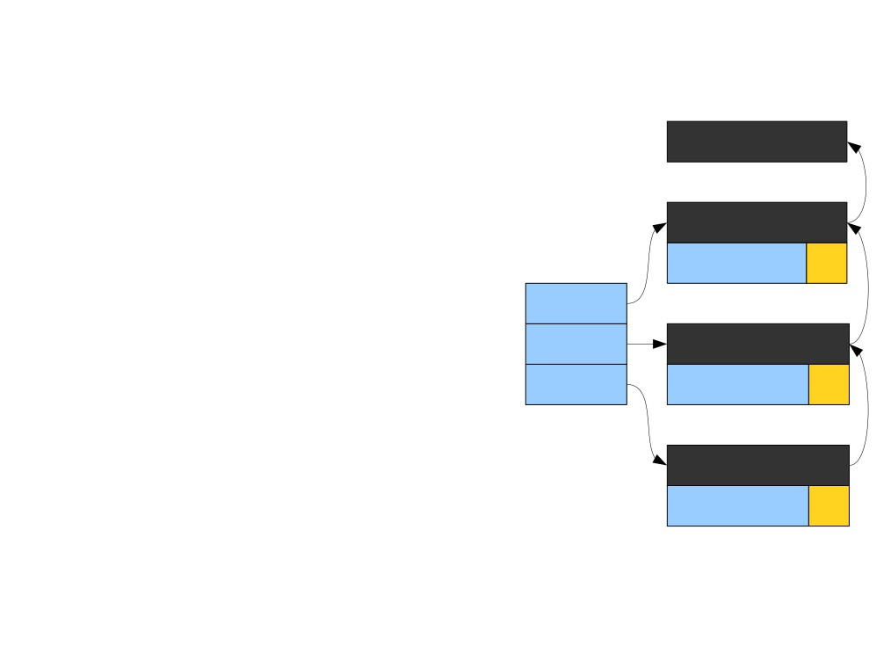
Explicit Disambiguation
Root Scope
public class Base {
public int value = 1;
}
Base
public class Derived extends Base { public int value = 2;
value 1
super
public void doSomething() { int value = 3;
this Derived
System.out.println(value); System.out.println(this.value); System.out.println(super.value); }
Locals value 2
}
doSomething
value 3

Slide 37
Explicit Disambiguation
Root Scope
public class Base {
public int value = 1;
}
Base
public class Derived extends Base { public int value = 2;
value 1
super
public void doSomething() { int value = 3;
this Derived
System.out.println(value); System.out.println(this.value); System.out.println(super.value); }
Locals value 2
}
doSomething
value 3

Slide 38
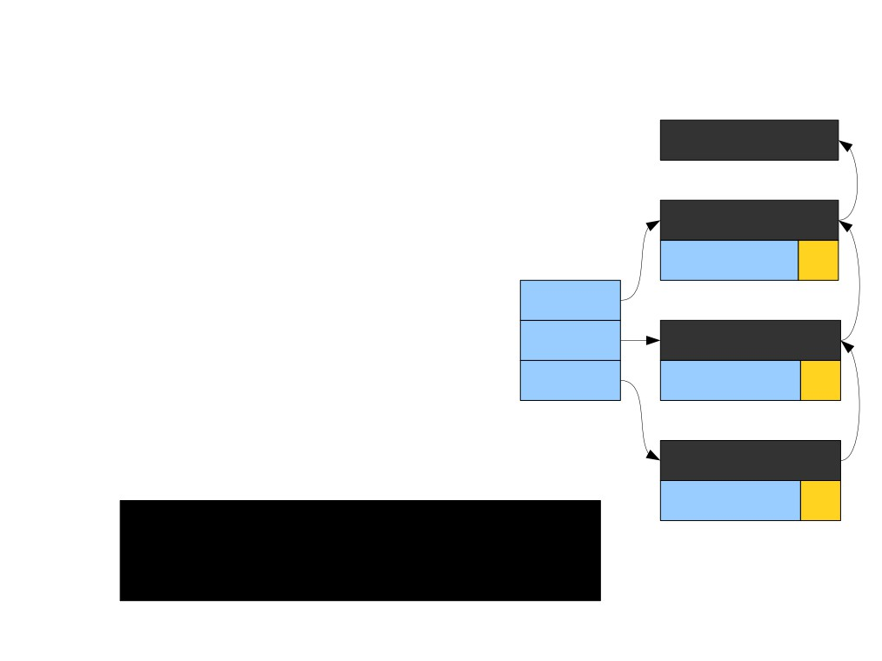
Explicit Disambiguation
Root Scope
public class Base {
public int value = 1;
}
Base
public class Derived extends Base { public int value = 2;
value 1
super
public void doSomething() { int value = 3;
this Derived
System.out.println(value); System.out.println(this.value); System.out.println(super.value); }
Locals value 2
}
doSomething
value 3
>

Slide 39
Explicit Disambiguation
Root Scope
public class Base {
public int value = 1;
}
Base
public class Derived extends Base { public int value = 2;
value 1
super
public void doSomething() { int value = 3;
this Derived
System.out.println(value);
Locals value 2
System.out.println(this.value); System.out.println(super.value); }
}
doSomething
value 3
>

Slide 40
Explicit Disambiguation
Root Scope
public class Base {
public int value = 1;
}
Base
public class Derived extends Base { public int value = 2;
value 1
super
public void doSomething() { int value = 3;
this Derived
System.out.println(value);
Locals value 2
System.out.println(this.value); System.out.println(super.value); }
}
doSomething
value 3
> 3

Slide 41
Explicit Disambiguation
Root Scope
public class Base {
public int value = 1;
}
Base
public class Derived extends Base { public int value = 2;
value 1
super
public void doSomething() { int value = 3;
this Derived
System.out.println(value);
Locals value 2
System.out.println(this.value);
System.out.println(super.value); }
}
doSomething
value 3
> 3

Slide 42
Explicit Disambiguation
Root Scope
public class Base {
public int value = 1;
}
Base
public class Derived extends Base { public int value = 2;
value 1
super
public void doSomething() { int value = 3;
this Derived
System.out.println(value);
Locals value 2
System.out.println(this.value);
System.out.println(super.value); }
}
doSomething
value 3
> 3
2

Slide 43
Explicit Disambiguation
Root Scope
public class Base {
public int value = 1;
}
Base
public class Derived extends Base { public int value = 2;
value 1
super
public void doSomething() { int value = 3;
this Derived
System.out.println(value); System.out.println(this.value);
Locals value 2
System.out.println(super.value);
}
doSomething
}
value 3
> 3
2

Slide 44
Explicit Disambiguation
Root Scope
public class Base {
public int value = 1;
}
Base
public class Derived extends Base { public int value = 2;
value 1
super
public void doSomething() { int value = 3;
this Derived
System.out.println(value); System.out.println(this.value);
Locals value 2
System.out.println(super.value);
}
doSomething
}
value 3
> 3
2
1

Slide 45
Explicit Disambiguation
Root Scope
public class Base {
public int value = 1;
}
Base
public class Derived extends Base { public int value = 2;
value 1
super
public void doSomething() { int value = 3;
this Derived
System.out.println(value); System.out.println(this.value); System.out.println(super.value); }
Locals value 2
}
doSomething
value 3
> 3
2
1

Slide 46
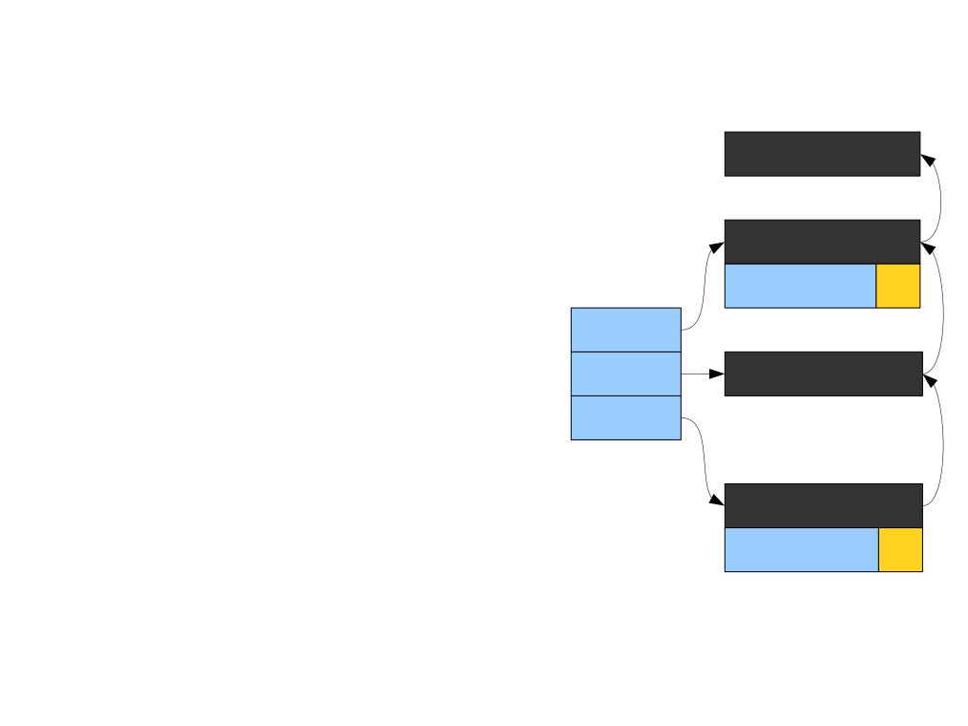
Explicit Disambiguation – no value
Declared in Derived
Root Scope
public class Base {
public int value = 1;
}
Base
public class Derived extends Base {
value 1
super
public void doSomething() { int value = 3;
this Derived
System.out.println(value); System.out.println(this.value); System.out.println(super.value); }
Locals
}
doSomething
value 3

Slide 47
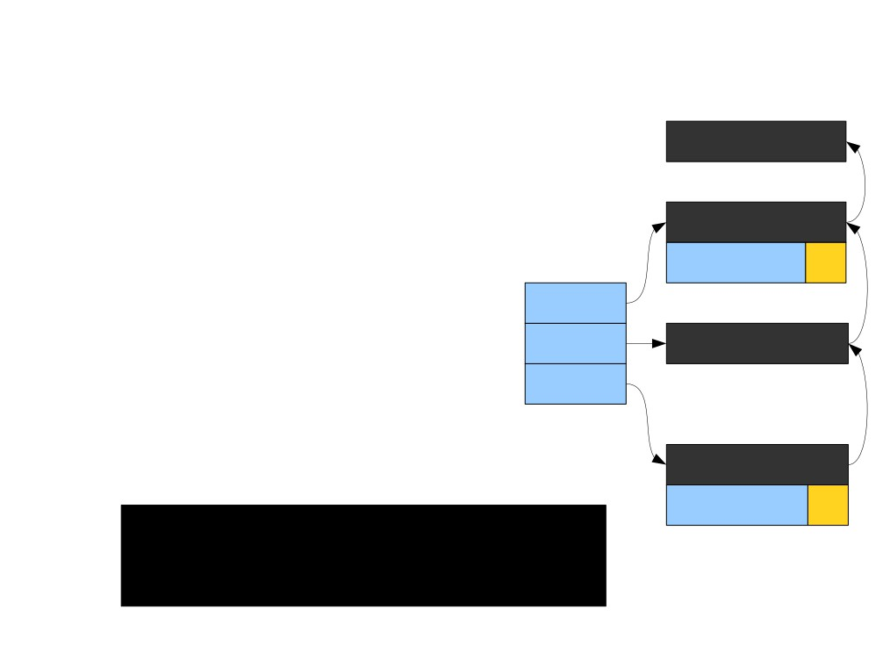
Explicit Disambiguation
Root Scope
public class Base {
public int value = 1;
}
Base
public class Derived extends Base {
value 1
super
public void doSomething() { int value = 3;
this Derived
System.out.println(value); System.out.println(this.value); System.out.println(super.value); }
Locals
}
doSomething
value 3
>

Slide 48
Explicit Disambiguation
Root Scope
public class Base {
public int value = 1;
}
Base
public class Derived extends Base {
value 1
super
public void doSomething() { int value = 3;
this Derived
System.out.println(value);
Locals
System.out.println(this.value); System.out.println(super.value); }
}
doSomething
value 3
>

Slide 49
Explicit Disambiguation
Root Scope
public class Base {
public int value = 1;
}
Base
public class Derived extends Base {
value 1
super
public void doSomething() { int value = 3;
this Derived
System.out.println(value);
Locals
System.out.println(this.value); System.out.println(super.value); }
}
doSomething
value 3
> 3

Slide 50
Explicit Disambiguation
Root Scope
public class Base {
public int value = 1;
}
Base
public class Derived extends Base {
value 1
super
public void doSomething() { int value = 3;
this Derived
System.out.println(value);
Locals
System.out.println(this.value);
System.out.println(super.value); }
}
doSomething
value 3
> 3

Slide 51
Explicit Disambiguation
Root Scope
public class Base {
public int value = 1;
}
Base
public class Derived extends Base {
value 1
super
public void doSomething() { int value = 3;
this Derived
System.out.println(value);
Locals
System.out.println(this.value);
System.out.println(super.value); }
}
doSomething
value 3
> 3
1

Slide 52
Explicit Disambiguation
Root Scope
public class Base {
public int value = 1;
}
Base
public class Derived extends Base {
value 1
super
public void doSomething() { int value = 3;
this Derived
System.out.println(value); System.out.println(this.value);
Locals
System.out.println(super.value);
}
doSomething
}
value 3
> 3
1

Slide 53
Explicit Disambiguation
Root Scope
public class Base {
public int value = 1;
}
Base
public class Derived extends Base {
value 1
super
public void doSomething() { int value = 3;
this Derived
System.out.println(value); System.out.println(this.value);
Locals
System.out.println(super.value);
}
doSomething
}
value 3
> 3
1
1

Slide 54
Explicit Disambiguation
Root Scope
public class Base {
public int value = 1;
}
Base
public class Derived extends Base {
value 1
super
public void doSomething() { int value = 3;
this Derived
System.out.println(value); System.out.println(this.value); System.out.println(super.value); }
Locals
}
doSomething
value 3
> 3
1
1

Slide 55
Disambiguating Scopes
● Maintain a second table of pointers into the scope stack.
● When looking up a value in a specific
scope, begin the search from that scope. ● Some languages allow you to jump up to any arbitrary base class (for example, C++).

