Slide 1
Semantic Analysis

Slide 2
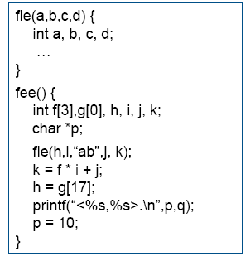
Find 6 problems with this code.
These issues go beyond syntax.
Notes:
Answers:
number of args to fie()
• declared g[0], used g[17]
• “ab” is not an int
• wrong dimension on use of f
• undeclared variable q
• 10 is not a character string

Slide 3
What kinds of questions does the semantic analysis/code generator need to answer?

Slide 4
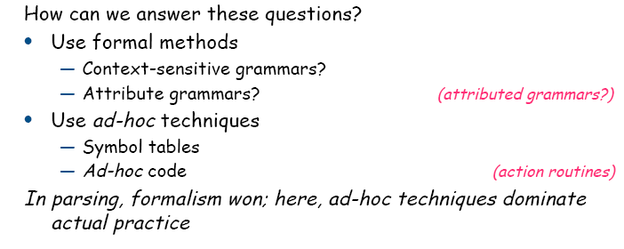
Semantic Analysis = Values/Meaning
Context-Sensitive Analysis

Slide 5
SCOPING: Consider the following code segment in a language with nested function definitions in which all parameters are passed by reference.
int a, b, c, d;
function f(int a, int x)
{ int b = 0;
function g()
{ int c = 3;
print (“in g:”,a,b,c,d,x);
call h(a,b,c);
print(“in g:”,a,b,c,d,x);
}
{ /*in f*/
print(“in f:”,a,b,c,d,x);
call g();
print(“in f:”,a,b,c,d,x);
a = 6;
}
function h(int x, int y, int z)
{ int d = 2;
print(“in h:”,a,b,c,d,x,y,z);
x = 3; y= 4; z = 5;
}
function main()
{ a = b = c = d = 99;
call f(b,c); print(“in main”,a,b,c,d); call h(a,b,c); print(“in main”, a,b,c,d);
}
1. Show the output of this program assuming static scoping.
2. Show the output of this program assuming dynamic scoping.

Slide 6
Exercise: Identifying the Scoping Rules of a PL
Using the Decaf spec,
List how new names are introduced
List rules for visibility of names

Slide 7
Exercise: Semantic Checks
Using Decaf handout, identify what semantic checks need to be done by the compiler. Runtime environment?

Slide 8
A Symbol Table Entry
For each kind of named object, what information is needed to
  Perform semantic checks
  Generate code efficiently (not have to traverse AST for the information in faraway places

Slide 9
Symbol Table Operations
What are the key operations to be performed on the symbol table?

Slide 10
Implementing a Symbol Table
What possible data structures could be used for storing a single scope?
Exercise: Assigned a given data structure, create arguments to “sell” yours as the one to be used, and arguments to “not buy” the others

Slide 11
A symbol table manager and data structure must implement:
enter_scope() start a new nested scope
lookup (x) finds current x (or null) via scoping rules
insert_symbol(x) add a symbol x to the table
local-lookup(x) determines if x in local scope
exit_scope() exit current scope

Slide 12
But, we have to deal with scopes and scoping rules
Separate table for each procedure (i.e., for each scope)
At a given point have symbol table for each nesting level ≤ current nesting level
Info is deleted as well as created

Slide 13
0
P1
linear list
1
P2
symbol
table
P1
symbol
table
P2
symbol
table
P3
2
P3
*
3
P4
P1
P2
P3
active
Search from bottom
When table not needed, delete the pointer to its symbol table else keep pointers to table - code generation, debugging - - delete only from active

Slide 14
Binary tree
P1
P2
P2
P3
P3
Search in current symbol table for id;
if not found find the previous table and continue in
this manner until the id is found

Slide 15
Hash table technique - Single hash table
Link together different entries for the same identifier
and associate nesting level with each occurrence of same name.
The first one is the latest occurrence of the name, i.e., highest nesting level
nesting
level
id
i
0
nesting level 0
i
1
nesting level 1
h(i)
k
2
h(k)
k
1

Slide 16
During exit from a procedure - delete all entries of the nesting level we are exiting
- must be able to do this - Remove links to most recent scope
Three ways to do this
1. Search for the correct items to remove - rehash expensive
2. Use extra pointer in each element to link all items of the same scope
3. Use a stack that has entries for each scope
level 1
level 2
level 3
Pop entry and delete from hash table - keep stack entries around

