Slide 1


The Scale Compiler
Presented by Rosh Dhanawade and Doug Wise

Slide 2
SCALE-Who and Where
A Scalable Compiler for Analytical Experiments
UMASS (Amherst)-Scale Compiler Group
  University of Texas (Austin)-Second University Involved

Slide 3
SCALE-Source
Parses-C, FORTRAN, Java-byte-code
  Using ANTLR, ANother Tool for Language Recognition
Outputs-C and Assembly Code
Intermediate Representation-SCRIBBLE
Architecture-TRIPS Architecture
  The Tera-op, Reliable, Intelligently adaptive Processing System
  Microprocessor technology being developed at the University of Texas
Notes:
Alpha, PowerPC, Sparc® V8, and Trips
This architecture presents some interesting challenges. In order to obtain the very high performance of which it is capable, the compiler must be able to construct basic blocks that are much larger than the ones seen in a typical C program. To accomplish this, we are using powerful inlining and unrolling combined with predication.

Slide 4
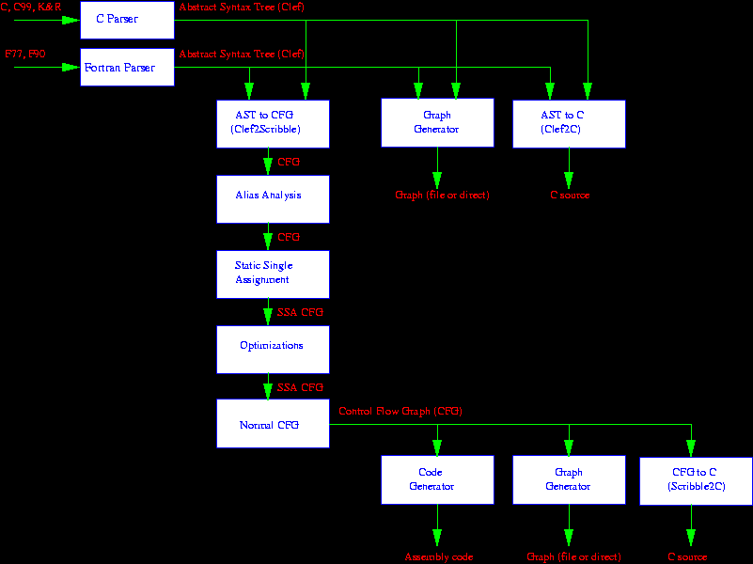
SCALE-Architecture

Slide 5
SCALE-Representations
AST
  AST to C, AST to Scribble
Scribble-Control Flow Graph
Notes:
Scale Clef AST is called the Common Language Encoding Form (Clef). High level optimizations can modify the Clef AST to provide improved code generation.
High level analysis can influence lower level optimizations through the addition of Annotations
High level forms can be lowered

Slide 6
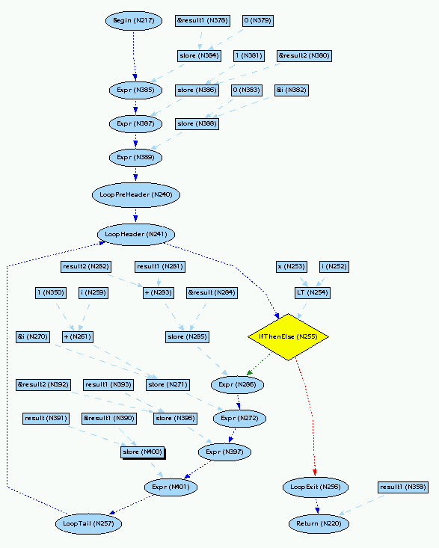
SCALE-Scribble

Slide 7
SCALE-Uses
Provide a powerful framework to support research into compiler optimizations
  e.g., Type-based alias analysis
Gather empirical results on new ideas
Compile multiple procedure-oriented languages
Notes:
alias analyses, static single assignment form (SSA), a collection of scalar optimizations, (PRE, value numbering, copy propagation, dead code elimination, and constant propagation)
Scale performs optimizations (except for inlining) in any order. The following optimizations are performed on the SSA form of the Scribble CFG:
Sparse Conditional Constant Propagation
Copy Propagation
Value Numbering
Loop Invariant Code Motion
Scalar Replacement for Array Elements
Loop Un-rolling
Partial Redundancy Elimination
The following optimizations are performed on the normal (non-SSA) form of the CFG. Inlining
Global Variable Replacement
Place struct Fields in Registers
Useless Copy Removal
Dead Variable Elimination
Some optimizations can be performed on either the SSA or normal form of the CFG.
Basic Block Redundant Load and Store Elimination.
Expression Tree Height Reduction

Slide 8
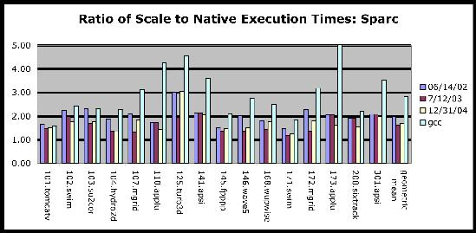
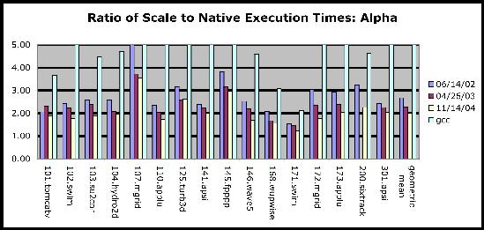
SCALE-Native Compilers: Fortran

Slide 9
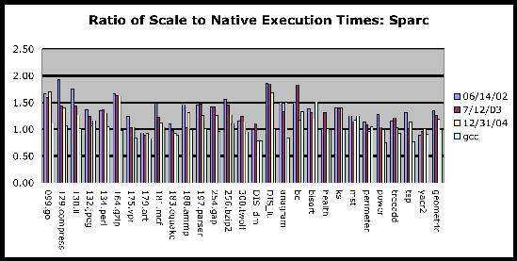
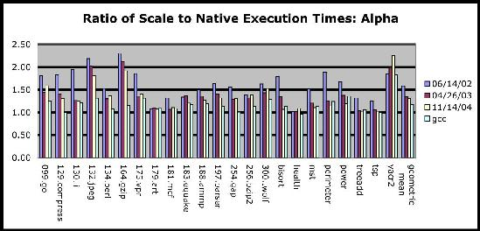
SCALE-Native Compilers: C

Slide 10
SCALE-Known Issues
The Java-based parsers have not been thoroughly tested.
The Mips® backend is not complete.
The PowerPC® backend is not under regression test.

Slide 11
SCALE-Future Enhancements
Constantly testing new Optimizations
Research in improving algorithms and representations behind the exiting optmizations

