Slide 1
Computational methods used in solving the Navier Stokes Equation
Presenter: Jonathon Nooner

Slide 2
Introduction to Finite Difference
Suppose that we have an f(x,y,t):
--- n is treated as a time index, i and j are treated as spatial indices

Slide 3
What is Navier Stokes?
The Navier Stokes Equations represent the momentum of a fluid. A fluid is anything that flows, it includes: air, water, oil, glass (over very long time frames).
Common applications would include simulations of asteroid collisions, airflow over an air foil,, plastic printing, etc.
In 3 dimensions there are 3 equations to represent momentum in each dimensions, a continuity equation and an energy equation are included.

Slide 4
Common problems encountered
Elastic Navier-Stokes equations*:
* Taken From: Jacobson, M. Z., “Fundamentals of Atmospheric Modeling”, Second Edition, 2005. Ch. 3, 4.

Slide 5
Example Research Problem
Anelastic Navier-Stokes equations*:
* Taken From: Lund, T. S., and D. C. Fritts, DC (2012), Numerical simulation of gravity wave breaking in the lower thermosphere, J of Geophysical Research. Vol 117. D21105.

Slide 6
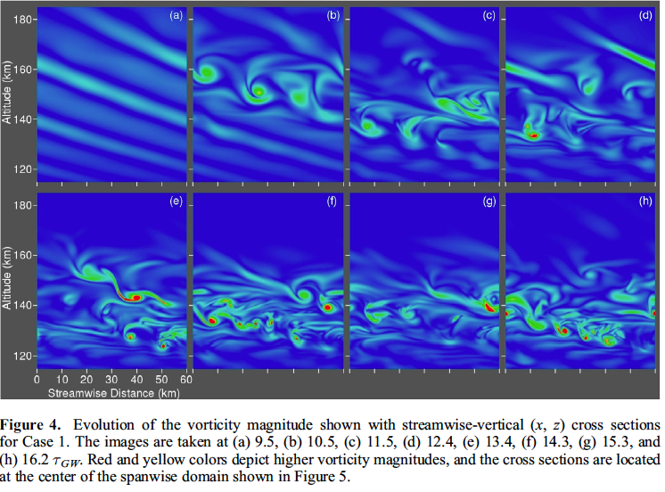
Output from Lund and Fritts’ Model

Slide 7
Commonly encountered issues with these problems
Such problems are quite difficult to solve.
Five Equations, Nonlinear, Computationally Expensive.
Has dimensions 60 x 60 x 100 km in x, y z respectively.
300 x 300 x 500 mesh points = 45 million points.
Computations like this are done on supercomputers; as an example, JANUS, which has 16416 total cores, and a maximum of 184 TFLOPS (x10^12 Floating Point Operations) available. **
** Data from: https://www.rc.colorado.edu/resources/janus

Slide 8
How does one approach such a problem?
What does the analytical solution for this problem look like? No one knows if an analytical solution exists. A millennial prize exists for whoever can find one.
We start small and build up.
The smallest equation that maintains the nonlinear characteristics of the Navier Stokes equations is the Burger’s equation.
*

Slide 9
Diffusive Burger’s Equation
On a digital computer, the domain will need to be split into discrete pieces. Analog computers do exist that can solve continuum equations natively by using operational amplifiers, but they are *significantly* harder to use, and not nearly as flexible as their digital kin.
For simplicity, we’ll begin with one of the easiest methods: Finite Difference – Forward Time Centered Space (Diffusion) Backward Space (Advection) Explicit
*

Slide 10
Diffusive Burger’s Equation
For an explicit representation of this equation, we solve for the state of the next timestep.
n + 1
n

Slide 11
CFL Condition
We are describing a continuous system using a discrete domain. Based on the rate that the velocity information is changing, you might think that there is a limit to how coarsely one can represent a continuum using a discrete domain… and you would be right!

Slide 12
Workflow
Set Initial Conditions
Calculate Timestep based on CFL Condition
Enforce Boundary Conditions
Calculate grid velocities for the next Timestep
Meet End Condition?
Increment Timestep
End
no
yes

Slide 13
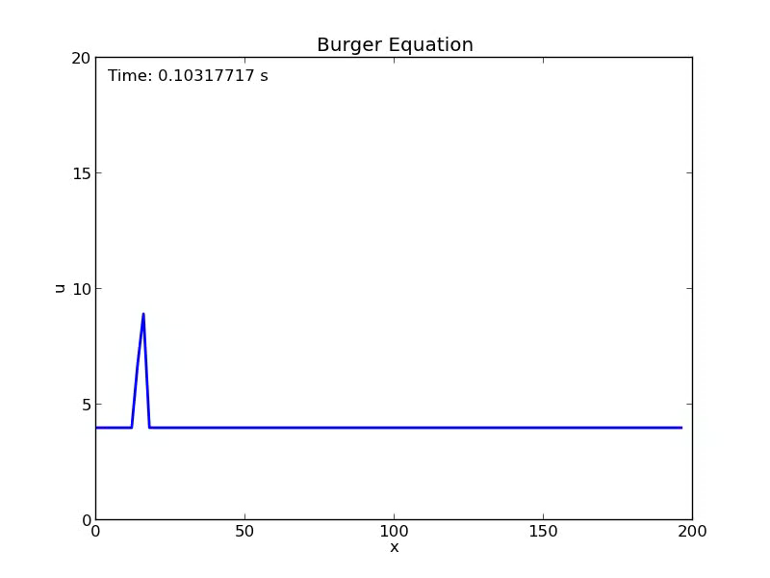
Output from Burger Equation

Slide 14
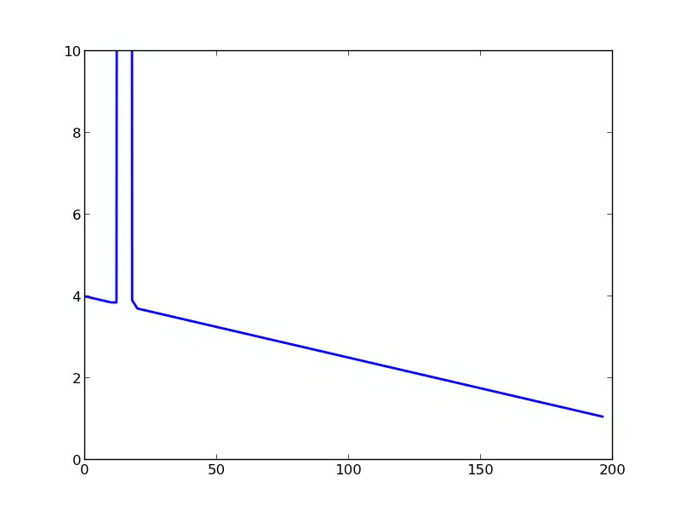
More Output

Slide 15
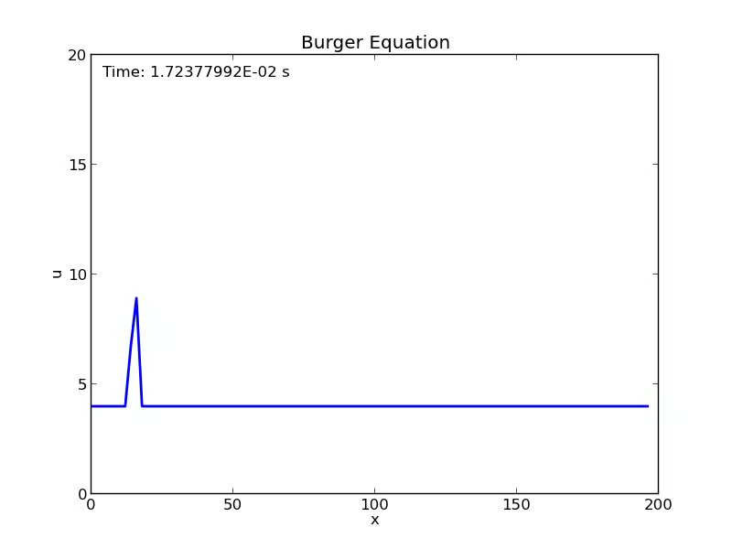
Be careful with your discretization scheme

Slide 16
2D Burgers Equation with Diffusion
Note that it is not necessary for the viscosity to be the same in both directions.
No continuity equation yet, so conservation of mass per flow area is not necessarily obeyed.

Slide 17
2D Burgers Equation Discretization
*

Slide 18
Shallow Water Equation Derivation
h(x)
h(x+dx)
u
u+du
p=p_{o}
z
A
B
x
x
x+dx
Mass Flowrate:
1D Continuity Equation:
2D Continuity Equation:

Slide 19
Shallow Water Equation Derivation
Gravitational Potential:
Material Derivative:
Momentum Equations:
Shallow Water Equations:

Slide 20
Any Questions?

