Slide 1
Shellcode
Chien-Chung Shen
cshen@udel.edu

Slide 2
Introduction
A a small piece of code, commonly written in machine code, used as the payload in the exploitation of a software vulnerability
It is called shellcode because it typically starts a command shell from which the attacker can control the compromised machine
The function of a payload is not limited to merely spawning a shell
Types of shellcode: local and remote; depending on whether it gives an attacker control over the machine it runs on (local) or over another machine through a network (remote)

Slide 3
Types of Shellcode
Local
used by an attacker who has limited access to a machine but can exploit a vulnerability (e.g., buffer overflow) in a higher-privileged process on that machine
if successfully executed, the shellcode will provide the attacker access to the machine with the same higher privileges as the targeted process
Remote
used when an attacker wants to target a vulnerable process running on another machine
if successfully executed, the shellcode can provide the attacker access to the target machine across the network

Slide 4
execve Shellcode
Create execve shellcode using the stack method to launch /bin/sh on Ubuntu 12.04 32-bit
System call execve has system call number 11
#ifndef _ASM_X86_UNISTD_32_H
#define _ASM_X86_UNISTD_32_H
/*
* This file contains the system call numbers.
*/
#define __NR_restart_syscall 0
#define __NR_exit 1
#define __NR_fork 2
#define __NR_read 3
#define __NR_write 4
#define __NR_open 5
#define __NR_close 6
#define __NR_waitpid 7
#define __NR_creat 8
#define __NR_link 9
#define __NR_unlink 10
#define __NR_execve 11
#define __NR_chdir 12
#define __NR_time 13
/usr/include/i386-linux-gnu/asm/unistd_32.h

Slide 5
Call execve in Shellcode
Arguments of execve()
EXECVE(2) Linux Programmer's Manual EXECVE(2)
NAME
execve - execute program
SYNOPSIS
#include <unistd.h>
int execve(const char *filename, char *const argv[], char *const envp[]);
filename: point to a string (/bin/sh) containing the path of the binary we want to execute
argv[]: the list of arguments to the program ([/bin/sh, NULL])
envp[]: the list of environment options (NULL pointer)

Slide 6
Map CPU Registers for execve Call
Registers eax, ebx, ecx, and edx are used for the system call using INT 0x80
In Linux, 0x80 interrupt handler is the kernel, and is used to make system calls to the kernel by other programs
The kernel is notified about which system call the program wants to make, by examining the value in the register %eax, which contains 11

Slide 7
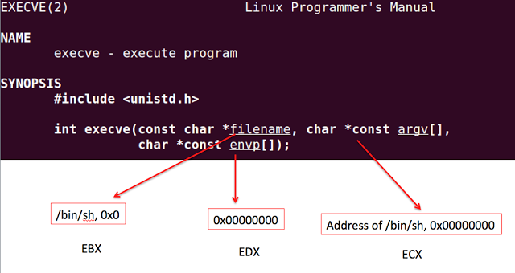
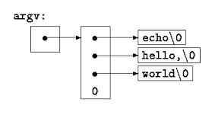
Map CPU Registers for execve Call
Pointer to null-terminated string “/bin/sh”
NULL pointer
Pointer to argv[]

Slide 8
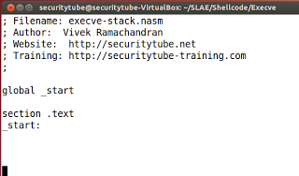
Shellcoding in Assembly
defined the TEXT section and let the entry point into this executable be _start

Slide 9
Shellcoding in Assembly
setup the stack with all the arguments required for execve
the stack for IA-32 grows from High memory to Low memory

Slide 10
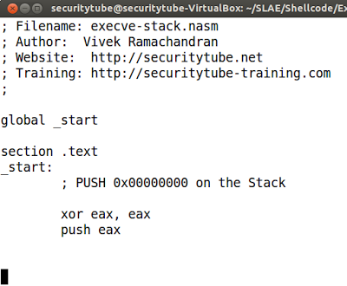
Shellcoding in Assembly
First, setup the EBX register for the 1st argument of execve()
EBX needs to point to '\x0' terminated "/bin/sh" in memory
We cannot do "PUSH 0x00000000" because Shellcode itself cannot contain NULLs (i.e., \x00)
We will have to create 0x00000000 in one of the registers and PUSH the register onto the stack
use XOR to zero out EAX and then PUSH EAX onto the stack

Slide 11
Shellcoding in Assembly
Now PUSH string "/bin/sh" onto the Stack
As the Stack grows from High memory to Low memory in x86, we will need to push "/bin/sh" in reverse order
Also, it would be easier to push data which is a multiple of 4 with the least number of instructions
"/bin/sh" is 7 bytes and we need to convert it to 8 bytes without messing up the filename
On Linux, "/bin/sh" invokes the same program as "//bin/sh”
PUSH "//bin/sh" (8 bytes) in reverse order onto the Stack, i.e., "hs/nib//"

Slide 12
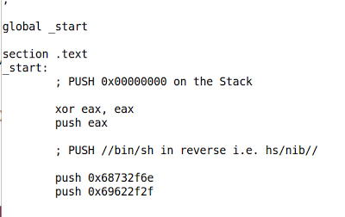
Shellcoding in Assembly
PUSH "//bin/sh" (8 bytes) in reverse order onto the Stack, i.e., "hs/nib//"
'//bin/sh'[::-1].encode('hex')
➔'68732f6e69622f2f'

Slide 13
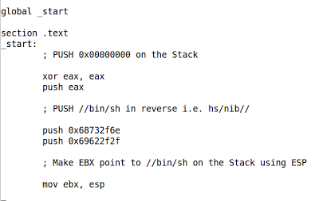
Shellcoding in Assembly
make EBX (1st argument) to point to the top of the stack
EBX is now contains the address of "//bin/sh" in memory

Slide 14
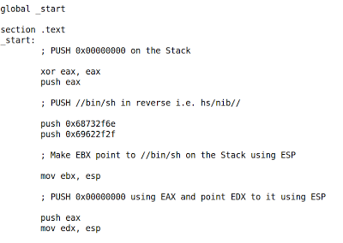
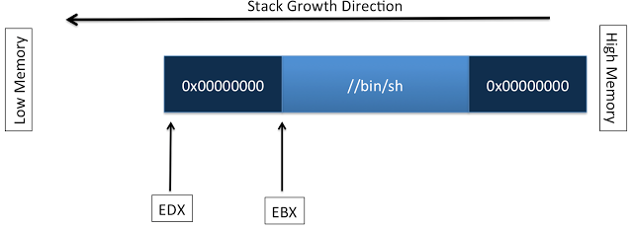
Shellcoding in Assembly
setup EDX (3rd argument) which should point to a NULL pointer
achieved by a PUSH EAX (remember EAX contains 0x00000000) and copying ESP into EDX

Slide 15
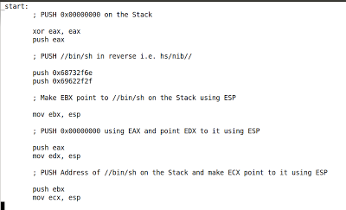
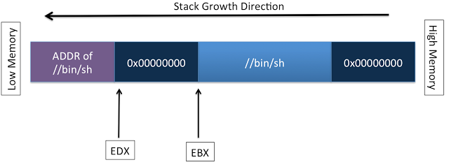
Shellcoding in Assembly
ECX needs to contain the address of [Address of //bin/sh in memory, 0x0000000]
Currently EBX contains the address of "//bin/sh" in memory so we PUSH EBX onto the stack
the top of the Stack now points to [Address of //bin/sh in memory, 0x00000000], so we copy ESP into ECX

Slide 16
Shellcoding in Assembly
All the arguments for execve() are now setup on the stack and EBX, ECX and EDX are pointing to them
To call execve(), setup EAX to contain "11" and invoke Interrupt 0x80
http://www.tutorialspoint.com/assembly_programming/assembly_quick_guide.htm

Slide 17
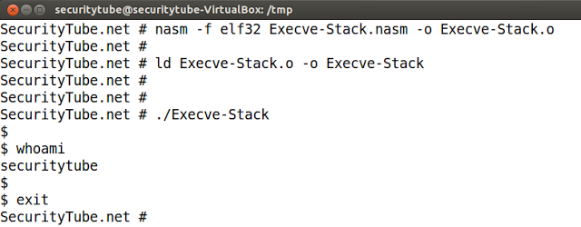
Assemble, Link and Test the Code

Slide 18
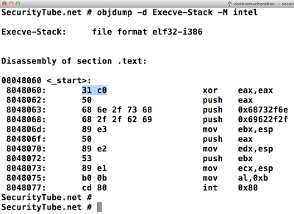
Examine Binary Using Objdump

Slide 19
Extract Opcodes to Create Shellcode

Slide 20
Compile shellcode.c and Run It
#include<stdio.h>
#include<string.h>
unsigned char code[] = \
"\x31\xc0\x50\x68\x6e\x2f\x73\x68\x68\x2\x2fx62\x69\x89\xe3\x50\x89\xe2\x53\x89\xe1\xb0\x0b\xcd\x80";
main()
{
printf("Shellcode Length: %d\n", strlen(code));
int (*ret)() = (int(*)())code;
ret();
}

