Slide 1
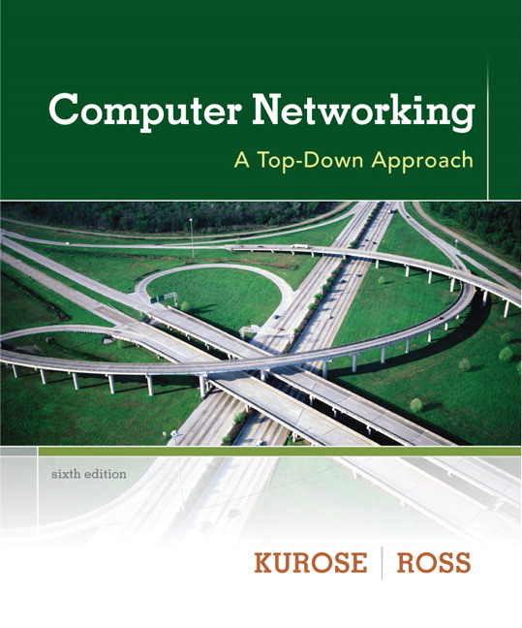

Chapter 8 Security
Computer Networking: A Top Down Approach 6th edition Jim Kurose, Keith Ross Addison-Wesley March 2012
A note on the use of these ppt slides:
We’re making these slides freely available to all (faculty, students, readers). They’re in PowerPoint form so you see the animations; and can add, modify, and delete slides (including this one) and slide content to suit your needs. They obviously represent a lot of work on our part. In return for use, we only ask the following:
If you use these slides (e.g., in a class) that you mention their source (after all, we’d like people to use our book!)
If you post any slides on a www site, that you note that they are adapted from (or perhaps identical to) our slides, and note our copyright of this material.
Thanks and enjoy! JFK/KWR
All material copyright 1996-2012
J.F Kurose and K.W. Ross, All Rights Reserved

Slide 2
SSL: Secure Sockets Layer
widely deployed security protocol
supported by almost all browsers, web servers
https
billions $/year over SSL
mechanisms: [Woo 1994], implementation: Netscape
variation - TLS: transport layer security, RFC 2246
provides
confidentiality
integrity
authentication
original goals:
Web e-commerce transactions
encryption (especially credit-card numbers)
Web-server authentication
optional client authentication
minimum hassle in doing business with new merchant
available to all TCP applications
secure socket interface
https://……

Slide 3
An example
An on-line order
If no confidentiality?
Credit card # may be stolen
If no data integrity?
Order may be altered
If no server authentication?
Fake company to collect all the information
SSL enhance TCP with confidentiality, data integrity, server authentication and client authentication

Slide 4
SSL and TCP/IP
SSL provides application programming interface (API) with socket to applications
C and Java SSL libraries/classes readily available

Slide 5

Can we use PGP?
-
K_{A}
.
.
-
-
K_{A}(H(m))
K_{S}
m
H( )
K_{A}( )
.
+
K_{S}( )
m
+
Internet
.
+
K_{S}
K_{B}( )
+
K_{B}(K_{S} )
+
K_{B}
TCP wants to send byte streams & interactive data (vs. email)
want set of secret keys for entire connection
want certificate exchange as part of protocol: handshake phase

Slide 6
Toy SSL: a simple secure channel
handshake: after establishing TCP connection, Alice and Bob use their certificates (public keys), private keys to authenticate each other and exchange shared secret
key derivation: Alice and Bob use shared secret to derive set of keys
data transfer: data to be transferred is broken up into series of records
connection closure: special messages to securely close connection

Slide 7
Toy: a simple handshake
MS: master secret
EMS: encrypted master secret
SSL hello: to verify that Alice is really Alice!
(CA certified) certificate contains Alice’s public key
Send Alice a encrypted master secret key (EMS)
Both parties now share a master secret (for this SSL session)

Slide 8
Toy SSL: key derivation
considered bad to use the same key for more than one cryptographic operation
use different keys for message authentication code (MAC) and encryption
Client and server use MS to generate four keys:
K_{c} = encryption key for data sent from client to server
M_{c} = MAC key for data sent from client to server
K_{s} = encryption key for data sent from server to client
M_{s} = MAC key for data sent from server to client
keys derived from Key Derivation Function (KDF)
takes master secret and (possibly) some additional random data and creates the keys

Slide 9
Message Authentication Code (MAC)
Alice and Bob share secret s (termed authentication key)
Alice creates message m, create m+s, calculate H(m+s) [Message Authentication Code (MAC)]
Alice send (m, H(m+s)) to Bob
Bob receives (m, h); knowing s, Bob calculates MAC H(m+s); if H(m+s) = h, everything is fine

Slide 10
Toy SSL: data records
As TCP is a byte-stream protocol, how would you encrypt data?
Would like to encrypt (application) data in constant stream, on the fly, and then pass the encrypted data, on the fly, to TCP
where would we put the MAC?
If at the end, no message integrity until all data processed
instead, break stream in series of records
each record carries a MAC for integrity check
encrypt each [record + MAC]
receiver can act on each record as it arrives
issue: in record, receiver needs to distinguish MAC from data
want to use variable-length records
length
data
MAC

Slide 11
Toy SSL: data records
data
data
fragment
MAC
data
fragment
MAC
record
header
encrypted
data and MAC
record
header
encrypted
data and MAC

Slide 12
Toy SSL: sequence numbers
problem: attacker can capture and replay record or re-order records
solution: put sequence number into MAC:
MAC = H(M_{x}, sequence||data)
note: no sequence number field
problem: attacker could replay all records
solution: use nonce

Slide 13
Toy: control information
problem: truncation attack:
attacker forges TCP connection close segment
one or both sides thinks there is less data than there actually is.
solution: record types, with one type for closure
type 0 for data; type 1 for closure
MAC = MAC(M_{x}, sequence||type||data)
Type: indicates either handshake msg or data msg

Slide 14

Toy SSL: summary
hello
certificate, nonce
K_{A}⁺(MS) = EMS
type 0, seq 1, data
Alice.com
type 0, seq 2, data
type 0, seq 1, data
encrypted
type 0, seq 3, data
type 1, seq 4, close
type 1, seq 2, close

Slide 15
Toy SSL isn’t complete
how long are fields?
which encryption protocols?
want negotiation?
allow client and server to support different encryption algorithms
allow client and server to choose together specific algorithm before data transfer

Slide 16
SSL cipher suite
cipher suite
public-key algorithm
symmetric encryption algorithm
MAC algorithm
SSL supports several cipher suites
negotiation: client, server agree on cipher suite
client offers choice
server picks one
common SSL symmetric ciphers
DES – Data Encryption Standard: block
3DES – Triple strength: block
RC2 – Rivest Cipher 2: block
RC4 – Rivest Cipher 4: stream
SSL Public key encryption
RSA

Slide 17
Real SSL: handshake (1)
Purpose
server authentication
negotiation: agree on crypto algorithms
establish keys
client authentication (optional)

Slide 18
Real SSL: handshake (2)
client sends list of algorithms it supports, along with client nonce
server chooses algorithms from list; sends back: choice + certificate + server nonce
client verifies certificate, extracts server’s public key, generates pre_master_secret, encrypts with server’s public key, sends to server
client and server independently compute encryption and MAC keys from pre_master_secret and nonces
client sends a MAC of all the handshake messages
server sends a MAC of all the handshake messages

Slide 19
Real SSL: handshaking (3)
last 2 steps protect handshake from tampering
client typically offers range of algorithms, some strong, some weak
man-in-the middle could delete stronger algorithms from list
last 2 steps prevent this
last two messages are encrypted

Slide 20
Real SSL: handshaking (4)
why two random nonces?
suppose Trudy sniffs all messages between Alice & Bob
next day, Trudy sets up TCP connection with Bob, sends exact same sequence of records
Bob (Amazon) thinks Alice made two separate orders for the same thing
solution: Bob sends different random nonce for each connection. This causes encryption keys to be different on the two days
Trudy’s messages will fail Bob’s integrity check

Slide 21
SSL record protocol
data
data
fragment
MAC
data
fragment
MAC
record
header
encrypted
data and MAC
record
header
encrypted
data and MAC
record header: content type; version; length
MAC: includes sequence number, MAC key M_{x}
fragment: each SSL fragment 2¹⁴ bytes (~16 Kbytes)

Slide 22
SSL record format
1 byte
2 bytes
3 bytes
content
type
length
SSL version
data
MAC
data and MAC encrypted (symmetric algorithm)

Slide 23
Real SSL handshake
The client sends a list of cryptographic algorithms it supports, along with a client nonce
From the list, the server chooses a symmetric algorithm (for example, AES), a public key algorithm (for example, RSA with a specific key length), and a MAC algorithm. It sends back to the client its choices, as well as a certificate and a server nonce
The client verifies the certificate, extracts the server’s public key, generates a Pre-Master Secret (PMS), encrypts the PMS with the server’s public key, and sends the encrypted PMS to the server.
Using the same key derivation function (as specified by the SSL standard), the client and server independently compute the Master Secret (MS) from the PMS and nonces. The MS is then sliced up to generate the two encryption and two MAC keys. Furthermore, when the chosen symmetric cipher employs CBC (such as 3DES or AES), then two Initialization Vectors (IVs)—one for each side of the connection—are also obtained from the MS. Henceforth, all messages sent between client and server are encrypted and authenticated (with the MAC).
The client sends a MAC of all the handshake messages.
The server sends a MAC of all the handshake messages.
Why nonces???
Prevent connection replay attack: Trudy sniffs all messages and replay them the next day

Slide 24
Real SSL connection
handshake: ClientHello
handshake: ServerHello
handshake: Certificate
handshake: ServerHelloDone
handshake: ClientKeyExchange
ChangeCipherSpec
everything
henceforth
is encrypted
handshake: Finished
ChangeCipherSpec
handshake: Finished
application_data
application_data
Alert: warning, close_notify
TCP FIN follows

Slide 25
Key derivation
client nonce, server nonce, and pre-master secret input into pseudo random-number generator.
produces master secret
master secret and new nonces input into another random-number generator: “key block”
because of resumption: TBD
key block sliced and diced:
client MAC key
server MAC key
client encryption key
server encryption key
client initialization vector (IV)
server initialization vector (IV)

Slide 26
Connection Closure
Using TCP FIN alone is not secure
Allow truncation attack where anyone else could end the SSL session
Indicate in the type field of record whether the record serves to terminate the SSL session (termed closure SSL record)
Although SSL type is sent in the clear, it is authenticated at receiver using the record’s MAC
If a TCP FIN were received earlier, something funny is going on

Slide 27
Questions
Without sequence # in SSL, Trudy (a woman-in-the-middle) can wreak havoc in an SSL session by interchanging TCP segments. Can Trudy do something similar by deleting a TCP segment? What does she need to do to succeed at the deletion attack? What effect will it have?
Alice and Bob are communicating over an SSL session. Suppose an attacker, who does not have any of the shared keys, inserts a bogus TCP segment into a packet stream with correct TCP checksum and sequence numbers (and correct IP addresses and port numbers). Will SSL at the receiving side accept the bogus packet and pass the payload to the receiving application? Why or why not?

