Slide 1
Firewalls
Chien-Chung Shen
cshen@udel.edu

Slide 2
The Need for Firewalls
Internet connectivity is essential
however it creates a threat (from the network)
vs. host-based security services (e.g., intrusion detection), not cost-effective
Inserted between premises network and Internet to establish a controlled link
can be a single computer system or a set of two or more systems working together
Used as a perimeter defence
single choke point to impose security and auditing
insulates internal systems from external networks

Slide 3
Design Goals
all traffic from inside to outside, and vice versa, must pass through firewall
only authorized traffic as defined by the local security policy will be allowed to pass
types of traffic authorized to pass through, including address range, protocols, applications, and content types
firewall itself is immune to penetration (hardened system with secured OS)

Slide 4
Firewall Capabilities and Limits
Capabilities
defines a single choke point to simplify security management
provides a location for monitoring security events (e.g., audit)
convenient platform for several Internet functions that are not security related (e.g., NAT, logging)
can serve as the platform for IPSec and Virtual Private Network (VPN)
Limitations
cannot protect against attacks bypassing firewall
may not protect fully against internal threats
improperly secured wireless LAN can be accessed from outside the organization
laptop, PDA, or portable storage device may be infected outside the corporate network then used internally

Slide 5
Firewall Architecture (1)
Firewalls can be designed to operate at any of the following layers in Internet protocol stack
Transport layer (e.g., packet filtering with iptables): examine every IP packet, check its IP header and its higher-level protocol headers (in order to figure out, say, whether it is TCP, UDP, ICMP packet, etc.) to decide whether or not to let the packet through and to determine whether or not to change any header fields
Application layer (e.g., HTTP proxy): examines requested session for whether it should be allowed or disallowed based on where the session request is coming from and the purpose of the requested session. Such firewalls are built with proxy servers
Shim layer: layer between Application layer and Transport layer (e.g., SOCKS proxy) – application independent proxy

Slide 6
Firewall Architecture (2)
For truly application layer firewalls, need a separate firewall for each type of service. E.g., separate firewalls for HTTP, FTP, SMTP, etc. Such firewalls are basically access control declarations built into the applications themselves. Typically, network admin enters such declarations in server configuration files of applications
Shim layer traps the application-level calls from intranet clients for connection to the servers in the internet
a proxy server can monitor all session requests that are routed through it in an application-independent manner to check the requested sessions for their legitimacy
only the proxy server, serving as a firewall, would require direct connectivity to the internet and the rest of the intranet can ”hide” behind the proxy server
Transport layer firewall based on packet filtering and application layer firewall implemented in proxy servers often coexists for enhanced security

Slide 7
Packet Filtering Firewall
Take advantage of fact that direct support for TCP/IP is built into kernels of all major OSes now
In Linux, packet filtering firewall is configured with iptables module which inserts and deletes rules from kernel’s packet filtering table
ordinarily, rules created by the iptables command would be lost on reboot
make the rules permanent with commands iptables-save and iptables-restore
The latest packet filtering framework in Linux is nftables, which was merged into the Linux kernel mainline on January 2014. nftables was developed to address the main shortcoming of iptables, where iptables’ packet filtering code is much too protocol specific (IPv4 vs. IPv6 vs. ARP, etc.), resulting in code replication when firewall engines are created with iptables

Slide 8
Firewall on Ubuntu
Iptables is a user-space application program that allows system administrator to configure tables provided by the Linux kernel firewall (implemented as different Netfilter modules) and the chains and rules it stores
Netfilter is a framework inside Linux kernel which offers flexibility for various networking-related operations to be implemented in form of customized handlers
offers various options for packet filtering, network address translation, and port translation
these functions provide the functionality required for directing packets through a network, as well as for providing ability to prohibit packets from reaching sensitive locations within a computer network

Slide 9
Firewall on Ubuntu
Installing Ubuntu on laptop automatically activates the iptables firewall but with an empty filter table (there are other tables in firewall)
$ iptables –L
Chain INPUT (policy ACCEPT) target prot opt source destination
Chain FORWARD (policy ACCEPT) target prot opt source destination
Chain OUTPUT (policy ACCEPT)
target prot opt source destination
show that iptables is on and running; no rules in the filter table; every packet will be subject to the policy ACCEPT
$ iptables –F // flush table

Slide 10
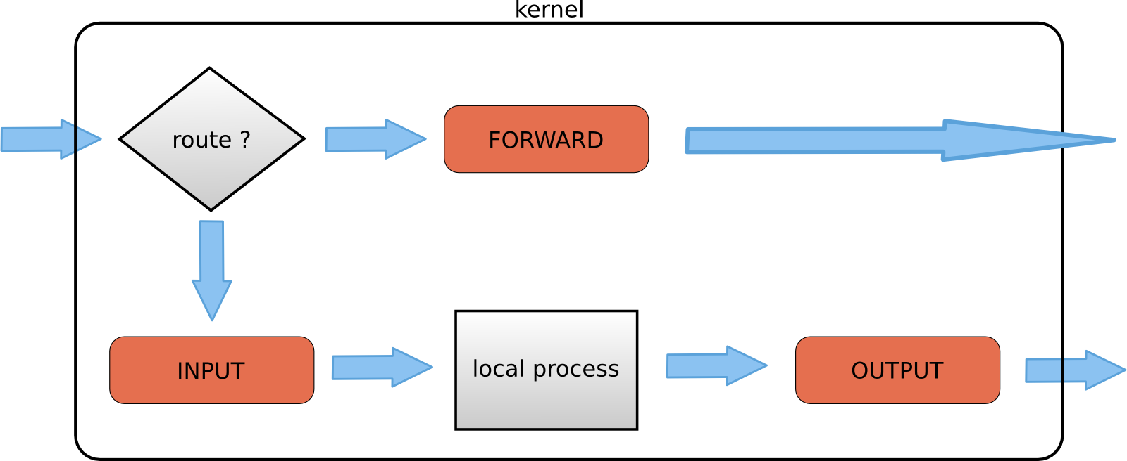
Chains in Iptables
When a packet reaches a in the diagram, that chain is examined to decide the fate of the packet. If the chain says to DROP the packet, it is killed there; if the chain says to ACCEPT the packet, it continues traversing the diagram
A chain is a checklist of rules: “if the packet header looks like this, then here's what to do with the packet”
chain

Slide 11
Chains in Iptables
When a packet comes in (say, through the Ethernet card) the kernel first looks at the destination of the packet: this is called routing
If it's destined for this box, the packet passes downwards to the INPUT chain. If it passes this, any processes waiting for that packet will receive it
Otherwise, if the kernel does not have forwarding enabled, or it doesn't know how to forward the packet, the packet is dropped. If forwarding is enabled, and the packet is destined for another network interface (if you have another one), then the packet goes rightwards on our diagram to the FORWARD chain. If it is ACCEPTed, it will be sent out
Finally, a program running on the box can send network packets. These packets pass through the OUTPUT chain immediately: if it says ACCEPT, then the packet continues out to whatever interface it is destined for

Slide 12
Linux iptables
Supports 4 tables: filter, nat, mangle, and raw
iptables -L == iptables -L –t filter
iptables -t filter -X
// delete user-defined chains

Slide 13
Stop Pinging
iptables -A INPUT -p icmp --icmp-type echo-request -j DROP
-A INPUT: append a new rule to the INPUT chain of the filter table
-p icmp: specifies the rule to be applied to ICMP packets only
--icmp-type echo-request: what specific subtype of ICMP packets this rule applies to
-j DROP: action to be taken (drop packets)
This rule says to drop all incoming ICMP packets that are of type echo-request

Slide 14
Allow ssh but Nothing Else
$ iptables -A INPUT -p tcp --destination-port 22 -j ACCEPT
$ iptables -A INPUT -j REJECT
-A INPUT: append a new rule to the INPUT chain of the filter table
-p tcp: rule is applied to TCP packets
--destination-port: port # (/etc/services)
-j ACCEPT: accept all such packets
$ iptables –L and ping // check outputs
How about –j DROP in the sencond rule?
do ping
but nothing comes back (vs. REJECT with error message)
$ iptables –A INPUT –j DROP // check outputs

Slide 15
Allow ssh but Nothing Else
$ iptables -A INPUT -p tcp --destination-port 22 -j ACCEPT
$ iptables -A INPUT -j REJECT
cshen@vm-1:~$ sudo iptables -L
[sudo] password for cshen:
Chain INPUT (policy ACCEPT)
target prot opt source destination
ACCEPT tcp -- anywhere anywhere tcp dpt:ssh
REJECT all -- anywhere anywhere reject-with icmp-port-unreachable
Job of REJECT is to send back message Destination Port Unreachable
(default)

Slide 16
Reject All Connection Requests
[TCP] connection request: SYN packet
Use mangle table
iptables -t mangle -A PREROUTING -p tcp -m tcp --tcp-flags SYN NONE -j DROP
iptables –t mangle –L // check mangle table
Try ssh ?
Can you ping ?

Slide 17
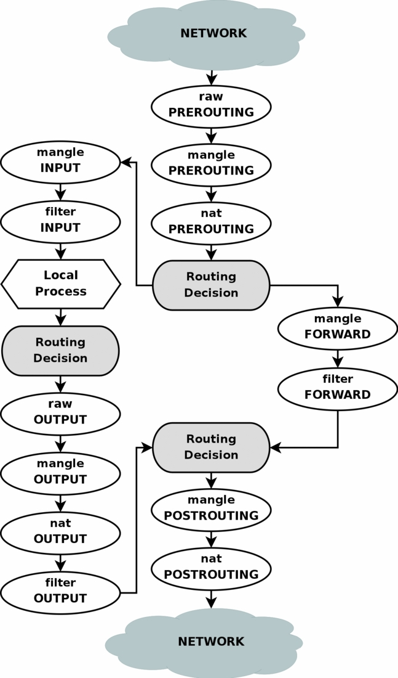
Chains & Tables
how packets traverse the different chains, and in which order
the order in which the tables are traversed

Slide 18
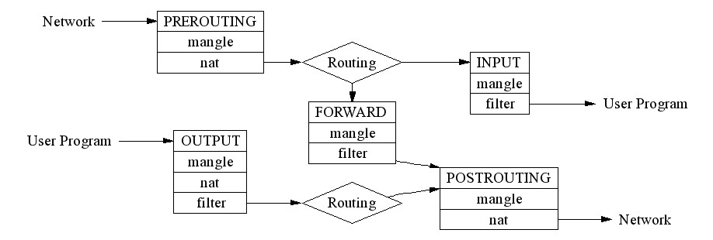
Four Tables
Four tables: filter, nat, mangle, raw
Each consists of rule chains
Each packet is subject to each of the rules in a table and the fate of the packet is decided by the first matching rule
In most common use cases you will only use two of these: filter and nat. The other tables are aimed at complex configurations involving multiple routers and routing decisions

Slide 19
filter Table
Contains at least three rule chains:
INPUT: for processing all incoming packets
OUTPUT: for processing all outgoing packets
FORWARD: for processing all packets being routed through the machine
INPUT, OUTPUT, and FORWARD of filter table are also referred to as built-in chains since they cannot be deleted (vs. user-defined chains)

Slide 20
Network Address Translation (NAT)
When your machine is connected to your home or small-business network and you are behind, say, a wireless router/access-point, you are in a private network (or realm with private addresses = a network whose addresses only have meaning to devices within that network)
The allowed address range is 10.0.0/24
When packet in private network is routed out to Internet at large, it is subject to NAT
Same things happens when packet from Internet at large is routed to your machine in private network; it is also subject to NAT, which would be the reverse of address translation carried out for outgoing packet

Slide 21

NAT: Network Address Translation
NAT translation table
WAN side addr LAN side addr
2: NAT router
changes datagram
source addr from
10.0.0.1, 3345 to
138.76.29.7, 5001,
updates table
1: host 10.0.0.1
sends datagram to
128.119.40.186, 80
138.76.29.7, 5001 10.0.0.1, 3345
…… ……
S: 10.0.0.1, 3345
D: 128.119.40.186, 80
10.0.0.1
1
2
S: 138.76.29.7, 5001
D: 128.119.40.186, 80
10.0.0.4
10.0.0.2
138.76.29.7
S: 128.119.40.186, 80
D: 10.0.0.1, 3345
4
S: 128.119.40.186, 80
D: 138.76.29.7, 5001
3
10.0.0.3
4: NAT router
changes datagram
dest addr from
138.76.29.7, 5001 to 10.0.0.1, 3345
3: reply arrives
dest. address:
138.76.29.7, 5001

Slide 22
nat Table
nat table is consulted when packet that creates a new connection is encountered
nat stands for Network Address Translation
When a machine acts as router, it would need to alter either source IP address in the packet passing through, or destination IP address, or both
Consists of three built-in chains:
PREROUTING for altering packets as soon as they come in
OUTPUT for altering locally-generated packets before routing
POSTROUTING for altering packets as they are about to go out

Slide 23
mangle Table
Used for specialized packet alteration
Has five rule chains:
PREROUTING for altering incoming packets before a routing decision is made concerning the packet
OUTPUT for altering locally generated outgoing packets
INPUT for altering packets coming into (destining to) the machine itself
FORWARD for altering packets being routed through the machine
POSTROUTING for altering packets immediately after the routing decision

Slide 24
raw Table
Used for configuring exceptions to connection tracking rules
specify a sequence of rules for connection tracking, but, at the same time, don’t want to expose a particular category of packets to those rules
for configuring packets so that they are exempt from connection tracking.
When a raw table is present, it takes priority over all other tables

Slide 25
security Table
used for Mandatory Access Control networking rules

Slide 26
Packet Processing in iptables
Tables consist of chains, which are lists of rules which are followed in order
The (default) filter table contains three built-in chains: INPUT, OUTPUT and FORWARD, which are activated at different points of the packet filtering process
The nat table includes PREROUTING, POSTROUTING, and OUTPUT chains
Packet filtering is based on rules, which are specified by multiple matches (conditions the packet must satisfy so that the rule can be applied), and one target (action taken when packet matches all conditions)
The typical things a rule might match on are
what interface the packet came in on (e.g., eth0 or eth1)
what type of packet it is (ICMP, TCP, or UDP), or
the destination port of the packet

Slide 27
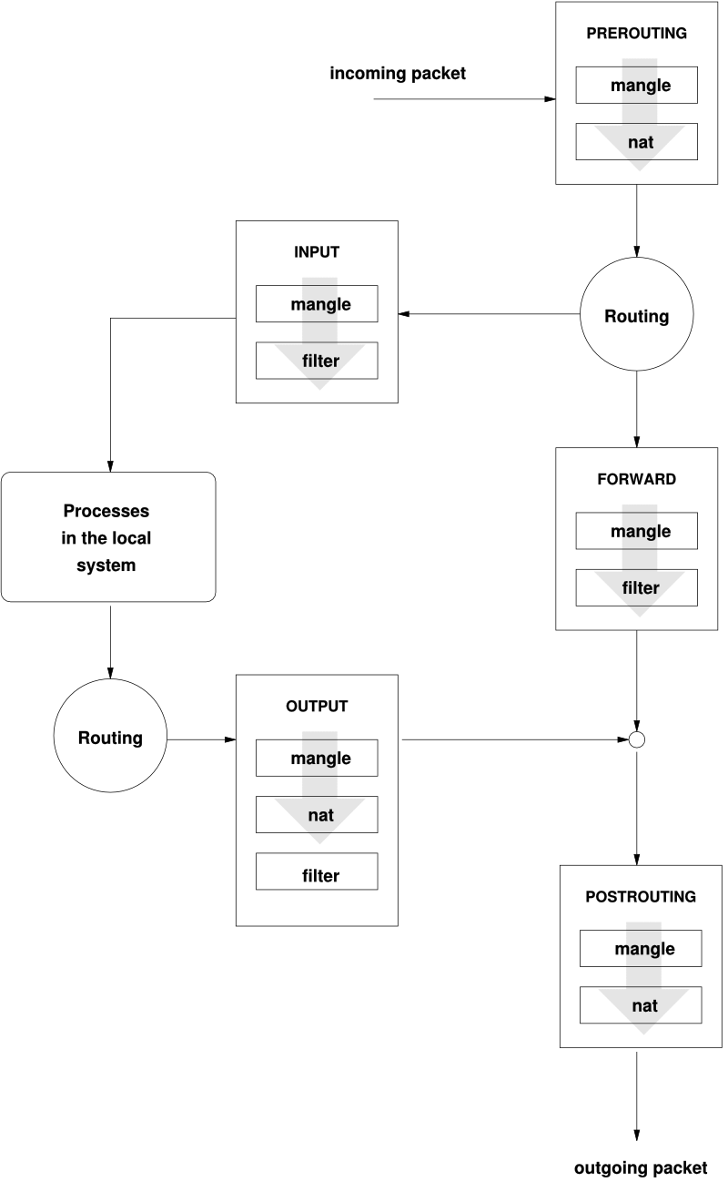
Packet Processing by filter Table
When packet comes in (say, through Ethernet NIC) kernel first looks at destination of packet (step labeled ‘routing’)
If routing decision is that packet is intended for the machine in which packet is being processed, packet passes to INPUT chain
If incoming packet is destined for another network interface on the machine, then packet goes to FORWARD chain. If accepted by FORWARD chain, packet is sent to the other interface
If program running on computer wants to send packet out of the machine, packet must traverse through OUTPUT chain. If it is accepted by any of the rules, it is sent to whatever interface packet is intended for
Each rule in a chain examines packet header. If condition part of rule matches packet header, action specified by rule is taken. Otherwise, packet moves on to next rule

Slide 28
Check Status of iptables
Execute as root lsmod | grep ip (show the status of modules in Linux kernel)
Or iptables –L for filter table (iptables –t nat –L)
Chain INPUT (policy ACCEPT) target prot opt source destination
Chain FORWARD (policy ACCEPT) target prot opt source destination
Chain OUTPUT (policy ACCEPT)
target prot opt source destination
Note policy shown for each built-in chain right next to name of chain
policy is what is applied to packet if it is not trapped by any rules in a chain

Slide 29
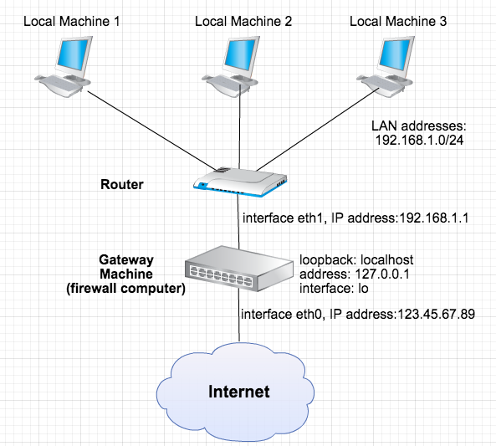
Firewall Scenario
Allow for unrestricted Internet access from all the machines in LAN
Allow for SSH access to the firewall machine from outside LAN
Permit Auth, that is used by services like SMTP and IRC
LAN is hosting a web server (on behalf of the whole LAN) and that this HTTPD server is running on machine 192.168.1.100. So the firewall must use NAT to redirect the incoming TCP port 80 requests to 192.168.1.100
Accept ICMP Echo requests coming from outside
Want firewall to respond back with TCP RST or ICMP Unreachable for incoming requests for blocked ports
Firewall must log filter statistics on the external interface of the firewall machine

Slide 30
Solution (1/2)
#! /bin/sh
# macro for external interface:
ext_if = "eth0" # macro for internal interface:
int_if = “eth1"
tcp_services = "22,113"
icmp_types = "ping"
comp_httpd = "192.168.1.100"
# NAT/Redirect modprobe ip_nat_ftp iptables -t nat -A POSTROUTING -o $ext_if -j MASQUERADE
iptables -t nat -i -A PREROUTING $ext_if -p tcp --dport 80 \
-j DNAT --to-destination $comp_httpd
# filter table rules # Forward only from external to webserver: iptables -A FORWARD -m state --state=ESTABLISHED,RELATED -j ACCEPT iptables -A FORWARD -i $ext_if -p tcp -d $comp_httpd --dport 80 --syn -j ACCEPT
# From internal is fine, rest rejected
iptables -A FORWARD -i $int_if -j ACCEPT
iptables -A FORWARD -j REJECT
Solution by Rusty Russell
https://en.wikipedia.org/wiki/Rusty_Russell
IP masquerade: one type of NAT that allows all hosts on a private network to use the Internet at the price of a single IP address

Slide 31
Solution (2/2)
# External can only come in to $tcp_services and $icmp_types iptables -A INPUT -m state --state=ESTABLISHED,RELATED -j ACCEPT iptables -A INPUT -i $ext_if -p tcp --dport $tcp_services --syn –j \
ACCEPT
for icmp in $icmp_types; do
iptables -A INPUT -p icmp --icmp-type $icmp -j ACCEPT
done
# Internal and loopback are allowed to send anything:
iptables -A INPUT -i $int_if -j ACCEPT iptables -A INPUT -i lo -j ACCEPT iptables -A INPUT -j REJECT
# logging
echo "1" > /proc/sys/net/ipv4/ip_forward

