Slide 1
Bot and Botnet
Chien-Chung Shen
cshen@udel.edu

Slide 2
Bots
Typically, viruses and worms are equipped with a certain fixed behavior. Any time they migrate to a new host, they try to engage in that same behavior
A bot is usually equipped with a larger repertoire of behaviors. Additionally, a bot maintains, directly or indirectly, a communication link with a human handler, known as a bot-master
The specific exploits that a bot engages in at any given time on any specific host depend on what commands it receives from bot-master
Bot does the bidding of the bot master
A bot-master can harness the power of several bots working together to bring about a result that could be more damaging than what can be accomplished by a single working all by itself
bots working together could mount a Distributed DoS attack
more difficult to squelch spam if it is spewing out simultaneously from several bots at random locations in a network
Rustock botnet (en.wikipedia.org/wiki/Rustock_botnet)

Slide 3
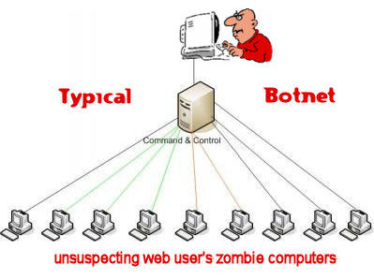
Botnets
A collection of bots working together for the same bot-master constitutes a botnet
Bot must have communication capabilities that allow it to receive commands and, in some cases, to return results to bot master
Command and control (C&C) structure
Modes of C&C server
Push: C&C Server acts like a broadcast server to broadcast the same message to all bots (IRC server)
Pull: bots send a request to the C&C server every once in a while for the latest commands (HTTPD server)

Slide 4
C&C of Botnet
Why IRC or HTTP?
botnet exploit is more likely to go undetected if communication between bots and C&C server uses standard protocols as opposed to some custom designed protocol
with standard protocols, it becomes much more difficult for packet sniffer and protocol analyzer to detect anomaly
Why C&C server?
indirection allows the communications between the human and the C&C server to be infrequent, making it that much harder to discover the human handler

Slide 5
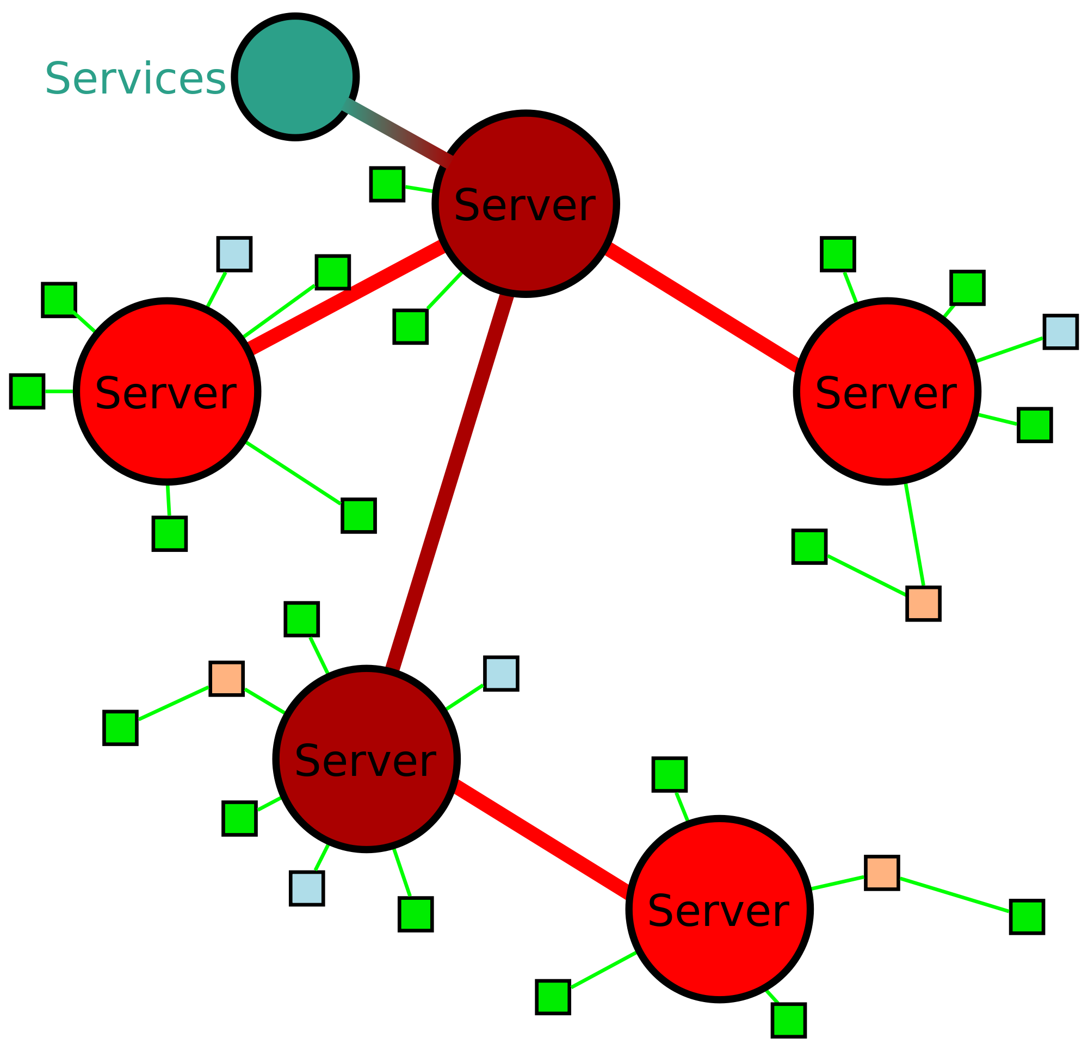
IRC Protocol
IRC: Internet Relay Chat
With regard to participating hosts, an IRC overlay can be thought of as spanning tree over underlying TCP/IP network of servers
the entire network looks like a single logical chat server to all the clients means that all of the individual servers must stay synchronized in real time with regard to the state of all the servers and of all the users in the network. It is this instant server-to-server synchronization that sets the IRC protocol apart from a run-of-the-mill chat server or, even, a social networking site

Slide 6
IRC Protocol
Each user in an IRC network is identified by a nickname that is commonly referred to as just “nick” for that user
The concept of a channel is fundamental to how the users organize themselves into different groups in an IRC network. By definition, a channel is simply a set of users
Local channel: local to each specific server
&localSchool => {a, b, c}
Global channel: global to all the servers
#movies => {a, b, x, y, z}

Slide 7
IRC Protocol
All messages, including those used for command and control, in an IRC network conform to the following syntax
1. an optional ’:’-prefixed string, followed by
2. a valid IRC command in ASCII, followed by
3. the arguments to the command
Sample commands
CONNECT <target server> [<port> [<remote server>]] INFO [<server>] JOIN <channel>{,<channel>} [<key>{,<key>}]
With regard to the use of IRC in botnets, channels can be made secret and users made invisible
Sending text to others
PRIVMSG #botnetUnderground :Hello Bots! Are you ready to wage war?
Writing an IRC bot in Python
https://gist.github.com/RobertSzkutak/1326452

Slide 8
Freenode IRC Network
If you are a fan of open source software in general, you should become familiar with the Freenode IRC network
http://en.wikipedia.org/wiki/Freenode
All of Ubuntu’s IRC channels are based on the Freenode servers
All of Wikipedia’s IRC channels (http://en.wikipedia.org/wiki/Wikipedia:IRC) are also on the Freenode network
The freenode network (irc.freenode.net) has "chat rooms" dedicated to Wikipedia 24 hours a day, in which Wikipedians can engage in real-time discussions with each other. Many Wikipedians have chatting open in one window and hop back and forth between it and other windows in which they are working on Wikipedia

