Slide 1
Phase Ordering
  Presented by: Sameer Kulkarni
  Dept of Computer & Information Sciences
  University of Delaware

Slide 2
Optimization??
does it really work??

Slide 3
No. of optimizations
O64 = 264 (on last count)
JikesRVM = 67

Slide 4
Search space
Consider a hypothetical case where we apply 40 optimizations
O64 : 3.98 x 10⁴⁷
Jikes: 4.1 x 10¹⁸

Slide 5
Could take a while
Considering the smaller problem, assume that running all the benchmarks take just 1 sec to run
Jikes would take: 130.2 billion years
Age of the universe 13 billion years

Slide 6
Some basic Optimizations
Constant Sub-expression Elimination
Loop Unrolling
Local Copy Prop
Branch Optimizations ...

Slide 7
Example
for(int i=0; i< 3;i++){
a = a + i + 1;
}
Loop Unrolling
CSE

Slide 8
Instruction Scheduling vs
Register Allocation
Maximizing Parallelism → IS
Minimizing Register Spilling → RA
Notes:
Instruction scheduling may be done either before or after register allocation or both before and after it. The advantage of doing it before register allocation is that this results in maximum parallelism. The disadvantage of doing it before register allocation is that this can result in the register allocator needing to use a number of registers exceeding those available. This will cause spill/fill code to be introduced which will reduce the performance of the section of code in question.
If the architecture being scheduled has instruction sequences that have potentially illegal combinations (due to a lack of instruction interlocks) the instructions must be scheduled after register allocation. This second scheduling pass will also improve the placement of the spill/fill code.
If scheduling is only done after register allocation then there will be false dependencies introduced by the register allocation that will limit the amount of instruction motion possible by the scheduler.

Slide 9
Phase Ord. vs Opt Levels
Opt Levels ~ Timing Constraints
Phase ordering ~ code interactions
Notes:
Phase ordering is different from Optimization levels
Opt Levels choose opt based on the time taken by them to optimize
Phase ordering aims at improving the final code by re-arranging the optimizations.
----- Meeting Notes (4/28/11 14:08) -----
One would think that base on the optimizations you would just need to know the best order to apply the optimizations,
However theorder would also change based on the code being compiled.

Slide 10
Whimsical??
Opt X would like to go before Opt Y, but not always.

Slide 11
Ideal Solution?
Oracle → Perfect sequence at the very start
Wise Man Solution → Given the present code predict the best optimization solution

Slide 12
Wise Man
Understand Compilers
Optimizations
Source Code
?

Slide 13
Possible Solutions
Pruning the search space
Genetic Algorithms
Estimating running times
Precompiled choices
Notes:
Have multiple images of the library and chose the best one depending on the architecture.

Slide 14
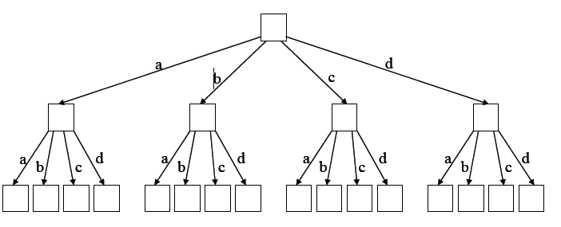
Pruning Search space
Fast and Efficient Searches for Effective Optimization Phase Sequences, Kulkarni et al. TACO 2005

Slide 15
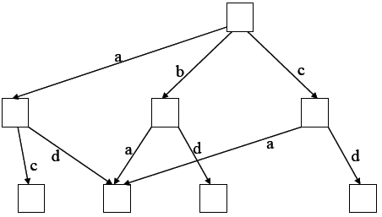
Optimization Profiling
Fast and Efficient Searches for Effective Optimization Phase Sequences, Kulkarni et al. TACO 2005
Notes:
Learn the interaction that one optimization has on other optimizations, and combine similar states

Slide 16
Genetic Algorithms
Fast Searches for Effective Optimization Phase Sequences, Kulkarni et al. PLDI ‘04

Slide 17
Exhaustive vs Heuristic [2]

Slide 18
Disadvantages
Benchmark Specific
Architecture dependent
Code disregarded
Notes:
Sequences that are found here may not be applicable to a different problem

Slide 19
Improvements
Profiling the application
Understand the code
Understanding optimizations
Continuous evaluation of transformations
Notes:
Sequences that are found here may not be applicable to a different problem

Slide 20
Proposed solution
Input = Code Features
Output = Running time
Evolve ➔Neural Networks
Notes:
Sequences that are found here may not be applicable to a different problem

Slide 21
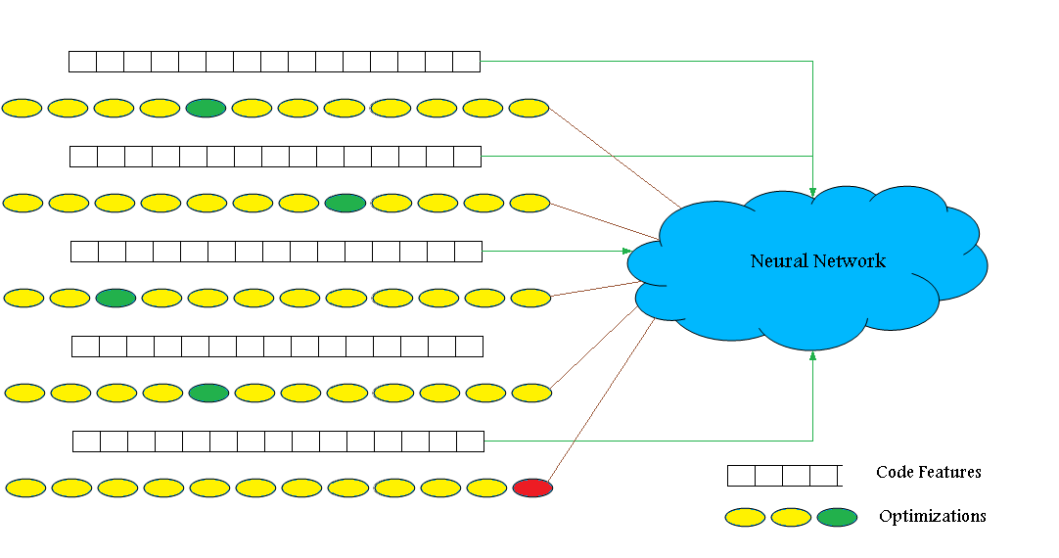
Proposed solution
Notes:
Sequences that are found here may not be applicable to a different problem

Slide 22
Experimental Setup
Neural Network Evolver (ANJI)
Training Set { javaGrande }
Testing Set { SpecJVM, Da Capo }

Slide 23
ANJI
Mutating & generating n/w s
Network → phase ordering
Timing Information
Scoring the n/w

Slide 24
Training Phase
Generations and Chromosomes
Random chromosomes
Back Propagation
Add/Remove/Update hidden nodes

Slide 25
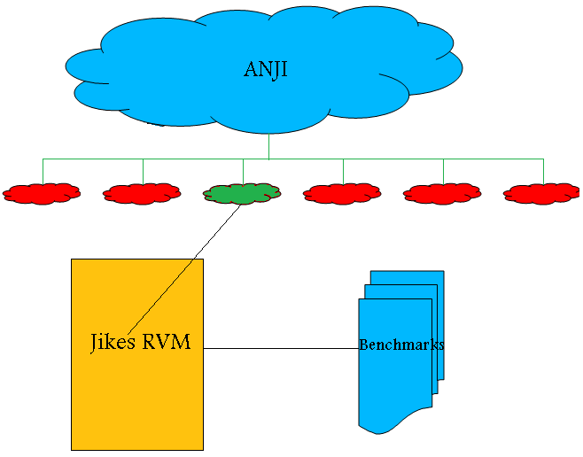
Experimental Setup
Notes:
Sequences that are found here may not be applicable to a different problem

Slide 26
Network Evolution
Notes:
Sequences that are found here may not be applicable to a different problem

Slide 27
Network Evolution
Notes:
Sequences that are found here may not be applicable to a different problem

Slide 28
javaGrande
Set of very small benchmarks
Low running times
Memory management
Machine Architecture

Slide 29
Testing
SpecJVM’98 & Da Capo
Champion n/w
Running times

Slide 30
Present Solution

Slide 31
Implementation in GCC
Milepost GCC
  Created for intelligent compilation
  Collecting source features
  Submitting features to common loc.
  Hooks into the Compilation process.

Slide 32
Possible Use Case

Slide 33
Structure for Phase Ordering
ANJI network from Source features

Slide 34
LLVM
Open Source Compiler
Modular Design
Easy to work with
All Optimizations are interchangeable

Slide 35
Questions
Most of the files and this presentation have been uploaded to http://www.cis.udel.edu/~skulkarn/ta.html
Notes:
What is JikesRVM and what it is not bytecode to machine code
Compilation : from website link, untar, run the java config command only once, create .ant.properties file. Run ant
Checking that it is working: rvm check path
How do you optimize, command line parameters.
Different IRs and optimization on the IRs.
For more information please go thru http://www.ugrad.cs.ubc.ca/~cs411/2006W2/handouts/jikes-IR-shane-brewer.pdf
Some Code snippets
Adding new CommandLine Parameters space sensitive

