Slide 1
Transport Layer
Our goals:
understand principles behind transport layer services:
  multiplexing/demultiplexing
  reliable data transfer
  flow control
  congestion control
learn about transport layer protocols in the Internet:
  UDP: connectionless transport
  TCP: connection-oriented transport
  TCP congestion control

Slide 2
Transport Layer – Topics
Review: multiplexing, connection and connectionless transport, services provided by a transport layer
UDP
Reliable transport
  Tools for reliable transport layer
    Error detection, ACK/NACK, ARQ
  Approaches to reliable transport
    Go-Back-N
    Selective repeat
  TCP
    Services
    TCP: Connection setup, acks and seq num, timeout and triple-dup ack, slow-start, congestion avoidance.

Slide 3

Transport Layer
application
transport
network
link
physical
messages
application
transport
network
link
physical
application
transport
network
link
physical
application
transport
network
link
physical
application
transport
network
link
physical
application
transport
network
link
physical
Key transport layer service: Send messages between Apps
Just specify the destination and the message and that’s it
Web Browser
App
Google Server
App
Transport
Transport
Network
Network
Key service the transport layer requires: Network should attempt to deliver segements.

Slide 4
Transport layer
Transfers messages between application in hosts
  For ftp you exchange files and directory information.
  For http you exchange requests and replies/files
  For smtp messages are exchanged
Services possibly provided
  Reliability
  Error detection/correction
  Flow/congestion control
  Multiplexing (support several messages being transported simultaneously)

Slide 5
Connection oriented / connectionless
TCP supports the idea of a connection
  Once listen and connect complete, there is a logical connection between the hosts.
  One can determine if the message was sent
UDP is connectionless
  Packets are just sent. There is no concept (supported by the transport layer) of a connection
  But the application can make a connection over UDP. So the application is each host will support the hand-shaking and monitoring the state of the “connection.”
There are other transport layer protocols such as SCTP besides TCP and UDP, but TCP and UDP are the most popular

Slide 6
TCP vs. UDP
Connection oriented
  Connections must be set up
  The state of the connection can be determined
Flow/congestion control
  Limits congestion in the network and end hosts
  Control how fast data can be sent
Larger Packet header
Automatically retransmits lost packets and reports if the message was not successfully transmitted
Check sum for error detection
Connectionless
  Connections do not need to be set-up
  No feedback provided as to whether packets were successfully delivered
No flow/congestion control
  Could cause excessive congestion and unfair usage
  Data can be sent exactly when it needs to be
Low overhead
Check sum for error detection

Slide 7
Applications and Transport Protocols
Application
TCP or UDP?
SMTP
TCP
Telnet
TCP
HTTP
TCP
FTP
TCP
NFS
TCP or UDP
Multimedia streaming via youtude
TCP
VoIP via Skype
UDP
DNS
UDP

Slide 8
Multiplexing with ports
Transport layer packet headers always contain source and destination port
IP headers have source and destination IPs
When a message is sent, the destination port must be known. However, the source port could be selected by the OS.
client
IP: A
server
IP: C
Client
IP:B
SP: 5775
App
P1
P4
P5
P6
DP: 80
P2
P1
P3
Transport
S-IP: B
D-IP:C
Network
TCP
SP: 9157
DP: 80
SP: 9157
S-IP: A
DP: 80
D-IP:C
S-IP: B
TCP
D-IP:C
TCP

Slide 9
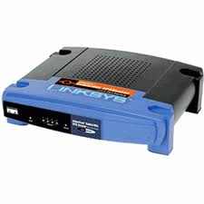
About multiplexing
HTTP usually has port 80 as the destination, but you can make a web server listen on any port that is not already used by another application
  ICANN registered ports (0-1024)
  HTTP: 80
  HTTP over SSL: 443
  FTP: 21
  Telnet: 23
  DNS: 53
  Microsoft server: 3389
  …
Typically, only one application can listen on a port at a time (tools such as PCAP can be used to listen on ports that are already in use. Wireshark uses PCAP)
For TCP, you cannot control the source port; the OS sets it. For UDP, you can set the source port.
A connection is defined as a 5 tuple: source IP, source port, destination IP, and destination port, and transport protocol.
NATs make use to these five pieces of information. NATs are discussed in detail in Chapter 4, but they are dependent on transport layer
Since connections are defined by ports and addresses, there cross layer dependencies (the transport layer cannot demultiplex without knowledge of the IP addresses, with is a concept of a different layer.)

Slide 10
Chapter 3 outline
3.1 Transport-layer services
3.2 Multiplexing and demultiplexing
3.3 Connectionless transport: UDP
3.4 Principles of reliable data transfer
3.5 Connection-oriented transport: TCP
  segment structure
  reliable data transfer
  flow control
  connection management
3.6 Principles of congestion control
3.7 TCP congestion control

Slide 11
UDP: User Datagram Protocol [RFC 768]
“no frills,” “bare bones” Internet transport protocol
“best effort” service, UDP segments may be:
  lost
  delivered out of order to app
connectionless:
  no handshaking between UDP sender, receiver
  each UDP segment handled independently of others
Why is there a UDP?
no connection establishment (which can add delay)
simple: no connection state at sender, receiver
small segment header
no congestion control: UDP can blast away as fast as desired

Slide 12
UDP: more
often used for streaming multimedia apps
  loss tolerant
  rate sensitive
other UDP uses
  DNS
  SNMP
reliable transfer over UDP: add reliability at application layer
  application-specific error recovery!
32 bits
Length, in
bytes of UDP
segment,
including
header
source port #
dest port #
length
checksum
Application
data
(message)
UDP segment format

Slide 13
UDP checksum
Goal: detect “errors” (e.g., flipped bits) in transmitted segment
Sender:
treat segment contents as sequence of 16-bit integers
checksum: addition (1’s complement sum) of segment contents
sender puts checksum value into UDP checksum field
Receiver:
compute checksum of received segment
check if computed checksum equals checksum field value:
  NO - error detected
  YES - no error detected. But maybe errors nonetheless? More later ….

Slide 14
Internet Checksum Example
Note
  When adding numbers, a carryout from the most significant bit needs to be added to the result
Example: add two 16-bit integers
1 1 1 1 0 0 1 1 0 0 1 1 0 0 1 1 0
1 1 1 0 1 0 1 0 1 0 1 0 1 0 1 0 1
1 1 0 1 1 1 0 1 1 1 0 1 1 1 0 1 1
1 1 0 1 1 1 0 1 1 1 0 1 1 1 1 0 0
1 0 1 0 0 0 1 0 0 0 1 0 0 0 0 1 1
wraparound
sum
checksum
Notes:
Kurose and Ross forgot to say anything about wrapping the carry and adding it to low order bit

Slide 15
Chapter 3 outline
3.1 Transport-layer services
3.2 Multiplexing and demultiplexing
3.3 Connectionless transport: UDP
3.4 Principles of reliable data transfer
3.5 Connection-oriented transport: TCP
  segment structure
  reliable data transfer
  flow control
  connection management
3.6 Principles of congestion control
3.7 TCP congestion control

Slide 16
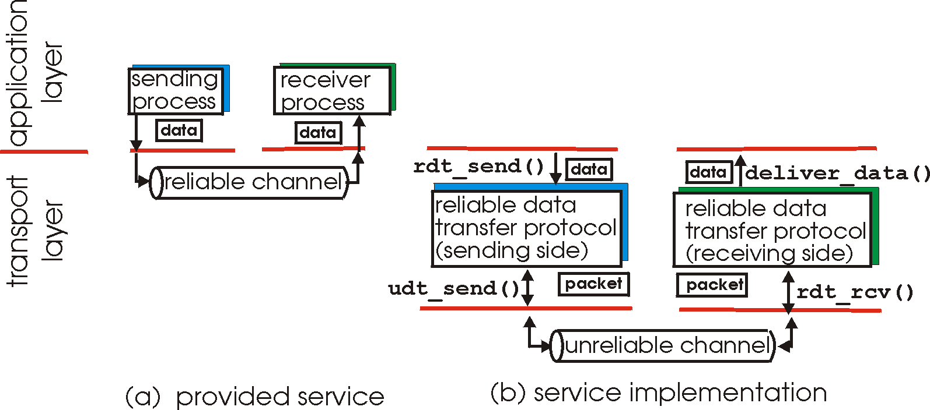
Principles of reliable data transfer

Slide 17
Principles of Reliable data transfer

Slide 18
Principles of reliable data transfer

Slide 19
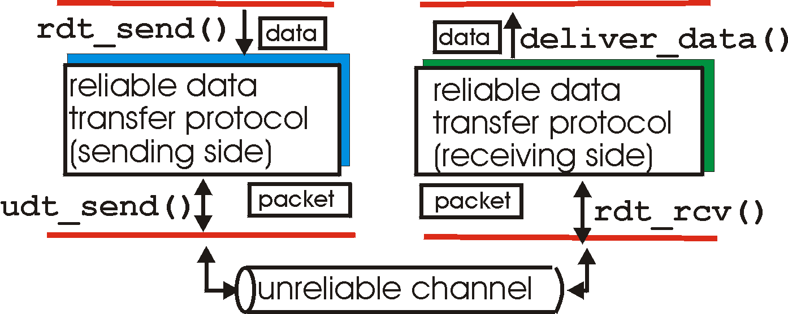
Reliable data transfer: getting started
rdt_send(): called from above, (e.g., by app.). Passed data to
deliver to receiver upper layer
deliver_data(): called by rdt to deliver data to upper
send
side
receive
side
udt_send(): called by rdt,
to transfer packet over
unreliable channel to receiver
rdt_rcv(): called when packet arrives on rcv-side of channel

Slide 20
Application implemented reliable data transfer
Application
Application
Main App
Main App
Application
Layer
reliable channel
communication
communication
Transport
Layer
UDP
unreliable channel
UDP
Pros and cons of implementing a reliable transport protocol in the application
Cons
It is already done by the OS, why “reinvent the wheel.”
The OS might have higher priority than the application.
Pros
The OS’s TCP is designed to work in every scenario, but your app might only exist in specific scenarios
  Network storage device
  Mobile phone
  Cloud app

Slide 21
Reliable data transfer: getting started
We’ll:
incrementally develop sender, receiver sides of reliable data transfer protocol (rdt)
consider only unidirectional data transfer
  but control info will flow on both directions!
use finite state machines (FSM) to specify sender, receiver
event causing state transition
actions taken on state transition
state: when in this “state” next state uniquely determined by next event
state
1
state
2
event
actions

Slide 22
Rdt1.0: reliable transfer over a reliable channel
Assume that the underlying channel is perfectly reliable
  no bit errors
  no loss of packets
Make separate FSMs for sender, receiver:
  sender sends data into underlying channel
  receiver read data from underlying channel
Wait for call from above
rdt_send(data)
Wait for call from below
rdt_rcv(segment)
segment = make_pkt(data)
udt_send(segment)
data = extract (segment)
deliver_data(data)
sender
receiver

Slide 23
Rdt2.0: channel with bit errors
underlying channel may flip bits in packets
  checksum to detect bit errors
the question: how to recover from errors:
  negative acknowledgements (NAKs): receiver explicitly tells sender that pkt had errors
    sender retransmits pkt on receipt of NAK
  acknowledgements (ACKs): receiver explicitly tells sender that pkt received OK
new mechanisms in rdt2.0 (beyond rdt1.0):
  error detection
  receiver feedback: control msgs (ACK,NAK) rcvr->sender

Slide 24
rdt2.0: FSM specification
rdt_send(data)
snkpkt = make_pkt(data, checksum)
udt_send(sndpkt)
receiver
Wait for call from above
Wait for ACK or NAK
Wait for call from below
sender
rdt_rcv(rcvpkt) && notcorrupt(rcvpkt)
extract(rcvpkt,data) deliver_data(data) udt_send(ACK)

Slide 25
rdt2.0: FSM specification
rdt_send(data)
snkpkt = make_pkt(data, checksum)
udt_send(sndpkt)
receiver
Wait for call from above
Wait for ACK or NAK
rdt_rcv(rcvpkt) && isACK(rcvpkt)
Wait for call from below
sender
rdt_rcv(rcvpkt) &&
notcorrupt(rcvpkt)
data = extract(rcvpkt)
deliver_data(data)
udt_send(ACK)

Slide 26
rdt2.0: FSM specification
rdt_send(data)
snkpkt = make_pkt(data, checksum)
udt_send(sndpkt)
receiver
rdt_rcv(rcvpkt) && isNAK(rcvpkt)
Wait for call from above
Wait for ACK or NAK
rdt_rcv(rcvpkt) && corrupt(rcvpkt)
udt_send(sndpkt)
udt_send(NAK)
rdt_rcv(rcvpkt) && isACK(rcvpkt)
Wait for call from below
sender
rdt_rcv(rcvpkt) &&
notcorrupt(rcvpkt)
data = extract(rcvpkt)
deliver_data(data)
udt_send(ACK)

Slide 27
rdt2.0 has a fatal flaw!
What happens if ACK/NAK corrupted?
sender doesn’t know what happened at receiver!
can’t just retransmit: possible duplicate
Handling duplicates:
sender retransmits current pkt if ACK/NAK garbled
sender adds sequence number to each pkt
receiver discards (doesn’t deliver up) duplicate pkt
stop and wait
Sender sends one packet,
then waits for receiver
response

Slide 28
rdt2.1: sender, handles garbled ACK/NAKs
rdt_send(data)
sndpkt = make_pkt(0, data, checksum)
udt_send(sndpkt)
rdt_rcv(rcvpkt) && (corrupt(rcvpkt) || isNAK(rcvpkt) )
Wait for call 0 from above
Wait for ACK or NAK 0
udt_send(sndpkt)
rdt_rcv(rcvpkt)
&& notcorrupt(rcvpkt)
&& isACK(rcvpkt)
rdt_rcv(rcvpkt) && notcorrupt(rcvpkt) && isACK(rcvpkt)
Wait for ACK or NAK 1
Wait for
call 1 from above
rdt_rcv(rcvpkt) &&
( corrupt(rcvpkt) ||
isNAK(rcvpkt) )
rdt_send(data)
udt_send(sndpkt)
sndpkt = make_pkt(1, data, checksum)
udt_send(sndpkt)

Slide 29
rdt2.1: receiver, handles garbled ACK/NAKs
rdt_rcv(rcvpkt) && !corrupt(rcvpkt) && has_seq0(rcvpkt)
extract(rcvpkt,data)
deliver_data(data)
sndpkt = make_pkt(ACK, chksum)
udt_send(sndpkt)
Wait for 0 from below
Wait for 1 from below

Slide 30
rdt2.1: receiver, handles garbled ACK/NAKs
rdt_rcv(rcvpkt) && !corrupt(rcvpkt) && has_seq0(rcvpkt)
extract(rcvpkt,data)
deliver_data(data)
sndpkt = make_pkt(ACK, chksum)
udt_send(sndpkt)
rdt_rcv(rcvpkt) && (corrupt(rcvpkt)
sndpkt = make_pkt(NAK, chksum)
udt_send(sndpkt)
Wait for 0 from below
Wait for 1 from below
rdt_rcv(rcvpkt) && ! corrupt(rcvpkt) && seqnum(rcvpkt)==1
sndpkt = make_pkt(ACK, chksum) udt_send(sndpkt)

Slide 31
rdt2.1: receiver, handles garbled ACK/NAKs
rdt_rcv(rcvpkt) && !corrupt(rcvpkt) && has_seq0(rcvpkt)
extract(rcvpkt,data)
deliver_data(data)
sndpkt = make_pkt(ACK, chksum)
udt_send(sndpkt)
rdt_rcv(rcvpkt) && (corrupt(rcvpkt)
rdt_rcv(rcvpkt) && (corrupt(rcvpkt)
sndpkt = make_pkt(NAK, chksum)
udt_send(sndpkt)
sndpkt = make_pkt(NAK, chksum)
udt_send(sndpkt)
Wait for 0 from below
Wait for 1 from below
rdt_rcv(rcvpkt) && ! corrupt(rcvpkt) && seqnum(rcvpkt)==1
rdt_rcv(rcvpkt) &&
not corrupt(rcvpkt) &&
has_seq0(rcvpkt)
sndpkt = make_pkt(ACK, chksum) udt_send(sndpkt)
sndpkt = make_pkt(ACK, chksum)
udt_send(sndpkt)
rdt_rcv(rcvpkt) && !corrupt(rcvpkt)
&& has_seq1(rcvpkt)
extract(rcvpkt,data)
deliver_data(data)
sndpkt = make_pkt(ACK, chksum)
udt_send(sndpkt)

Slide 32
rdt2.1: sender, handles garbled ACK/NAKs
rdt_send(data)
sndpkt = make_pkt(0, data, checksum)
udt_send(sndpkt)
rdt_rcv(rcvpkt) &&
( corrupt(rcvpkt) ||
isNAK(rcvpkt) )
Wait for call 0 from above
Wait for ACK or NAK 0
udt_send(sndpkt)
rdt_rcv(rcvpkt)
&& notcorrupt(rcvpkt)
&& isACK(rcvpkt)
rdt_rcv(rcvpkt)
&& notcorrupt(rcvpkt)
&& isACK(rcvpkt)
Λ
Λ
Wait for ACK or NAK 1
Wait for
call 1 from above
rdt_rcv(rcvpkt) &&
( corrupt(rcvpkt) ||
isNAK(rcvpkt) )
rdt_send(data)
udt_send(sndpkt)
sndpkt = make_pkt(1, data, checksum)
udt_send(sndpkt)

Slide 33
rdt2.1: receiver, handles garbled ACK/NAKs
rdt_rcv(rcvpkt) && notcorrupt(rcvpkt)
&& has_seq0(rcvpkt)
extract(rcvpkt,data)
deliver_data(data)
sndpkt = make_pkt(ACK, chksum)
udt_send(sndpkt)
rdt_rcv(rcvpkt) && (corrupt(rcvpkt)
rdt_rcv(rcvpkt) && (corrupt(rcvpkt)
sndpkt = make_pkt(NAK, chksum)
udt_send(sndpkt)
sndpkt = make_pkt(NAK, chksum)
udt_send(sndpkt)
Wait for
0 from below
Wait for
1 from below
rdt_rcv(rcvpkt) &&
not corrupt(rcvpkt) &&
has_seq1(rcvpkt)
rdt_rcv(rcvpkt) &&
not corrupt(rcvpkt) &&
has_seq0(rcvpkt)
sndpkt = make_pkt(ACK, chksum)
udt_send(sndpkt)
sndpkt = make_pkt(ACK, chksum)
udt_send(sndpkt)
rdt_rcv(rcvpkt) && notcorrupt(rcvpkt)
&& has_seq1(rcvpkt)
extract(rcvpkt,data)
deliver_data(data)
sndpkt = make_pkt(ACK, chksum)
udt_send(sndpkt)

Slide 34
rdt2.1: discussion
Sender:
seq # added to pkt
two seq. #’s (0,1) will suffice. Why?
must check if received ACK/NAK corrupted
twice as many states
  state must “remember” whether “current” pkt has 0 or 1 seq. #
Receiver:
must check if received packet is duplicate
  state indicates whether 0 or 1 is expected pkt seq #
note: receiver can not know if its last ACK/NAK received OK at sender

Slide 35
rdt2.2: a NAK-free protocol
same functionality as rdt2.1, using ACKs only
instead of NAK, receiver sends ACK for last pkt received OK
  receiver must explicitly include seq # of pkt being ACKed
duplicate ACK at sender results in same action as NAK: retransmit current pkt

Slide 36
rdt2.2: sender, receiver fragments
rdt_send(data)
sndpkt = make_pkt(0, data, checksum)
udt_send(sndpkt)
rdt_rcv(rcvpkt) &&
( corrupt(rcvpkt) ||
isACK(rcvpkt,1) )
Wait for call 0 from above
Wait for ACK
0
udt_send(sndpkt)
sender FSM
fragment
rdt_rcv(rcvpkt)
&& notcorrupt(rcvpkt)
&& isACK(rcvpkt,0)
rdt_rcv(rcvpkt) &&
(corrupt(rcvpkt) ||
has_seq1(rcvpkt))
Λ
Wait for
0 from below
receiver FSM
fragment
udt_send(sndpkt)
rdt_rcv(rcvpkt) && notcorrupt(rcvpkt)
&& has_seq1(rcvpkt)
extract(rcvpkt,data)
deliver_data(data)
sndpkt = make_pkt(ACK1, chksum)
udt_send(sndpkt)
What happens if a pkt is duplicated?

Slide 37
rdt3.0: channels with errors and loss
New assumption: underlying channel can also lose packets (data or ACKs)
  checksum, seq. #, ACKs, retransmissions will be of help, but not enough
Approach: sender waits “reasonable” amount of time for ACK
retransmits if no ACK received in this time
if pkt (or ACK) just delayed (not lost):
  retransmission will be duplicate, but use of seq. #’s already handles this
  receiver must specify seq # of pkt being ACKed
requires countdown timer

Slide 38
rdt3.0 sender
rdt_send(data)
rdt_rcv(rcvpkt) &&
( corrupt(rcvpkt) ||
isACK(rcvpkt,1) )
sndpkt = make_pkt(0, data, checksum)
udt_send(sndpkt)
start_timer
Wait for
call 0from above
Wait for ACK0
timeout
udt_send(sndpkt)
start_timer
rdt_rcv(rcvpkt)
&& notcorrupt(rcvpkt)
&& isACK(rcvpkt,0)
stop_timer
Wait for
call 1 from above

Slide 39
rdt3.0 sender
rdt_send(data)
rdt_rcv(rcvpkt) &&
( corrupt(rcvpkt) ||
isACK(rcvpkt,1) )
sndpkt = make_pkt(0, data, checksum)
udt_send(sndpkt)
start_timer
rdt_rcv(rcvpkt)
Wait for
call 0from above
Wait for ACK0
timeout
udt_send(sndpkt)
start_timer
rdt_rcv(rcvpkt)
&& notcorrupt(rcvpkt)
&& isACK(rcvpkt,1)
rdt_rcv(rcvpkt)
&& notcorrupt(rcvpkt)
&& isACK(rcvpkt,0)
stop_timer
stop_timer
Wait for ACK1
Wait for
call 1 from above
timeout
udt_send(sndpkt)
start_timer
rdt_rcv(rcvpkt)
rdt_rcv(rcvpkt) &&
( corrupt(rcvpkt) ||
isACK(rcvpkt,0) )
rdt_send(data)
sndpkt = make_pkt(1, data, checksum)
udt_send(sndpkt)
start_timer

Slide 40
rdt3.0 in action
sender
receiver
sender
receiver
send pkt0
send pkt0
rec pkt0
rec pkt0
rec ack0
send ack0
send ack0
send pkt1
rec ack0
send pkt1
TO
rec pkt1
send ack1
resend pkt1
rec ack1
send pkt1
rec pkt1
send ack1
rec ack1
rec pkt1
send pkt2
time
rec pkt2
time

Slide 41
rdt3.0 in action
sender
receiver
sender
receiver
send pkt0
rec pkt0
send pkt0
send ack0
rec ack0
rec pkt0
send pkt1
send ack0
rec pkt1
rec ack0
TO
send pkt1
send ack1
rec pkt1
send pkt1
TO
send ack1
rec ack1
send pkt2
rec pkt1
send pkt1
send ack1
rec ack1
rec pkt2
rec pkt1
send no pkt (dupACK)
send ack1
send pkt?
send ack2
rec ack1
rec ack2
send pkt2
send pkt2
time
time

Slide 42
rdt3.0 sender
rdt_send(data)
rdt_rcv(rcvpkt) &&
( corrupt(rcvpkt) ||
isACK(rcvpkt,1) )
sndpkt = make_pkt(0, data, checksum)
udt_send(sndpkt)
start_timer
rdt_rcv(rcvpkt)
Wait for
call 0from above
Wait for ACK0
timeout
udt_send(sndpkt)
start_timer
rdt_rcv(rcvpkt)
&& notcorrupt(rcvpkt)
&& isACK(rcvpkt,1)
rdt_rcv(rcvpkt)
&& notcorrupt(rcvpkt)
&& isACK(rcvpkt,0)
stop_timer
stop_timer
Wait for ACK1
Wait for
call 1 from above
timeout
udt_send(sndpkt)
start_timer
rdt_rcv(rcvpkt)
rdt_rcv(rcvpkt) &&
( corrupt(rcvpkt) ||
isACK(rcvpkt,0) )
rdt_send(data)
sndpkt = make_pkt(1, data, checksum)
udt_send(sndpkt)
start_timer

Slide 43
Performance of rdt3.0
rdt3.0 works, but performance stinks
ex: 1 Gbps link, 15 ms prop. delay, 8000 bit packet and 100bit ACK:
  What is the total delay
    Data transmission delay
      8000/10⁹ = 8×10⁻⁶
    ACK Transmission delay
      100/10⁹ = 10⁻⁷ sec
    Total Delay
      2×15ms + .008 + .0001=30.0081ms
Utilization
  Time transmitting / total time
  .008 / 30.0081 = 0.00027
This is one pkt every 30msec or 33 kB/sec over a 1 Gbps link!
Is this only a problem on fast links? That is, was this a problem in 1974 when data rates were very low?

Slide 44
rdt3.0: stop-and-wait operation
sender
receiver
first packet bit transmitted, t = 0
last packet bit transmitted, t = L / R
first packet bit arrives
RTT
last packet bit arrives, send ACK
ACK arrives, send next
packet, t = RTT + L / R

Slide 45
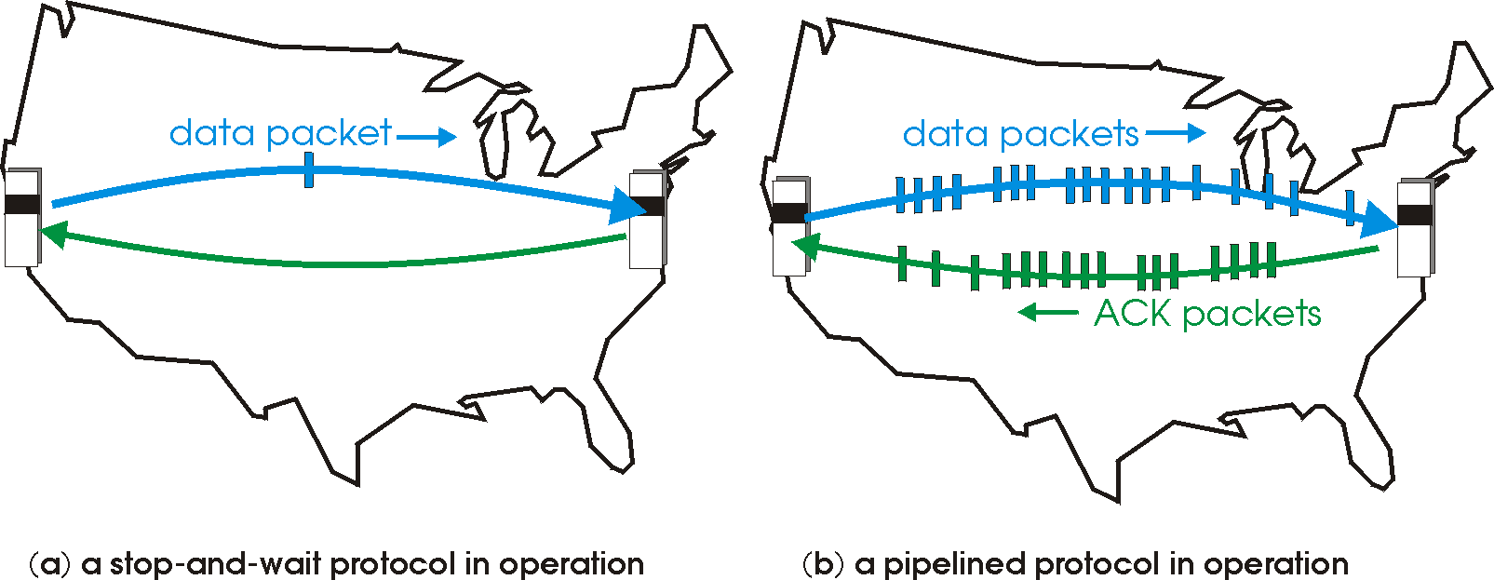
Pipelined protocols
Pipelining: sender allows multiple, “in-flight”, yet-to-be-acknowledged pkts
  range of sequence numbers must be increased
  buffering at sender and/or receiver
Two generic forms of pipelined protocols: go-Back-N, selective repeat

Slide 46
Pipelining: increased utilization
sender
receiver
first packet bit transmitted, t = 0
last bit transmitted, t = L / R
first packet bit arrives
RTT
last packet bit arrives, send ACK
last bit of 2nd packet arrives, send ACK
last bit of 3rd packet arrives, send ACK
ACK arrives, send next
packet, t = RTT + L / R
Increase utilization
by a factor of 3!

Slide 47
Pipelining Protocols
Go-back-N: big pic
Sender can have up to N unacked packets in pipeline
Rcvr only sends cumulative acks
  Doesn’t ack packet if there’s a gap
Sender has timer for oldest unacked packet
  If timer expires, retransmit all unacked packets
Selective Repeat: big pic
Sender can have up to N unacked packets in pipeline
Rcvr acks individual packets
Sender maintains timer for each unacked packet
  When timer expires, retransmit only unack packet

Slide 48
Go-Back-N
Sender:
k-bit seq # in pkt header
“window” of up to N, unack’ed pkts allowed
ACK(n): ACKs all pkts up to, including seq # n - “cumulative ACK”
  may receive duplicate ACKs (see receiver)
timer for each in-flight pkt
timeout(n): retransmit pkt n and all higher seq # pkts in window

Slide 49
Go-Back-N
State of pkts
Pkt that could be sent
unACKed pkt
ACKed pkt
Unused pkt
pkts
start
0 unACKed pkts
window
N=12
send pkt
1 unACKed pkts
window
Next pkt to be sent
send pkts
N unACKed pkts
window
ACK arrives
N-1 unACKed pkts
window
Sliding window
Send pkt
N unACKed pkts
window
N=12

Slide 50
Go-Back-N
Pkt that could be sent
unACKed pkt
ACKed pkt
Unused pkt
N unACKed pkts
window
ACK arrives
N-1 unACKed pkts
window
Send pkt
N unACKed pkts
window
N unACKed pkts
window
No ACK arrives …. timeout
0 unACKed pkts
window

Slide 51
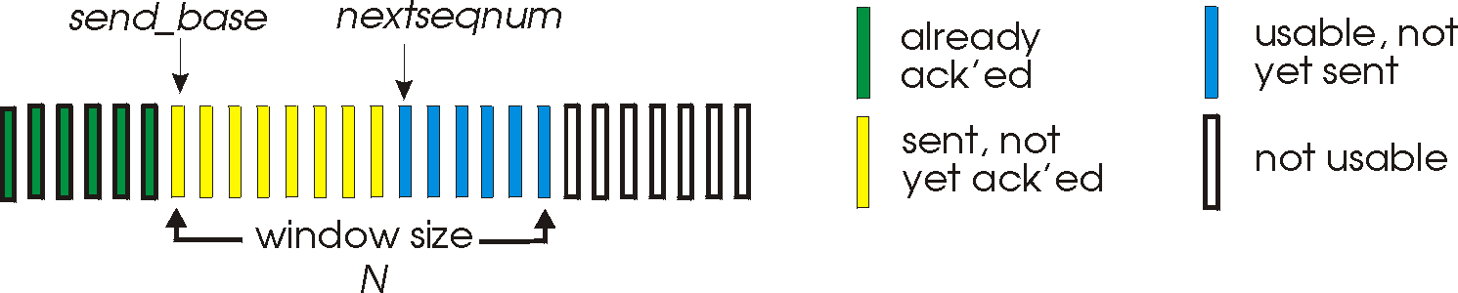
Go-Back-N
base

Slide 52
GBN: sender extended FSM
base
rdt_send(data)
if (nextseqnum < base+N) {
sndpkt[nextseqnum] = make_pkt(nextseqnum,data,chksum)
udt_send(sndpkt[nextseqnum])
startTimer(nextseqnum)
nextseqnum++
}
else
refuse_data(data)
start
base=1
nextseqnum=1
Wait
rdt_rcv(rcvpkt) && !corrupt(rcvpkt)
for i = base to getacknum(rcvpkt) { stop_timer(i)
}
base = getacknum(rcvpkt)+1

Slide 53
GBN: sender extended FSM
base
rdt_send(data)
if (nextseqnum < base+N) {
sndpkt[nextseqnum] = make_pkt(nextseqnum,data,chksum)
udt_send(sndpkt[nextseqnum])
startTimer(nextseqnum)
nextseqnum++
}
else
refuse_data(data)
start
base=1
nextseqnum=1
timeout
udt_send(sndpkt[base])
startTimer(base)
udt_send(sndpkt[base+1])
startTimer(base+1)
…
udt_send(sndpkt[nextseqnum-1])
startTimer(nextseqnum-1)
Wait
rdt_rcv(rcvpkt)
&& corrupt(rcvpkt)
rdt_rcv(rcvpkt) && !corrupt(rcvpkt)
for i = base to getacknum(rcvpkt) { stop_timer(i)
}
base = getacknum(rcvpkt)+1

Slide 54
GBN: sender extended Activity Diagram
Waiting for file
Set N
Set NextPktToSend=0
Set LastACKed=-1
Clear Timers(LastACKed+1 to NextPktToSend-1)
NextPktToSend = LastACKed+1
otherwise
Timer expires
NextPktToSend – LastACKed<N
Wait
Send pkt[NextPktToSend] with SeqNum= NextPktToSend
NextPktToSend++
Set Timer(NextPktToSend) = Now + TO
ACK arrived with ACKNum = AN
Clear Timers(LastACKed+1 to AN)
LastACKed = AN

Slide 55
GBN: Receiver Activity Diagram
start
Set NextPktToRec = 0
Clear ReceiverBuffer
Clear ReceivedPkts
ReceiverBase = 0
wait
Place Pkt in ReceiverBuffer[SeqNum]
ReceivedPkts[SeqNum]=1
otherwise
Send ACK with ACKNum = NextPktToRec - 1
ReceivedPkts[NextPktToRec] == 1
NextPktToRec++
Send pkt to app
Actually, there is not need for a receiver buffer

Slide 56
GBN: sender extended FSM
Using only one timer
base
rdt_send(data)
if (nextseqnum < base+N) {
sndpkt[nextseqnum] = make_pkt(nextseqnum,data,chksum)
udt_send(sndpkt[nextseqnum])
if (base == nextseqnum)
start_timer
nextseqnum++
}
else
refuse_data(data)
Λ
base=1
nextseqnum=1
timeout
Wait
start_timer
udt_send(sndpkt[base])
udt_send(sndpkt[base+1])
…
udt_send(sndpkt[nextseqnum-1])
rdt_rcv(rcvpkt)
&& corrupt(rcvpkt)
rdt_rcv(rcvpkt) &&
notcorrupt(rcvpkt)
base = getacknum(rcvpkt)+1
If (base == nextseqnum)
stop_timer
else
restart_timer

Slide 57
GBN: receiver extended FSM
expectedSeqNum
Received
!Received
rdt_rcv(rcvpkt) &&
(currupt(rcvpkt) || seqNum(rcvpkt)!=expectedSeqNum)
sndpkt = make_pkt(expectedSeqNum-1,ACK,chksum)
udt_send(sndpkt)
rdt_rcv(rcvpkt)
&& !currupt(rcvpkt)
&& seqNum(rcvpkt)==expectedSeqNum
start up
expectedSeqNum=1
Wait
extract(rcvpkt,data)
deliver_data(data)
sndpkt = make_pkt(expectedSeqNum,ACK,chksum)
udt_send(sndpkt)
expectedSeqNum++
CumACK-only: always send ACK for correctly-received pkt with highest in-order seq #
  may generate duplicate ACKs
  need only remember expectedSeqNum
wrong seq# arrives:
  discard (don’t buffer) -> no receiver buffering!
  Re-ACK pkt with highest in-order seq #

Slide 58
GBN in Action
sender
receiver
Send pkt0
Send pkt1
Send pkt2
Rec 0, give to app, and Send ACK=0
Send pkt3
Rec 1, give to app, and Send ACK=1
Rec 2, give to app, and Send ACK=2
Rec 3, give to app, and Send ACK=3
Send pkt4
Send pkt5
Send pkt6
Rec 4, give to app, and Send ACK=4
Send pkt7
Rec 5, give to app, and Send ACK=5
Send pkt8
Rec 7, discard, and Send ACK=5
Send pkt9
TO
Rec 8, discard, and Send ACK=5
Rec 9, discard, and Send ACK=5
Send pkt6
Send pkt7
Send pkt8
Send pkt9
Rec 6, give to app,. and Send ACK=6
Rec 7, give to app,. and Send ACK=7
Rec 8, give to app,. and Send ACK=8
Rec 9, give to app,. and Send ACK=9

Slide 59
Optimal size of N in GBN (or selective repeat)
sender
receiver
Send pkt0
Send pkt1
Send pkt2
Send pkt3
RTT
Send pkt4
Send pkt5
Send pkt6
Send pkt7

Slide 60
Optimal size of N in GBN (or selective repeat)
sender
receiver
Q: How large should N be?
A: Large enough so that the transmitter is constantly transmitting.
How many pkts can be transmitted before the first ACK arrives?
==
How many pkts can be transmitter in one RTT?
N = RTT / (L/R)
Send pkt0
Send pkt1
Send pkt2
Send pkt3
RTT
This is only a first crack at the size of N:
What if there are other data transfers sharing the link?
What if the receiver has a slower link than the transmitter?
What if some intermediate link is the slowest?
1Gbps
1Gbps
1Mbps
sender
1Mbps
1Gbps
sender
receiver
receiver

Slide 61
Selective Repeat
receiver individually acknowledges all correctly received pkts
  buffers pkts, as needed, for eventual in-order delivery to upper layer
sender only resends pkts for which ACK is not received
  sender timer for each unACKed pkt
sender window
  N consecutive seq #’s
  again limits seq #s of sent, unACKed pkts

Slide 62
Selective repeat in action
State of pkts
Pkt that could be sent
unACKed pkt
ACKed pkt
Unused pkt
Delivered to app
ACKed +
Buffered
Window
N=6
Window
N=6
Window
N=6
Window
N=6
Window
N=6
Window
N=6
Window
N=6
Window
N=6

Slide 63
Selective repeat in action
State of pkts
Pkt that could be sent
unACKed pkt
ACKed pkt
Unused pkt
Delivered to app
ACKed +
Buffered
Window
N=6
Window
N=6
Window
N=6
Window
N=6
Window
N=6
Window
N=6
Window
N=6
Window
N=6

Slide 64
Selective repeat in action
State of pkts
Pkt that could be sent
unACKed pkt
ACKed pkt
Unused pkt
Delivered to app
ACKed +
Buffered
Window
N=6
Window
N=6
Window
N=6
Window
N=6

Slide 65
Selective repeat in action
State of pkts
Pkt that could be sent
unACKed pkt
ACKed pkt
Unused pkt
Delivered to app
ACKed +
Buffered
Window
N=6
Window
N=6
Window
N=6
Window
N=6
TO

Slide 66
Selective repeat
sender
receiver
data from above :
if next available seq # in window, send pkt
timeout(n):
resend pkt n, restart timer
ACK(n) in [sendbase,sendbase+N]:
mark pkt n as received
if n smallest unACKed pkt, advance window base to next unACKed seq #
pkt n in [rcvbase, rcvbase+N-1]
send ACK(n)
out-of-order: buffer
in-order: deliver (also deliver buffered, in-order pkts), advance window to next not-yet-received pkt
pkt n in [rcvbase-N,rcvbase-1]
ACK(n)
otherwise:
ignore
sendbase
rcvbase
Window
N=6
Window
N=6

Slide 67
Summary of transport layer tools used so far
ACK and NACK
Sequence numbers (and no NACK)
Time out
Sliding window
  Optimal size = ?
Cumulative ACK
  Buffer at the receiver is optional
Selective ACK
  Requires buffering at the receiver

Slide 68
Chapter 3 outline
3.1 Transport-layer services
3.2 Multiplexing and demultiplexing
3.3 Connectionless transport: UDP
3.4 Principles of reliable data transfer
3.5 Connection-oriented transport: TCP
  segment structure
  reliable data transfer
  flow control
  connection management
3.6 Principles of congestion control
3.7 TCP congestion control

Slide 69
Go to other slides

Slide 70
TCP: Overview RFCs: 793, 1122, 1323, 2018, 2581
point-to-point:
  one sender, one receiver
reliable, in-order byte steam:
Pipelined and time-varying window size:
  TCP congestion and flow control set window size
send & receive buffers
full duplex data:
  bi-directional data flow in same connection
  MSS: maximum segment size
connection-oriented:
  handshaking (exchange of control msgs) init’s sender, receiver state before data exchange
flow controlled:
  sender will not overwhelm receiver

Slide 71
TCP segment structure
32 bits
URG: urgent data
(generally not used)
counting
by bytes
of data
(not segments!)
source port #
dest port #
sequence number
ACK: ACK #
valid
acknowledgement number
head
len
not
used
U
Receive window
A
P
R
S
PSH: push data now
(generally not used)
F
# bytes
rcvr willing
to accept
checksum
Urg data pnter
RST, SYN, FIN:
connection estab
(setup, teardown
commands)
Options (variable length)
application
data
(variable length)
Internet
checksum
(as in UDP)

Slide 72
TCP seq. #’s and ACKs
Seq. #’s:
  byte stream “number” of first byte in segment’s data
  It can be used as a pointer for placing the received data in the receiver buffer
ACKs:
  seq # of next byte expected from other side
  cumulative ACK
Host A
Host B
User
types
‘C’
Seq=42, ACK=79, data = ‘C’
host ACKs
receipt of
‘C’, echoes
back ‘C’
Seq=79, ACK=43, data = ‘C’
host ACKs
receipt
of echoed
‘C’
Seq=43, ACK=80
time
simple telnet scenario

Slide 73
Seq no and ACKs
Byte numbers
101
102
103
104
105
106
107
108
109
110
111
H
E
L
L
O
W
O
R
L
D
Seq no: 101
ACK no: 12
Data: HEL
Length: 3
Seq no: 12
ACK no:
Data:
Length: 0
104
Seq no: 104
ACK no: 12
Data: LO W
Length: 4
Seq no: 12
ACK no:
Data:
Length: 0
108

Slide 74
Seq no and ACKs - bidirectional
Byte numbers
101
102
103
104
105
106
107
108
109
110
111
12
13
14
15
16
17
18
H
E
L
L
O
W
O
R
L
D
G
O
O
D
B
U
Y
Seq no: 101
ACK no: 12
Data: HEL
Length: 3
12
Seq no:
ACK no:
Data: GOOD
Length: 4
104
104
Seq no:
ACK no:
Data: LO W
Length: 4
16
16
Seq no:
ACK no:
Data: BU
Length: 2
108

Slide 75
TCP Round Trip Time and Timeout
Q: how to set TCP timeout value (RTO)?
If RTO is too short: premature timeout
  unnecessary retransmissions
If RTO is too long:
  slow reaction to segment loss
Can RTT be used?
  No, RTT varies, there is no single RTT
  Why does RTT varying?
    Because statistical multiplexing results in queuing
How about using the average RTT?
  The average is too small, since half of the RTTs are larger the average
Q: how to estimate RTT?
SampleRTT: measured time from segment transmission until ACK receipt
  ignore retransmissions
SampleRTT will vary, want estimated RTT “smoother”
  average several recent measurements, not just current SampleRTT

Slide 76
TCP Round Trip Time and Timeout
EstimatedRTT = (1- α)*EstimatedRTT + α*SampleRTT
Exponential weighted moving average
influence of past sample decreases exponentially fast
typical value: α = 0.125

Slide 77
Example RTT estimation:

Slide 78
TCP Round Trip Time and Timeout
Setting the timeout (RTO)
RTO = EstimtedRTT plus “safety margin”
  large variation in EstimatedRTT -> larger safety margin
first estimate of how much SampleRTT deviates from EstimatedRTT:
DevRTT = (1-β)*DevRTT +
β*|SampleRTT-EstimatedRTT|
(typically, β = 0.25)
Then set timeout interval:
RTO = EstimatedRTT + 4*DevRTT

Slide 79
TCP Round Trip Time and Timeout
RTO = EstimatedRTT + 4*DevRTT
Might not always work
RTO = max(MinRTO, EstimatedRTT + 4*DevRTT)
MinRTO = 250 ms for Linux
500 ms for windows
1 sec for BSD
So in most cases RTO = minRTO
Actually, when RTO>MinRTO, the performance is quite bad; there are many spurious timeouts.
Note that RTO was computed in an ad hoc way. It is really a signal processing and queuing theory question…

Slide 80
RTO details
ACK arrives, and so RTO timer is restarted
When a pkt is sent, the timer is started, unless it is already running.
When a new ACK is received, the timer is restarted
Thus, the timer is for the oldest unACKed pkt
  Q: if RTO=RTT+ε, are there many spurious timeouts?
  A: Not necessarily
RTO
RTO
RTO
RTO
This shifting of the RTO means that even if RTO<RTT, there might not be a timeout.
However, for the first packet sent, the timer is started. If RTO<RTT of this first packet, then there will be a spurious timeout.
While it is implementation dependent, some implementations estimate RTT only once per RTT.
The RTT of every pkt is not measured.
Instead, if no RTT is being measured, then the RTT of the next pkt is measured. But the RTT of retransmitted pkts is not measured
Some versions of TCP measure RTT more often.

Slide 81
Lost Detection
It took a long time to detect the loss with RTO
But by examining the ACK no, it is possible to determine that pkt 6 was lost
Specifically, receiving two ACKs with ACK no=6 indicates that segment 6 was lost
A more conservative approach is to wait for 4 of the same ACK no (triple-duplicate ACKs), to decide that a packet was lost
This is called fast retransmit
Triple dup-ACK is like a NACK
sender
receiver
Send pkt0
Send pkt2
Send pkt3
Rec 0, give to app, and Send ACK no= 1
Rec 1, give to app, and Send ACK no= 2
Rec 2, give to app, and Send ACK no = 3
Rec 3, give to app, and Send ACK no =4
Send pkt4
Send pkt5
Send pkt6
Rec 4, give to app, and Send ACK no = 5
Send pkt7
Rec 5, give to app, and Send ACK no = 6
Send pkt8
Rec 7, save in buffer, and Send ACK no = 6
Send pkt9
TO
Send pkt10
Rec 8, save in buffer, and Send ACK no = 6
Rec 9, save in buffer, and Send ACK no = 6
Send pkt11
Rec 10, save in buffer, and Send ACK no = 6
Send pkt12
Send pkt13
Rec 11, save in buffer, and Send ACK no = 6
Send pkt6
Rec 12, save in buffer, and Send ACK no= 6
Send pkt7
Rec 13, save in buffer, and Send ACK no=6
Send pkt8
Send pkt9
Rec 6, give to app,. and Send ACK no =14
Rec 7, give to app,. and Send ACK no =14
Rec 8, give to app,. and Send ACK no =14
Rec 9, give to app,. and Send ACK no=14

Slide 82
Fast Retransmit
sender
receiver
Send pkt0
Send pkt2
Send pkt3
Rec 0, give to app, and Send ACK no= 1
Rec 1, give to app, and Send ACK no= 2
Rec 2, give to app, and Send ACK no = 3
Rec 3, give to app, and Send ACK no =4
Send pkt4
Send pkt5
Send pkt6
Rec 4, give to app, and Send ACK no = 5
Send pkt7
Rec 5, give to app, and Send ACK no = 6
Send pkt8
Rec 7, save in buffer, and Send ACK no = 6
Send pkt9
first dup-ACK
Send pkt10
Rec 8, save in buffer, and Send ACK no = 6
Rec 9, save in buffer, and Send ACK no = 6
second dup-ACK
Send pkt11
Rec 10, save in buffer, and Send ACK no = 6
third dup-ACK
Send pkt6
Send pkt12
Rec 11, save in buffer, and Send ACK no = 6
Retransmit pkt 6
Rec 6, save in buffer, and Send ACK= 12
Send pkt13
Send pkt14
Rec 12, save in buffer, and Send ACK=13
Send pkt15
Send pkt16
Rec 13, give to app,. and Send ACK=14
Rec 14, give to app,. and Send ACK=15
Rec 15, give to app,. and Send ACK=16
Rec 16, give to app,. and Send ACK=17

Slide 83
TCP ACK generation [RFC 1122, RFC 2581]
Event at Receiver
Arrival of in-order segment with
expected seq #. All data up to
expected seq # already ACKed
Arrival of in-order segment with
expected seq #. One other
segment has ACK pending
Arrival of out-of-order segment
higher-than-expect seq. # .
Gap detected
Arrival of segment that
partially or completely fills gap
TCP Receiver action
Delayed ACK. Wait up to 500ms
for next segment. If no next segment,
send ACK
Immediately send single cumulative
ACK, ACKing both in-order segments
Immediately send duplicate ACK,
indicating seq. # of next expected byte
Immediate send ACK, provided that
segment starts at lower end of gap

Slide 84
Chapter 3 outline
3.1 Transport-layer services
3.2 Multiplexing and demultiplexing
3.3 Connectionless transport: UDP
3.4 Principles of reliable data transfer
3.5 Connection-oriented transport: TCP
  segment structure
  reliable data transfer
  flow control
  connection management
3.6 Principles of congestion control
3.7 TCP congestion control

Slide 85
TCP segment structure
32 bits
URG: urgent data
(generally not used)
counting
by bytes
of data
(not segments!)
source port #
dest port #
sequence number
ACK: ACK #
valid
acknowledgement number
head
len
not
used
U
Receive window
A
P
R
S
PSH: push data now
(generally not used)
F
# bytes
rcvr willing
to accept
checksum
Urg data pnter
RST, SYN, FIN:
connection estab
(setup, teardown
commands)
Options (variable length)
application
data
(variable length)
Internet
checksum
(as in UDP)

Slide 86
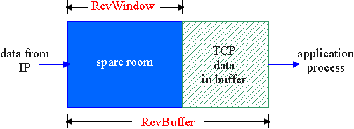
TCP Flow Control
flow control
sender won’t overflow
receiver’s buffer by
transmitting too much,
too fast
receive side of TCP connection has a receive buffer:
speed-matching service: matching the send rate to the receiving app’s drain rate
The sender never has more than a receiver windows worth of bytes unACKed
This way, the receiver buffer will never overflow
app process may be slow at reading from buffer

Slide 87
Flow control – so the receive doesn’t get overwhelmed.
The number of unacknowledged packets must be less than the receiver window.
As the receivers buffer fills, decreases the receiver window.
Seq#=20
Ack#=1001
Data = ‘Hi’, size = 2 (bytes)
SYN had seq#=14
Seq #
15
16
17
18
19
20
21
22
Seq#=1001
Ack#=22
Data size =0
Rwin=2
buffer
S
t
e
v
e
H
i
Seq#=22
Ack#=1001
Data = ‘By’, size = 2 (bytes)
15
16
17
18
19
20
21
22
S
t
e
v
e
H
i
B
y
Seq#=1001
Ack#=24
Data size =0
Rwin=0
The rBuffer is full
Application reads buffer
24
25
26
27
28
29
30
31
Seq#=1001
Ack#=24
Data size =0
Rwin=9
Seq#=4
Ack#=1001
Data = ‘e’, size = 1 (bytes)
24
25
26
27
28
29
30
31
e

Slide 88
Seq#=20
Ack#=1001
Data = ‘Hi’, size = 2 (bytes)
SYN had seq#=14
Seq #
15
16
17
18
19
20
21
22
Seq#=1001
Ack#=22
Data size =0
Rwin=2
buffer
S
t
e
v
e
H
i
Seq#=22
Ack#=1001
Data = ‘By’, size = 2 (bytes)
15
16
17
18
19
20
21
22
S
t
e
v
e
H
i
B
y
Seq#=1001
Ack#=24
Data size =0
Rwin=0
Application reads buffer
24
25
26
27
28
29
30
31
3 s
Seq#=1001
Ack#=24
Data size =0
Rwin=9
Seq#=4
Ack#=1001
Data = , size = 0 (bytes)
window probe
Seq#=1001
Ack#=24
Data size =0
Rwin=9
Seq#=4
Ack#=1001
Data = ‘e’, size = 1 (bytes)
24
25
26
27
28
29
30
31
e

Slide 89
Seq#=20
Ack#=1001
Data = ‘Hi’, size = 2 (bytes)
SYN had seq#=14
Seq #
15
16
17
18
19
20
21
22
Seq#=1001
Ack#=22
Data size =0
Rwin=2
buffer
S
t
e
v
e
H
i
Seq#=22
Ack#=1001
Data = ‘By’, size = 2 (bytes)
15
16
17
18
19
20
21
22
S
t
e
v
e
H
i
B
y
Seq#=1001
Ack#=24
Data size =0
Rwin=0
3 s
Seq#=4
Ack#=1001
Data = , size = 0 (bytes)
Seq#=1001
Ack#=24
Data size =0
Rwin=0
The buffer is still full
6 s
Max time between probes is 60 or 64 seconds
Seq#=4
Ack#=1001
Data = , size = 0 (bytes)

Slide 90
Receiver window
The receiver window field is 16 bits.
Default receiver window
  By default, the receiver window is in units of bytes.
  Hence 64KB is max receiver size for any (default) implementation.
  Is that enough?
    Recall that the optimal window size is the bandwidth delay product.
    Suppose the bit-rate is 100Mbps = 12.5MBps
    2^16 / 12.5M = 0.005 = 5msec
    If RTT is greater than 5 msec, then the receiver window will force the window to be less than optimal
    Windows 2K had a default window size of 12KB
Receiver window scale
  During SYN, one option is Receiver window scale.
  This option provides the amount to shift the Receiver window.
  Eg. Is rec win scale = 4 and rec win=10, then real receiver window is 10<<4 = 160 bytes.

Slide 91
Chapter 3 outline
3.1 Transport-layer services
3.2 Multiplexing and demultiplexing
3.3 Connectionless transport: UDP
3.4 Principles of reliable data transfer
3.5 Connection-oriented transport: TCP
  segment structure
  reliable data transfer
  flow control
  connection management
3.6 Principles of congestion control
3.7 TCP congestion control

Slide 92
TCP Connection Management
Recall: TCP sender, receiver establish “connection” before exchanging data segments
initialize TCP variables:
  seq. #s
  buffers, flow control info (e.g. RcvWindow)
  Establish options and versions of TCP
Three way handshake:
Step 1: client host sends TCP SYN segment to server
  specifies initial seq #
  no data
Step 2: server host receives SYN, replies with SYNACK segment
  server allocates buffers
  specifies server initial seq. #
Step 3: client receives SYNACK, replies with ACK segment, which may contain data

Slide 93
TCP segment structure
32 bits
URG: urgent data
(generally not used)
counting
by bytes
of data
(not segments!)
source port #
dest port #
sequence number
ACK: ACK #
valid
acknowledgement number
head
len
not
used
U
Receive window
A
P
R
S
PSH: push data now
(generally not used)
F
# bytes
rcvr willing
to accept
checksum
Urg data pnter
RST, SYN, FIN:
connection estab
(setup, teardown
commands)
Options (variable length)
application
data
(variable length)
Internet
checksum
(as in UDP)

Slide 94
Connection establishment
Seq no=2197
Ack no = xxxx
SYN=1
ACK=0
Reset the sequence number
Send SYN
The ACK no is invalid
Although no new data has arrived, the ACK no is incremented (2197 + 1)
Send SYN-ACK
Seq no = 12
ACK no = 2198
SYN=1
ACK=1
Send ACK
(for syn)
Although no new data has arrived, the ACK no is incremented (2197 + 1)
Seq no = 2198
ACK no = 13
SYN = 0
ACK =1

Slide 95
Connection with losses
SYN
Total waiting time
3+6+12+24+48+64 = 157sec
3 sec
SYN
2x3=6 sec
SYN
12 sec
SYN
64 sec
Give up

Slide 96
SYN Attack
attacker
SYN
Reserve memory for TCP connection.
Must reserve enough for the receiver buffer.
And that must be large enough to support high data rate
ignored
SYN-ACK
SYN
SYN
SYN
SYN
SYN
157sec
SYN
SYN
Victim gives up on first SYN-ACK and frees first chunk of memory

Slide 97
SYN Attack
attacker
SYN
ignored
SYN-ACK
SYN
Total memory usage:
  Memory per connection x number of SYNs sent in 157 sec
Number of syns sent in 157 sec:
  157 x 10Mbps / (SYN size x 8) = 157 x 31250 = 5M
Suppose Memory per connection = 20K
Total memory = 20K x 5M = 100GB … machine will crash
SYN
SYN
SYN
SYN
157sec
SYN
SYN

Slide 98
Defense from SYN Attack
attacker
SYN
If too many SYNs come from the same host, ignore them
ignored
SYN-ACK
SYN
SYN
SYN
ignore
SYN
ignore
SYN
ignore
SYN
ignore
SYN
ignore
Better attack
Change the source address of the SYN to some random address

Slide 99
SYN Cookie
Do not allocate memory when the SYN arrives, but when the ACK for the SYN-ACK arrives
The attacker could send fake ACKs
But the ACK must contain the correct ACK number
Thus, the SYN-ACK must contain a sequence number that is
  not predictable
  and does not require saving any information.
This is what the SYN cookie method does

Slide 100
TCP Connection Management (cont.)
Closing a connection:
Step 1: client end system sends TCP packet with FIN=1 to the server
Step 2: server receives FIN, replies with ACK with ACK no incremented Closes connection,
The server close its side of the conenction whenever it wants (by send a pkt with FIN=1)
client
server
close
FIN
ACK
close
FIN
ACK
timed wait
closed

Slide 101
TCP Connection Management (cont.)
Step 3: client receives FIN, replies with ACK.
  Enters “timed wait” - will respond with ACK to received FINs
Step 4: server, receives ACK. Connection closed.
Note: with small modification, can handle simultaneous FINs.
client
server
closing
FIN
ACK
closing
FIN
ACK
timed wait
closed
closed

Slide 102
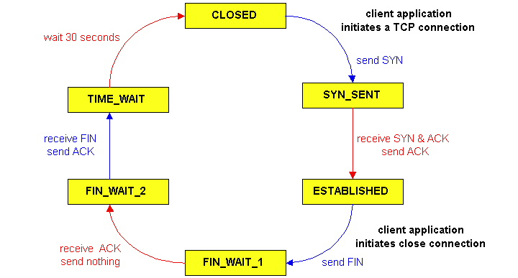
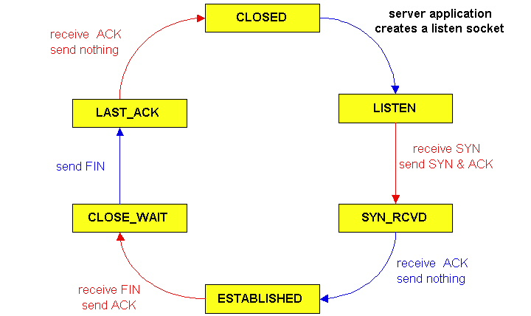
TCP Connection Management (cont)
TCP server
lifecycle
TCP client
lifecycle

Slide 103
Chapter 3 outline
3.1 Transport-layer services
3.2 Multiplexing and demultiplexing
3.3 Connectionless transport: UDP
3.4 Principles of reliable data transfer
3.5 Connection-oriented transport: TCP
  segment structure
  reliable data transfer
  flow control
  connection management
3.6 Principles of congestion control
3.7 TCP congestion control

Slide 104
Principles of Congestion Control
Congestion:
informally: “too many sources sending too much data too fast for network to handle”
different from flow control!
manifestations:
  lost packets (buffer overflow at routers)
  long delays (queueing in router buffers)
On the other hand, the host should send as fast as possible (to speed up the file transfer)
a top-10 problem!
  Low quality solution in wired networks
  Big problems in wireless (especially cellular)

Slide 105
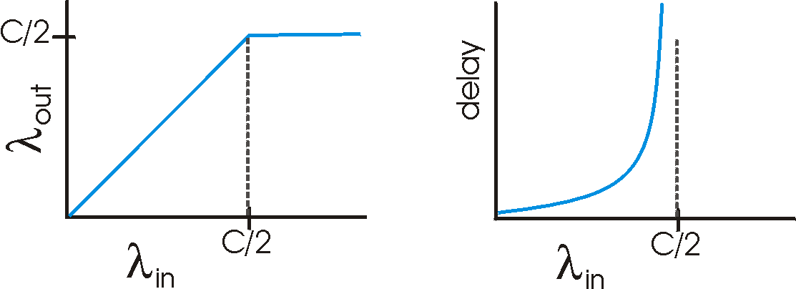
Causes/costs of congestion: scenario 1
two senders, two receivers
one router, infinite buffers
no retransmission
Host A
λ_{in} : original data
λ_{out}
Host B
unlimited shared output link buffers
large delays when congested
maximum achievable throughput

Slide 106
Causes/costs of congestion: scenario 2
one router, finite buffers
sender retransmission of lost packet
Host A
λ_{in} : original data
λ_{out}
λ'_{in} : original data, plus retransmitted data
Host B
finite shared output link buffers

Slide 107
Causes/costs of congestion: scenario 3
Q: what happens as λ_{in} increases?
The total data rate is the sending rate + the retransmission rate.
four senders
multihop paths
timeout/retransmit
Host A
λ_{in} : original data
λ_{out}
λ’: retransmitted data
finite shared output link buffers
A
Host B
B
D
Host C
C
Congestion at A will cause losses at router A and force host B to increase its sending rate of retransmitted pkts
This will cause congestion at router B and force host C to increase its sending rate
And so on

Slide 108
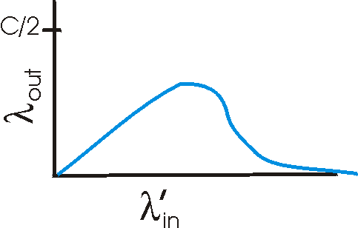
Causes/costs of congestion: scenario 3
Host A
λ_{out}
Host B
Another “cost” of congestion:
when packet dropped, any “upstream transmission capacity used for that packet was wasted!

Slide 109
Approaches towards congestion control
Two broad approaches towards congestion control:
End-end congestion control:
no explicit feedback from network
congestion inferred from end-system observed loss, delay
approach taken by TCP
Network-assisted congestion control:
routers provide feedback to end systems
  single bit indicating congestion (SNA, DECbit, TCP/IP ECN, ATM)
  explicit rate sender should send at (XCP)
Today, the network does not provide help to TCP. But this will likely change with wireless data networking

Slide 110
Chapter 3 outline
3.1 Transport-layer services
3.2 Multiplexing and demultiplexing
3.3 Connectionless transport: UDP
3.4 Principles of reliable data transfer
3.5 Connection-oriented transport: TCP
  segment structure
  reliable data transfer
  flow control
  connection management
3.6 Principles of congestion control
3.7 TCP congestion control

Slide 111
TCP congestion control: additive increase, multiplicative decrease (AIMD)
In go-back-N, the maximum number of unACKed pkts was N
In TCP, cwnd is the maximum number of unACKed bytes
TCP varies the value of cwnd
Approach: increase transmission rate (window size), probing for usable bandwidth, until loss occurs
  additive increase: increase cwnd by 1 MSS every RTT until loss detected
    MSS = maximum segment size and may be negotiated during connection establishment. Otherwise, it is set to 576B
  multiplicative decrease: cut cwnd in half after loss
Saw tooth
behavior: probing
for bandwidth
cwnd
time

Slide 112
Fast recovery
Upon the two DUP ACK arrival, do nothing. Don’t send any packets (InFlight is the same).
Upon the third Dup ACK,
  set SSThres=cwnd/2.
  Cwnd=cwnd/2+3
  Retransmit the requested packet.
Upon every DUP ACK, cwnd=cwnd+1.
If InFlight<cwnd, send a packet and increment InFlight.
When a new ACK arrives, set cwnd=ssthres (RENO).
When an ACK arrives that ACKs all packets that were outstanding when the first drop was detected, cwnd=ssthres (NEWRENO)

Slide 113
Congestion Avoidance (AIMD)
When an ACK arrives: cwnd = cwnd + 1 / floor(cwnd)
When a drop is detected via triple-dup ACK, cwnd = cwnd/2
cwnd
inflight
ssthresh
4000
0
0
SN: 1000
AN: 30
Length: 1000
4000
1000
0
4000
2000
0
SN: 2000
AN: 30
Length: 1000
4000
3000
0
SN: 3000
AN: 30
Length: 1000
SN: 30
AN: 2000
RWin: 10000
SN: 30
AN: 3000
RWin: 9000
4000
4000
0
SN: 4000
AN: 30
Length: 1000
SN: 30
AN: 4000
Rwin: 8000
SN: 30
AN: 2000
RWin: 7000
4250
3000
0
4250
4000
0
SN: 5000
AN: 30
Length: 1000
4500
3000
0
4500
4000
0
SN: 6000
AN: 30
Length: 1000
4750
3000
0
4750
4000
0
SN: 7000
AN: 30
Length: 1000/
5000
3000
0
5000
4000
0
SN: 8000
AN: 30
Length: 1000/
5000
5000
0
SN: 9000
AN: 30
Length: 1000/

Slide 114
Congestion Avoidance (AIMD)
When an ACK arrives: cwnd = cwnd + 1 / floor(cwnd)
When a drop is detected via triple-dup ACK, cwnd = cwnd/2
cwnd
inflight
ssthresh
8000
0
0
8000
1000
0
SN: 1MSS. L=1MSS
SN: 2MSS. L=1MSS
SN: 3MSS. L=1MSS
SN: 4MSS. L=1MSS
SN: 5MSS. L=1MSS
SN: 6MSS. L=1MSS
AN=2MSS
SN: 7MSS. L=1MSS
AN=3MSS
8000
8000
0
SN: 8MSS. L=1MSS
AN=4MSS
8125
8000
0
8250
8000
0
SN: 9MSS. L=1MSS
8375
8000
0
SN: 10MSS. L=1MSS
AN=4MSS
SN: 11MSS. L=1MSS
AN=4MSS
AN=4MSS
AN=4MSS
7000
8000
4000
3rd dup-ACK
AN=4MSS
8000
8000
4000
SN: 4MSS. L=1MSS
AN=4MSS
9000
9000
4000
SN: 12MSS. L=1MSS
10000
10000
4000
SN: 13MSS. L=1MSS
AN=12MSS
4000
2000
0
SN: 14MSS. L=1MSS
SN: 15MSS. L=1MSS

Slide 115
TCP Performance
Q2: at what rate does cwnd increase?
  How often does cwnd increase by 1
  Each RTT, cwnd increases by 1
dRate/dt = 1/RTT
Q1: What is the rate that packets are sent?
  How many pkts are send in a RTT?
  Rate = cwnd / RTT
Seq#
(MSS)
cwnd
4
1
2
3
RTT
4
2
3
4
5
4.25
5
4.5
6
4.75
7
5
8
5
9
6
7
8
RTT
5.2
10
9
5.4
11
10
5.6
12
5.8
13
11
6
14
12
15
13
14
15

Slide 116
TCP Start Up
What should the initial value of cwnd be?
  Option one: large, it should be a rough guess of the steady state value of cwnd
    But this might cause too much congestion
  Option two: do it more slowly = slow start
Slow Start
  Initially, cwnd = cwnd0 (typical 1, 2 or 3)
  When an non-dup ack arrives
    cwnd = cwnd + 1
  When a pkt loss is detected, exit slow start

Slide 117
Slow start
cwnd
SYN: Seq#=20 Ack#=X
SYN: Seq#=1000 Ack#=21
SYN: Seq#=21 Ack#=1001
1
Seq#=21 Ack#=1001 Data=‘…’ size =1000
2
Seq#=1001 Ack#=1021 size =0
Seq#=1021 Ack#=1001 Data=‘…’ size =1000
Seq#=2021 Ack#=1001 Data=‘…’ size =1000
3
Seq#=1001 Ack#=1021 size =0
Seq#=1021 Ack#=1001 Data=‘…’ size =1000
Seq#=1001 Ack#=1021 size =0
4
Seq#=2021 Ack#=1001 Data=‘…’ size =1000
Seq#=1021 Ack#=1001 Data=‘…’ size =1000
Seq#=2021 Ack#=1001 Data=‘…’ size =1000
5
6
7
8
4
Triple dup ack

Slide 118
drop
drops
Slow start
Congestion avoidance
After a drop in slow start, TCP switches to AIMD (congestion avoidance)
How quickly does cwnd increase during slow start?
How much does it increase in 1 RTT?
It roughly doubles each RTT – it grows exponentially
dcnwd/dt = 2 cwnd

Slide 119
Slow start
The exponential growth of cwnd during slow start can get a bit of control.
To tame things:
Initially:
  cwnd = 1, 2 or 3
  SSThresh = SSThresh0 (e.g., 44MSS)
When an new ACK arrives
  cwnd = cwnd + 1
  if cwnd >= SSThresh, go to congestion avoidance
  If a triple dup ACK occures, cwnd=cwnd/2 and go to congestion avoidance

Slide 120
TCP Behavior
Cwnd=ssthresh
drops
cwnd
Slow start
Congestion avoidance
drop
drops
cwnd
Slow start
Congestion avoidance

Slide 121
Time out?
Detecting losses with time out is considered to be an indication of severe
When time out occurs:
  Ssthresh = cwnd/2
  cwnd = 1
  RTO = 2xRTO
  Enter slow start

Slide 122
Time Out
cwnd
SSThresh
8
X
RTO
1
4
2
4
Cwnd = ssthresh => exit slow start and enter congestion avoidance
3
4
4
4
4.25
X
4.5
X
4.75
X
5
X

Slide 123
Time out
RTO
2xRTO
Give up if no ACK for ~120 sec
min(4xRTO, 64 sec)

Slide 124
Rough view of TCP congestion control
Cwnd=ssthres
drops
Slow start
Congestion avoidance
drop
drops
Slow start
Congestion avoidance
drop
drops
Slow start
Congestion
avoidance
Slow start

Slide 125
TCP Tahoe (old version of TCP)
Enter slow start after every loss
drop
drops
Slow start
Congestion
avoidance
Slow start

Slide 126
Summary of TCP congestion control
Theme: probe the system.
  Slowly increase cwnd until there is a packet drop. That must imply that the cwnd size (or sum of windows sizes) is larger than the BWDP.
  Once a packet is dropped, then decrease the cwnd. And then continue to slowly increase.
Two phases:
  slow start (to get to the ballpark of the correct cwnd)
  Congestion avoidance, to oscillate around the correct cwnd size.
Cwnd>ssthress
Triple dup ack
Connection
establishment
Slow-start
Congestion
avoidance
timeout
Connection
termination

Slide 127
Slow start state chart

Slide 128
Congestion avoidance state chart

Slide 129
TCP sender congestion control
State | Event | TCP Sender Action | Commentary
Slow Start (SS) | ACK receipt for previously unacked data | CongWin = CongWin + MSS, If (CongWin > Threshold) set state to “Congestion Avoidance” | Resulting in a doubling of CongWin every RTT
Congestion Avoidance (CA) | ACK receipt for previously unacked data | CongWin = CongWin+MSS * (MSS/CongWin) | Additive increase, resulting in increase of CongWin by 1 MSS every RTT
SS or CA | Loss event detected by triple duplicate ACK | Threshold = CongWin/2, CongWin = Threshold, Set state to “Congestion Avoidance” | Fast recovery, implementing multiplicative decrease. CongWin will not drop below 1 MSS.
SS or CA | Timeout | Threshold = CongWin/2, CongWin = 1 MSS, Set state to “Slow Start” | Enter slow start
SS or CA | Duplicate ACK | Increment duplicate ACK count for segment being acked | CongWin and Threshold not changed

Slide 130
TCP Performance 1: ACK Clocking
What is the maximum data rate that TCP can send data?
source
1Gbps
10Mbps
1Gbps
destination
Rate that pkts are sent = 1 pkt for each ACK
= 1 pkt every 1.2 msec
Rate that pkts are sent = 10 Mbps/pkt size
= 1 pkt each 1.2 msec
Rate that pkts are sent = 1 Gbps/pkt size
= 1 pkt each 12 usec
Rate that pkts are sent = 10 Mbps/pkt size
= 1 pkt each 1.2 msec
Rate that ACKs are sent: ACK 1 pkts = 10 Mbps/pkt size
= 1 ACK every 1.2 msec
Rate that ACKs are sent: ACK 1 pkts = 10 Mbps/pkt size
= 1 ACK every 1.2 msec
Rate that ACKs are sent: ACK 1 pkts = 10 Mbps/pkt size
= 1 ACK every 1.2 msec
The sending rate is the correct date rate. No congestion should occur!
This is due to ACK clocking; pkts are clocked our as fast as ACK arrive

Slide 131
TCP throughput

Slide 132
TCP throughput

Slide 133
TCP throughput
w
Mean value
= (w+w/2)/2
= w*3/4
w/2
Throughput = w/RTT = w*3/4/RTT

Slide 134
TCP Throughput
How many packets sent during one cycle (i.e., one tooth of the saw-tooth)?
The “tooth” starts at w/2, increments by one, up to w
w/2 + (w/2+1) + (w/2+2) + …. + (w/2+w/2)
= w/2 * (w/2+1) + (0+1+2+…w/2)
= w/2 * (w/2+1) + (w/2*(w/2+1))/2
= (w/2)^2 + w/2 + 1/2(w/2)^2 + 1/2w/2
= 3/2(w/2)^2 + 3/2(w/2)
~ 3/8 w^2
w/2 +1 terms
So one out of 3/8 w^2 packets is dropped.
This gives a loss probability of p = 1/(3/8 w^2)
Or w = sqrt(8/3) / sqrt(p)
Combining with the first eq.
Throughput = w*3/4/RTT = sqrt(8/3)*3/4 / (RTT * sqrt(p))
= sqrt(3/2) / (RTT * sqrt(p))

Slide 135
TCP Fairness
Fairness goal: if K TCP sessions share same bottleneck link of bandwidth R, each should have average rate of R/K
TCP connection 1
TCP
connection 2
bottleneck
router
capacity R

Slide 136
Why is TCP fair?
Two competing sessions:
Additive increase gives slope of 1, as throughout increases
multiplicative decrease decreases throughput proportionally
R
equal bandwidth share
loss: decrease window by factor of 2
congestion avoidance: additive increase
Connection 2 throughput
loss: decrease window by factor of 2
congestion avoidance: additive increase
Connection 1 throughput
R

Slide 137
RTT unfairness
Throughput = sqrt(3/2) / (RTT * sqrt(p))
A shorter RTT will get a higher throughput, even if the loss probability is the same
TCP connection 1
TCP
connection 2
bottleneck
router
capacity R
Two connections share the same bottleneck, so they share the same critical resources
A yet the one with a shorter RTT receives higher throughput, and thus receives a higher fraction of the critical resources

Slide 138
Fairness (more)
Fairness and UDP
Multimedia apps often do not use TCP
  do not want rate throttled by congestion control
Instead use UDP:
  pump audio/video at constant rate, tolerate packet loss
Research area: TCP friendly
Fairness and parallel TCP connections
nothing prevents app from opening parallel connections between 2 hosts.
Web browsers do this
Example: link of rate R supporting 9 connections;
  new app asks for 1 TCP, gets rate R/10
  new app asks for 11 TCPs, gets R/2 !

Slide 139
TCP problems: TCP over “long, fat pipes”
Example: 1500 byte segments, 100ms RTT, want 10 Gbps throughput
Requires window size W = 83,333 in-flight segments
Throughput in terms of loss rate:
➜ p = 2·10⁻¹⁰
  Random loss from bit-errors on fiber links may have a higher loss probability
New versions of TCP for high-speed
1
.
22
⋅
MSS
RTT
p

Slide 140
TCP over wireless
In the simple case, wireless links have random losses.
These random losses will result in a low throughput, even if there is little congestion.
However, link layer retransmissions can dramatically reduce the loss probability
Nonetheless, there are several problems
  Wireless connections might occasionally break.
    TCP behaves poorly in this case.
  The throughput of a wireless link may quickly vary
    TCP is not able to react quick enough to changes in the conditions of the wireless channel.

Slide 141
Chapter 3: Summary
principles behind transport layer services:
  multiplexing, demultiplexing
  reliable data transfer
  flow control
  congestion control
instantiation and implementation in the Internet
  UDP
  TCP
Next:
leaving the network “edge” (application, transport layers)
into the network “core”

