Slide 1
csta » pacse
Computer Science Teachers Association, Philadelphia Area Chapter
Tammy Pirmann, President

Slide 3
Why CSTA?
It is THE national organization for computer science educators
Resources!
K-12 Curriculum for Computer Science
Teacher certification, data and reports
National level advocacy for computer science education as a core subject
The SOURCE, a Web Repository of lesson plans

Slide 4
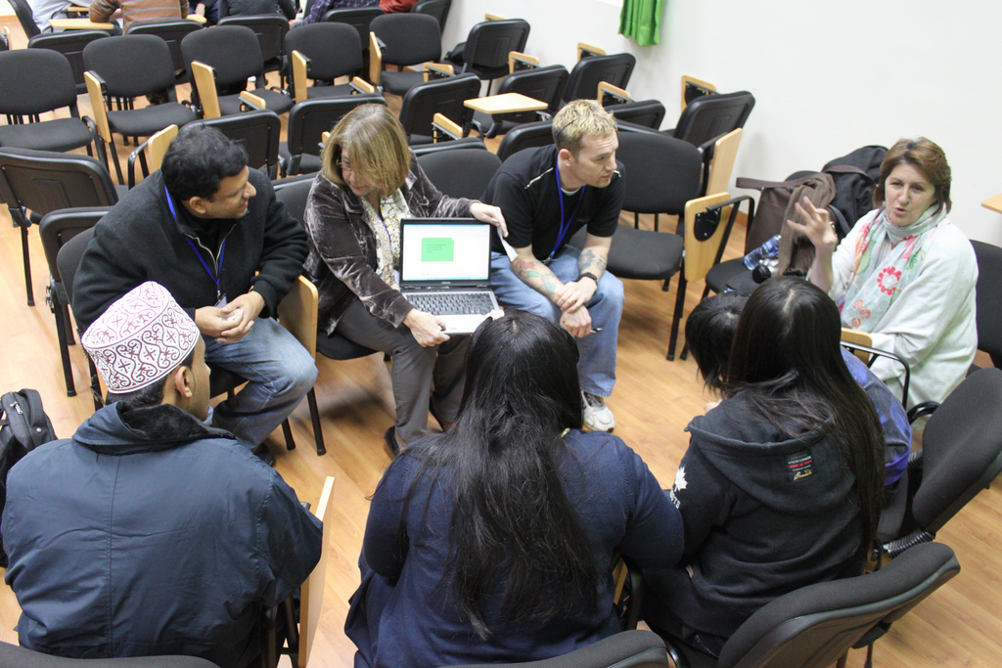

Slide 5
Why a Chapter?
Local chapter serves as your “department”
Connecting and sharing with other computer science teachers!
Promising practices
Course ideas
Pedagogy
Recruitment ideas

Slide 6
Promising Practices
Project based courses
Authentic learning
Service learning
Interdisciplinary projects/courses
Teaming students
Vertical inspiration
Process-Oriented Guided-Inquiry Learning

Slide 7
Projects
Application of knowledge and skills learned in the classroom
Can be a highly motivating problem that causes the student to seek out additional knowledge to solve the problem
Tougher to grade, but easier to share
Successfully completed projects can be used in recruitment

Slide 8
Authentic Learning
This is a type of learning that is meant to have relevance beyond the context of the classroom and past the final exam. It is learning that gives the learner skills and knowledge that will support them in their role as a worker, as a citizen and as a human being. --Rob Wall (robwall.ca)
No more bank account or prime number programs
Authentic audience for writing could be via a website or blog or wiki – who is going to read it?

Slide 9
Service Learning
Experiential education
Community service, frequently to younger people
Examples in CS:
HS students build a “quest” game for elementary students, the map is the middle school
MS students create a learning activity in Scratch or Alice for use by Kindergarten students
Students build an App of benefit to the community
Web site designed and built by students to serve a need in the community

Slide 10
Interdisciplinary Projects
CS is uniquely positioned for interdisciplinary projects
CS combines with EVERYTHING!
Science – scientific computing projects
Art – digital graphics and user interface design
Language – computers are used extensively for communication
Music – media computation projects

Slide 11
Teaming
Pair programming has been proven to be effective in programming courses
Lab partners are an established mode in all science courses
Social constructivism
Teams can be 2, 3, 4 or even larger
Important to allow students to talk about what they are learning with other students

Slide 12
Vertical Inspiration
Capstone courses generate a lot of personal excitement in students with regard to the project
Tap into that excitement by having capstone students present their project to the next lower level
Collaborate with a local college to provide an avenue for CS students to present projects to HS
HS senior students can present projects to MS students or HS freshmen
http://inspire-ct.org

Slide 13
POGIL
Process-oriented – focus on soft skills such as teamwork, leadership, and communication
Guided-inquiry – start with a well defined model and lead students to the desired concept with carefully structured questions
Teacher is a facilitator, not the source of all knowledge
Concepts “discovered” by the student stay with them longer than those “told” to them
http://pogil.org

Slide 14
Promising Models
Big Ideas course, breadth before depth
Computational thinking, logic and algorithms before learning a programming language
Media computation, students create images, sounds and video artifacts while learning programming
Robotics, both engineering heavy and engineering light types available, many programming languages to choose from

Slide 15
Promising Models
3-D virtual worlds such as Alice
Drag and drop programming such as Scratch, BYOB or AppInventor
Game Development
Serious games and simulations require the same skills as entertainment games
Some students are inherently drawn to gaming, but don’t focus too much on the “gamer” stereotype

Slide 16
Sharing
What models and practices have you found to show promise in your classroom?

Slide 17
Resources
csta.acm.org
ncwit.org
pogil.org
cspogil.org
inspire-ct.org
mediacomputation.org
csprinciples.org
byob.berkeley.edu
scratch.mit.edu
alice.org
unity3d.com
yoyogames.com

