Slide 1
Potions Class
Assistant Professor James Atlas
(on loan from the University of Delaware)

Slide 2
Pair Programming
James Atlas
Assistance Professor, University of Delaware

Slide 3
Pair programming basics
2 people working together on a program with 1 computer
Driver
Navigator
Switch roles approximately every 20 minutes

Slide 4
http://www.youtube.com/watch?v=rG_U12uqRhE
Notes:
3:55 start, 7:58 end

Slide 5
Questions?

Slide 6
Pair programming exercise
http://mazonka.com/subleq/online/hsqjs.cgi
subleq a, b, c ; Mem[b] = Mem[a] - Mem[b] ; if (Mem[b] ≤ 0) goto c
-1 9 -1 9 -1 6 9 9 0 0
The above code echoes the input
Write a program that increments the input by one
Notes:
-1 12 -1
0 12 6
12 -1 12
9 9 -1
0

Slide 7
What was your comfort level?
How well did you stick to your role?

Slide 8
My experiences
106 – CS1 for engineers, 80 students per section
All assignments are pair programming
108 – CS1 for majors and arts/sciences, 60 students
Project is pair programming (semester long project with 4 checkpoints)
Individual practice sets
220 – C++ / data structures, 60 students
5 pair programming assignments
Each assignment has individual reflection, diagramming, and code/algorithmic analysis

Slide 9
Advantages – the obvious
Higher quality programs in less time
Deeper understanding
Helps build supportive peer groups
Reduces grading labor
"real world" environment

Slide 10
Advantages – not so obvious
Reduces reliance on TA/instructor
Reduces cheating
Increases student confidence and sense of accomplishment
Works for a class with high variance in background **
Minimal change to existing courses

Slide 11
Implementation details
Buy-in (training)
Forming Pairs
Assessment

Slide 12
Buy-in (training)
Clear instruction in class about how to function as a pair
Videos, hand outs, and class exercises can help
All staff must be informed and supportive

Slide 13
Forming Pairs
Randomly
researchers at NC ST found this worked for 93% of pairs
Survey, matched criteria
Student choice

Slide 14
Assessment
Important to have, but the form of it not as important
Changing pairs forces its own assessment

Slide 15
Some unsolicited endorsements!
Computer science is not for me, but I like the fact that you get to work with a partner for most labs, its helps a lot
Pair programming today was pretty cool
Peer [sic] programming really helps students learn more about the subject together
I liked working with partners on all the labs. It was easier to learn that way

Slide 16
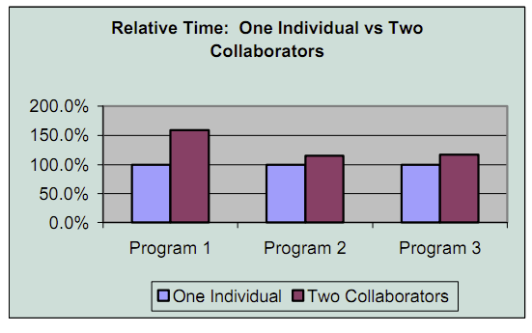
University of Utah, Junior/Senior Software Engineering
Cockburn & Williams, The Costs and Benefits of Pair Programming, 2000. avail: http://openseminar.org/se/modules/3/index/screen.do

Slide 17
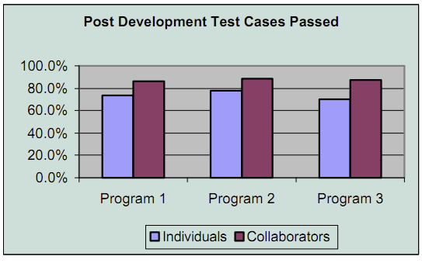
University of Utah, Junior/Senior Software Engineering
Cockburn & Williams, The Costs and Benefits of Pair Programming, 2000. avail: http://openseminar.org/se/modules/3/index/screen.do

Slide 18
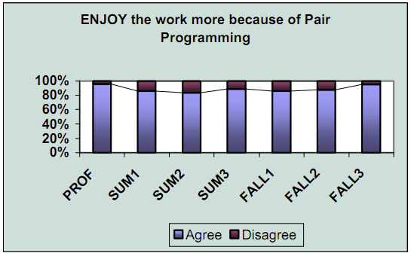
University of Utah, Junior/Senior Software Engineering
Cockburn & Williams, The Costs and Benefits of Pair Programming, 2000. avail: http://openseminar.org/se/modules/3/index/screen.do

Slide 19
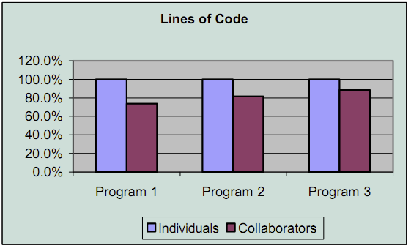
University of Utah, Junior/Senior Software Engineering
Cockburn & Williams, The Costs and Benefits of Pair Programming, 2000. avail: http://openseminar.org/se/modules/3/index/screen.do

Slide 20
Resources
Full implementation guide - NCWIT pair programming http://www.ncwit.org/resources.res.box.pair.html
Pair programming introduction video (thanks to Laurie Williams at NC ST)
http://www.youtube.com/watch?v=rG_U12uqRhE
Notes:
3:55 start, 7:58 end

