Slide 1

Gender & Computing
Joanne McGrath Cohoon
J. McGrath Cohoon, UVA, NCWIT
2011

Slide 2

The Big Picture
Data on diversity in computing in HS and college
Why few girls study computing
Slides for explaining why CS should be offered in HS

Slide 3
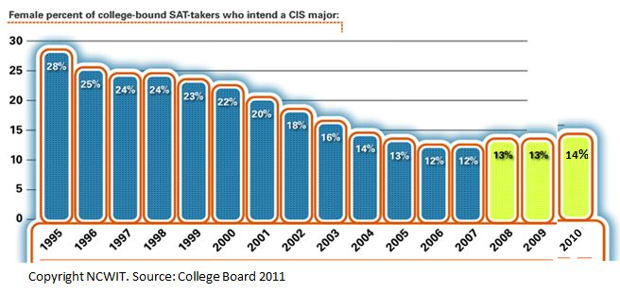
Few HS girls intend a CS major
Of major STEM fields, female representation got worse only in CS

Slide 4
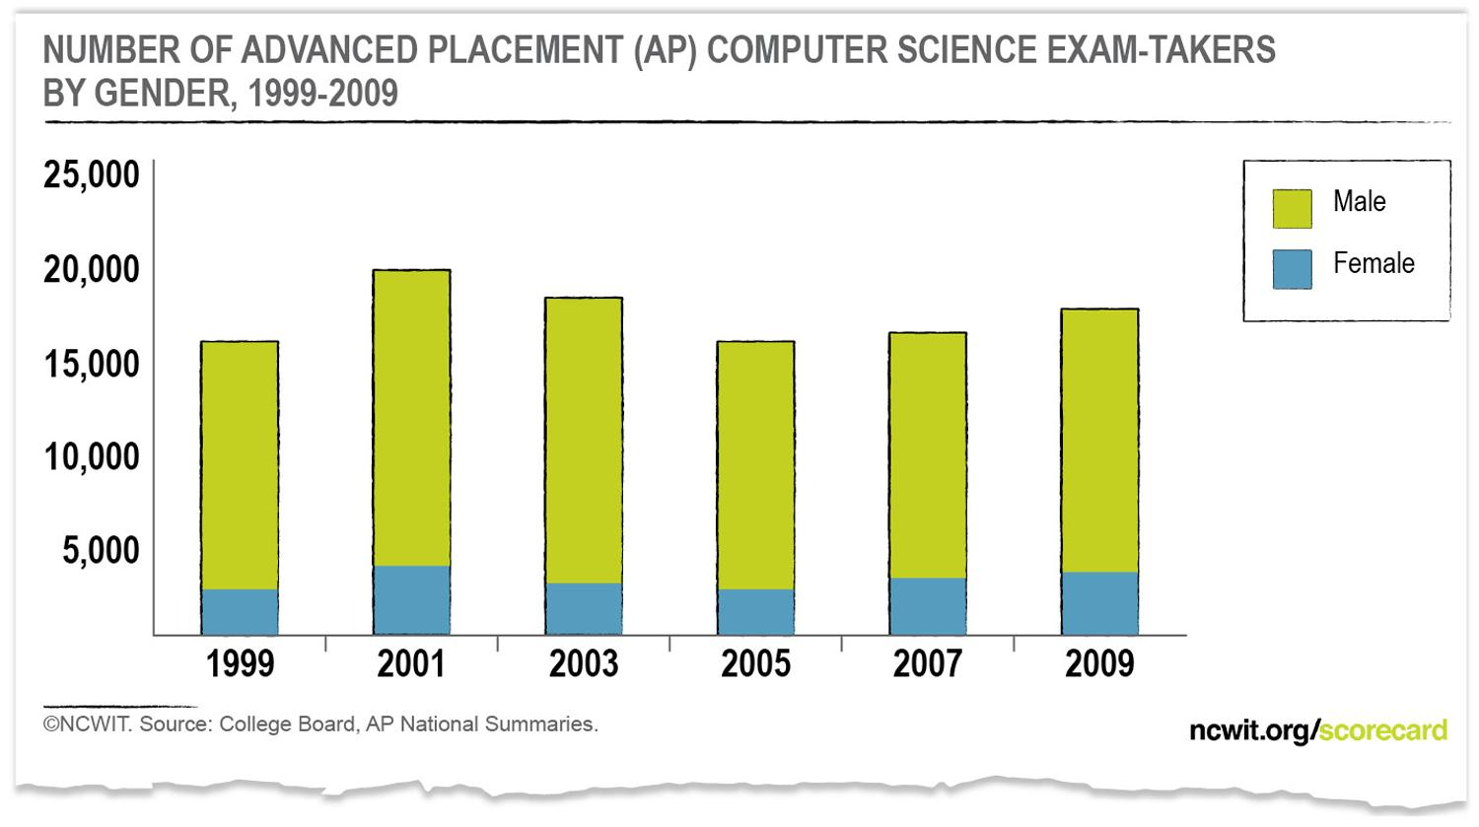
Low Participation in Advanced CS
Less than 1% of AP exam-takers took a CS exam in 2010
Girls were a small portion of them (19%)
Notes:
AP research indicates that students taking an AP exam in a given subject area are more likely to take college coursework in that area than students who had not taken the AP.
Yet only 1% of AP exam-takers – whether male or female -- took a computer science AP exam in 2009.
Increasing the number of girls – and boys – at this stage of the pipeline would be good news for an industry in need of able minds.
The number of girls taking the CS AP exam reached a high point in 2009 (3,861). The next highest number of girls taking the CS AP exam was in 2001 (3,531).

Slide 5
We Know Young Women Have Technical Potential
Young women make up the majority of:
Undergraduate degree recipients (57%)
AP Calculus test takers (51%)
YET
Computer & Information Sciences degree recipients (18%) (down from 37% in 1985)
AP Computer Science test takers(19%)
Notes:
Preaching to the choir, so you can go over this quickly.

Slide 6
CS Bachelor Degrees, 2009
n=6,779 women; 31,215 men Source: IPEDS

Slide 7
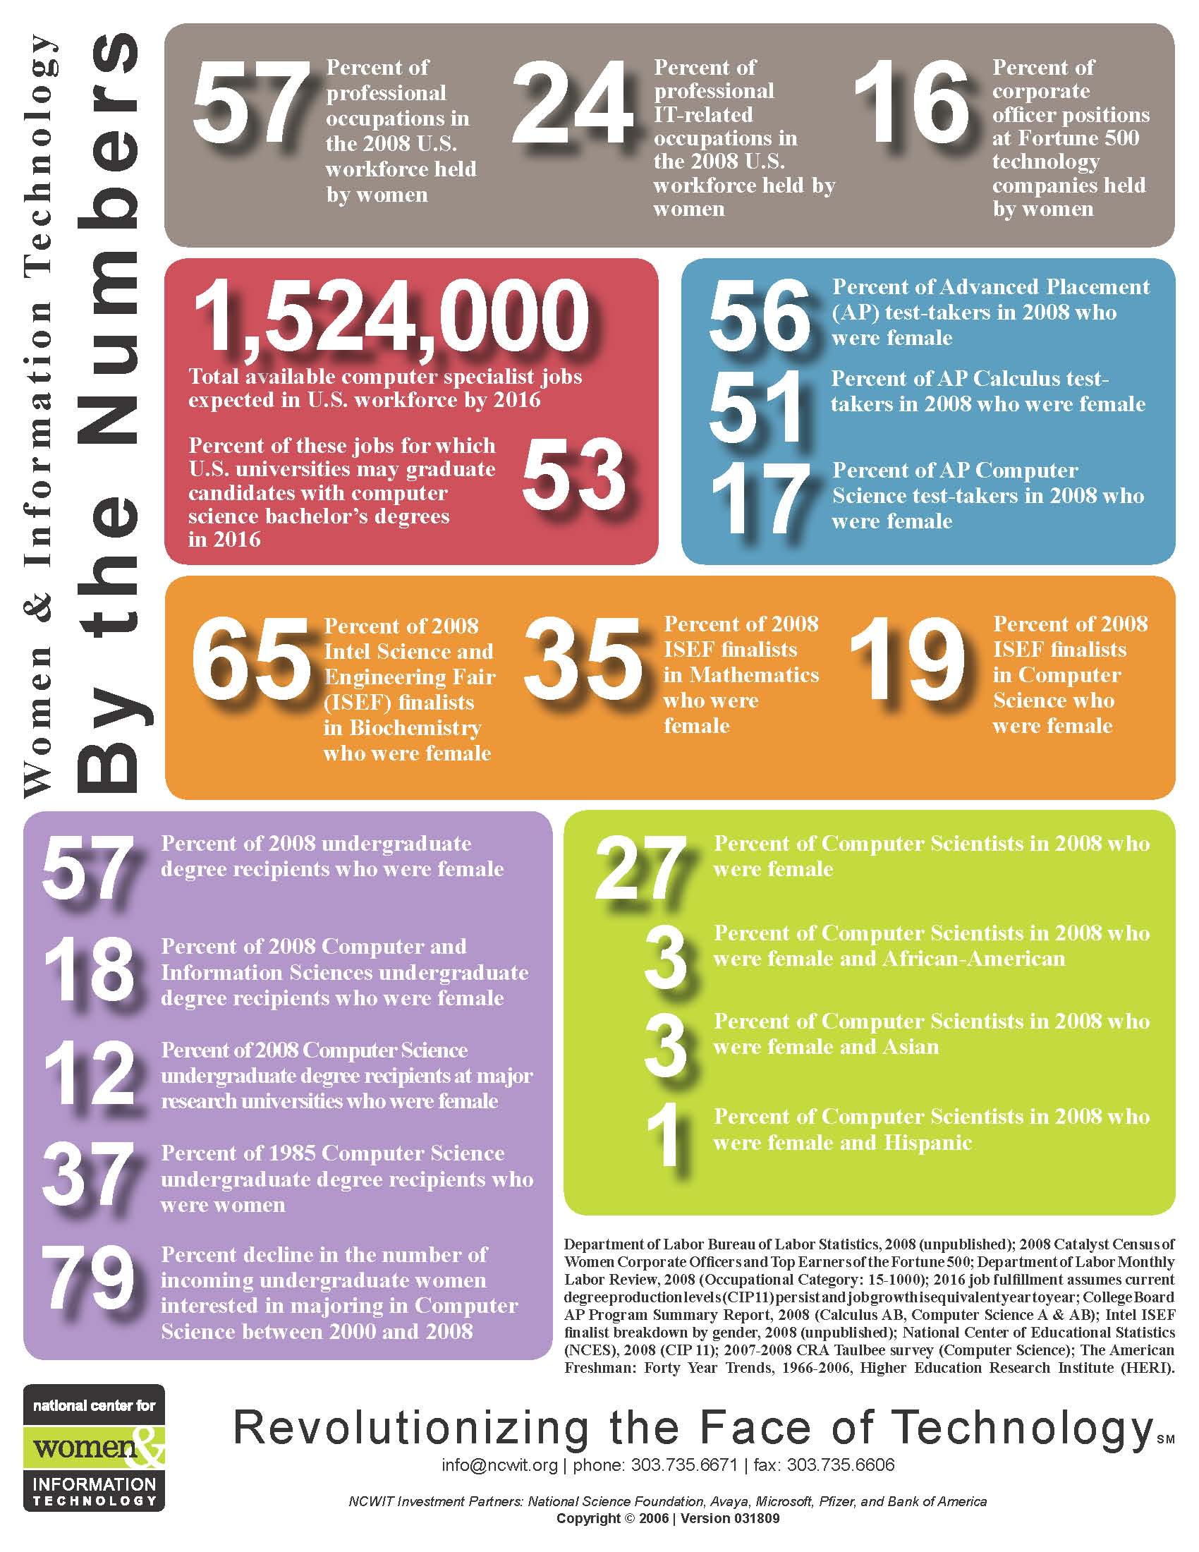
More Info on Female Underrepresentation

Slide 8


Why do few females pursue CS?
What can be done about it?
Stereotypes & unconscious bias reduce confidence & interest
Little support and encouragement reduces confidence they could succeed
  Lack of information allows stereotypes to reduce interest
Educational policies allow
choices influenced by stereotypes

Slide 9

Stereotypes & unconscious bias reduce confidence & interest
Cultural belief in the disconnect between “feminine” and “technical”
  Generalizations are useful mental shortcuts everyone uses, but they can mislead us
  “Girls don’t think that way” – reduces confidence
Fear of confirming stereotypes about my group
  Hinders performance
  Affects choices and aspirations
  Set harsh standards and
  opt out if we don’t meet them

Slide 10
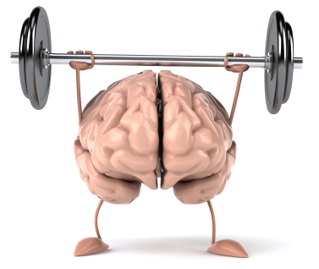
Overcome negative consequences of stereotypes
Foster belief in extensibility of intellect
                According to work done by Aronson, Steele
Build confidence through
Mastery experiences
Observing others succeed
Verbal persuasion
According to research related to Bandura’s work on self-efficacy

Slide 11
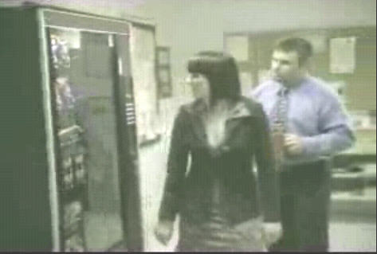
Support and encouragement are lacking
Cheering works!
http://www.youtube.com/watch?v=_gQ84-vWNGU
Cohoon, 2006

Slide 12

Lack of information abounds
Few students, parents, or teachers (people) know what computer scientists do
Too many sources misinform, steer girls away

Slide 13

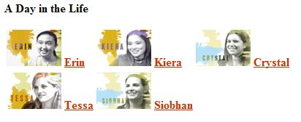
Good sources for CS career information
cs.washington.edu/education/ugrad/prospective
More on this tomorrow
For a list of computing career resources, see http://www.ncwit.org/resources.careers.it.html

Slide 14
Policies steer girls away
Choices made when gender stereotypes are most influential
Fewer women in countries with
  Belief in gender differences
  Weak STEM requirements
Restricted choices
  Real CS rarely offered
  Competes with electives

Slide 15

Girls studied computing when they had
Early, positive experiences with computing
Adult encouragement
Positive female role models
Information about what computing professionals actually do
Notes:
Findings from different researchers suggest that certain factors help encourage students to pursue computing:
Early, positive experiences with computing, adult encouragement (especially from parents), positive role models (female role models affect girls), and more information about what computing professionals actually do in their jobs.
SOURCES:
Cohoon, J. M. and Aspray W. (2006). Introduction. In McGrath Cohoon, J. & W. Aspray (Eds.) Women and information technology: Research on under-representation. Cambridge, MA: MIT Press.; Jones, T., & Clark, V.A. (1995). Diversity as a determinant of attitudes: A possible explanation of the apparent advantage of single-sex settings. Journal of Educational Computing Research, 12(1), 51-64.; Schaumburg, H. (2001). Fostering girls’ computer literacy through laptop learning: Can mobile computers help to level out the gender difference? Paper presented at the National Educational Computing Conference, Chicago.
Shashaani, Lily. (1993). Gender-based differences in attitudes toward computers. Computers and Education, 20(2), 169-181.; Girls Scouts of the USA and NCWIT. (2008). Evaluating Promising Practices in Informal Information Technology (IT) Education for Girls PHASE III: Women in IT—Survey Results (www.ncwit.org/gseval); Tillberg, H. & Cohoon, J.M. (2005). Attracting women to the CS major. Frontiers: A Journal of Women Studies, 26(1), 126-140.
Dryburgh, H. (2000). Underrepresentation of girls and women in computer science: Classification of 1990s research. Journal of Educational Computing Research, 23(2), 181–202.
Barker, L. & Aspray, W. (2006). The State of Research on Girls and IT. In McGrath Cohoon, J. & W. Aspray (Eds.) Women and information technology: Research on under-representation. Cambridge, MA: MIT Press.

Slide 16
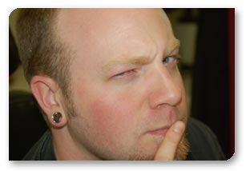
Who do you most need to persuade that high school CS is important?
Students?
Teacher colleagues?
Principal?
School Board?
???
What information would help persuade them?

Slide 17
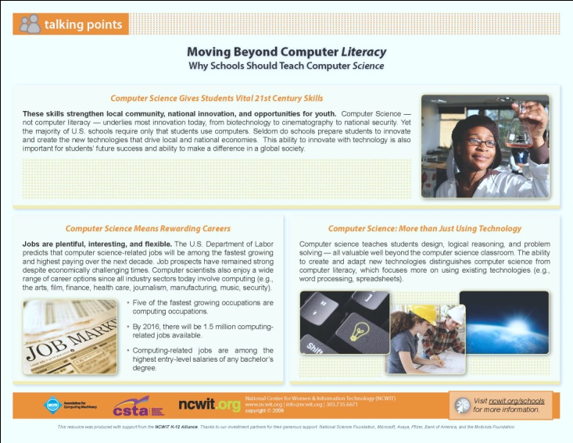
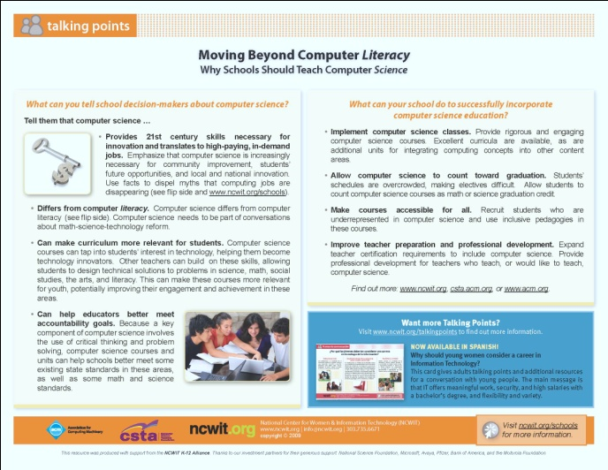
Free Resources to Help You Inform Others
Why schools should
teach CS
ACM materials for
educators and
policymakers www.csedweek.org
CSTA brochure for policymakers
csta.acm.org/About/sub/AboutFiles/CSTAPolicyBrochure.pdf
Notes:
These are just a few of the resources NCWIT offers for free on their Website. You can make a difference in the state of computing at the secondary level by using these resources in your local area.
Reach out to school teachers, guidance counselors, academic advisors, and principals to help change the image of computing. Use the NCWIT Talking Points card (www.ncwit.org/youngwomen).
Get specific statistics about computing education and workforce in your area at the NCWIT website (www.ncwit.org/cseducation).
Partner with a local youth group or summer camp to work with kids during out-of-school time, when they may be even more receptive. For ideas, refer to NCWIT’s card and accompanying website, Offer Computing Workshops and Camps: They Benefit Both Students and the Teachers Who Offer Them (www.ncwit.org/summercamps).

Slide 18
Another resource that could help you persuade others of computing’s importance

Slide 19
The Importance of Teaching Computer Science in High School
J. McGrath Cohoon
Senior Research Scientist
National Center for Women & Information Technology
University of Virginia

Slide 20
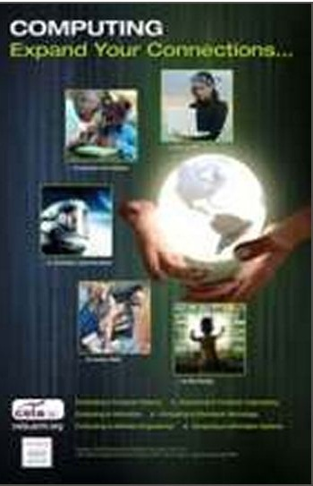
What is computer Science?

Slide 21



Computer science studies computers and problem-solving processes, including their
  Principles
  Designs
  Applications
  Impact

Slide 22

Why should students study computer science?
Intellectually engaging and developmental
Flexible, creative, rewarding careers
Unmet workforce need

Slide 23
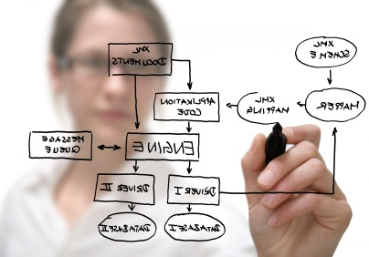
Great Career! Best Jobs in America 2011
Software Engineer
Mathematician
Actuary
Statistician
Computer Systems Analyst
According to CareerCast

Slide 24
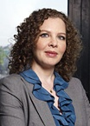
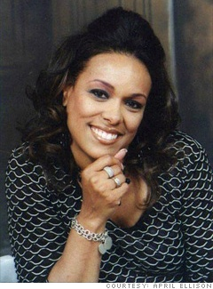
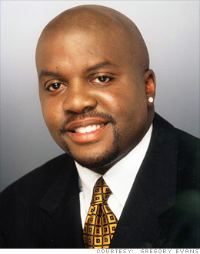
Three of the top ten occupations are computing
Systems Engineer
IT Project Manager
Network Security Consultant
Manage large complex projects
Plan, organize, and oversee the team on a computing project
Protect important computer systems from infiltration
Source: CNNMoney.com, Best Jobs in America
Notes:
These are real people in these jobs (in order of jobs listed). Photos copied from CNNMoney.com website on Best Jobs in America.

Slide 25

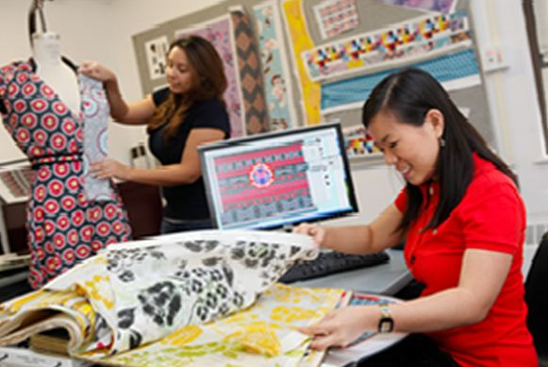
Computing offers exciting work that affects our world and the people in it
Create technology for
Tracking endangered dolphins
Mobile forensics labs for instant analysis at crime scenes
GPS systems that guide blind people
Scanning DNA for childhood diseases
Designing and displaying new fashions
Source: dotdiva.org

Slide 26
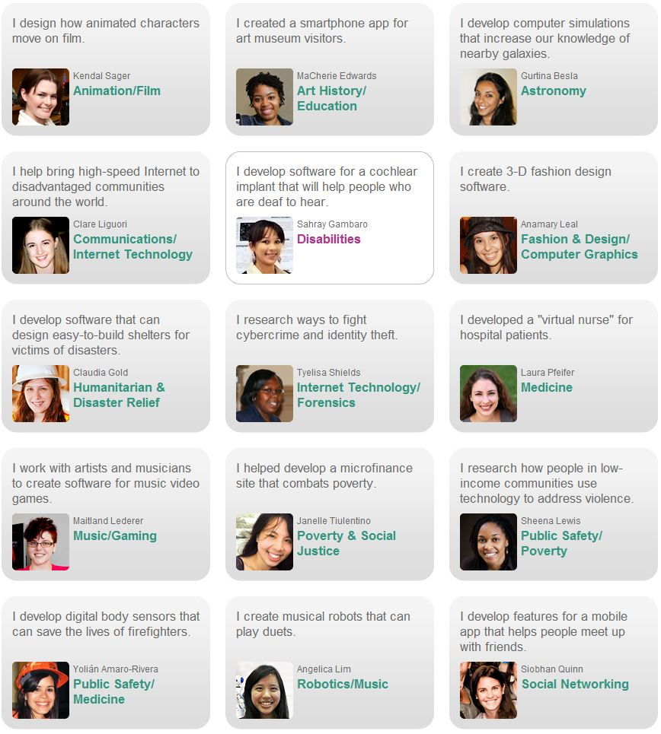
Computer Scientists work in every industry
Source: dotdiva.org

Slide 27
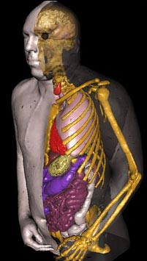

Computing is the basis for advancements in all fields

Slide 28
Computing occupations are well paid
Source: Bureau of Labor Statistics (BLS)

Slide 29
More Growth Expected than any other Professional Occupation
NCWIT. Source: U.S. Department of Labor, Bureau of Labor Statistics

Slide 30
Expected number of job openings is high
Bachelor Level STEM Jobs due to Growth and Replacement for 2018

Slide 31
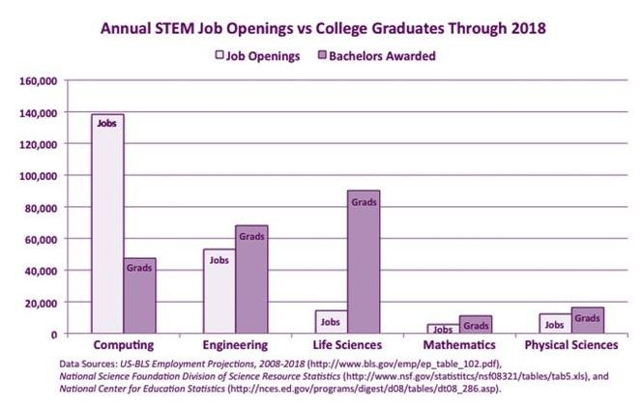
Workforce needs could go unmet
…unless we attract more students to computing

Slide 32

Why offer CS in high school?

Slide 33
CS teaches vital 21st century skills
Problem solving
Logical reasoning
Design
Creating and
adapting technology
NOT just using technology

Slide 34
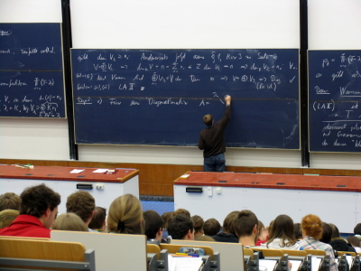
Colleges often expect familiarity
Students are more likely to succeed in computing if they have positive early experiences

Slide 35

Contribute to local economy

Slide 36
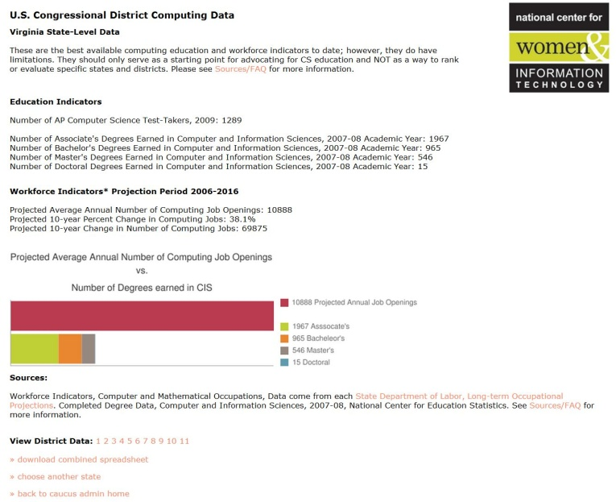
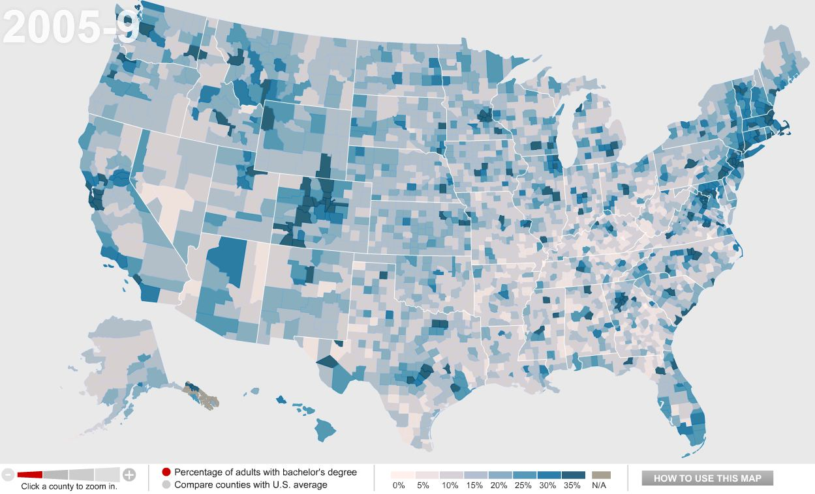
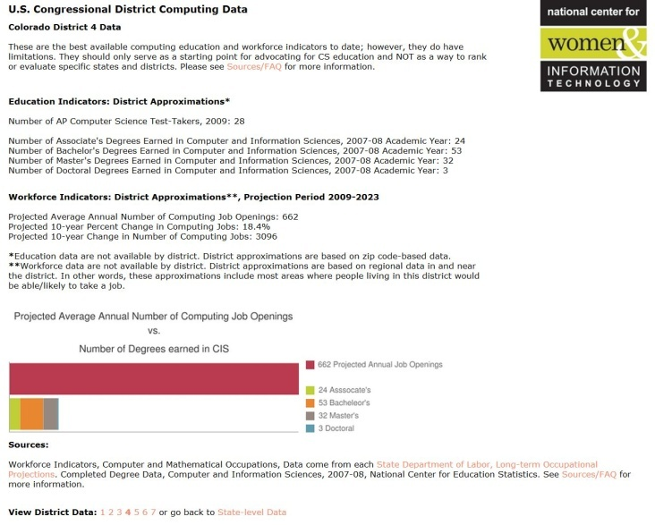
Get state and local CS education and workforce data
Online at www.ncwit.org/work.campaigns.cse.html

Slide 37
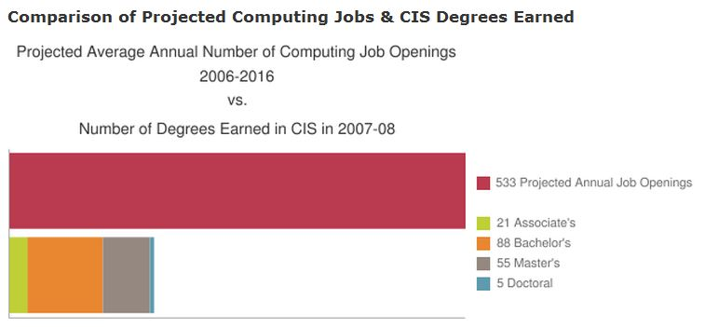
Delaware Projections

Slide 38

Sources for more information

Slide 39

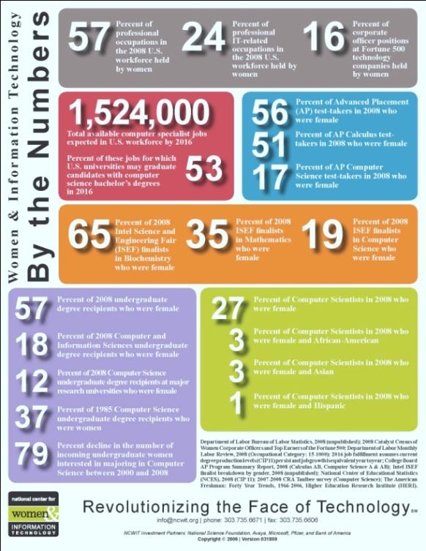

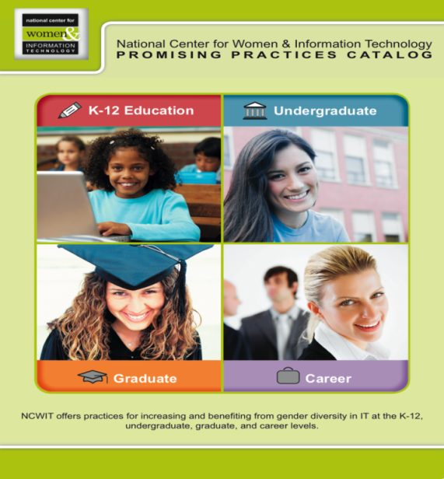
NCWIT has free resources for more information
Talking Points Cards
Programs in a Box
Practice Sheets
Facts & Figures
Notes:
NCWIT has developed resources based on research for K-12, Undergraduate, Graduate, and Career stages

Slide 40
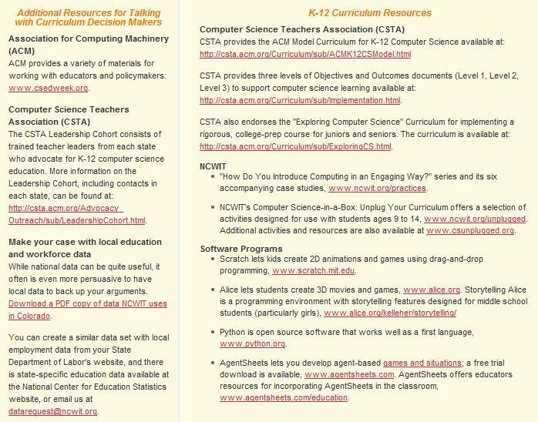
CSTA has free resources for more information

Slide 41

Questions?
Now that you know
Data on diversity in CS
Why few girls study CS
Why CS should be taught in HS
What will you do with this information?
Notes:
Are there any additional questions?

Slide 42
