Slide 1

Axiomatic Analysis and Optimization of
Information Retrieval Models
SIGIR 2014 Tutorial
Hui Fang
Dept. of Electrical and Computer Engineering
University of Delaware
USA
http://www.eecis.udel.edu/~hfang
ChengXiang Zhai
Dept. of Computer Science
University of Illinois at Urbana-Champaign
USA
http://www.cs.illinois.edu/homes/czhai

Slide 2
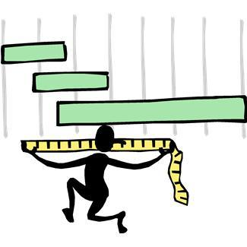

Goal of Tutorial
Axiomatic Approaches to IR
Review major research progress
Discuss promising research directions
You can expect to learn
  Basic methodology of axiomatic analysis and optimization of retrieval models
  Novel retrieval models developed using axiomatic analysis

Slide 3
Organization of Tutorial
Motivation
Axiomatic Analysis and Optimization: Early Work
Axiomatic Analysis and Optimization: Recent Work
Summary

Slide 4

Organization of Tutorial
Motivation
Axiomatic Analysis and Optimization: Early Work
Axiomatic Analysis and Optimization: Recent Work
Summary

Slide 5






Search is everywhere, and part of everyone’s life
Web Search
Desk Search
Enterprise Search
Social Media Search
Site Search
… …

Slide 6



Search accuracy matters!
# Queries /Day
X 1 sec
X 10 sec
4,700,000,000
~1,300,000 hrs
~13,000,000 hrs
1,600,000,000
~440,000 hrs
~4,400,000 hrs
… …
~5,500 hrs
2,000,000
~550 hrs
How can we improve all search engines in a general way?
Sources:
Google, Twitter: http://www.statisticbrain.com/
PubMed: http://www.ncbi.nlm.nih.gov/About/tools/restable_stat_pubmed.html

Slide 7

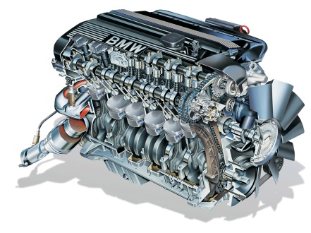
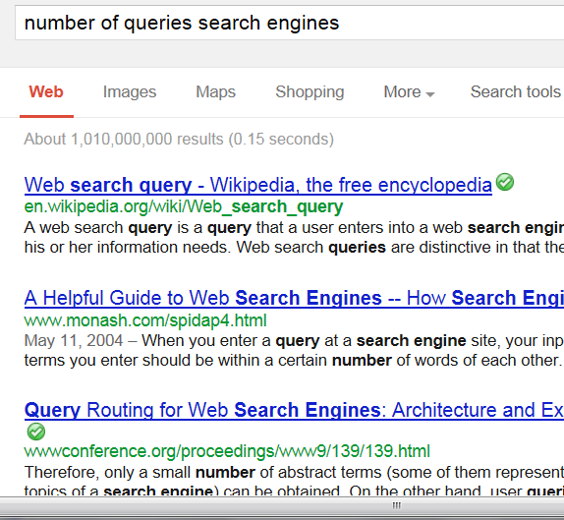


Behind all the search boxes…
Document collection
k
number of queries search engines
Query q
d
Ranked
list
Machine Learning
How can we optimize a retrieval model?
Retrieval
Model
Score(q,d)
Natural Language Processing

Slide 8
Retrieval model = computational definition of “relevance”
S(“world cup schedule”, d )
s(“world”, d )
s(“cup”, d )
s(“schedule”, d )
How many times does “schedule” occur in d?
Term Frequency (TF): c(“schedule”, d)
How long is d? Document length: |d|
How often do we see “schedule” in the entire collection C?
Document Frequency: df(“schedule”)
P(“schedule”|C)

Slide 9
Scoring based on bag of words in general
q
d
w
Sum over
matched query terms
Inverse
Document
Frequency
(IDF)
Term Frequency (TF)
Document length

Slide 10
Improving retrieval models is a long-standing challenge.
Vector Space Models: [Salton et al. 1975], [Singhal et al. 1996], …
Classic Probabilistic Models: [Maron & Kuhn 1960], [Harter 1975], [Robertson & Sparck Jones 1976], [van Rijsbergen 1977], [Robertson 1977], [Robertson et al. 1981], [Robertson & Walker 1994], …
Language Models: [Ponte & Croft 1998], [Hiemstra & Kraaij 1998], [Zhai & Lafferty 2001], [Lavrenko & Croft 2001], [Kurland & Lee 2004], …
Non-Classic Logic Models: [van Rijsbergen 1986], [Wong & Yao 1995], …
Divergence from Randomness: [Amati & van Rijsbergen 2002], [He & Ounis 2005], …
Learning to Rank: [Fuhr 1989], [Gey 1994], ...
…
Many different models were proposed and tested.

Slide 11
Some are working very well (equally well)
Pivoted length normalization (PIV) [Singhal et al. 1996]
BM25 [Robertson & Walker 1994]
PL2 [Amati & van Rijsbergen 2002]
Query likelihood with Dirichlet prior (DIR) [Ponte & Croft 1998], [Zhai & Lafferty 2001]
but many others failed to work well…

Slide 12
Some state of the art retrieval models
PIV (vector space model)
DIR (language modeling approach)
BM25 (classic probabilistic model)
PL2 (divergence from randomness)

Slide 13
PIV, DIR, BM25 and PL2 tend to perform similarly.
Performance Comparison (MAP)
 | AP88-89 | DOE | FR88-89 | Wt2g | Trec7 | trec8
PIV | 0.23 | 0.18 | 0.19 | 0.29 | 0.18 | 0.24
DIR | 0.22 | 0.18 | 0.21 | 0.30 | 0.19 | 0.26
BM25 | 0.23 | 0.19 | 0.23 | 0.31 | 0.19 | 0.25
PL2 | 0.22 | 0.19 | 0.22 | 0.31 | 0.18 | 0.26
Why do they tend to perform similarly even though they were derived in very different ways?

Slide 14
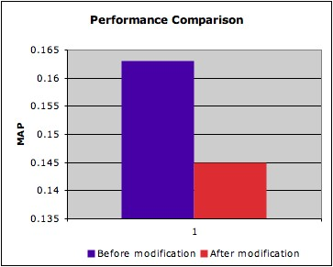
Performance sensitive to small variations in a formula
PIV:
Why is a state of the art retrieval function better than many other variants?

Slide 15
Additional Observations
PIV (vector space model) 1996
DIR (language modeling approach) 2001
BM25 (classic probabilistic model) 1994
PL2 (divergence from randomness) 2002
Why does it seem to be hard to beat these strong baseline methods?
“Ad Hoc IR – Not Much Room for Improvement” [Trotman & Keeler 2011]
“Has Adhoc Retrieval Improved Since 1994?” [Armstrong et al. 2009]
Are they hitting the ceiling of bag-of-words assumption?
  If yes, how can we prove it?
  If not, how can we find a more effective one?

Slide 16
Suggested Answers: Axiomatic Analysis
Why do these methods tend to perform similarly even though they were derived in very different ways?
Why are they better than many other variants?
Why does it seem to be hard to beat these strong baseline methods?
Are they hitting the ceiling of bag-of-words assumption?
  If yes, how can we prove it?
  If not, how can we find a more effective one?
They share some nice common properties
These properties are more important than how each is derived
Other variants don’t have all the “nice properties”
  We don’t have a good knowledge about their deficiencies
Need to formally define “the ceiling” (= complete set of “nice properties”)

Slide 17

Organization of Tutorial
Motivation
Axiomatic Analysis and Optimization: Early work
Axiomatic Analysis and Optimization: Recent Work
Summary

Slide 18
Axiomatic Relevance Hypothesis (ARH)
Relevance can be modeled by a set of formally defined constraints on a retrieval function.
  If a function satisfies all the constraints, it will perform well empirically.
  If function satisfies more constraints than function , would perform better than empirically.
Analytical evaluation of retrieval functions
  Given a set of relevance constraints
  Function is analytically more effective than function iff the set of constraints satisfied by is a proper subset of those satisfied by
  A function is optimal iff it satisfies all the constraints in

Slide 19
Axiomatic Analysis and Optimization
Function space
C₂
S₂
C₃
S₃
S₁
C₁
Retrieval constraints

Slide 20
Axiomatic Analysis and Optimization: Early Work – Outline
Formalization of Information Retrieval Heuristics
Analysis of Retrieval Functions with Constraints
Development of Novel Retrieval Functions
C₂
C₁
C₃

Slide 21
Different functions, but similar heuristics
PIV (vector space model)
DIR (language modeling approach)
BM25 (classic probabilistic model)
PL2 (divergence from randomness)
TF weighting
IDF weighting
Length Norm.

Slide 22
Are they performing well because they implement similar retrieval heuristics?
Can we formally capture these necessary retrieval heuristics?
For details, see
Hui Fang, Tao Tao and ChengXiang Zhai: A Formal Study of Information Retrieval Heuristics, SIGIR’04.
Hui Fang, Tao Tao and ChengXiang Zhai: Diagnostic Evaluation of Information Retrieval Models. ACM Transaction of Information Systems, 29(2), 2011.

Slide 23
Term Frequency Constraints (TFC1)
TF weighting heuristic I: Give a higher score to a document with more occurrences of a query term.
TFC1
q
Q:
Let Q be a query and D be a document.
D:
If and ,
q
then
D₁:
t
D₂:

Slide 24
Term Frequency Constraints (TFC2)
TF weighting heuristic II:
Require that the amount of increase in the score due to adding a query term must decrease as we add more terms.
TFC2
Let Q be a query with only one query term q.
Let D₁ be a document.
then
q
Q:
D₁:
q
D₂:
q
q
D₃:

Slide 25
Term Frequency Constraints (TFC3)
TF weighting heuristic III:
Favor a document with more distinct query terms.
TFC3
Let q be a query and w₁, w₂ be two query terms.
w₁
w₂
q:
Assume
and
d₁:
If
and
d₂:
then

Slide 26
Length Normalization Constraints (LNCs)
Document length normalization heuristic: Penalize long documents(LNC1); Avoid over-penalizing long documents (LNC2) .
LNC1
Q:
Let Q be a query and D be a document.
If t is a non-query term,
D:
t
D’:
then
LNC2
Q:
Let Q be a query and D be a document.
If , and D_{k} is constructed by concatenating D with itself k times,
D:
D_{k}:
then

Slide 27
TF & Length normalization Constraint
(TF-LNC)
TF-LN heuristic: Regularize the interaction of TF and document length.
TF-LNC
q
Let Q be a query and D be a document.
Q:
If q is a query term,
D:
q
then
D’:

Slide 28
Seven Basic Relevance Constraints
[Fang et al. 2011]
Constraints | Intuitions
TFC1 | To favor a document with more occurrences of a query term
TFC2 | To ensure that the amount of increase in score due to adding a query term repeatedly must decrease as more terms are added
TFC3 | To favor a document matching more distinct query terms
TDC | To penalize the words popular in the collection and assign higher weights to discriminative terms
LNC1 | To penalize a long document (assuming equal TF)
LNC2, TF-LNC | To avoid over-penalizing a long document
TF-LNC | To regulate the interaction of TF and document length

Slide 29
Disclaimers
Given a retrieval heuristic, there could be multiple ways of formalizing it as constraints.
When formalizing a retrieval constraint, it is necessary to check its dependency on other constraints.

Slide 30
Weak or Strong Constraints?
The Heuristic captured by TDC:
To penalize the words popular in the collection and assign higher weights to discriminative terms
Our first attempt:
  Let Q={q₁, q₂}. Assume |D₁|=|D₂| and c(q₁,D₁)+c(q₂,D₁)=c(q₁,D₂)+c(q₂,D₂). If td(q₁)>=td(q₂) and c(q₁,D₁)>=c(q₁,D₂), we have
Our second attempt (a relaxed version):
  Let Q={q₁, q₂}. Assume |D₁|=|D₂| and D₁ contains only q₁ and D₂ contains only q₂.
  If td(q₁)>=td(q₁), we have

Slide 31
Key Steps of Constraint Formalization
Identify desirable retrieval heuristics
Formalize a retrieval heuristic as reasonable retrieval constraints.
After formalizing a retrieval constraint, check how it is related to other retrieval constraints.
  Properties of a constraint set
    Completeness
    Redundancy
    Conflict

Slide 32
Axiomatic Analysis and Optimization: Early Work – Outline
Formalization of Information Retrieval Heuristics
Analysis of Retrieval Functions with Constraints
Development of Novel Retrieval Functions
C₂
a retrieval function
C₁
C₃

Slide 33
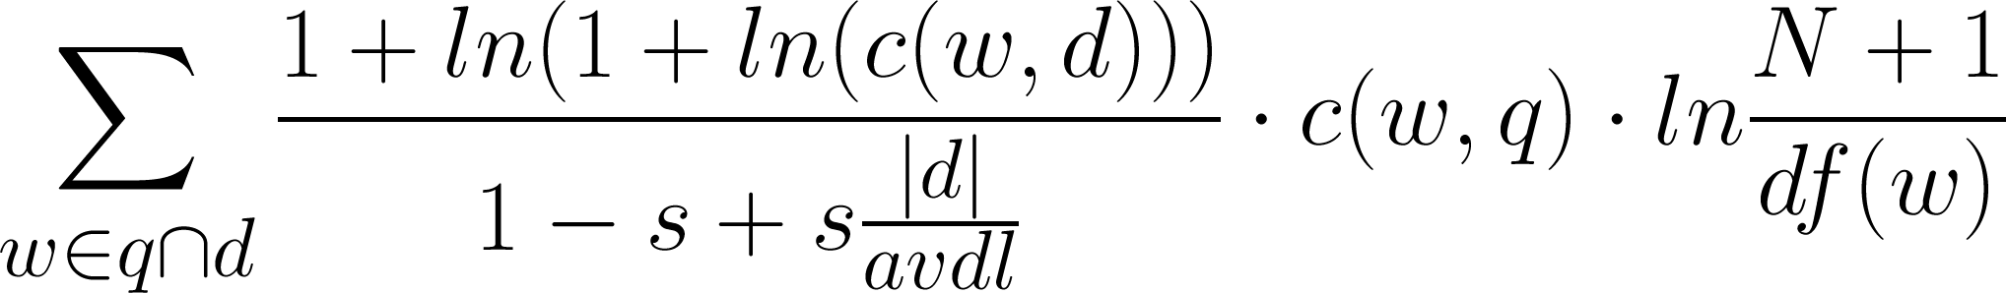
An Example of Constraint Analysis
PIV:
LNC2:
Let q be a query.
q:
If
and
d₁:
then
d₂:
Does PIV satisfy LNC2?

Slide 34
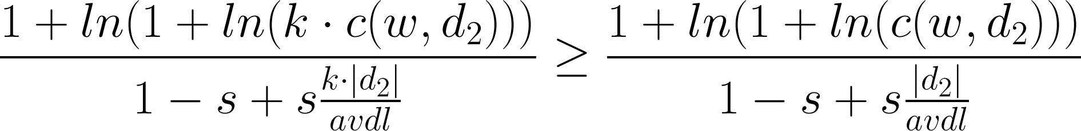
An Example of Constraint Analysis
LNC2:
Let q be a query.
If
and
then

Slide 35
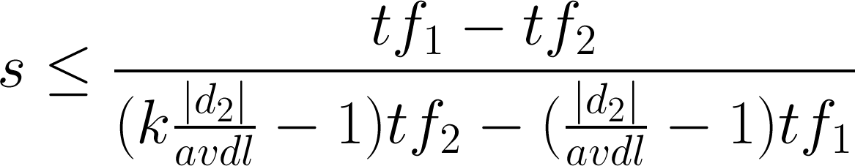
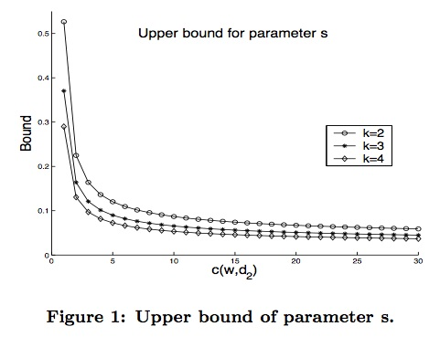
An Example of Constraint Analysis
Assuming

Slide 36
An Example of Constraint Analysis
PIV:
C₂
S_{0.1}
S_{0.3}
Function space
S_{0.5}
C₃
C₁
Retrieval constraints

Slide 37
Review: Axiomatic Relevance Hypothesis
Relevance can be modeled by a set of formally defined constraints on a retrieval function.
  If a function satisfies all the constraints, it will perform well empirically.
  If function satisfies more constraints than function , would perform better than empirically.
Analytical evaluation of retrieval functions
  Given a set of relevance constraints
  Function is analytically more effective than function iff the set of constraints satisfied by is a proper subset of those satisfied by
  A function is optimal iff it satisfies all the constraints in

Slide 38
Testing the Axiomatic Relevance Hypothesis
Is the satisfaction of these constraints correlated with good empirical performance of a retrieval function?
Can we use these constraints to analytically compare retrieval functions without experimentation?
“Yes!” to both questions
  When a formula does not satisfy the constraint, it often indicates non-optimality of the formula.
  Violation of constraints may pinpoint where a formula needs to be improved.
  Constraint analysis reveals optimal ranges of parameter values

Slide 39
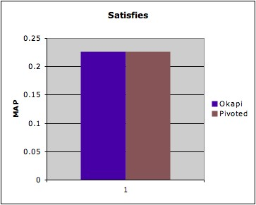
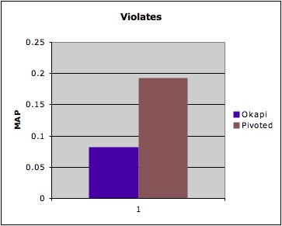
Violation of Constraints → Poor Performance
Okapi BM25
Negative → Violates the constraints
Keyword Queries
(constraint satisfied by BM25)
Verbose Queries
(constraint violated by BM25)
PIV
BM25
PIV
BM25

Slide 40
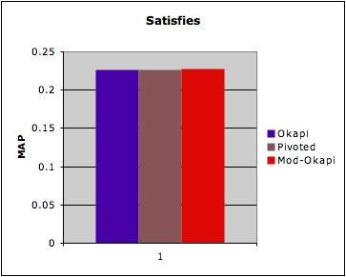
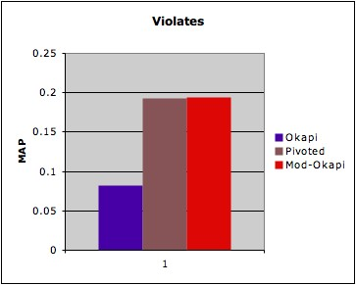
Constraints Analysis → Guidance for Improving an Existing Retrieval Function
Modified Okapi BM25
Make it satisfy constraints; expected to improve performance
Keyword Queries
(constraint satisfied by BM25)
Verbose Queries
(constraint violated by BM25)
Modified BM25
BM25
PIV
PIV
BM25

Slide 41
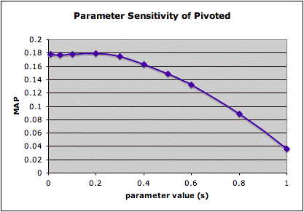
Conditional Satisfaction of Constraints → Parameter Bounds
PIV
LNC2 ➔ s<0.4
0.4

Slide 42
Systematic Analysis of 4 State of the Art Models
[Fang et al. 2011]
Parameter s must be small
Function | TFCs | TDC | LNC1 | LNC2 | TF-LNC
PIV | Yes | Yes | Yes | C1* | C2*
DIR | Yes | Yes | Yes | C3 | Yes
BM25 (Original) | C4 | Yes | C4 | C4 | C4
BM25 (Modified) | Yes | Yes | Yes | Yes | Yes
PL2 (Original) | C5 | C6* | C7 | C8* | C8*
PL2 (modified) | Yes | C6* | Yes | C8* | C8*
Problematic when a query term occurs less frequently in a doc than expected
Negative IDF
Problematic with common terms; parameter c must be large

Slide 43
Perturbation tests:
An empirical way of analyzing the constraints
For details, see
Hui Fang, Tao Tao and ChengXiang Zhai: Diagnostic Evaluation of Information Retrieval Models. ACM Transaction of Information Systems, 29(2), 2011.

Slide 44
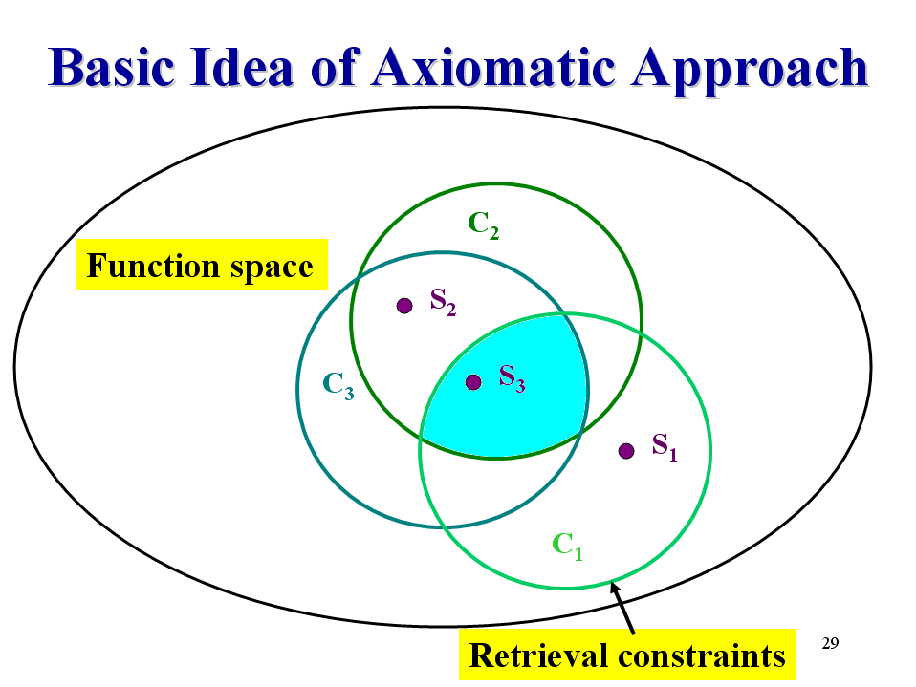
What if constraint analysis is NOT sufficient?
S₅
S₄

Slide 45




Medical Diagnosis Analogy
Non-optimal retrieval function
Better performed retrieval function
Design tests with available instruments
observe symptoms
provide treatments
How to find available instruments? How to design diagnostic tests?

Slide 46
Relevance-Preserving Perturbations
Perturb term statistics
Keep relevance status
Document scaling perturbation:
cD(d,d,K)
concatenate every document with itself K times

Slide 47
Relevance-Preserving Perturbations
Name | Semantic
Relevance addition | Add a query term to a relevant document
Noise addition | Add a noisy term to a document
Internal term growth | Add a term to a document that original contains the term
Document scaling | Concatenate D with itself K times
Relevance document concatenation | Concatenate two relevant documents K times
Non-relevant document concatenation | Concatenate two non-relevant documents K times
Noise deletion | Delete a term from a non-relevant document
Document addition | Add a document to the collection
Document deletion | Delete a document from the collection

Slide 48
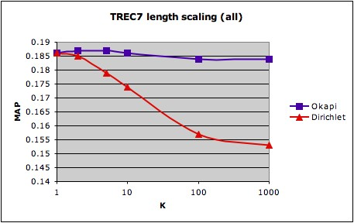
Length Scaling Test (LV3)
1. Identify the aspect to be diagnosed
test whether a retrieval function over-penalizes long documents
2. Choose appropriate perturbations
cD(d,d,K)
3. Perform the test and interpret the results
Dirichlet over-penalizes long documents!

Slide 49
Summary of All Tests
Tests | What to measure?
Length variance reduction (LV1) | The gain on length normalization
Length variance amplification (LV2) | The robustness to larger document variance
Length scaling (LV3) | The ability at avoid over-penalizing long documents
Term noise addition (TN) | The ability to penalize long documents
Single query term growth (TG1) | The ability to favor docs with more distinct query terms
Majority query term growth (TG2) | Favor documents with more query terms
All query term growth (TG3) | Balance TF and LN more appropriately

Slide 50
Diagnostic Results for DIR
Weaknesses
  over-penalizes long documents (TN, LV3)
  fails to implement one desirable property of TF (TG1)
Strengths
  performs better in a document with higher document length variance (LV2)
  implements another desirable property of TF (TG2)

Slide 51
Identifying the weaknesses makes it possible to improve the performance
 | MAP |  |  | P@30
 | trec8 | wt2g | FR | trec8 | wt2g | FR
DIR | 0.257 | 0.302 | 0.202 | 0.365 | 0.331 | 0.151
Imp.D. | 0.263 | 0.323 | 0.228 | 0.373 | 0.345 | 0.166

Slide 52
Axiomatic Analysis and Optimization: Early Work – Outline
Formalization of Information Retrieval Heuristics
Analysis of Retrieval Functions with Constraints
Development of Novel Retrieval Functions
C₂
Functions satisfying all constraints
C₁
C₃

Slide 53
Our Goal

Slide 54
Three Questions
How to define the constraints?
How to define the function space?
How to search in the function space?
We’ve talked about that; more later
One possibility: leverage existing state of the art functions
One possibility: search in the neighborhood of
existing state of the art functions
For details, see
Hui Fang and ChengXiang Zhai: An Exploration of Axiomatic Approaches to Information Retrieval, SIGIR’05.

Slide 55
Inductive Definition of Function Space
Define the function space inductively
Primitive weighting function (f)
cat
big
S(Q,D) = S( , ) = f ( , )
Q:
D:
Query growth function (h)
S(Q,D) = S( , ) = S( , )+h( , , )
dog
big
Document growth function (g)
S(Q,D) = S( , ) = S( , )+g( , , )
Notes:
Bag of terms

Slide 56
Derivation of New Retrieval Functions
An existing function
decompose
generalize
constrain
assemble
A new function

Slide 57
Derivation of New Document Growth Function
Pivoted Normalization
decompose
generalize
constrain

Slide 58
Derivation of New Retrieval Functions
existing function
decompose
C₃
C₁
generalize
S’
constrain
S
C₂
assemble
new function

Slide 59
A Sample Derived Function based on BM25
[Fang & Zhai 2005]
QTF
IDF
TF
length normalization

Slide 60
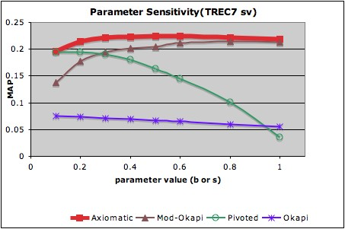
The derived function is less sensitive to the parameter setting
better
Axiomatic Model

Slide 61

Organization of Tutorial
Motivation
Axiomatic Analysis and Optimization: Early Work
Axiomatic Analysis and Optimization: Recent Work
Summary

Slide 62
Axiomatic Analysis and Optimization: Recent Work
– Outline
Lower-bounding TF Normalization
Axiomatic Analysis of Pseudo-Relevance Feedback Models
Axiomatic Analysis of Translational Model
For details, see
Yuanhua Lv and ChengXiang Zhai: Lower Bounding Term Frequency Normalization, CIKM’11.

Slide 63
Review: Constraint Analysis Results
[Fang et al. 2011]
Function | TFCs | TDC | LNC1 | LNC2 | TF-LNC
PIV | Yes | Yes | Yes | C1* | C2*
DIR | Yes | Yes | Yes | C3 | Yes
BM25 (Original) | C4 | Yes | C4 | C4 | C4
BM2 (Modified) | Yes | Yes | Yes | Yes | Yes
PL2 (Original) | C5 | C6* | C7 | C8* | C8*
PL2 (modified) | Yes | C6* | Yes | C8* | C8*
Modified BM25 satisfies all the constraints!
Without knowing its deficiency, we can’t easily propose
a new model working better than BM25

Slide 64
How to identify more deficiencies?
We need more constraints!
But how?

Slide 65
A Recent Success of Axiomatic Analysis:
Lower Bounding TF Normalization
[Lv & Zhai 2011a]
Existing retrieval functions lack a lower bound for normalized TF with document length.
  A very long document matching two query terms can have a lower score than a short document matching only one query term
Long documents are overly penalized!

Slide 66
Lower Bounding TF Constraints (LB1)
The presence –absence gap (0-1 gap) shouldn’t be closed due to length normalization.
Q :
Q’ :
q
D₁:
D₂:

Slide 67
Lower Bounding TF Constraints (LB2)
Repeated occurrence of an already matched query term isn’t as important as the first occurrence of an otherwise absent query term.
q₁
q₂
Q:
D₁:
D₁’:
D₂:
D₂’:

Slide 68
Constraint Comparison (1)
LB1
TFLNC
q
Q
q
Q
Q’ :
Q’ :
D₁:
D₁:
D₂:
D₂:
Both constraints are designed to avoid over-penalizing long documents. However, LB1 is more general since it puts less restriction on the document length.

Slide 69
Constraint Comparison (2)
LB2
TFC3
q₁
q₂
Q:
q₁
q₂
Q:
D₁:
D₁:
D₂:
D₂:
D₁’:
D₂’:
D₁:
D₂:
Both constraints are designed to favor documents covering more distinct query terms. However, LB2 is more general since it puts less restriction on the document length.

Slide 70
No retrieval model satisfies both LB constraints
Model | LB1 | LB2 | Parameter and/or query restrictions
BM25 | Yes | No | b and k₁ should not be too large
PIV | Yes | No | s should not be too large
PL2 | No | No | c should not be too small
DIR | No | Yes | µ should not be too large; query terms should be discriminative

Slide 71
Solution: a general approach to lower- bounding TF normalization
Current retrieval model:
Lower-bounded retrieval model:
Term frequency
Document length
If c(t, D) = 0
Otherwise
Appropriate Lower Bound

Slide 72
Example: Dir+, a lower-bounded version of the query likelihood function
Dir:
Dir+:
Dir+ incurs almost no additional computational cost

Slide 73
Example: BM25+, a lower-bounded version of BM25
BM25:
BM25+:
BM25+ incurs almost no additional computational cost

Slide 74
BM25+ Improves over BM25
Query | Method | WT10G | WT2G | Terabyte | Robust04
Short | BM25 | 0.1879 | 0.3104 | 0.2931 | 0.2544
 | BM25+ | 0.1962 | 0.3172 | 0.3004 | 0.2553
Verbose | BM25 | 0.1745 | 0.2484 | 0.2234 | 0.2260
 | BM25+ | 0.1850 | 0.2624 | 0.2336 | 0.2274

Slide 75
Axiomatic Analysis and Optimization: Recent Work
– Outline
Lower-bounding TF Normalization
Axiomatic Analysis of Pseudo-Relevance Feedback Models
Axiomatic Analysis of Translational Model
For details, see
Stephane Clinchant and Eric Gaussier: A Theoretical Analysis of Pseudo-Relevance Feedback Models, ICTIR’13.

Slide 76
Pseudo-Relevance Feedback
Original Query
IR System
Initial Results
Expanded Query
Selecting expansion terms
Final Results
Initial Retrieval
Query Expansion
Second Round Retrieval
Notes:
Heart to +-,no different docs, different line style

Slide 77
Existing PRF Methods
Mixture model [Zhai&Lafferty 2001b]
Divergence minimization [Zhai&Lafferty 2001b]
Geometric relevance model [Lavrenko et al. 2001]
eDCM (extended dirichlet compound multinomial) [Xu&Akella 2008]
DRF Bo2 [Amati et al. 2003]
Log-logistic model [Cinchant et al. 2010]
…

Slide 78
Motivation for the PRF Constraints
[Clinchant and Gaussier, 2011a] [ Clinchant and Gaussier, 2011b][ Clinchant and Gaussier, 2013]
Performance Comparison
Settings | Mixture Model | Log-logistic model | Divergence minimization
Robust-A | 0.280 | 0.292 | 0.263
Trec-1&2-A | 0.263 | 0.284 | 0.254
Robust-B | 0.282 | 0.285 | 0.259
Trec-1&2-B | 0.273 | 0.294 | 0.257
Robust-A
Settings | MIX | LL | DIV
Avg (tf) | 62.9 | 46.7 | 53.9
Avg (df) | 6.4 | 7.21 | 8.6
Avg (idf) | 4.3 | 5.1 | 2.2
Log-logistic model is more effective because it selects terms
that are not too common (high IDF and small TF)
that still occur in sufficient number o feedback documents (average DF)
Notes:
Tf: # of occurrences of this word in the feedback set
Df: # of feedback document containing the word
IDF: idf in the collection .

Slide 79
PRF Heuristic Constraints
[Clinchant and Gaussier, 2013]
TF effect
  The feedback weight should increase with the term frequency.
Concavity effect
  The above increase should be less marked in high frequency ranges.
IDF effect
    When all other things being equal, the feedback weight of a term with higher IDF value should be larger.
Document length effect
  The number of occurrences of feedback terms should be normalized by the length of documents they appear in.
DF effect
  When all other things being equal, terms occurring in more feedback documents should receive higher feedback weights.

Slide 80
Summary of Constraint Analysis
 | TF | Concave | IDF | Doc Len | DF
Mixture | Y | Cond. | Y | N | N
Div Min | Y | Y | Cond. | Y | Y
G. Rel. | Y | Y | N | Y | Y
Bo | Y | N | Cond. | N | N
Log-Logistic | Y | Y | Y | Y | Y
The authors also discussed how to revise the mixture model and geometric relevance model to improve the performance.

Slide 81
Axiomatic Analysis and Optimization: Recent Work
– Outline
Lower-bounding TF Normalization
Axiomatic Analysis of Pseudo-Relevance Feedback Models
Axiomatic Analysis of Translational Model
For details, see
Maryam Karimzadehgan and ChengXiang Zhai: Axiomatic Analysis of Translation Language Model for Information Retrieval, ECIR’12.

Slide 82
The Problem of Vocabulary Gap
Query = auto wash
auto
wash
…
P(“auto”)
P(“wash”)
d1
How to support inexact matching?
{“car” , “vehicle”} ⬅==➔ “auto”
“buy” ⬅====➔ “wash”
auto
buy
auto
d2
car
wash
vehicle
P(“auto”)
P(“wash”)
d3

Slide 83
Translation Language Models for IR [Berger & Lafferty 1999]
Query = auto wash
“translate”
auto
wash
…
“auto”
“auto”
d1
Query = car wash
“car”
auto
buy
auto
P(“auto” |d3)= p(“car”|d3) x p_{t}(“auto”| “car”)
+ p(“vehicle”|d3) x p_{t}(“auto”| “vehicle”)
d2
How to estimate?
P(“car”|d3)
car
wash
vehicle
P(“auto”)
P(“wash”)
“car”
P_{t}(“auto”| “car”)
d3
“auto”
“vehicle”
P(“vehicle”|d3)
P_{t}(“auto”| “vehicle”)

Slide 84
Axiomatic Analysis of Translational Model
[Karimzadehgan & Zhai 2012]
Estimation of translation model
How do we know whether one estimation method is better than another one?
Is there any better way than pure empirical evaluation?
Can we analytically prove the optimality of a translation language model?
p_{t}(w|u) = Pr(d mentions u ➔ d is about w)

Slide 85
General Constraint 1:
Constant Self-Trans. Prob.
w v
Q:
w
D₁:
v
D₂:
If p(w|w)>p(v|v), D1 would be
(unfairly) favored

Slide 86
General Constraint 2
w
Q:
Exact query match
w
D₁:
u
D₂:
The constraint must be satisfied to ensure a document with exact matching gets higher score.

Slide 87
General Constraint 3
Again to avoid over-rewarding inexact matches

Slide 88
Constraint 4 – Co-occurrence
Q: “Australia”
“Australia” co-occurs more with “Brisbane” than with “Chicago”
D: … “Brisbane …”
D’: … “Chicago …”
p(Australia | Brisbane) > p(Australia | Brisbane)

Slide 89
Constraint 5 – Co-occurrence
Q: “Brisbane”
p(Brisbane | Queensland) > p(Brisbane | Australia)
D: … “Queensland” …
D’: … “Australia” …

Slide 90
Analysis of Mutual Information-based Translation Language Model
Can we design a method to better satisfy the constraints?

Slide 91


New Method:
Conditional Context Analysis
?
Spain
Europe
$$p(Europe|Spain)$$
high
Europe
Spain
$$p(Spain|Europe)$$
low
Main Idea:
… … Europe … …. Spain … ….
P(Spain|Europe)=3/5
P(Europe|Spain) =3/3
… … Europe … …. Spain … ….
… … Europe … …. Spain … ….
… … Europe … …. France … ….
… … Europe … …. France … ….
… … … …. … ….

Slide 92
Conditional Context Analysis: Detail

Slide 93
Heuristic Adjustment of Self-Translation Probability
Old way (non-constant self translation)
w = u
New way (constant self translation)

Slide 94
Cross validation results
Data | MAP |  |  |  |  | Precision @10
 | MI | CMI | Cond | CCond |  | MI | CMI | Cond | CCond
TREC7 | 0.1854 | 0.1872+ | 0.1864 | 0.1920*^ |  | 0.42 | 0.408 | 0.418 | 0.418
WSJ | 0.2658 | 0.267+ | 0.275 | 0.278*^ |  | 0.44 | 0.442 | 0.448 | 0.448
DOE | 0.1750 | 0.1774+ | 0.1758 | 0.1844*^ |  | 0.1956 | 0.2 | 0.2043 | 0.2
Conditional-based Approach Works better than Mutual Information-based
Constant Self-Translation Probability Improves Performance

Slide 95

Organization of Tutorial
Motivation
Axiomatic Analysis and Optimization: Early Work
Axiomatic Analysis and Optimization: Recent Work
Summary

Slide 96
Updated Answers: Axiomatic Analysis
Why do these methods tend to perform similarly even though they were derived in very different ways?
Why are they better than many other variants?
Why does it seem to be hard to beat these strong baseline methods?
Are they hitting the ceiling of bag-of-words assumption?
  If yes, how can we prove it?
  If not, how can we find a more effective one?
They share some nice common properties
These properties are more important than how each is derived
  Relevance more accurately modeled with constraints
Other variants don’t have all the “nice properties”
  We don’t have a good knowledge about their deficiencies
  We didn’t find a constraint that they fail to satisfy
  No, they have NOT hit the ceiling yet!
Need to formally define “the ceiling” (= complete set of “nice properties”)

Slide 97
Summary: Axiomatic Relevance Hypothesis
Formal retrieval function constraints for modeling relevance
Axiomatic analysis as a way to assess optimality of retrieval models
Inevitability of heuristic thinking in developing retrieval models for bridging the theory-effectiveness gap
Possibility of leveraging axiomatic analysis to improve the state of the art models
Axiomatic Framework = constraints + constructive function space based on existing or new models and theories

Slide 98
What we’ve achieved so far
A large set of formal constraints on retrieval functions
A number of new functions that are more effective than previous ones
Some specific questions about existing models that may potentially be addressed via axiomatic analysis
A general axiomatic framework for developing new models
  Definition of formal constraints
  Analysis of constraints (analytical or empirical)
  Improve a function to better satisfy constraints

Slide 99
For a comprehensive list of the constraints propose so far, check out:
http://www.eecis.udel.edu/~hfang/AX.html

Slide 100
Inevitability of heuristic thinking and necessity of axiomatic analysis
The “theory-effectiveness gap”
  Theoretically motivated models don’t automatically perform well empirically
  Heuristic adjustment seems always necessary
  Cause: inaccurate modeling of relevance
How can we bridge the gap?
  The answer lies in axiomatic analysis
  Use constraints to help identify the error in modeling relevance, thus obtaining insights about how to improve a model

Slide 101
Two unanswered “why questions” that may benefit from axiomatic analysis
The derivation of the query likelihood retrieval function relies on 3 assumptions: (1) query likelihood scoring; (2) independency of query terms; (3) collection LM for smoothing; however, it can’t explain why some apparently reasonable smoothing methods perform poorly
No explanation why other divergence-based similarity function doesn’t work well as the asymmetric KL-divergence function D(Q||D)

Slide 102
Open Challenges
Does there exist a complete set of constraints?
  If yes, how can we define them?
  If no, how can we prove it?
How do we evaluate the constraints?
  How do we evaluate a constraint? (e.g., should the score contribution of a term be bounded? In BM25, it is.)
  How do we evaluate a set of constraints?
How do we define the function space?
  Search in the neighborhood of an existing function?
  Search in a new function space?

Slide 103
Open Challenges
How do we check a function w.r.t. a constraint?
  How can we quantify the degree of satisfaction?
  How can we put constraints in a machine learning framework? Something like maximum entropy?
How can we go beyond bag of words? Model pseudo feedback? Cross-lingual IR?
Conditional constraints on specific type of queries? Specific type of documents?

Slide 104
Possible Future Scenario 1:
Impossibility Theorems for IR
We will find inconsistency among constraints
Will be able to prove impossibility theorems for IR
  Similar to Kleinberg’s impossibility theorem for clustering
J. Kleinberg. An Impossibility Theorem for Clustering. Advances in Neural Information Processing Systems (NIPS) 15, 2002

Slide 105
Future Scenario 2:
Sufficiently Restrictive Constraints
We will be able to propose a comprehensive set of constraints that are sufficient for deriving a unique (optimal) retrieval function
  Similar to the derivation of the entropy function
C. E. Shannon, A mathematical theory of communication, Bell system technical journal, Vol. 27 (1948) Key: citeulike:1584479

Slide 106
Future Scenario 3 (most likely):
Open Set of Insufficient Constraints
We will have a large set of constraints without conflict, but insufficient for ensuring good retrieval performance
Room for new constraints, but we’ll never be sure what they are
We need to combine axiomatic analysis with a constructive retrieval functional space and supervised machine learning

Slide 107
Generalization of the axiomatic analysis process (beyond IR)
Set an objective function, e.g.,
  Ranking: S(Q,D)
  Diversification: f(D, q, w(), dsim())
Identify variables that have impacts to the objective function
Formalize constraints based on the variables
  For each variable, figure out its desirable behavior with respect to the objective function, and these desirable properties would be formalized as axioms (i.e., constraints).
    Exploratory data analysis
  Study the relations among multiple variables and formalize the desirable properties of these relations as additional constraints.

Slide 108
Generalization of the axiomatic analysis process (beyond IR) (cont.)
For all the formalized constraints, study their dependencies and conflicts, and remove redundant constraints.
Function Derivation
  If no conflict constraints, find instantiations of the objective function that can satisfy all constraints.
    Derive new functions
    Modify existing ones
  If there are conflict constraints, study the trade-off and identify scenarios that requires a subset of non-conflict constraints, and then derive functions based on these constraints.

Slide 109
Towards General Axiomatic Thinking
Given a task of designing a function to solve a problem: Y=f(X)
  Identify properties function f should satisfy
  Formalize such properties with mathematically well defined constraints
  Use the constraints to help identify the best function
Potentially helpful for designing any function
Constraints can be of many different forms (inequality, equality, pointwise, listwise, etc)
  Pointwise: For all “a” that satisfies a certain condition, f(a)=b
  Pairwise: For all a and b that satisfy a certain condition, f(a)>f(b) (or f(a)=f(b))
  Listwise: For all a1, a2, … and ak that satisfy a certain condition, then f(a1)>f(a2)>…. >f(ak ) (or f(a1)=….=f(ak))

Slide 110
Axiomatic Thinking & Machine Learning
Learn f using supervised learning = constrain the choice of f with an empirical objective function (minimizing errors on training data)
However, the learned functions may violate obvious constraints due to limited training data (the data is almost always limited!)
Axiomatic thinking can help machine learning by regularizing the function space or suggesting a certain form of the functions
For example, f(X)=a1*x1+a2*x2+…+ak*xk
  A simple constraint can be if x2 increases, f(X) should increase (derivative w.r.t. x2 is positive) ➔ a2>0
  Another constraint can be: the second derivative w.r.t. x2 is negative (i.e., “diminishing return”) ➔ the assumed function form is non-optimal; alternative forms should be considered

Slide 111
Some Examples of Axiomatic Thinking outside IR (1)
ProWord: An Unsupervised Approach to Protocol Feature Word Extraction, by Zhuo Zhang, Zhibin Zhang, Patrick P. C. Lee, Yunjie Liu and Gaogang Xie. INFOCOM, 2014.
  “Our idea is inspired by the heuristics in information retrieval such as TF-IDF weighting, and we adapt such heuristics into traffic analysis. ProWord uses a ranking algorithm that maps different dimensions of protocol feature heuristics into different word scoring functions and uses the aggregate score to rank the candidates.”

Slide 112
Some Examples of Axiomatic Thinking outside IR (2)
A Formal Study of Feature Selection in Text Categorization, by Yan Xu, Journal of Communication and computer, 2009
  “In this paper, we present a formal study of Feature selection (FS) in text categorization. We first define three desirable constraints that any reasonable FS function should satisfy, then check these constraints on some popular FS methods …. Experimental results indicate that the empirical performance of a FS function is tightly related to how well it satisfies these constraints”

Slide 113
Some Examples of Axiomatic Thinking outside IR (3)
eTuner: Tuning Schema Matching Software Using Synthetic Scenarios, by Yoonkyong Lee, Mayssam Sayyadian, Anhai Doan and Arnon S. Rosenthal. VLDB Journal, 2007.
  Using constraints to help generate test cases for schema matching
  Cited [Fang & Zhai 2004] as a relevant work

Slide 114

The End

Slide 115
References

Slide 116
Axiomatic Approaches (1)
[Bruza&Huibers, 1994] Investigating aboutness axioms using information fields. P. Bruza and T. W. C. Huibers. SIGIR 1994.
[Fang, et. al. 2004] A formal study of information retrieval heuristics. H. Fang, T. Tao and C. Zhai. SIGIR 2004.
[Fang&Zhai, 2005] An exploration of axiomatic approaches to information retrieval. H. Fang and C. Zhai, SIGIR 2005.
[Fang&Zhai, 2006] Semantic term matching in axiomatic approaches to information retrieval. H. Fang and C. Zhai, SIGIR 2006.
[Tao&Zhai, 2007] An exploration of proximity measures in information retrieval. T. Tao and C. Zhai, SIGIR 2007.
[Cummins&O’Riordan, 2007] An axiomatic comparison of learned term-weighting schemes in information retrieval: clarifications and extensions, Artificial Intelligence Review, 2007.
[Fang, 2008] A Re-examination of query expansion using lexical resources. H. Fang. ACL 2008.

Slide 117
Axiomatic Approaches (2)
[Na et al., 2008] Improving Term Frequency Normalization for multi-topical documents and application to language modeling approaches. S. Na, I Kang and J. Lee. ECIR 2008.
[Gollapudi&Sharma, 2009] An axiomatic approach for result diversification. S. Gollapudi and Sharma, WWW 2009.
[Cummins & O’Riordan 2009] Ronan Cummins and Colm O'Riordan. Measuring constraint violations in information retrieval, SIGIR 2009.
[Zheng&Fang, 2010] Query aspect based term weighting regularization in information retrieval. W. Zheng and H. Fang. ECIR 2010.
[Clinchant&Gaussier,2010] Information-based models for Ad Hoc IR. S. Clinchant and E. Gaussier, SIGIR 2010.
[Clinchant&Gaussier, 2011] Retrieval constraints and word frequency distributions a log-logistic model for IR. S. Clinchant and E. Gaussier. Information Retrieval. 2011.
[Fang et al., 2011] Diagnostic evaluation of information retrieval models. H. Fang, T. Tao and C. Zhai. TOIS, 2011.
[Lv&Zhai, 2011a] Lower-bounding term frequency normalization. Y. Lv and C. Zhai. CIKM 2011.

Slide 118
Axiomatic Approaches (3)
[Lv&Zhai, 2011b] Adaptive term-frequency normalization for BM25. Y. Lv and C. Zhai. CIKM 2011. [Lv&Zhai, 2011] When documents are very long, BM25 fails! Y. Lv and C. Zhai. SIGIR 2011.
[Clinchant&Gaussier, 2011a] Is document frequency important for PRF? S. Clinchant and E. Gaussier. ICTIR 2011.
[Clinchant&Gaussier, 2011b] A document frequency constraint for pseudo-relevance feedback models. S. Clinchant and E. Gaussier. CORIA 2011.
[Zhang et al., 2011] How to count thumb-ups and thumb-downs: user-rating based ranking of items from an axiomatic perspective. D. Zhang, R. Mao, H. Li and J. Mao. ICTIR 2011.
[Lv&Zhai, 2012] A log-logistic model-based interpretation of TF normalization of BM25. Y. Lv and C. Zhai. ECIR 2012.
[Wu&Fang, 2012] Relation-based term weighting regularization. H. Wu and H. Fang. ECIR 2012.
Shima Gerani, ChengXiang Zhai, Fabio Crestani: Score Transformation in Linear Combination for Multi-criteria Relevance Ranking. ECIR 2012: 256-267

Slide 119
Axiomatic Approaches (4)
[Li&Gaussier, 2012] An information-based cross-language information retrieval model. B. Li and E. Gaussier. ECIR 2012.
[Karimzadehgan&Zhai, 2012] Axiomatic analysis of translation language model for information retrieval. M. Karimzadehgan and C. Zhai. ECIR 2012.
[Cummins and O’Riodan 2012] Ronan Cummins and Colm O'Riordan. A Constraint to Automatically Regulate Document-Length Normalisation, 21st ACM International Conference on Information and Knowledge Management (CIKM), Oct 29 - Nov 2,2012, Maui, Hawaii, USA
[Clinchant&Gaussier, 2013] A Theoretical Analysis of Pseudo-Relevance Feedback Models. ICTIR 2013.

Slide 120
Other References (1)
[Salton et al. 1975] A theory of term importance in automatic text analysis. G. Salton, C.S. Yang and C. T. Yu. Journal of the American Society for Information Science, 1975.
[Singhal et al. 1996] Pivoted document length normalization. A. Singhal, C. Buckley and M. Mitra. SIGIR 1996.
[Maron&Kuhn 1960] On relevance, probabilistic indexing and information retrieval. M. E. Maron and J. L. Kuhns. Journal o fhte ACM, 1960.
[Harter 1975] A probabilistic approach to automatic keyword indexing. S. P. Harter. Journal of the American Society for Information Science, 1975.
[Robertson&Sparck Jones 1976] Relevance weighting of search terms. S. Robertson and K. Sparck Jones. Journal of the American Society for Information Science, 1976.
[van Rijsbergen 1977] A theoretical basis for the use of co-occurrence data in information retrieval. C. J. van Rijbergen. Journal of Documentation, 1977.
[Robertson 1977] The probability ranking principle in IR. S. E. Robertson. Journal of Documentation, 1977.

Slide 121
Other References (2)
[Robertson 1981] Probabilistic models of indexing and searching. S. E. Robertson, C. J. van Rijsbergen and M. F. Porter. Information Retrieval Search, 1981.
[Robertson&Walker 1994] Some simple effective approximations to the 2-Poisson model for probabilistic weighted retrieval. S. E. Robertson and S. Walker. SIGIR 1994.
[Ponte&Croft 1998] A language modeling approach to information retrieval. J. Ponte and W. B. Croft. SIGIR 1998.
[Hiemstra&Kraaij 1998] Twenty-one at TREC-7: ad-hoc and cross-language track. D. Hiemstra and W. Kraaij. TREC-7. 1998.
[Zhai&Lafferty 2001] A study of smoothing methods for language models applied to ad hoc information retrieval. C. Zhai and J. Lafferty. SIGIR 2001.
[Lavrenko&Croft 2001] Relevance-based language models. V. Lavrenko and B. Croft. SIGIR 2001.
[Kurland&Lee 2004] Corpus structure, language models, and ad hoc information retrieval. O. Kurland and L. Lee. SIGIR 2004.

Slide 122
Other References (3)
[van Rijsbergen 1986] A non-classical logic for information retrieval. C. J. van Rijsbergen. The Computer Journal, 1986.
[Wong&Yao 1995] On modeling information retrieval with probabilistic inference. S. K. M. Wong and Y. Y. Yao. ACM Transactions on Information Systems. 1995.
[Amati&van Rijsbergen 2002] Probabilistic models of information retrieval based on measuring the divergence from randomness. G. Amati and C. J. van Rijsbergen. ACM Transactions on Information Retrieval. 2002.
[He&Ounis 2005] A study of the dirichlet priors for term frequency normalization. B. He and I. Ounis. SIGIR 2005.
[Gey 1994] Inferring probability of relevance using the method of logistic regression. F. Gey. SIGIR 1994.
[Zhai&Lafferty 2001] Model-based feedback in the language modeling approach to information retrieval. C. Zhai and J. Lafferty. CIKM 2001.
[Tao et al. 2006] Regularized estimation of mixture models for robust pseudo-relevance feedback. T. Tao and C. Zhai. SIGIR 2006.

Slide 123
Other References (4)
[Amati et al. 2003] Foundazione Ugo Bordoni at TREC 2003: robust and web track. G. Amati and C. Carpineto, G. Romano and F. U. Bordoni. TREC 2003.
[Xu and Akella 2008] A new probabilistic retrieval model based on the dirichlet compound multinomial distribution. Z. xu and R. Akella. SIGIR 2008.
[Berger&Lafferty 1999] Information retrieval as statistical translation. A. Berger and J. Lafferty. SIGIR 1999.
[Kleinberg 2002] An Impossibility Theorem for Clustering. J. Kleinberg. Advances in Neural Information Processing Systems, 2002
[Shannon 1948] A mathematical theory of communication. C. E Shannon. Bell system technical journal, 1948.
[Trotman & Keeler 2011] Ad Hoc IR – Not Much Room for Improvement. A. Trotman and D. Keeler, SIGIR 2011.
[Armstrong et al 2009] Has Adhoc Retrieval Improved Since 1994? T. G. Armstrong, A. Moffat, W. Webber and J. Zobel, SIGIR 2009.

